Slide 1
HPS2-THRIVE: Treatment of HDL to Reduce the Incidence of Vascular Events
Jane Armitage on behalf of the
THRIVE Collaborative Group
Financial Disclosure: Designed, conducted and analysed by Oxford University independently of the grant source (Merck & Co). No honoraria or consultancy fees accepted.

Slide 2
25,673 high-risk patients with occlusive arterial disease from China, Scandinavia and UK
Randomized comparison:
ER niacin/laropiprant (ERN/LRPT) 2g daily versus placebo
Primary end point: Major vascular events after median follow-up of 4 years
Pre-specified safety analyses: Median follow-up of 3.4 years (to January 2012)
Background LDL-lowering therapy with:
Simvastatin 40mg (+/- ezetimibe 10mg) daily

Slide 3
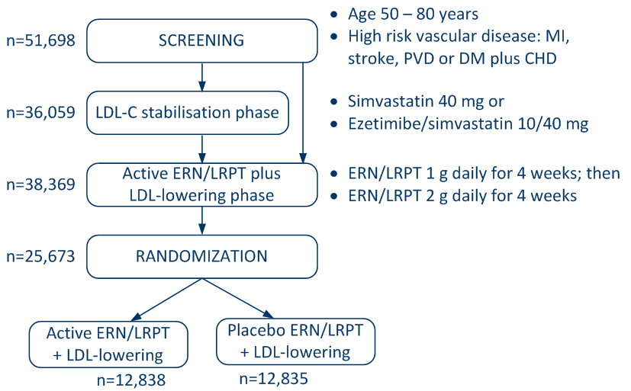
HPS2-THRIVE: Design and randomization

Slide 4
Reasons for withdrawal (%) before randomization
 | LDL-lowering stabilisation phase | Active ERN/LRPT phase
Entered phase | 36059 (100%) | 38369 (100%)
Mean duration of phase (wk) | 4.6 | 7.4
Reason excluded
Medical | 2209 (6.1%) | 9762 (25.4%)
Non-medical | 1998 (5.5%) | 3858 (10.1%)
Any reason | 4055 (11.2%) | 12696 (33.1%)

Slide 5
Medical reasons for withdrawal before randomization
 | LDL-lowering stabilisation phase | Active ERN/LRPT phase
Number entering phase | 36059 | 38369
Muscle symptoms | 270 (0.7%) | 499 (1.3%)
Any GI symptoms | 455 (1.3%) | 2124 (5.5%)
New onset diabetes | 0 (0.0%) | 3 (<0.1%)
Other diabetes related | 26 (<0.1%) | 661 (1.7%)
Any skin | 170 (0.5%) | 4331 (11.3%)
Flushing | 20 (<0.1%) | 647 (1.7%)
Pruritus | 80 (0.2%) | 2539 (6.6%)
Rash | 65 (0.2%) | 1418 (3.7%)
Any medical reason | 2209 (6.1%) | 9762 (25.4%)

Slide 6
Lipid levels by region: effect of 8 weeks ERN/LRPT during pre-randomization run-in
 |  | N | Baseline Mean (SD) | Change
 |  |  |  | Absolute |  | %
LDL cholesterol mmol/L
 | China | 10932 | 1.51 (0.41) | -0.32
 | Europe | 14741 | 1.74 (0.43) | -0.36
 | All | 25673 | 1.64 (0.44) | -0.34 | -20%
HDL cholesterol mmol/L
 | China | 10932 | 1.06 (0.24) | +0.15
 | Europe | 14741 | 1.19 (0.31) | +0.20
 | All | 25673 | 1.14 (0.29) | +0.18 | +17%

Slide 7
Characteristics of randomized participants
% or mean (SD) | China | Europe | All regions
Number randomized | 10932 | 14741 | 25673
Men | 79% | 85% | 21229 (83%)
Age (years) | 62.9 | 65.4 | 64.4 (7.5)
Prior disease
Coronary | 77% | 80% | 20137 (78%)
Cerebrovascular | 41% | 25% | 8170 (32%)
Peripheral arterial | 05% | 18% | 3214 (13%)
Diabetes | 42% | 26% | 8432 (33%)

Slide 8
Pre-specified interim safety assessments
Reasons for discontinuation of study treatment overall and in various categories
Myopathy (muscle symptoms with CK >10x ULN) and rhabdomyolysis (subset with end-organ damage)
Confirmed elevation of ALT >3x ULN on 2 occasions within about one week
Presumed drug-related hepatitis: symptoms with either (i) ALT >5x ULN; or (ii) ALT >3x ULN with bilirubin >3x ULN or ALP >3x ULN plus no other cause identified
ULN = upper limit of normal

Slide 9
Reasons for stopping study treatment in pre-specified categories after 3.4 years
####
 | ERN/LRPT 12838 |  | Placebo 12835
Any medical | 2011 (15.7%) |  | 958 (7.5%)
Skin | 659 (5.1%) |  | 151 (1.2%)
Diabetes-related | 116 (0.9%) |  | 51 (0.4%)
Gastrointestinal | 465 (3.6%) |  | 200 (1.6%)
Musculoskeletal | 205 (1.6%) |  | 114 (0.9%)
Liver | 49 (0.7%) |  | 39 (0.5%)
Other | 518 (4.0%) |  | 404 (3.1%)
Any non-medical | 1073 (8.4%) |  | 1014 (7.9%)
Any reason | 3084 (24.0%) |  | 1972 (15.4%)
Overall 88% were non-serious reasons

Slide 10
Skin and gastrointestinal reasons for stopping study treatment after 3.4 years
 | ERN/LRPT 12838 |  | Placebo 12835
Any skin | 659 (5.1%) |  | 151 (1.2%)
Flushing | 98 |  | 13
Pruritus | 413 |  | 85
Rash | 124 |  | 44
Other skin | 24 |  | 9
Any gastrointestinal | 465 (3.6%) |  | 200 (1.6%)
Upper gastrointestinal | 216 |  | 94
Lower gastrointestinal | 190 |  | 66

Slide 11
Myopathy by study treatment and by region after 3.4 years
 | ERN/LRPT 12838 | Placebo 12835 | Risk ratio
China | 62 (1.13%) | 10 (0.18%)
Europe | 7 (0.09%) | 2 (0.03%)
All cases | 69 (0.54%) | 12 (0.09%) | 5.8 (3.1 – 10.7)
Rhabdomyolysis | 7 (0.05%) | 03 (0.02%)
Two-thirds of myopathy cases
presented within the first year

Slide 12
Effect of ERN/LRPT on liver safety after 3.4 years
 |  | ERN/LRPT (12838) |  | Placebo (12835)
Number with ALT:
Consecutive >3x ULN |  | 81 (0.6%) |  | 31 (0.2%)
Any >3x ULN |  | 286 (2.2%) |  | 119 (0.9%)
>10x ULN |  | 42 (0.3%) |  | 22 (0.2%)
>3x ULN + bilirubin ≥2x ULN |  | 15 (0.1%) |  | 18 (0.1%)
Presumed drug-related hepatitis |  | 4 (0.031%) |  | 2 (0.016%)

Slide 13
HPS2-THRIVE summary
Largest ever randomized trial of effects of ER niacin on safety and CV events in diverse high-risk patients
Among those tolerating ERN/LRPT for 8 weeks, 76% remain compliant with active treatment after 3 years (vs 85% allocated placebo)
ERN/LRPT increases risk of myopathy among patients on statin therapy, particularly in the Chinese
No clear adverse effects of ERN/LRPT on liver, but known niacin side-effects on skin & GI confirmed
Effects of 4 years of ERN/LRPT on vascular events in HPS2-THRIVE available in 2013

