Slide 1


Long-term outcomes for neoadjuvant versus adjuvant chemotherapy in early breast cancer: meta-analysis of individual patient data from ten randomised trials
Early Breast Cancer Trialists’ Collaborative Group (EBCTCG)
THE LANCET Oncology
Volume 19, No. 1, p27–39, January 2018
Notes:
The following slides show the main results of the EBCTCG individual patient data meta-analysis of trials of the same chemotherapy randomised to be given either before or after surgery.
1

Slide 2
Why give neoadjuvant chemotherapy?
Neoadjuvant chemotherapy:
can make breast-conserving surgery more feasible
might be more likely to eradicate micrometastatic disease
provides a measure of response of the tumour to the neoadjuvant chemotherapy regimen
EBCTCG: THE LANCET Oncology 19(1); 27–39, 2018
Notes:
There are several reasons why neoadjuvant chemotherapy may be preferred to adjuvant chemotherapy given after surgery.
2

Slide 3
Ten trials* of neoadjuvant vs adjuvant chemotherapy
  Chemo → Surgery → Chemo vs.
  Surgery → Same Chemo
  (4 trials, 918 women)
  or
  Chemo → Surgery vs.
  Surgery → Same Chemo
  (6 trials, 3838 women)
* Data not available for six small trials, ~500 women randomised
EBCTCG: THE LANCET Oncology 19(1); 27–39, 2018
Notes:
The trials included in the meta-analysis have two designs. In 4 trials, the neoadjuvant chemotherapy is started before surgery and completed after and in 6 trials all chemotherapy is completed before any surgery.
3

Slide 4
Chemotherapy regimens
EBCTCG: THE LANCET Oncology 19(1); 27–39, 2018
Notes:
In the 10 available trials, patients entered between 1983 and 2002. Median follow-up was 9 years (IQR 5-14) with latest follow-up in 2013.
e
4

Slide 5
Neoadjuvant vs adjuvant chemotherapy: main results
Neoadjuvant chemotherapy:
Increases the probability of breast-conserving surgery:
(neoadjuvant 65%, adjuvant 49%)
Increases the risk of local recurrence: (5.5% more by year 15: 21.4% vs. 15.9%)
No significant difference in breast cancer mortality or overall survival
EBCTCG: THE LANCET Oncology 19(1); 27–39, 2018
Notes:
The slides to follow summarise tumour responses rates (in the neoadjuvant group only), the effect of any response on extent of surgery, and compare effects of neoadjuvant versus adjuvant chemotherapy on long-term breast cancer recurrence and mortality.
Before showing them, here is a summary of the main results of the analysis.
In these trials women allocated to neoadjuvant chemotherapy had an increased probability of receiving less extensive local therapy but also an increased risk of local recurrence.
No benefits or harms were found for neoadjuvant over adjuvant chemotherapy in terms of breast cancer mortality or overall survival.
5

Slide 6
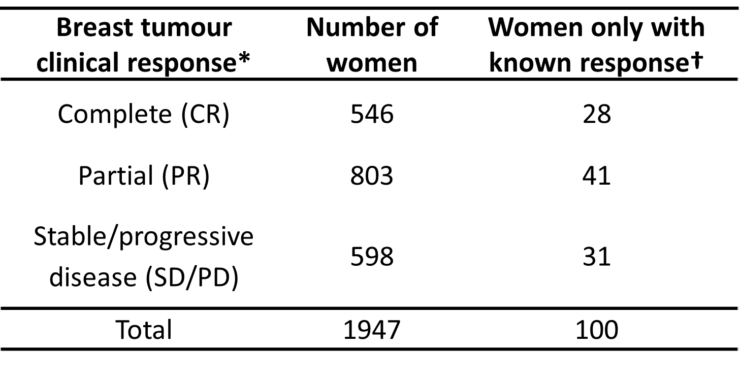
Breast tumour clinical response
(neoadjuvant group only)
*CR: no clinical evidence of disease, PR: ≥50% reduction in initial tumour size, SD/PD: <50% reduction or any increase in size.
† 440 women had unknown clinical response and are excluded from the table.
EBCTCG: THE LANCET Oncology 19(1); 27–39, 2018
Notes:
Tumour response information was missing for 440 women, but in 1947 women who had their response measured, 28% of them had their breast tumour respond completely to the neoadjuvant chemotherapy whereas 41% and 31% had either a partial or no response.
6

Slide 7
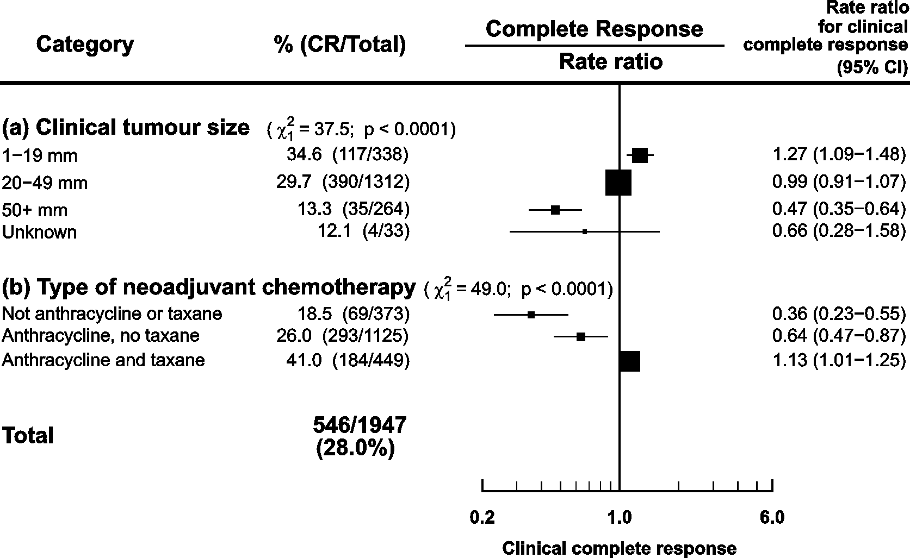
Likelihood of tumour response by tumour size and type of chemotherapy
Notes: Percents with complete response are unadjusted.
Rate ratios are after adjustment for tumour size and trial, confidence intervals are group specific.
EBCTCG: THE LANCET Oncology 19(1); 27–39, 2018
Notes:
The likelihood of achieving a complete response to neoadjuvant chemotherapy depended mainly on tumour size (smaller tumours responding more frequently) and the type of chemotherapy used (taxane better than no taxane).
7

Slide 8
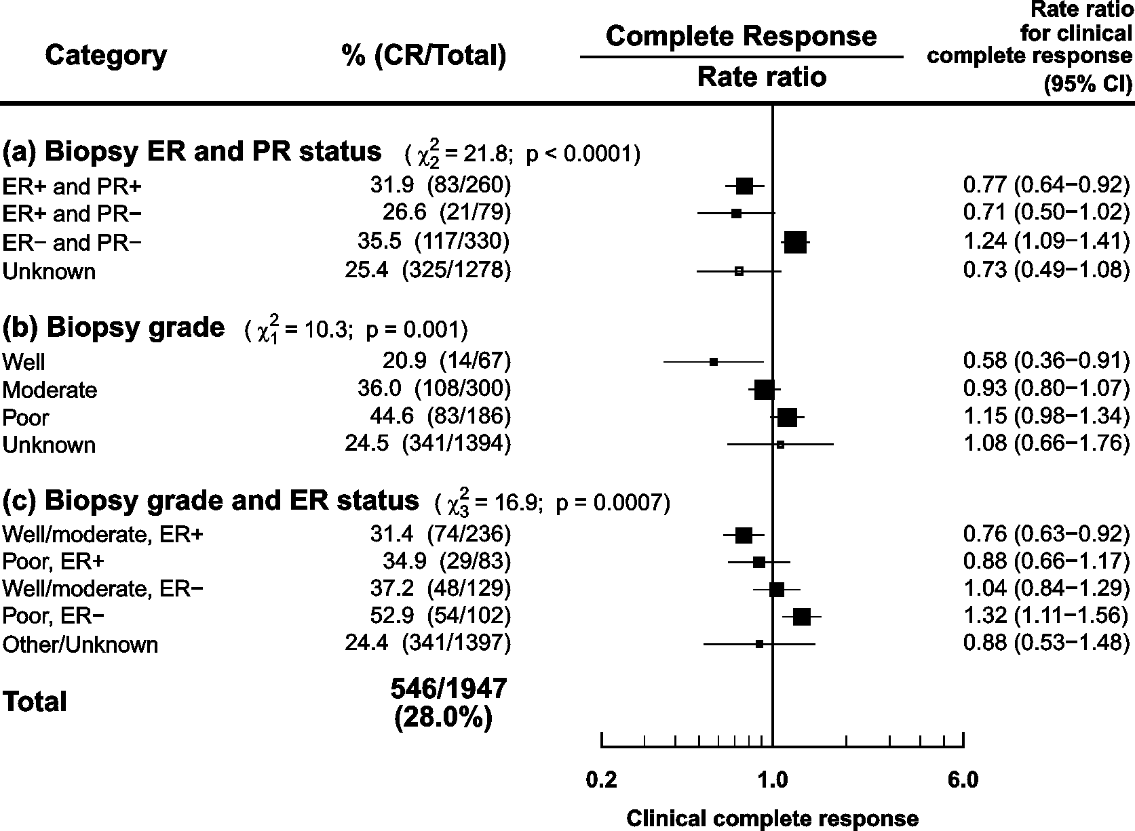
Likelihood of tumour response by
ER & PR status and grade (at biopsy)
Notes: Percents with complete response are unadjusted.
Rate ratios are after adjustment for tumour size and trial, confidence intervals are group specific.
Notes:
Completer response was also more likely in ER-negative than ER-positive tumours, and in high than low/intermediate grade tumours. Tumours that were ER- and high grade had the highest complete response rates showing that the effects or ER and grade are additive.
8

Slide 9
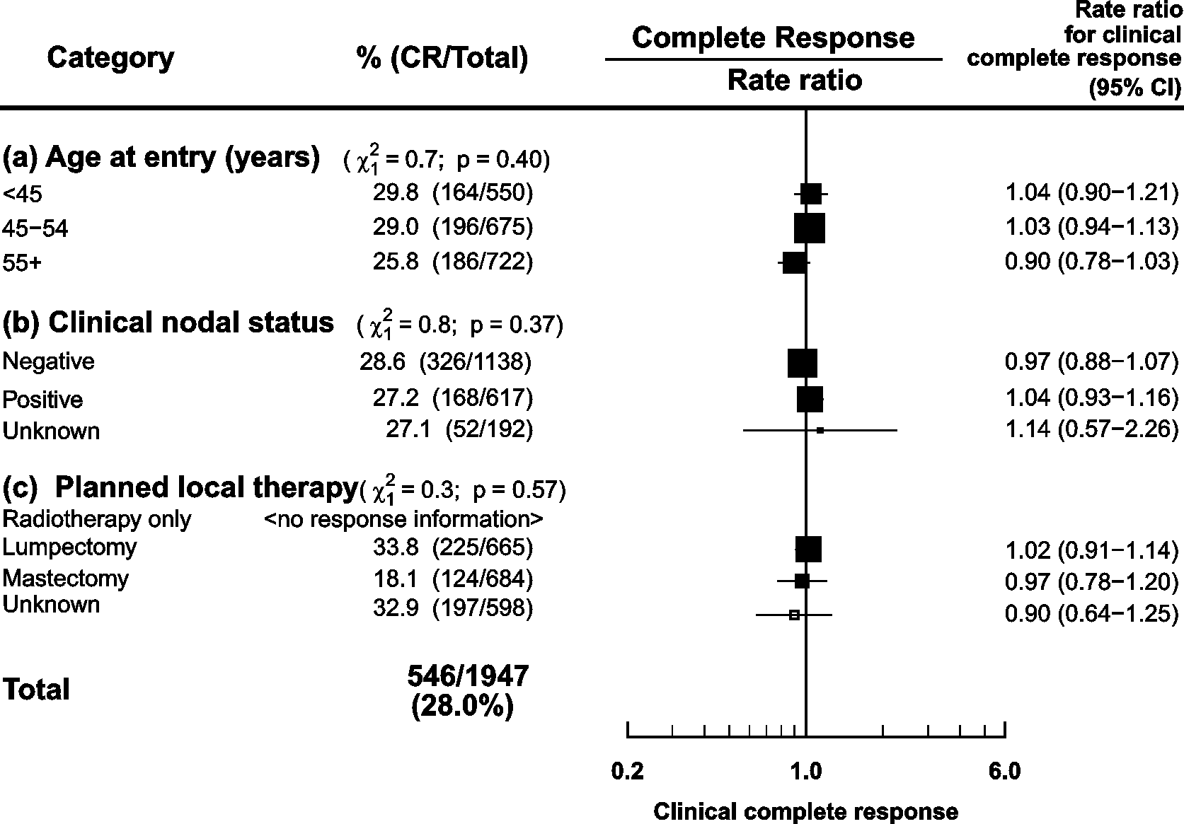
Likelihood of tumour response by age, nodal status, and local therapy
Notes: Percents with complete response are unadjusted.
Rate ratios are after adjustment for tumour size and trial, confidence intervals are group specific.
Notes:
Age at diagnosis, clinical nodal status, and extent of planned local therapy (based on tumour characteristics before randomisation) were not correlated with the rate of complete clinical response.
9

Slide 10
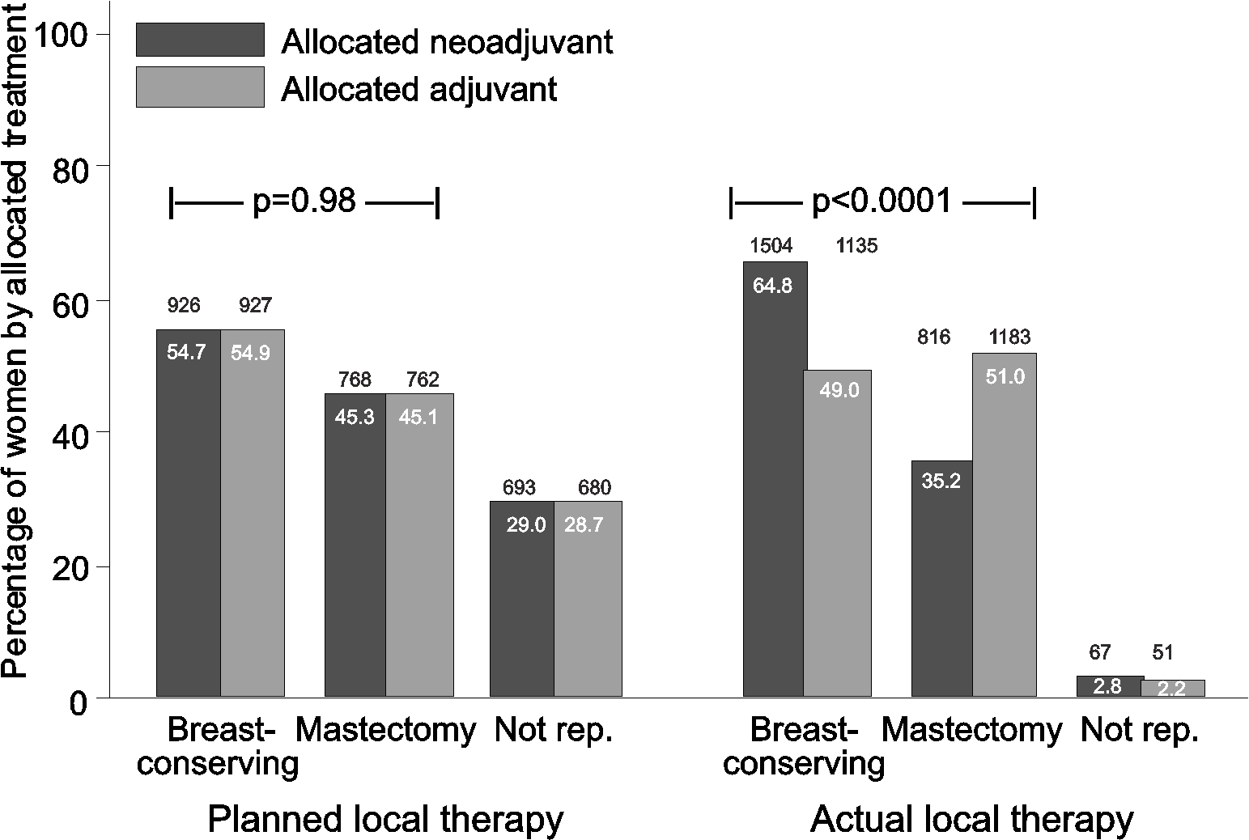
Surgery: Planned versus actual
EBCTCG: THE LANCET Oncology 19(1); 27–39, 2018
Notes:
The surgery considered appropriate prior to randomisation, was evenly balanced between the randomised groups. However, the extent of surgery actually given (ie breast conserving or mastectomy) differed with those allocated neoadjuvant chemotherapy more likely to have breast conserving surgery then the women allocated adjuvant chemotherapy.
10

Slide 11
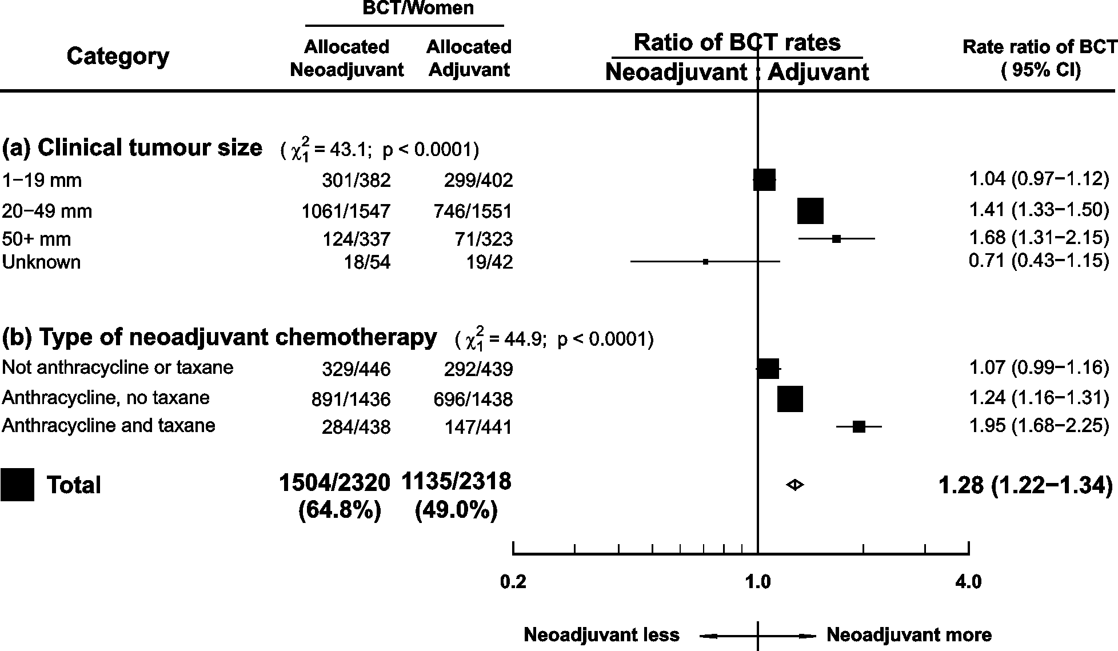
Breast-conserving therapy (BCT) rates by tumour size and type of chemotherapy
Notes: Rate ratios are after adjustment for tumour size and trial.
Notes:
The biggest effect of neoadjuvant chemotherapy on breast conserving surgery rates was seen in larger tumours, and in women given taxane and anthracycline chemotherapy.
11

Slide 12
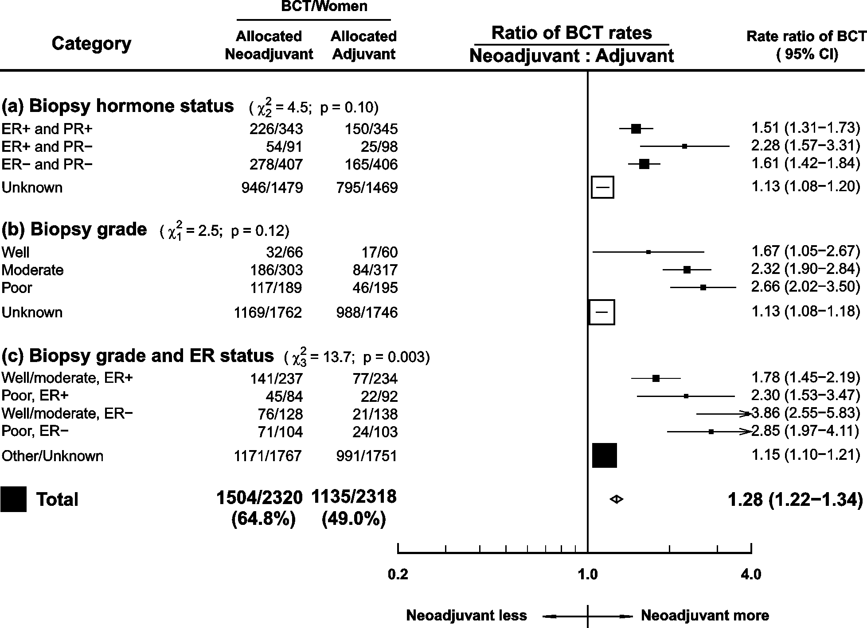
Breast-conserving therapy (BCT) rates by
ER & PR status and grade
Notes: Rate ratios are after adjustment for tumour size and trial.
EBCTCG: THE LANCET Oncology 19(1); 27–39, 2018
Notes:
The effect of neoadjuvant chemotherapy on breast conserving surgery rates was somewhat bigger in women with ER-negative and with high-grade tumours but these differences were less marked than those with tumour size and type of chemotherapy
12

Slide 13
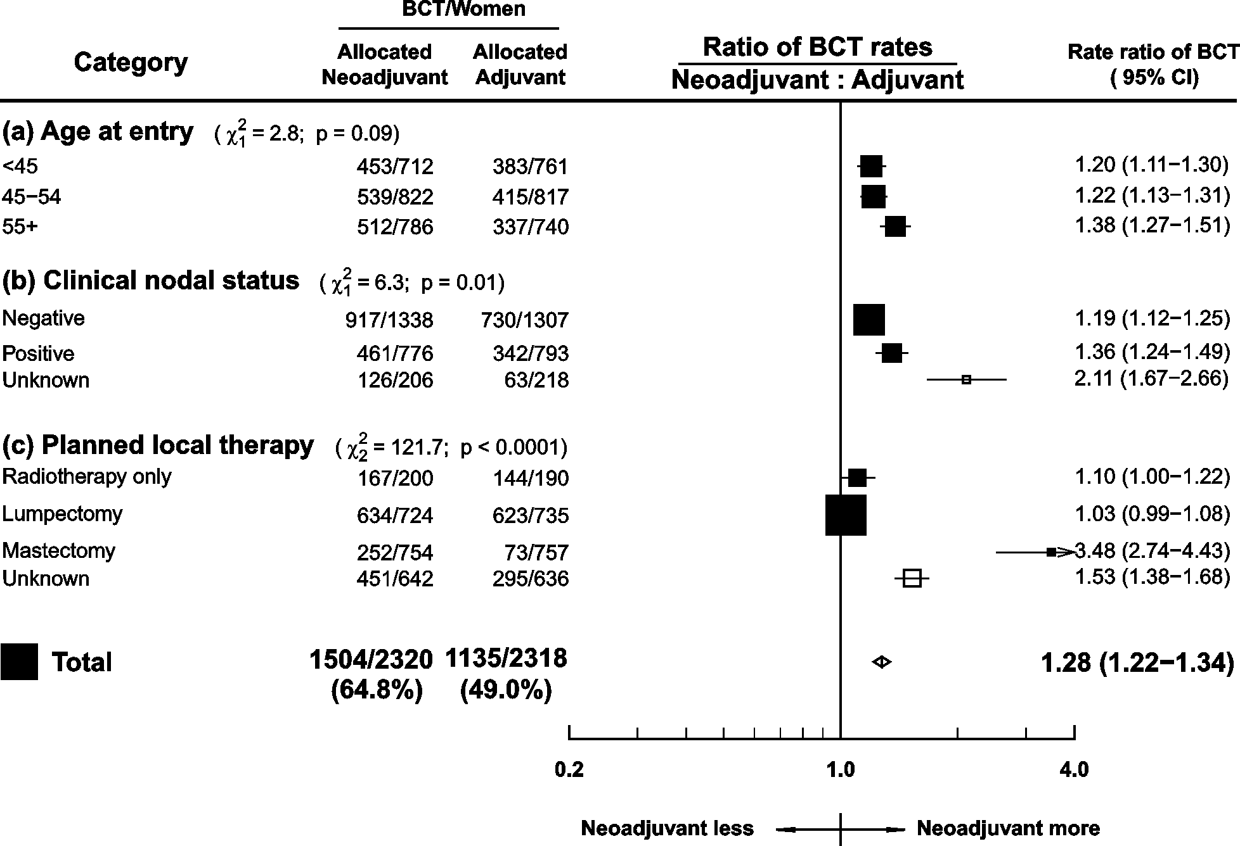
Breast-conserving therapy (BCT) rates by age, nodal status, and local therapy
Notes:
Rate ratios are after adjustment for tumour size and trial.
EBCTCG: THE LANCET Oncology 19(1); 27–39, 2018
Notes:
The effect of neoadjuvant chemotherapy on breast conserving surgery rates was only weakly related to age and nodal status. As expected, the differences in the proportion of women receiving breast-conserving surgery between the neoadjuvant and adjuvant chemotherapy groups was much larger in those for whom mastectomy was originally planned than those who had breast conserving surgery planned from the outset.
13

Slide 14
PROBLEMS!!!
The aim of randomised trial is to balance risk factors between the comparison groups
However, fewer women received mastectomy in the neoadjuvant than adjuvant chemotherapy groups
So, any differences in recurrence or mortality between neoadjuvant and adjuvant chemotherapy might be explained by extent of surgery or by timing of chemotherapy
(Also, limited detail on radiotherapy)
EBCTCG: THE LANCET Oncology 19(1); 27–39, 2018
Notes:
Because of the reduction in the extent of local therapy, due to downstaging of the tumour, in women allocated neoadjuvant chemotherapy, the effect of the timing of chemotherapy on risk of recurrence can’t be assessed reliably.
Another problem patient level data on the use of radiotherapy were not available so it was known whether radiotherapy use differed between treatment groups. However, trial reports suggest that was generally not the case.
14

Slide 15
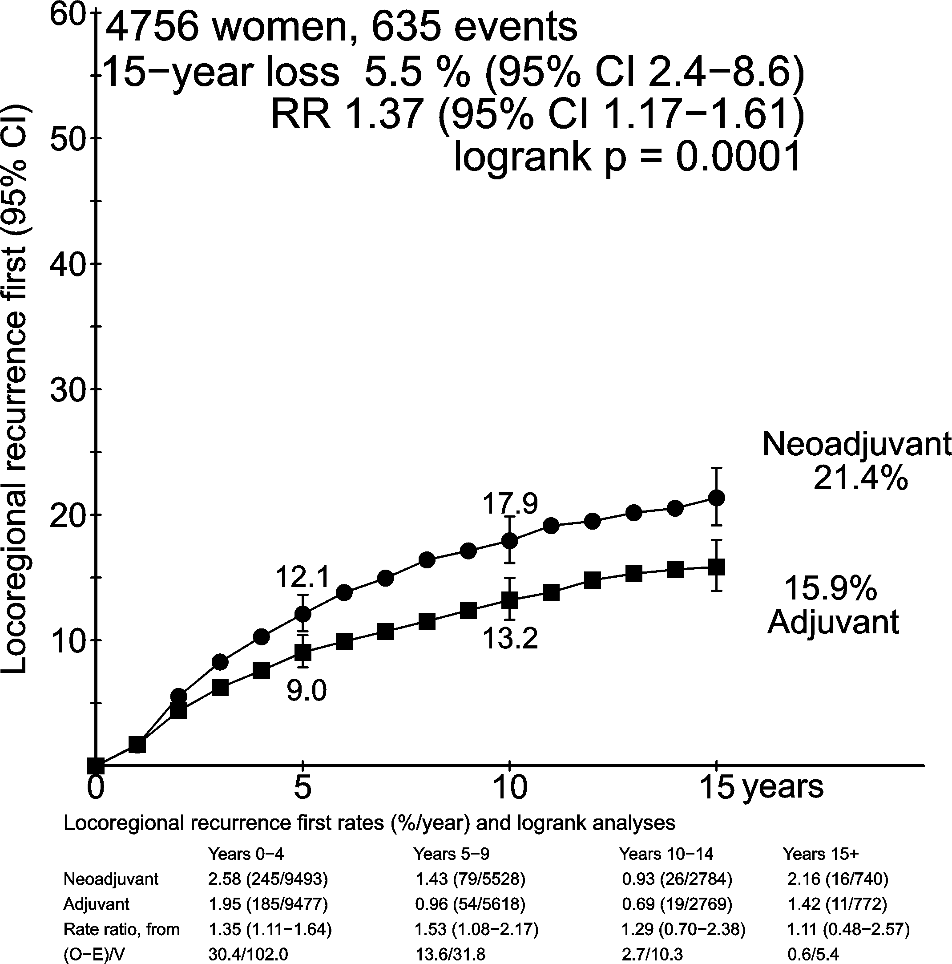
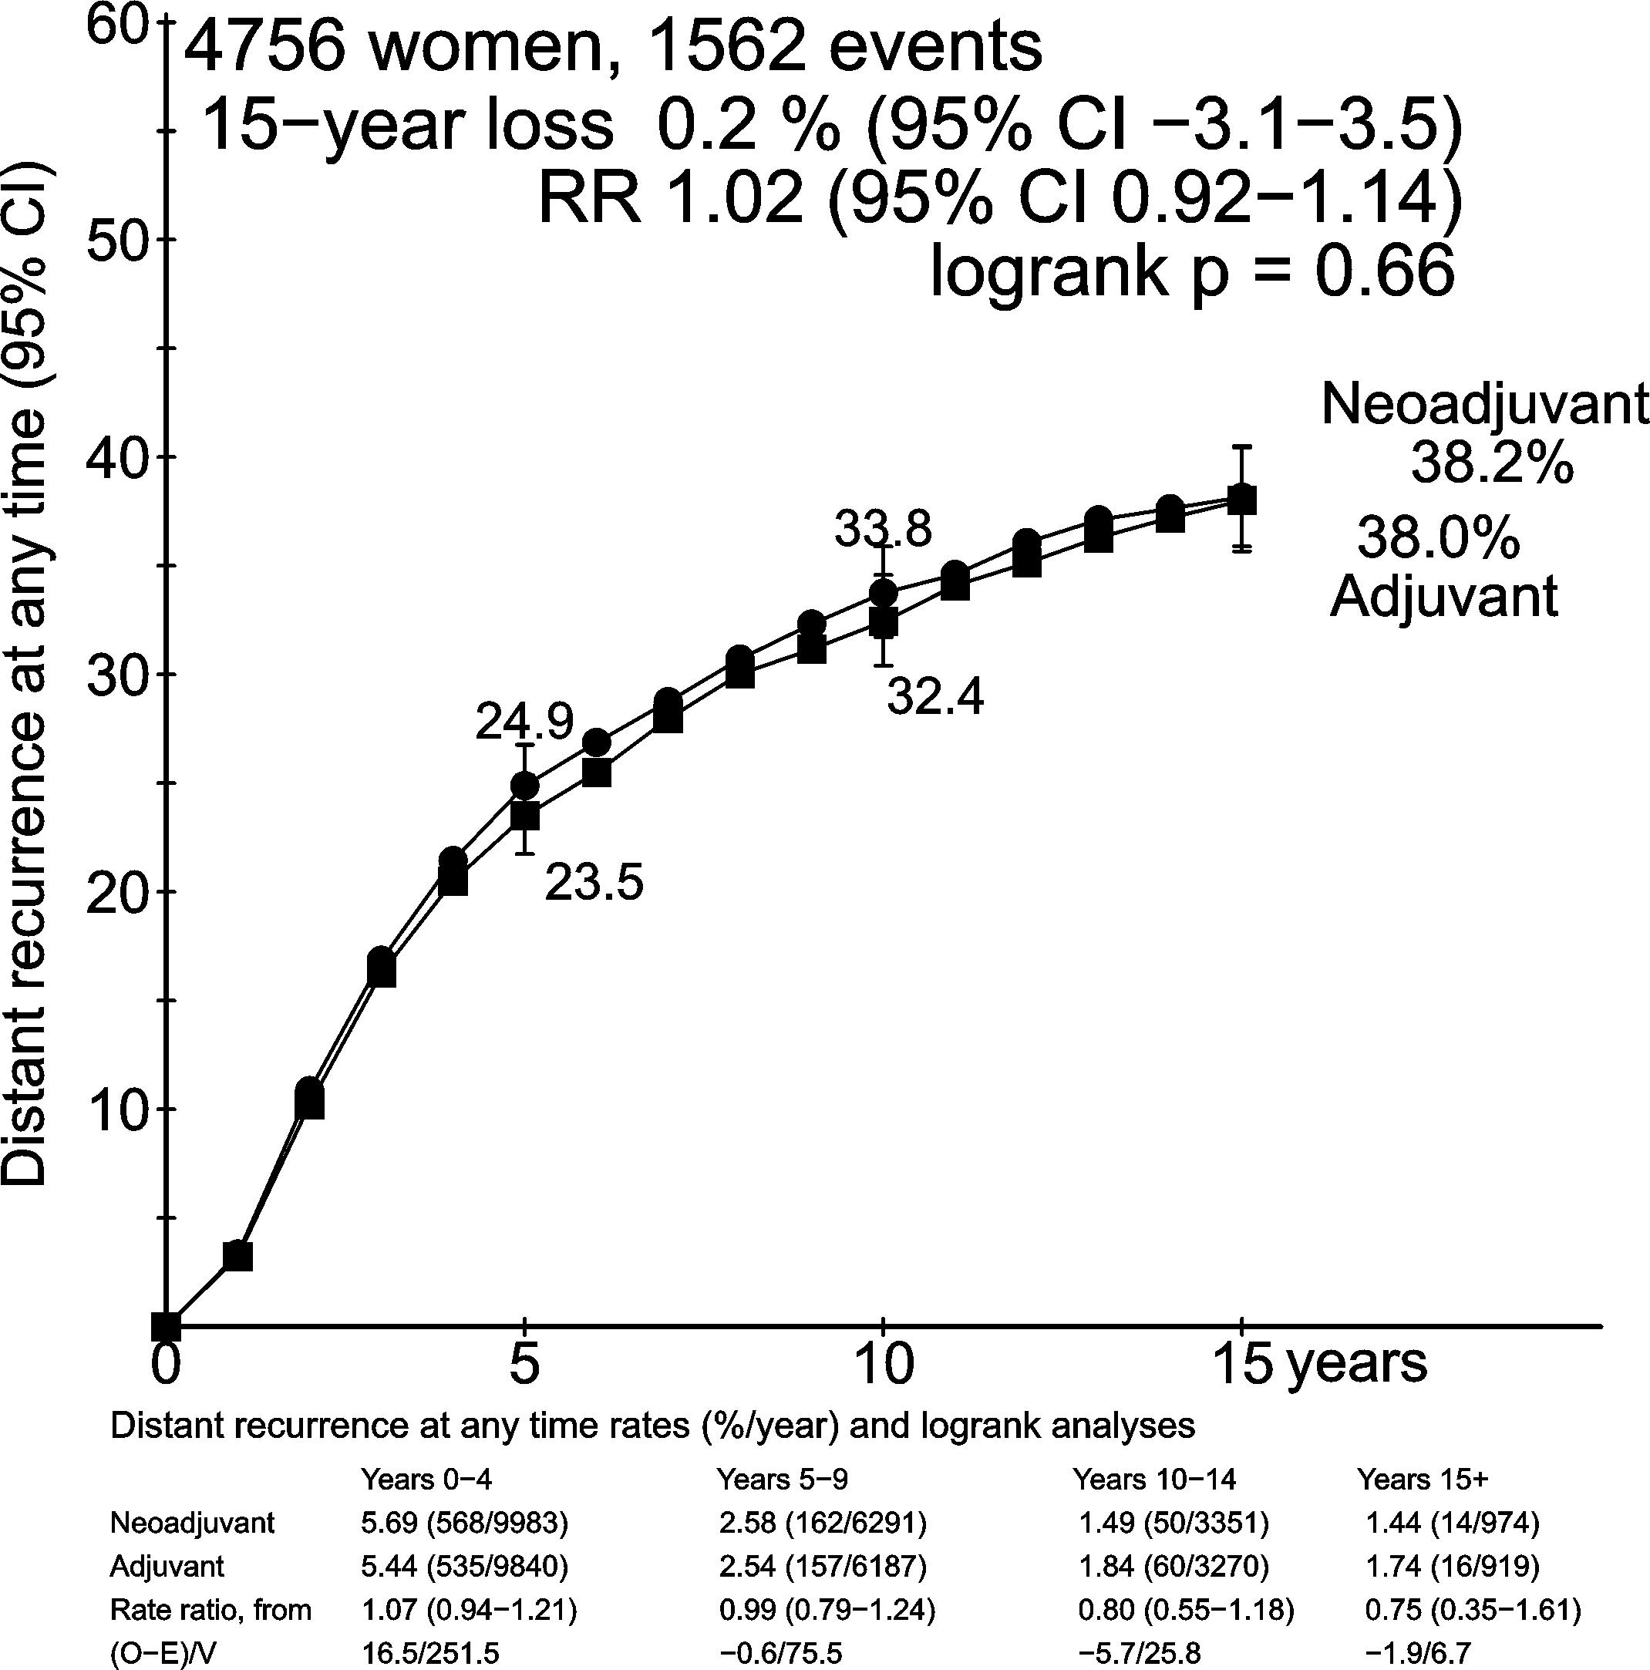
Effect of neoadjuvant chemotherapy on recurrence
EBCTCG: THE LANCET Oncology 19(1); 27–39, 2018
Notes:
Women allocated to neoadjuvant chemotherapy had higher local recurrence risk, 21.4% vs 15.9%, by year 15. A loss of 5.5%. The annual rate of local recurrence was statistically significantly higher for the neoadjuvant group through periods 0-4 and 5-9 years after randomisation.
However, this higher local recurrence rate did not translate into an overall increased distant recurrence risk.
15

Slide 16
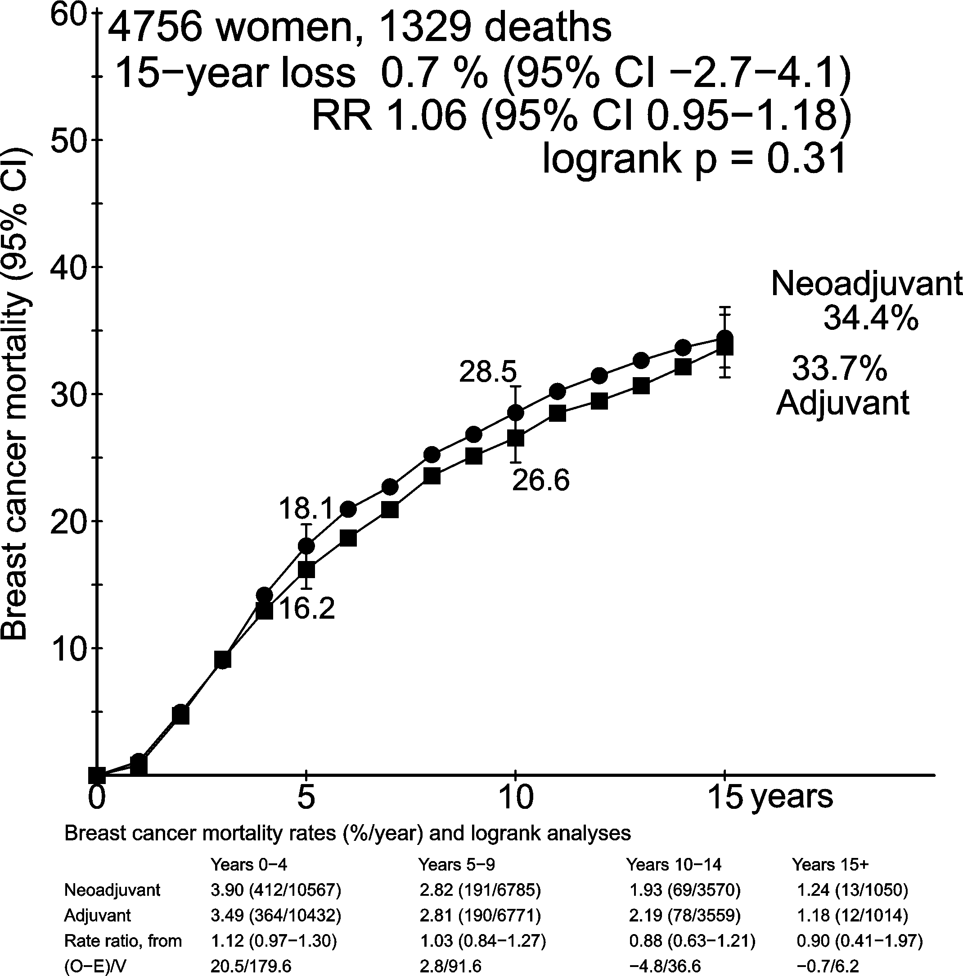
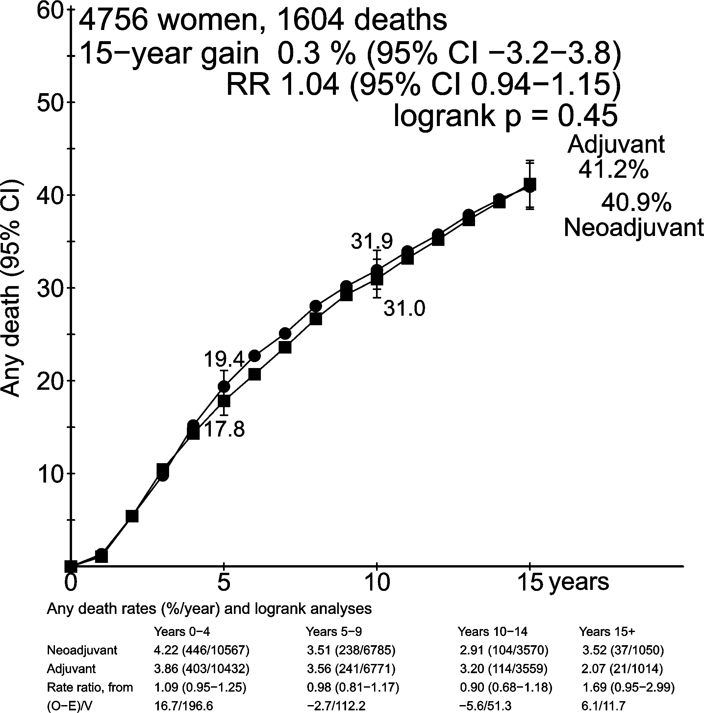
Effect of neoadjuvant chemotherapy on mortality
EBCTCG: THE LANCET Oncology 19(1); 27–39, 2018
Notes:
15-year breast cancer mortality risk was slightly increased in women allocated to neoadjuvant chemotherapy, 0.7%, compared to those in the adjuvant group but not significantly so.
Patterns of all cause mortality where very similar between the groups over the follow-up period.
16

Slide 17
Neoadjuvant vs adjuvant chemotherapy: main results
Neoadjuvant chemotherapy:
Increases the probability of breast-conserving surgery:
(neoadjuvant 65%, adjuvant 49%)
Increases the risk of local recurrence: (5.5% more by year 15: 21.4% vs. 15.9%)
No significant difference in breast cancer mortality or overall survival
EBCTCG: THE LANCET Oncology 19(1); 27–39, 2018
Notes:
The slides to follow summarise tumour responses rates (in the neoadjuvant group only), the effect of any response on extent of surgery, and compare effects of neoadjuvant versus adjuvant chemotherapy on long-term breast cancer recurrence and mortality.
Before showing them, here is a summary of the main results of the analysis.
In these trials women allocated to neoadjuvant chemotherapy had an increased probability of receiving less extensive local therapy but also an increased risk of local recurrence.
No benefits or harms were found for neoadjuvant over adjuvant chemotherapy in terms of breast cancer mortality or overall survival.
17

Slide 18
Neoadjuvant vs adjuvant chemotherapy: conclusions
Local recurrence risk after breast-conserving surgery may be higher in tumours downsized by NACT than in similar sized tumours without NACT
Strategies to mitigate this increased risk should be considered e.g.
  Careful tumour localisation
  Detailed pathological assessment
  Appropriate radiotherapy
EBCTCG: THE LANCET Oncology 19(1); 27–39, 2018
Notes:
What is, or are, the main messages from these trials?
It seems, after conserving surgery, tumours downsized by neoadjuvant chemotherapy may carry a higher local recurrence risk compared to tumours of the same dimensions without neoadjuvant chemotherapy
Strategies to mitigate the increased risk should be considered.
18

Slide 19
EXTRA slides
EBCTCG: THE LANCET Oncology 19(1); 27–39, 2018

Slide 20
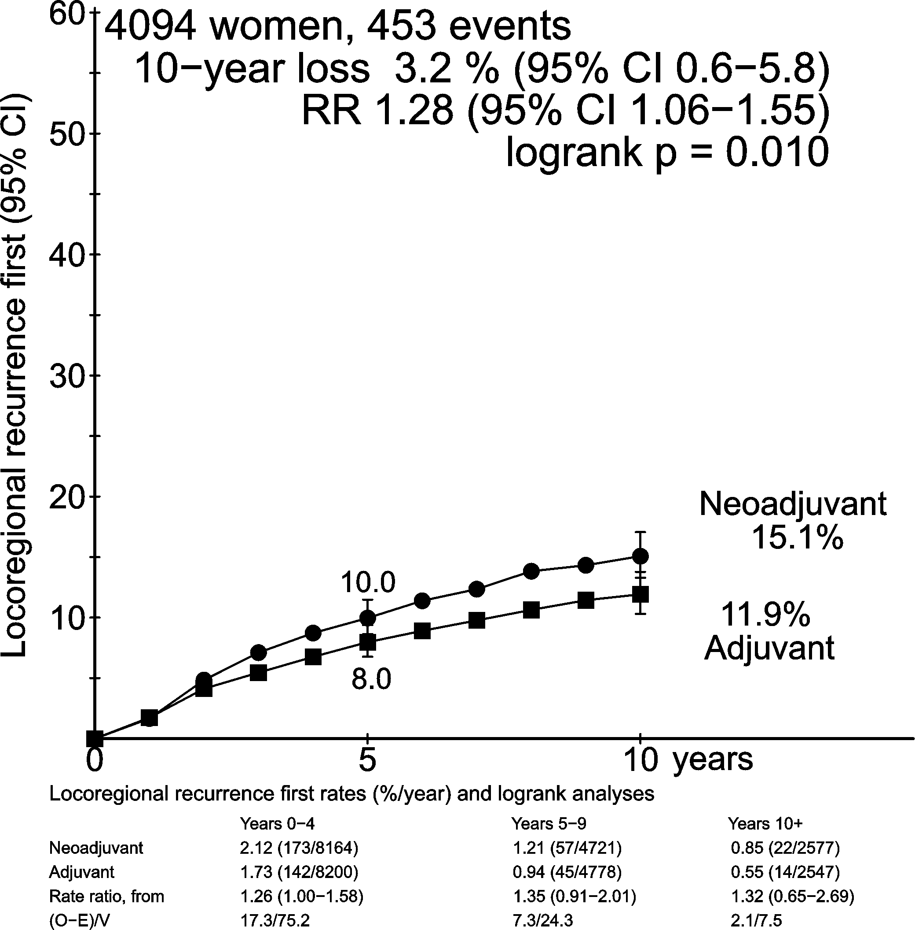
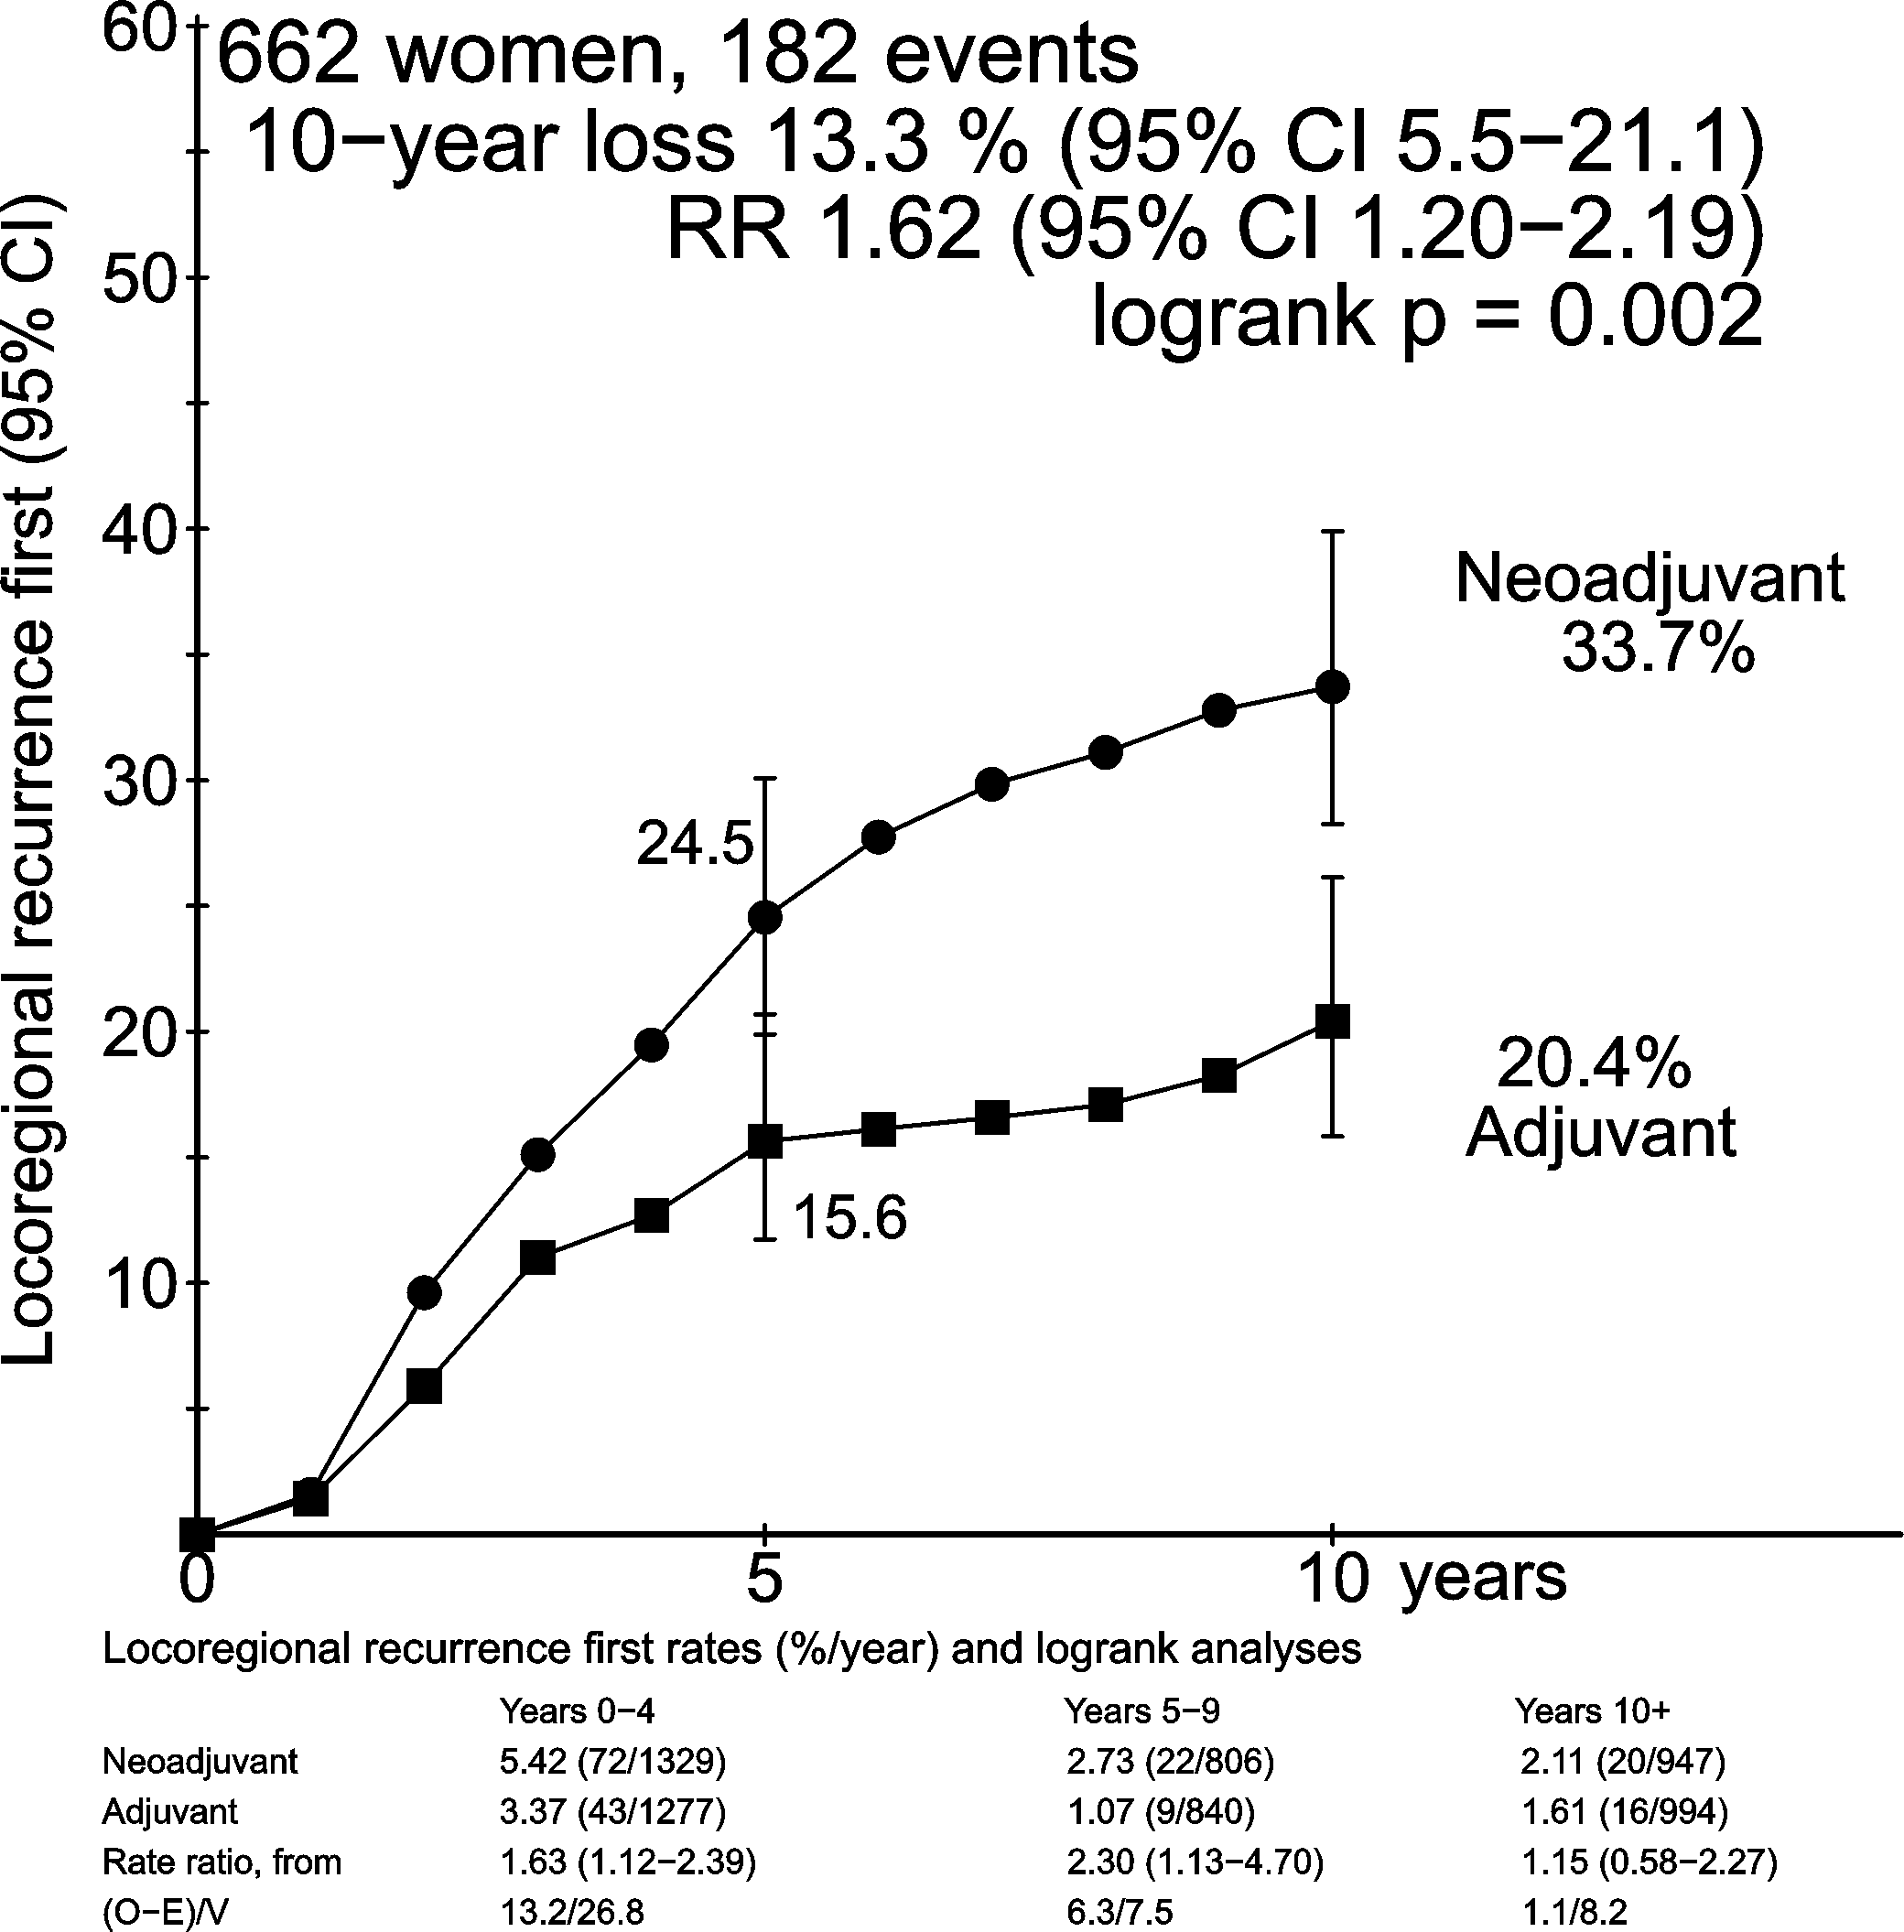
Effect of neoadjuvant chemotherapy on local recurrence by use of surgery
(IB Bordeaux & Institut Curie S6)
EBCTCG: THE LANCET Oncology 19(1); 27–39, 2018
.
Notes:
Women allocated to neoadjuvant chemotherapy in these trials had higher local recurrence than those allocated to the same chemotherapy but given in the adjuvant setting. This risk was attenuated in trials were surgery was more commonly used, 15.1% vs 11.9% (p=0.01), when indirectly compared to the two trials in which surgery could be avoided in the event of a complete clinical response to neoadjuvant chemotherapy; 33.7% vs 20.4% (p=0.002).
20

Slide 21
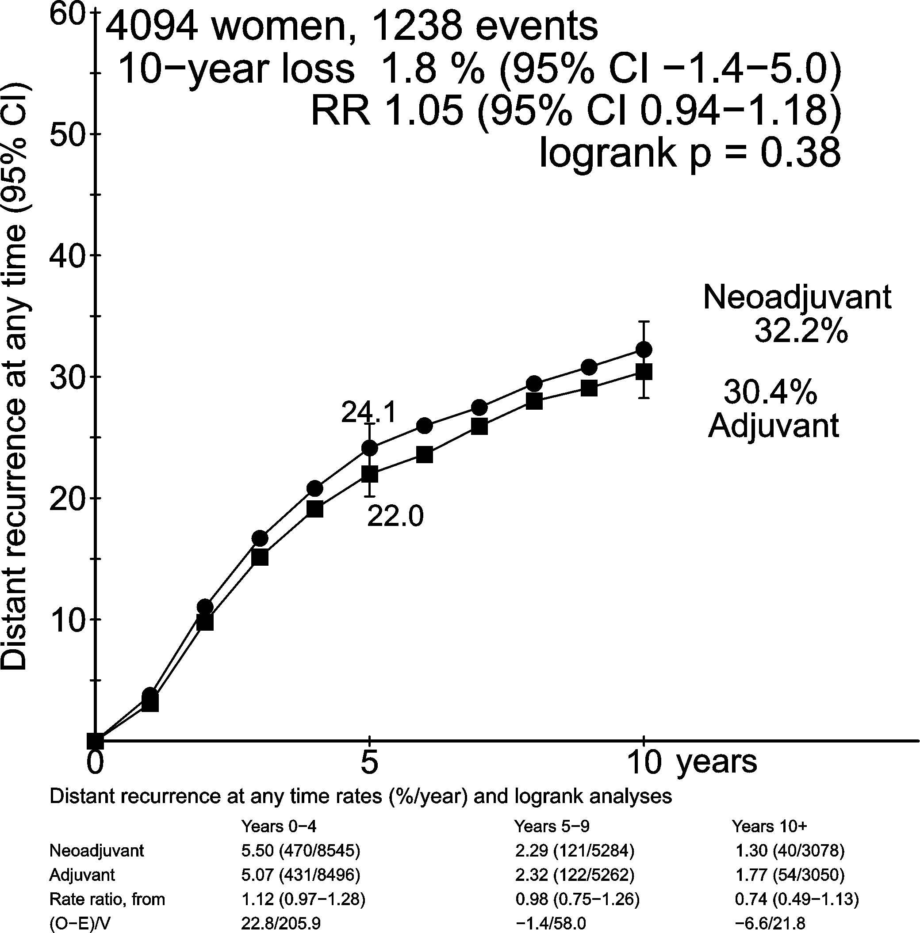
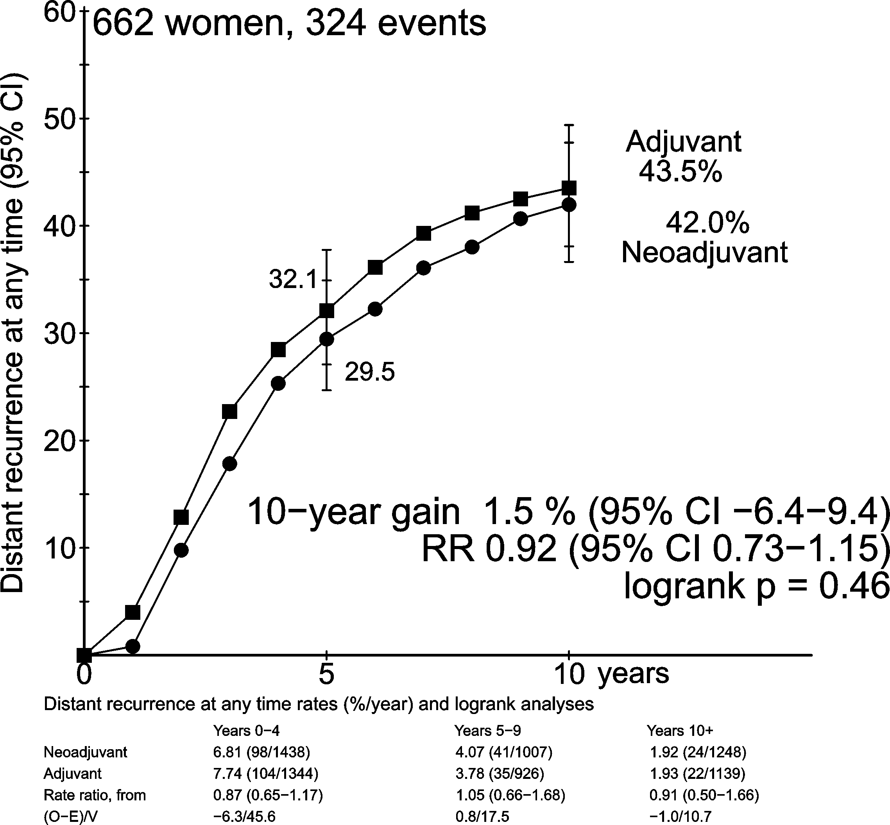
Effect of neoadjuvant chemotherapy on distant recurrence by use of surgery
(IB Bordeaux & Institut Curie S6)
EBCTCG: THE LANCET Oncology 19(1); 27–39, 2018
.
Notes:
However, in neither of the two sets of trials, when considered by frequency of use of surgery, was there a significant increase in distant recurrence in women allocated to neoadjuvant chemotherapy.
21

Slide 22
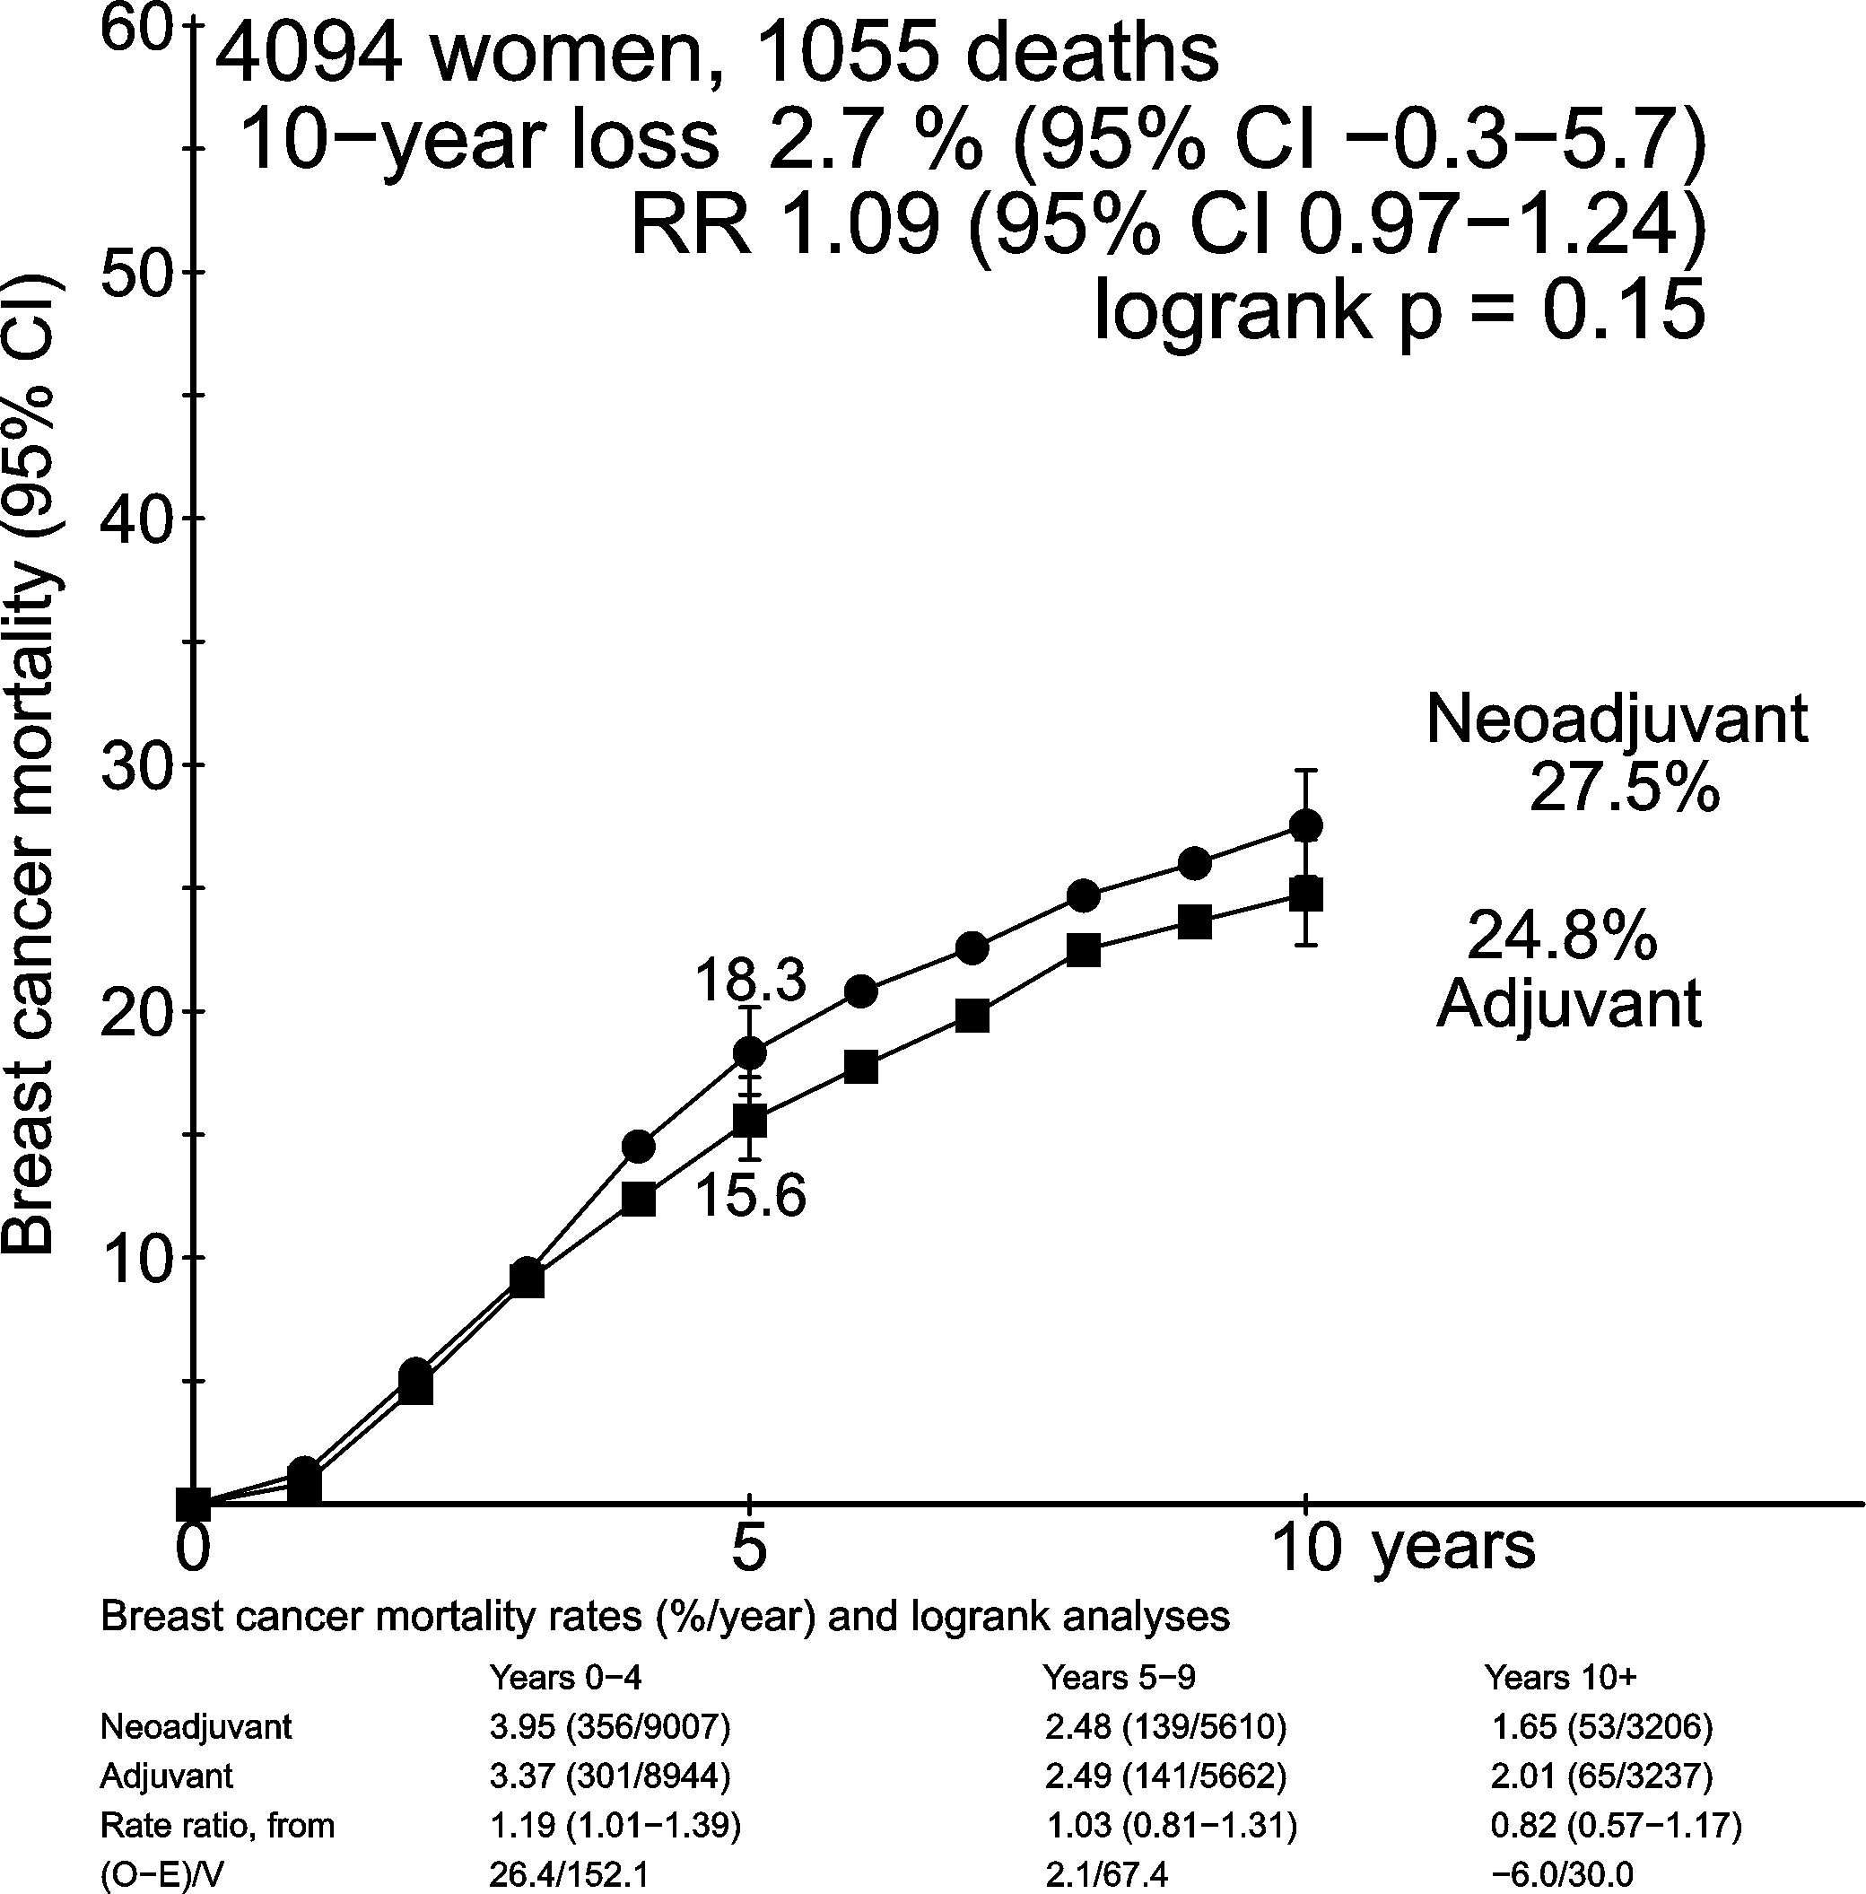
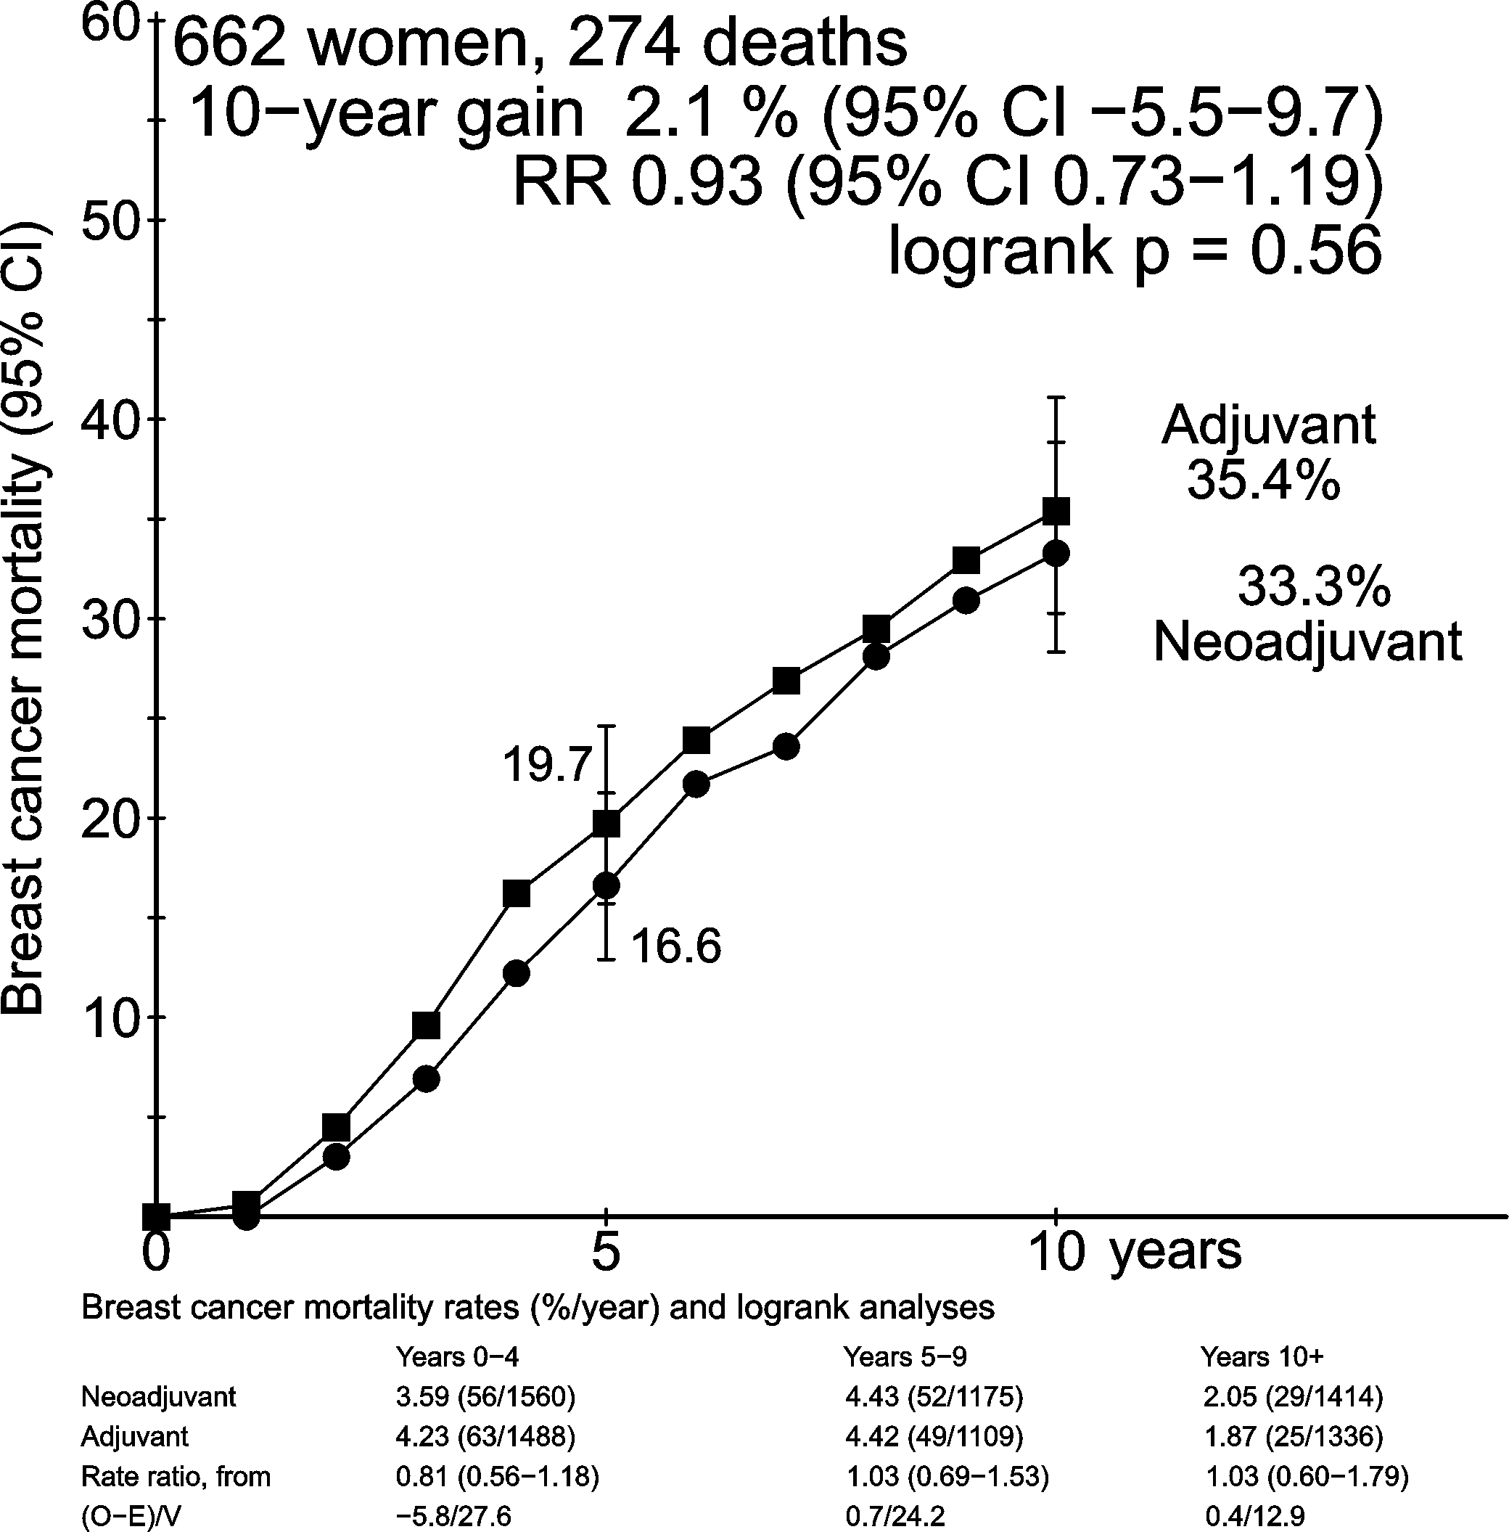
Effect of neoadjuvant chemotherapy on breast cancer mortality by use of surgery
(IB Bordeaux & Institut Curie S6)
EBCTCG: THE LANCET Oncology 19(1); 27–39, 2018
Notes:
Risk of breast cancer mortality was not significantly different for women allocated to neoadjuvant chemotherapy compared to the adjuvant group and did not depend on the frequency of the use of surgery.
22

