Slide 1

Increasing the dose intensity of chemotherapy by more frequent administration or sequential scheduling: a patient-level meta-analysis of 37 298 women with early breast cancer in 26 randomised trials
Early Breast Cancer Trialists’ Collaborative Group (EBCTCG)
www.thelancet.com
Published online Feb 7, 2019

Slide 2
Background
Adjuvant chemotherapy for women with early breast cancer, using anthracycline and taxane based schedules, reduces the risk of death from breast cancer by about one third*
Cytokinetic modelling suggests that increasing the dose intensity of cytotoxic chemotherapy may enhance efficacy^
*EBCTCG, Lancet 2012
^Norton, Semin. Oncol. 1997

Slide 3
Methods
Eligible clinical trials were identified by systematic review of studies that started before 2008 and randomly assigned women to either dose dense versus standard schedule chemotherapy, or to sequential versus concurrent anthracycline and taxane based treatment.
Individual patient data were provided for 26 trials that included 93% of women randomised in the 33 relevant trials (37 298 / 40 070)
Data from trial groups was collected in 2015-2018

Slide 4
Primary analysis
Any recurrence of invasive breast cancer: includes distant, locoregional, or new primary in the contralateral breast
Breast cancer mortality: by logrank subtraction
Death without recurrence
All-cause mortality

Slide 5
Planned subgroup analyses
Follow up period (years 0-1, 2-4, 5-9, 10+)
Site of recurrence
Method of dose intensification
Use of taxane
Number of escalated cycles (≤4 vs ≥6)
Age (<45, 45-54, 55-69, 70+)
Tumour diameter
Nodal status (negative, N1-3, N4+)
Tumour grade (1, 2, 3)
ER/PR status (positive, negative, unknown)
HER2 status
Ki67
Histological sub-type

Slide 6
Dose intensity trials
Dose-dense (2-weekly) vs Standard schedule (3- or 4-weekly)
Same chemotherapy drugs and doses: 7 trials, n=10,004
Some differences in chemotherapy: 5 trials, n=5,508
Sequential (3-weekly) vs Concurrent (3-weekly)
Same drugs in each group: 5 trials, n=9,644
Some differences in drugs used: 1 trial, n=1,384
Sequential (2-weekly) vs Concurrent (3-weekly)
Some differences in drugs used: 6 trials, n=6,532
Same total dose in fewer cycles
Same chemotherapy drugs: 2 trials, n=4,226

Slide 7
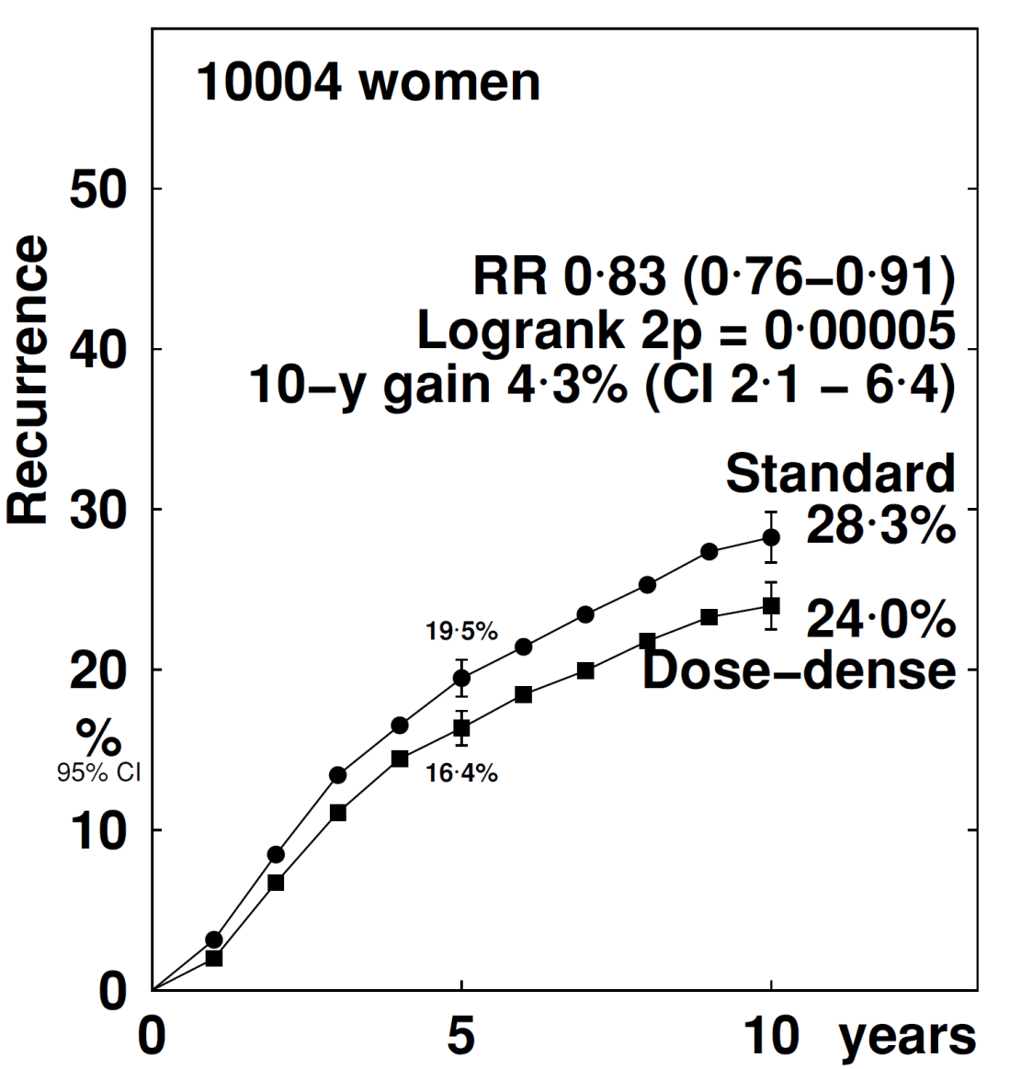
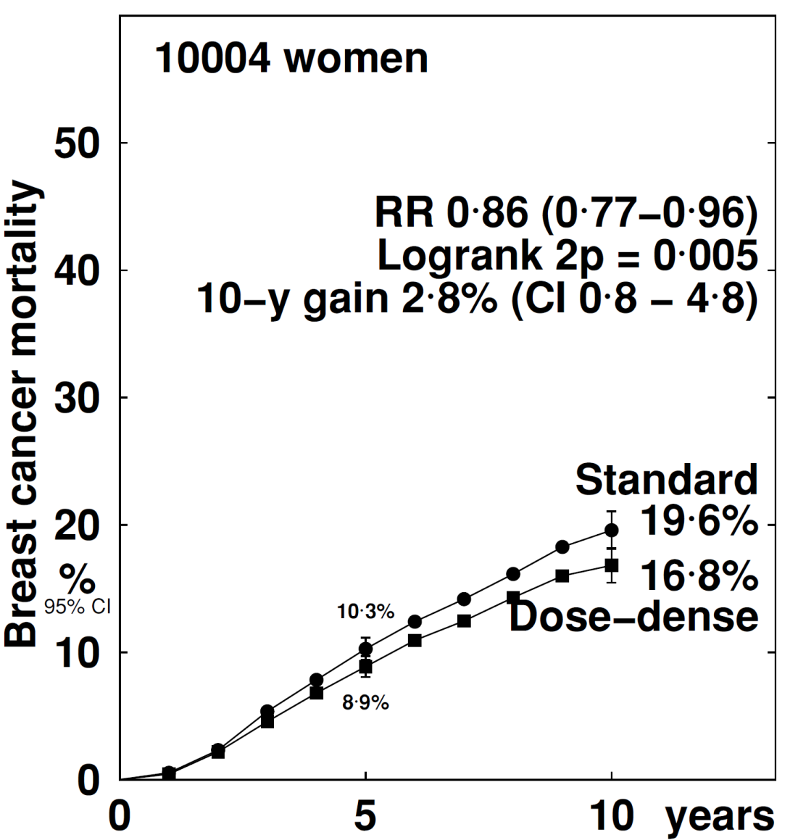
2-weekly (dose dense) vs the same chemotherapy given 3-weekly
Any Recurrence
Breast Cancer Mortality

Slide 8
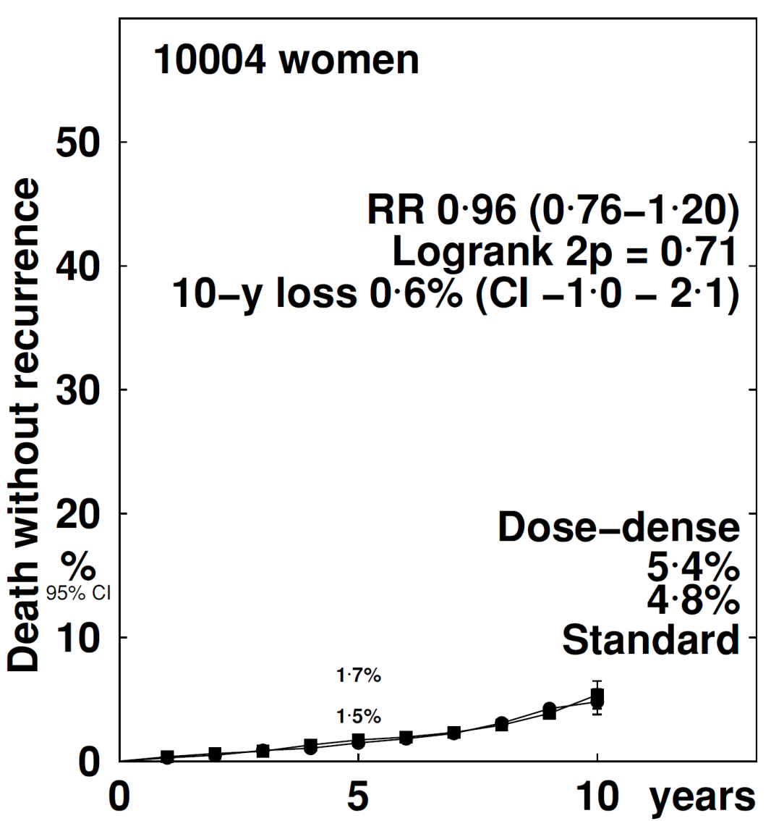
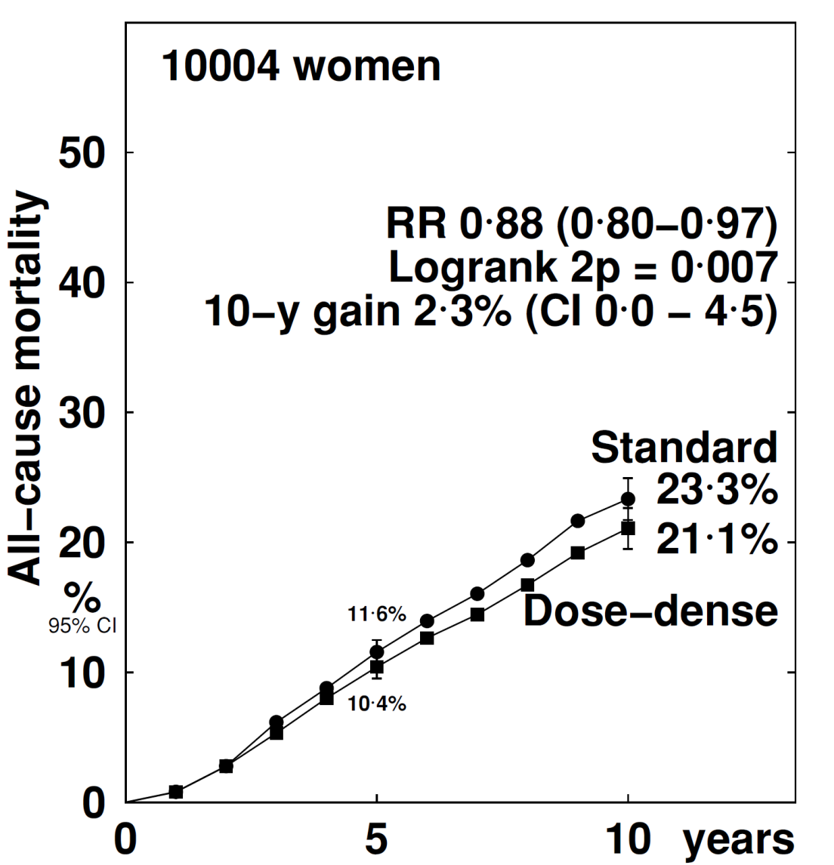
2-weekly (dose dense) vs the same chemotherapy given 3-weekly
Death without recurrence
All-cause mortality

Slide 9
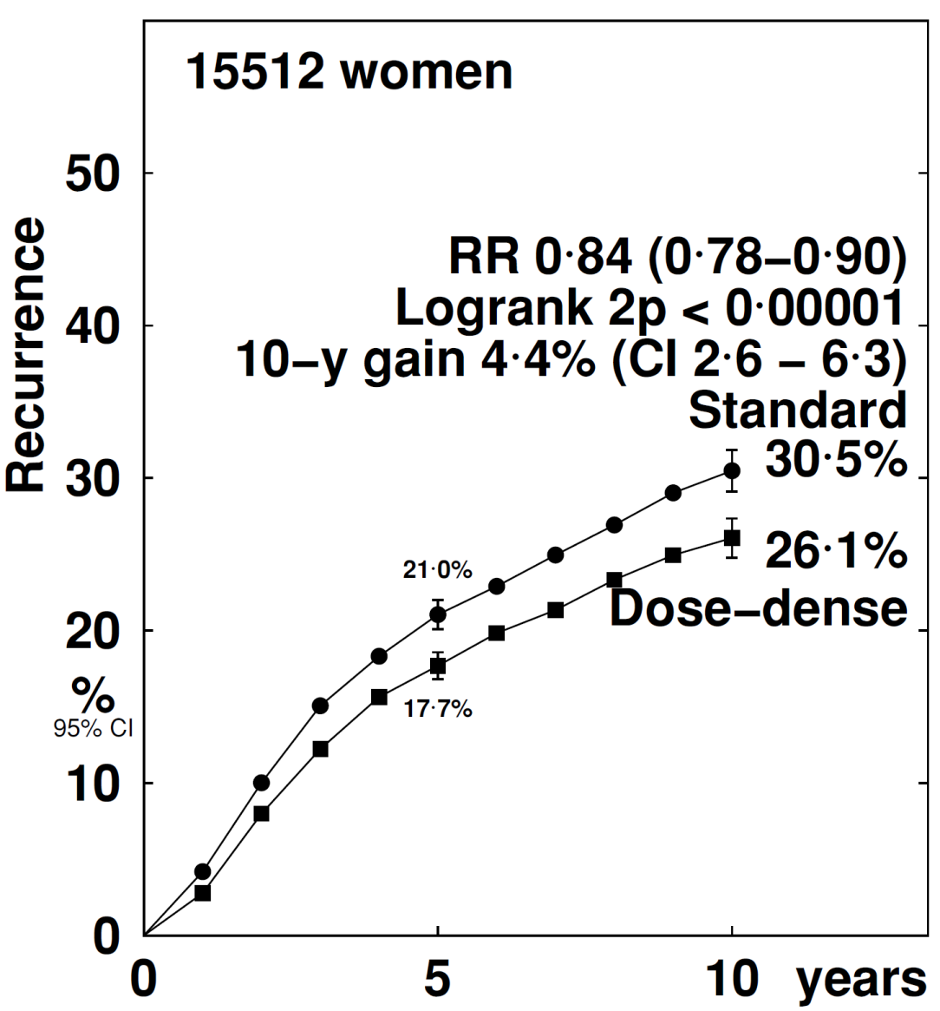
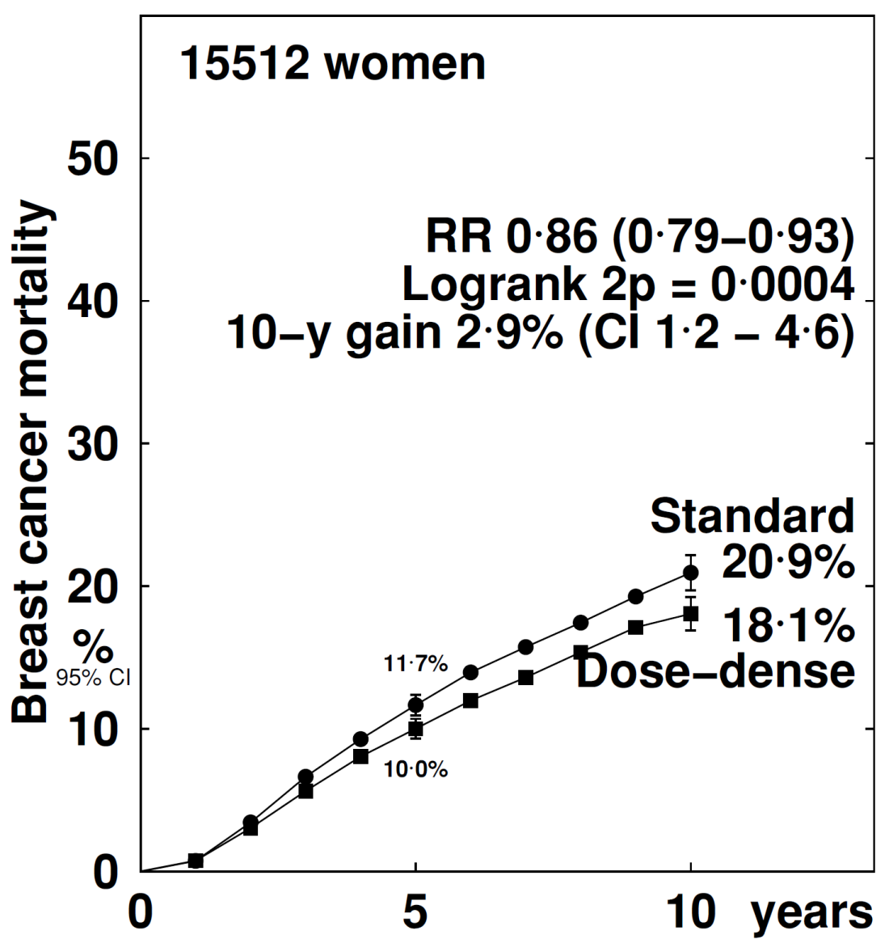
2-weekly vs 3-weekly chemotherapy: all trials (including the 5 trials where chemotherapy differed between arms)
Any Recurrence
Breast Cancer Mortality

Slide 10
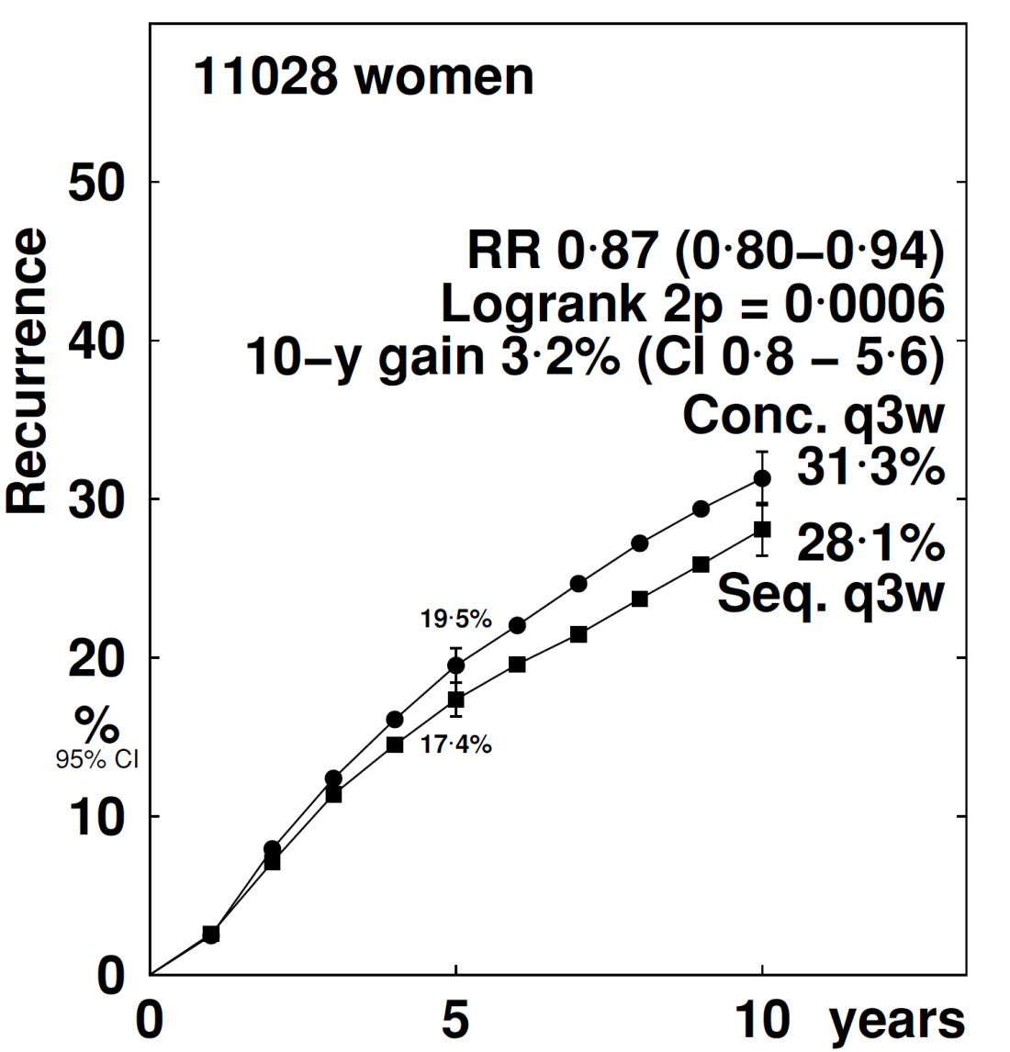
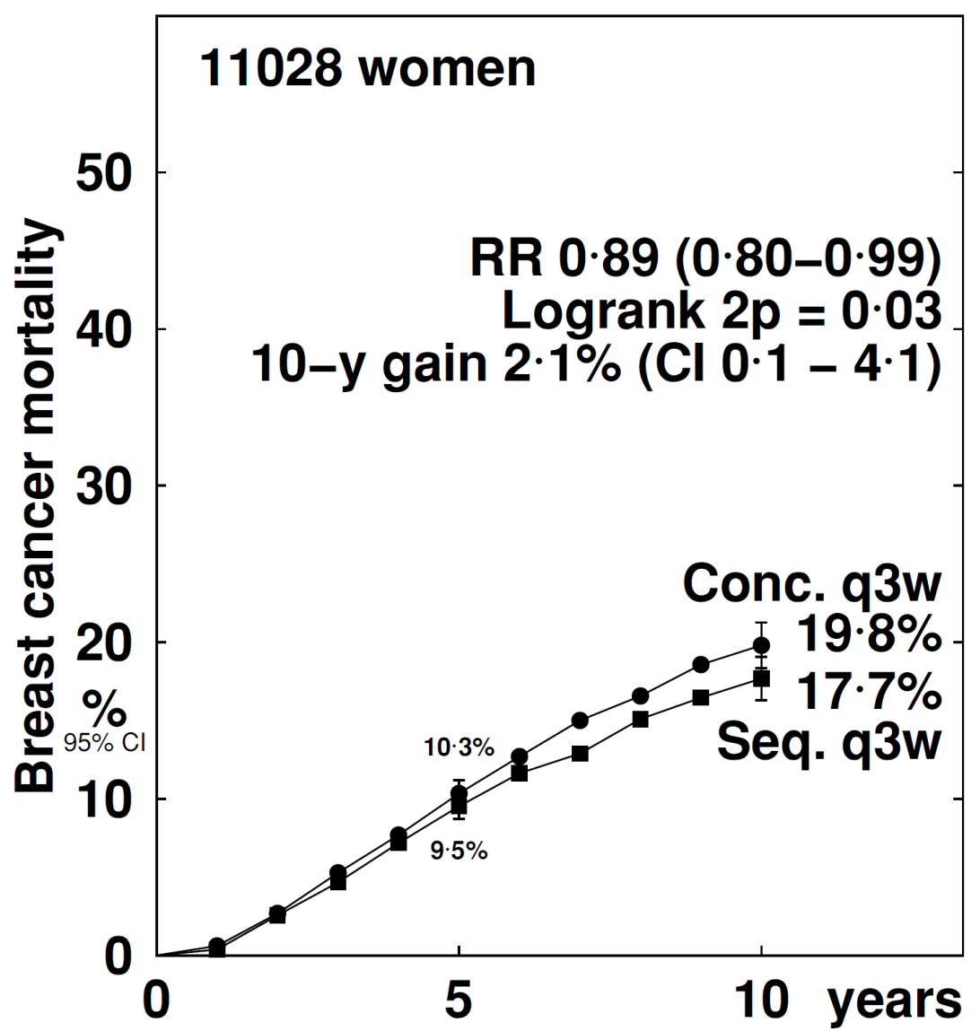
Sequential (3-weekly) vs Concurrent (3-weekly) chemotherapy
Any Recurrence
Breast Cancer Mortality

Slide 11
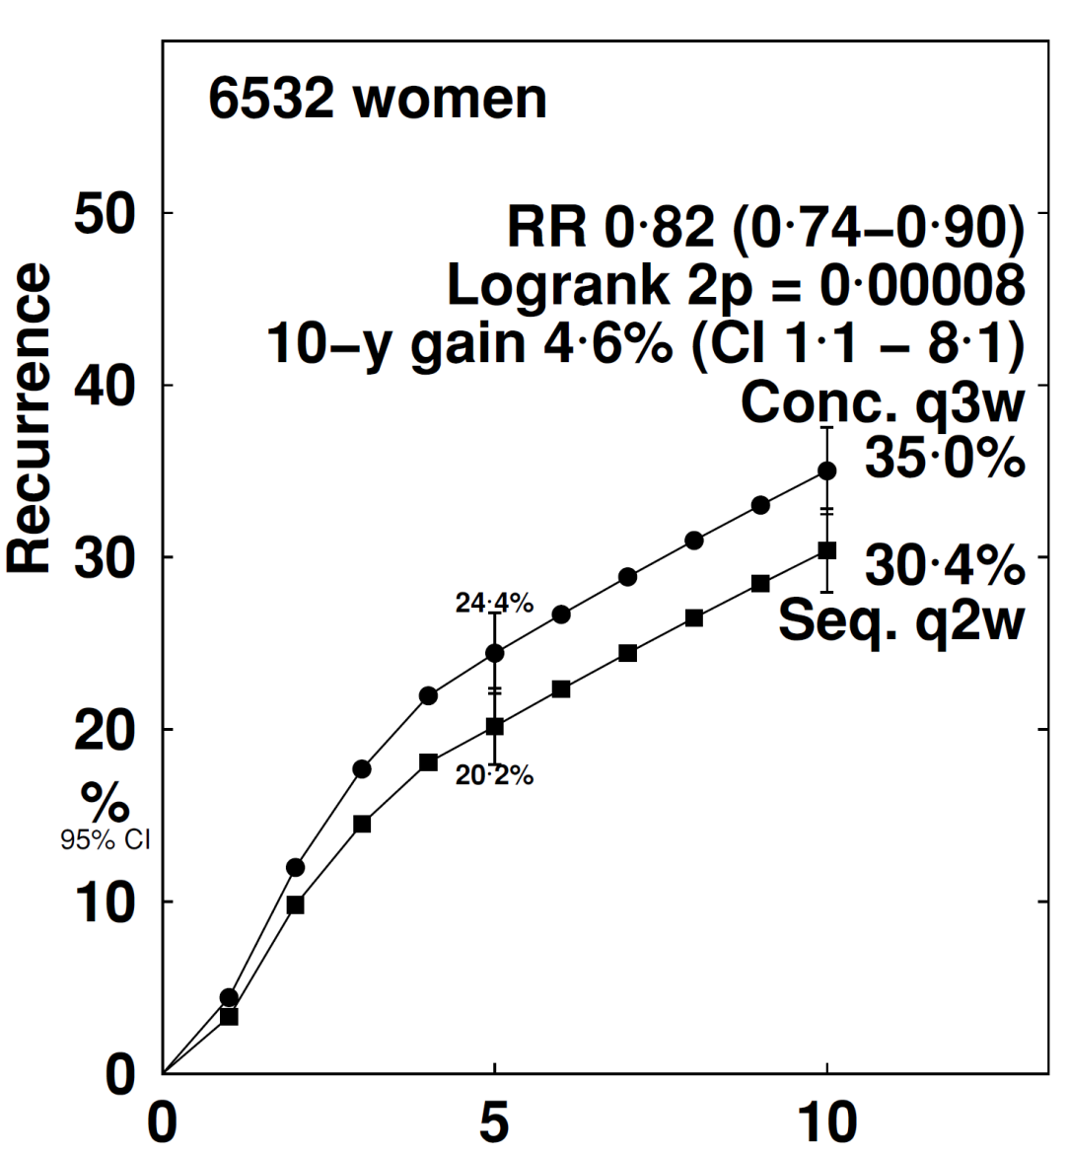
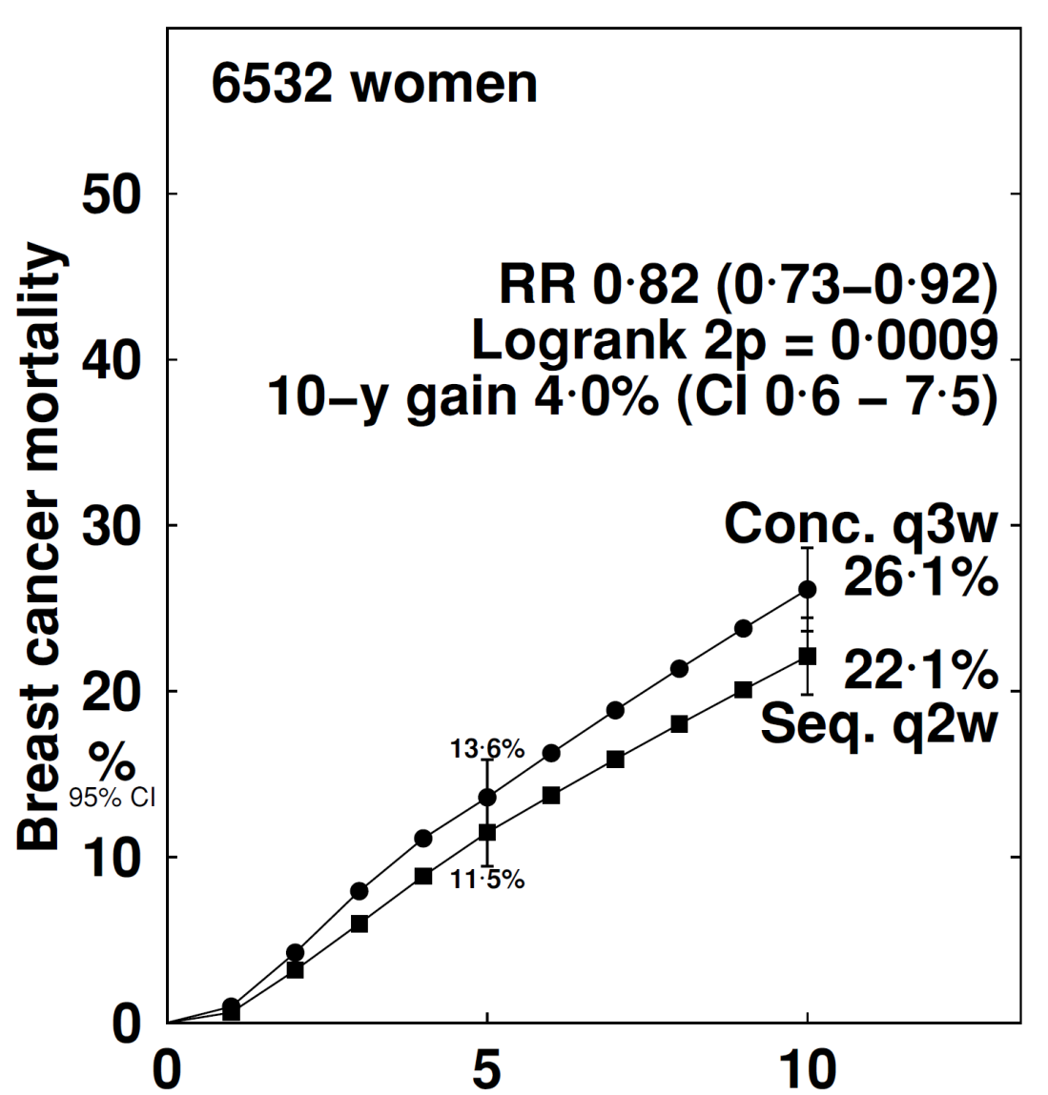
Sequential (2-weekly) vs Concurrent (3-weekly) chemotherapy
Any Recurrence
Breast Cancer Mortality

Slide 12
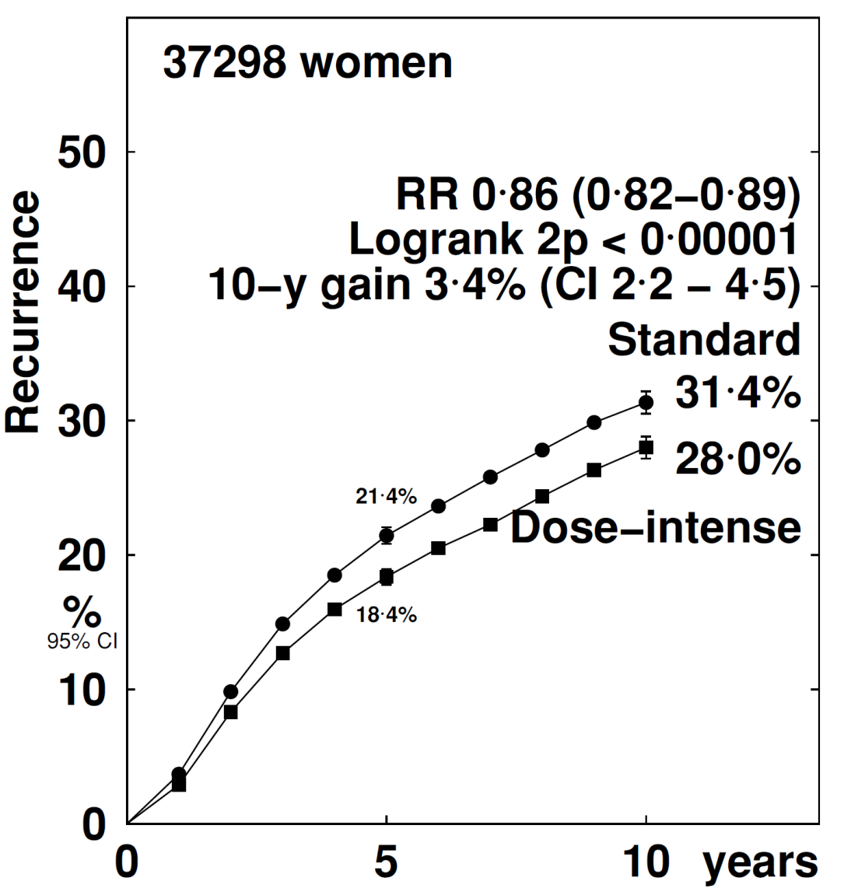
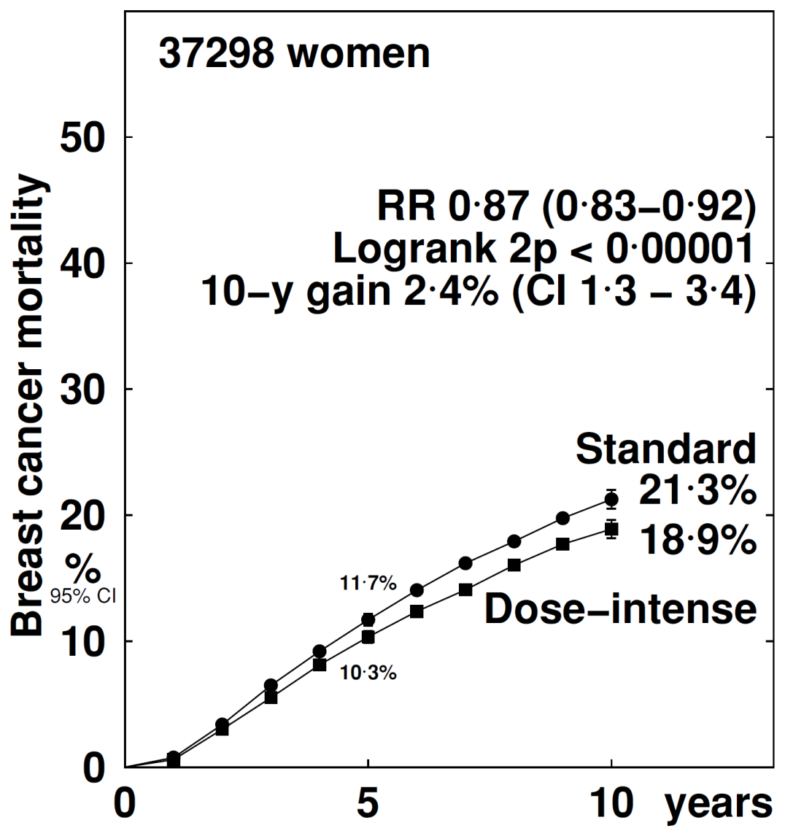
Pooled analysis of all 26 dose-dense and sequential trials
Any Recurrence
Breast Cancer Mortality

Slide 13
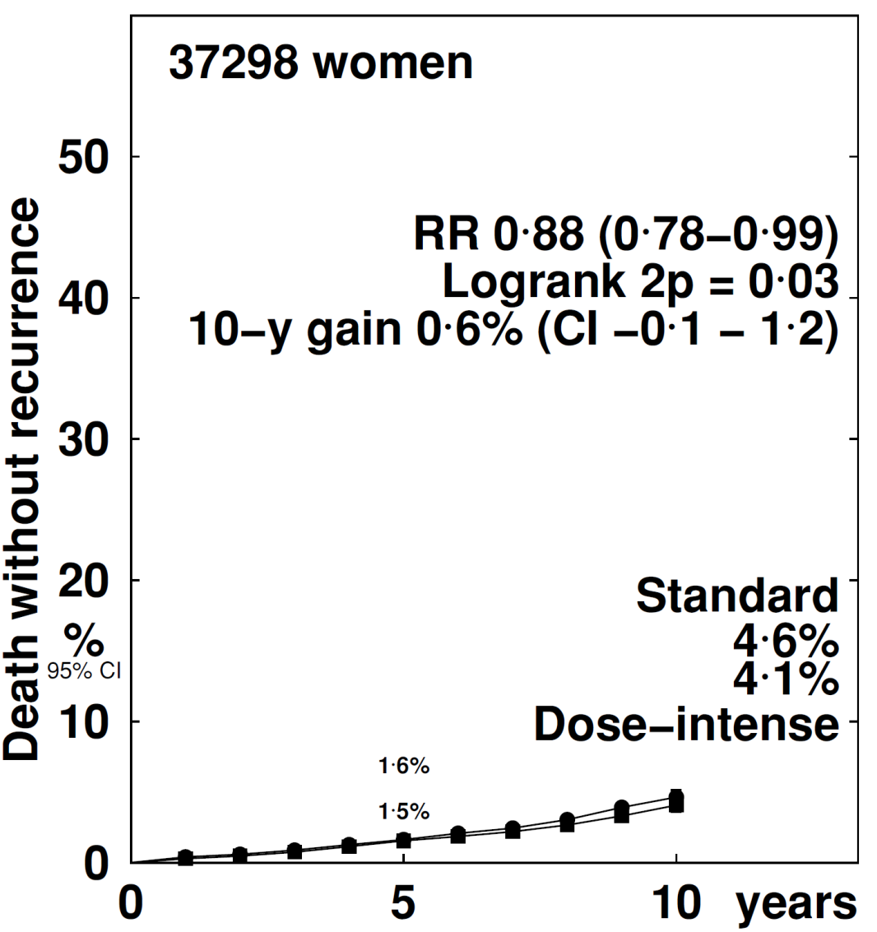
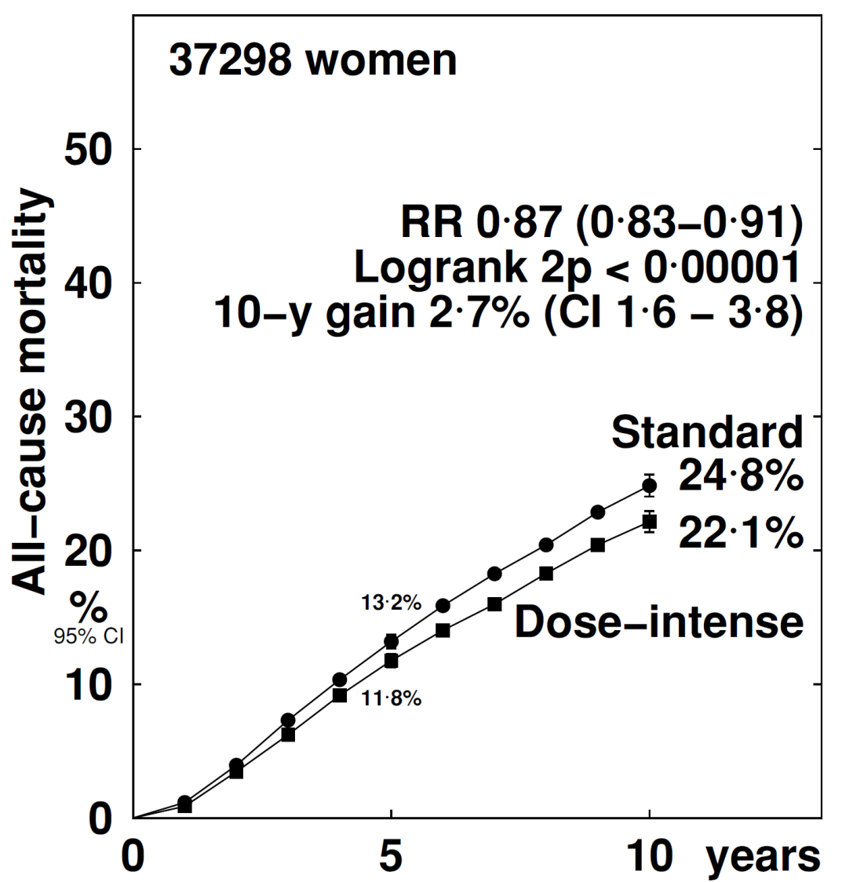
Pooled analysis of all 26 dose-dense and sequential trials
Death without recurrence
All-cause mortality

Slide 14
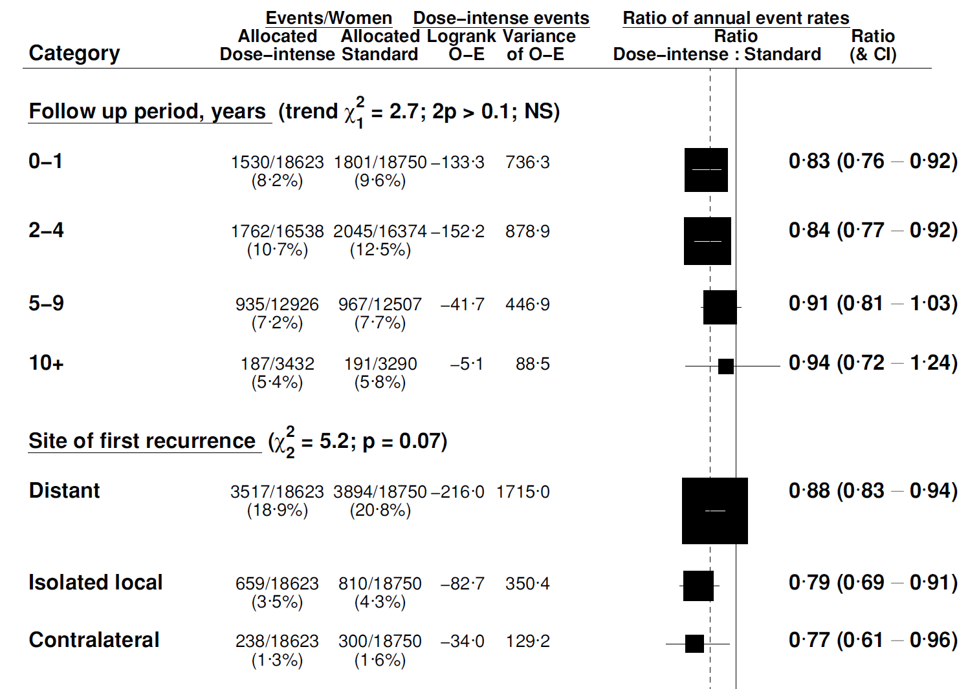
All trials: recurrence by FU period and site
Unknowns omitted

Slide 15
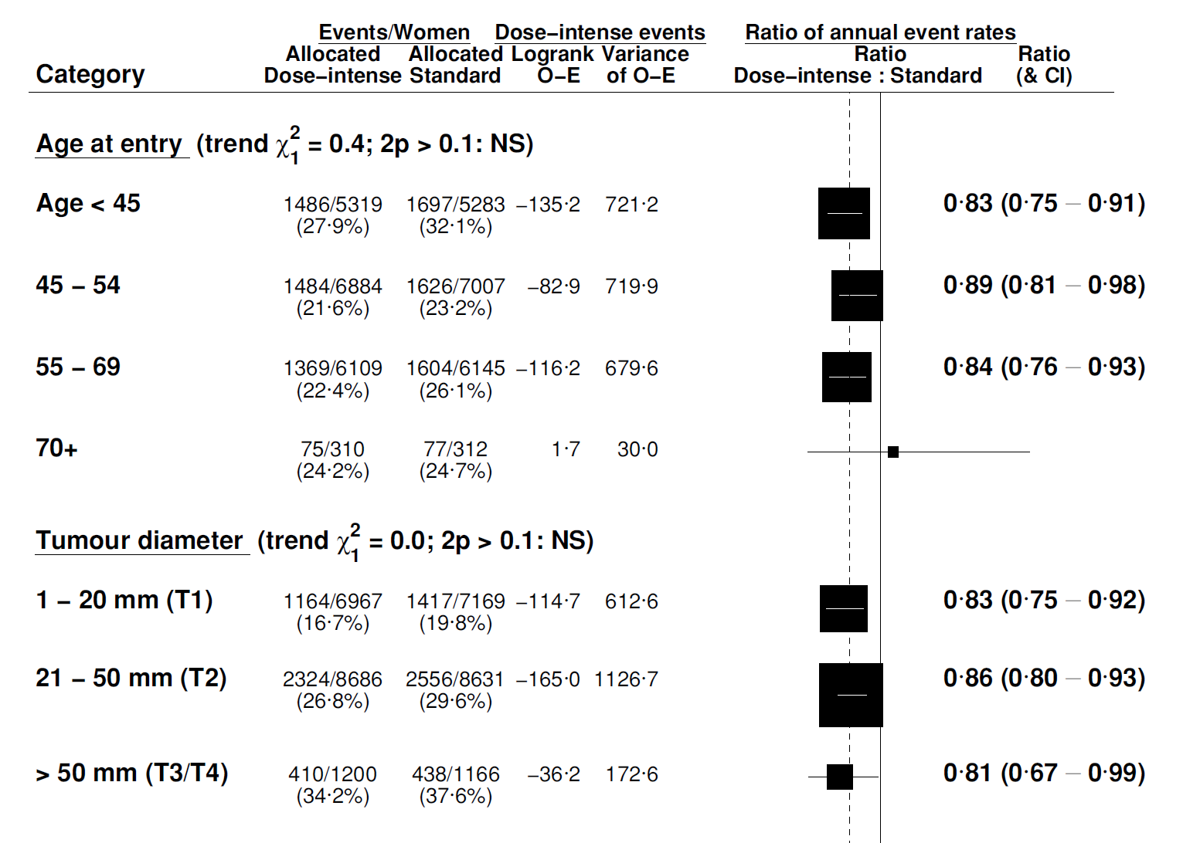
All trials: recurrence by age and T-stage
Unknowns omitted

Slide 16
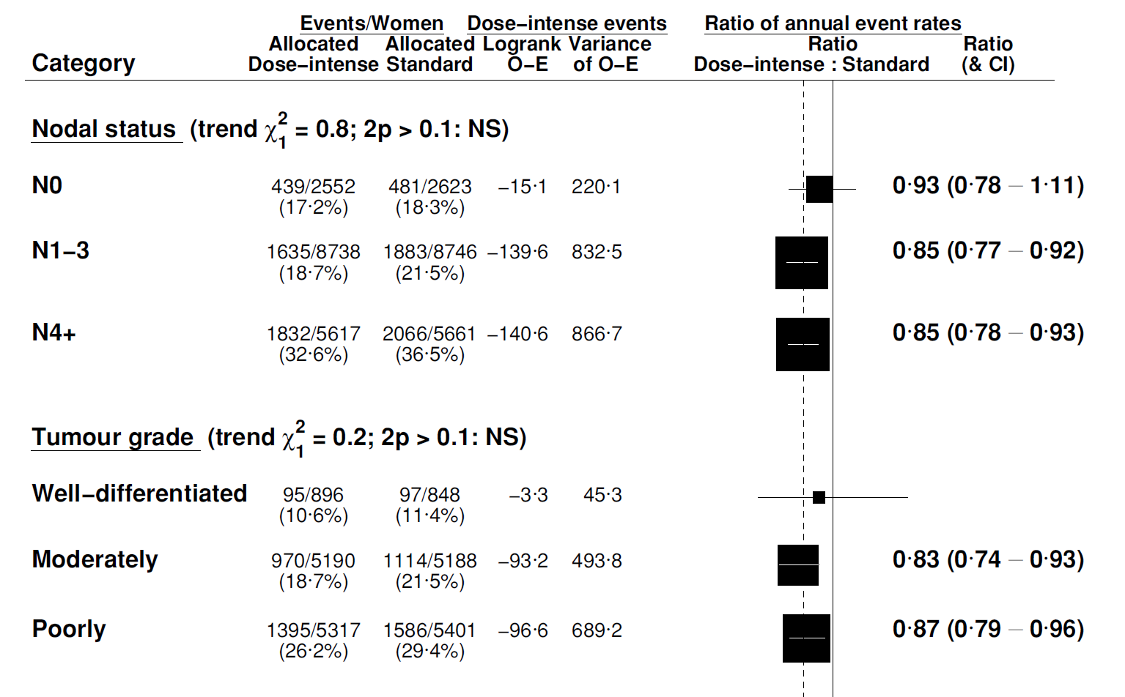
All trials: recurrence by nodal status and grade
Unknowns omitted

Slide 17
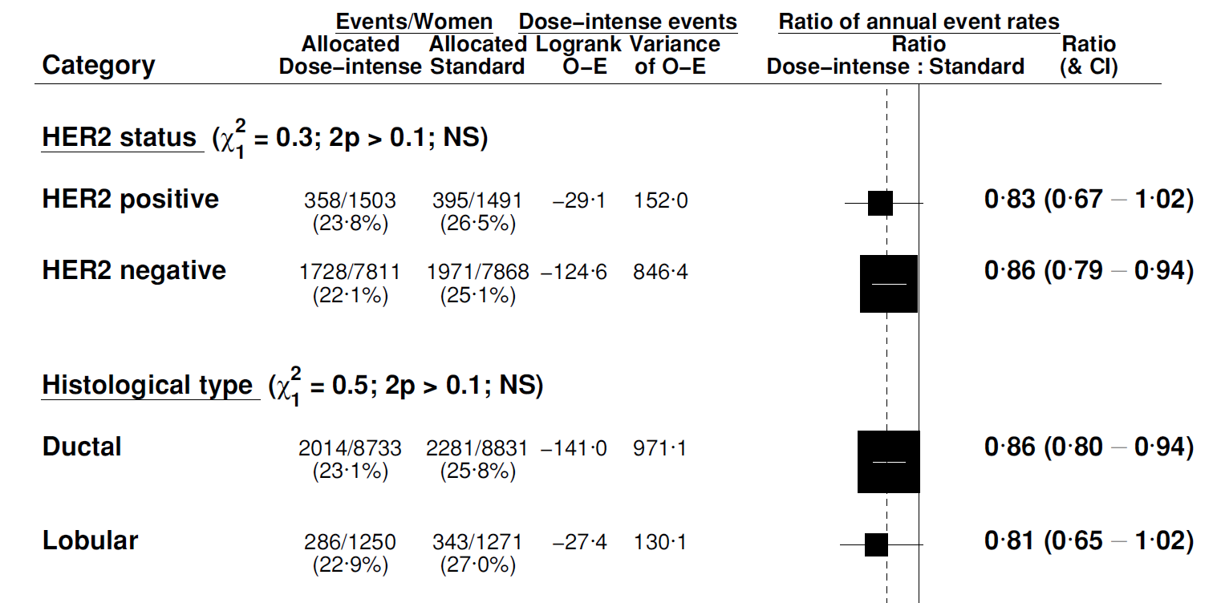
Recurrence by HER2 status and histology
Unknowns omitted

Slide 18
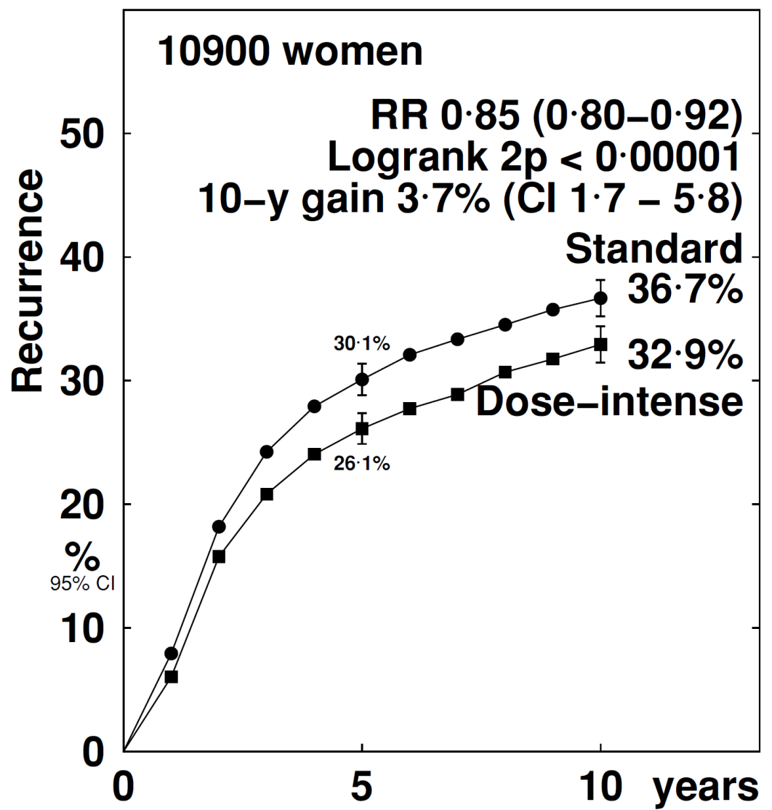
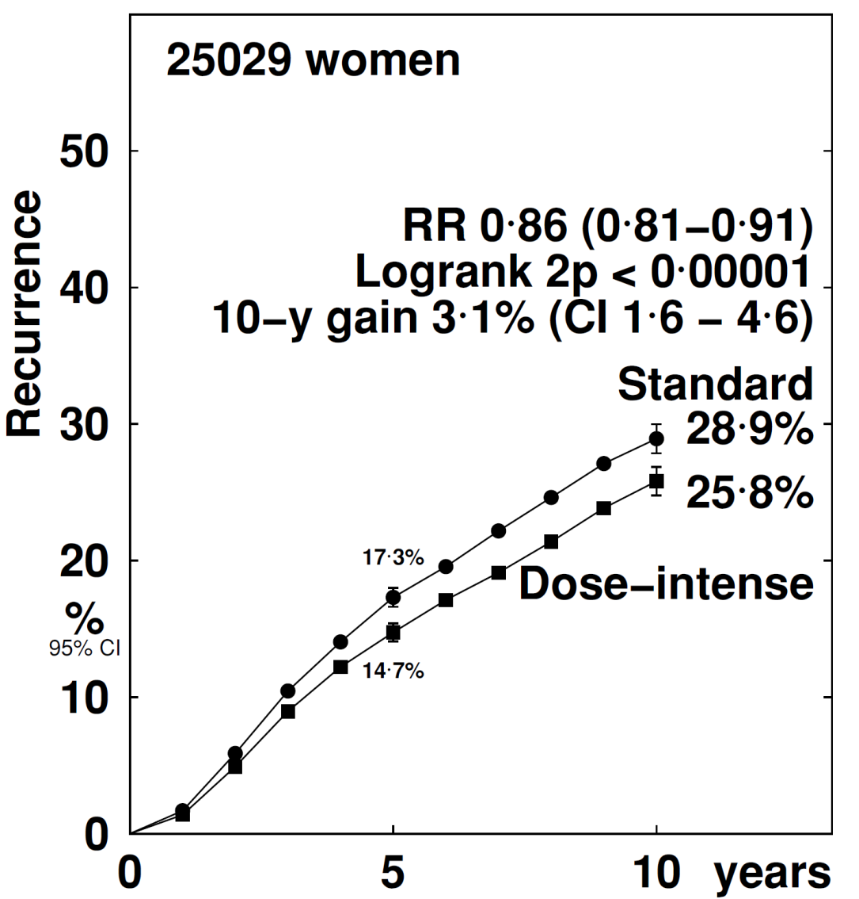
Pooled Analysis: recurrence by ER status
ER- Negative
ER- Positive

Slide 19
Conclusions
Shortening the interval between cycles and sequential administration of anthracycline and taxane based chemotherapy reduces recurrence and death from breast cancer by about 15%
Reductions in recurrence were similar in ER-positive and ER-negative disease and did not differ significantly by any other tumour or patient characteristic
No increase seen in death without recurrence (overall or during chemotherapy)

Slide 20


Acknowledgements
The Early Breast Cancer Trialists’
Collaborative Group (EBCTCG)
Trialists who shared their data
37,000 women in 26 trials
The funding bodies

