Slide 1
Local and systemic therapies:
several MODERATE survival gains
MODERATE improvements in early detection,
in local control, in endocrine therapy and
in chemotherapy have, in aggregate,
SUBSTANTIALLY reduced national mortality rates
EBCTCG, Lancet 2011

Slide 2
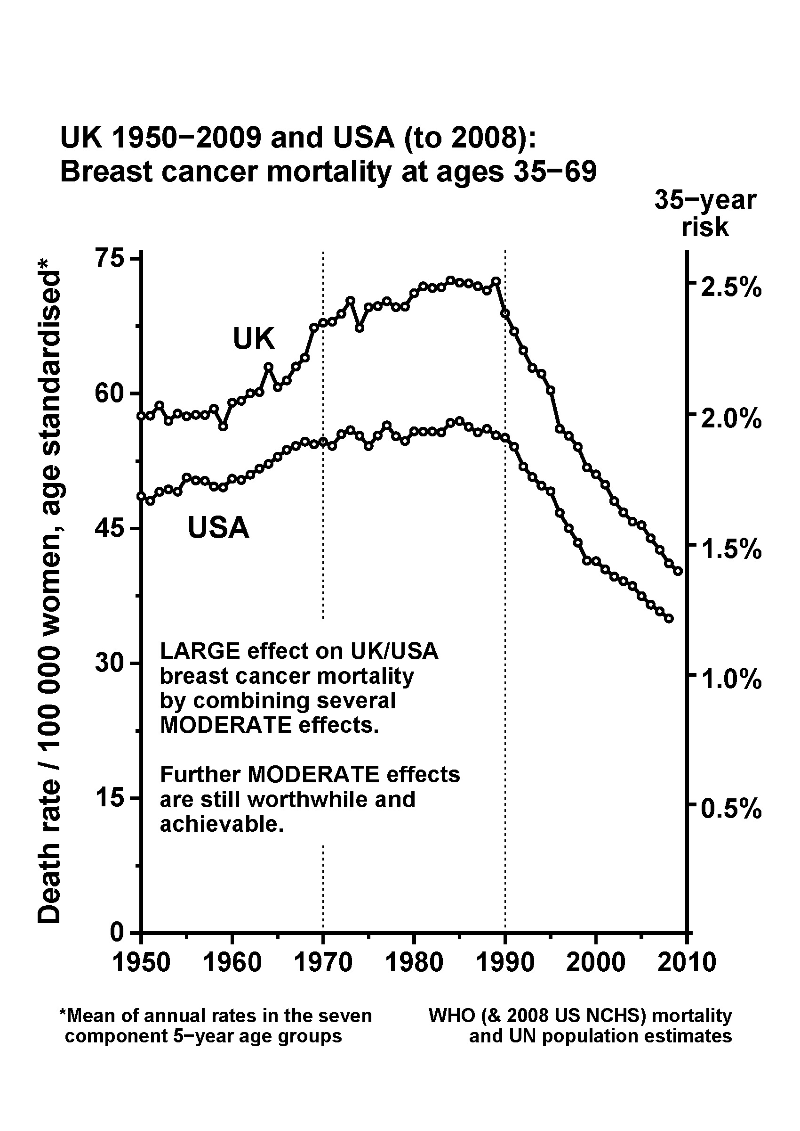
EBCTCG,
Lancet 2011

Slide 3
Reliable assessment of MODERATE differences in LONG-TERM survival by the 5-yearly worldwide overview
(with tens of thousands randomised)
Need all the main randomised trial results,
both to get big enough numbers and to
avoid undue emphasis on particular studies
EBCTCG, Lancet 2011

Slide 4
Early Breast Cancer Trialists’
Collaborative Group (EBCTCG)
So as not to miss any MODERATE
differences in long-term survival,
the world’s trialists have shared
their data every 5 years since 1985
1985, 1990, 1995, 2000, 2005, 2010
EBCTCG, Lancet 2011

Slide 5
EBCTCG collaborators (620)
ACETBC, Tokyo, Japan O Abe, R Abe, K Enomoto, K Kikuchi, H Koyama, H Masuda, Y Nomura, Y Ohashi, K Sakai, K Sugimachi, M Toi, T Tominaga, J Uchino, M Yoshida. Addenbrooke’s Hospital, Cambridge, UK J L Haybittle. Anglo-Celtic Cooperative Oncology Group, UK C F Leonard. ARCOSEIN Group, France G Calais, P Geraud. ATLAS Trial Collaborative Study Group, Oxford, UK V Collett, C Davies, A Delmestri, J Sayer. Auckland Breast Cancer Study Group, New Zealand V J Harvey, I M Holdaway, R G Kay, B H Mason. Australian New Zealand Breast Cancer Trials Group, Sydney, Australia J F Forbes, N Wilcken. Austrian Breast Cancer Study Group, Vienna, Austria R Bartsch, P Dubsky, C Fesl, H Fohler, M Gnant, R Greil, R Jakesz, A Lang, G Luschin-Ebengreuth, C Marth, B Mlineritsch, H Samonigg, C F Singer, G G Steger, H Stoger. Beatson Oncology Centre, Glasgow, UK P Canney, H M A Yosef. Belgian Adjuvant Breast Cancer Project, Liège, Belgium C Focan. Berlin-Buch Akademie der Wissenschaften, Germany U Peek. Birmingham General Hospital, UK G D Oates, J Powell. Bordeaux Institut Bergonié, France M Durand, L Mauriac. Bordet Institute, Brussels, Belgium A Di Leo, S Dolci, D Larsimont, J M Nogaret, C Philippson, M J Piccart. Bradford Royal Infirmary, UK M B Masood, D Parker, J J Price. Breast Cancer International Research Group (BCIRG) M A Lindsay, J Mackey, M Martin. Breast Cancer Study Group of the Comprehensive Cancer Centre, Limburg, Netherlands P S G J Hupperets. British Association of Surgical Oncology BASO II Trialists, London, UK T Bates, R W Blamey, U Chetty, I O Ellis, E Mallon, D A L Morgan, J Patnick, S Pinder. British Columbia Cancer Agency, Vancouver, Canada I Olivotto, J Ragaz. Cancer and Leukemia Group B, Washington DC, USA D Berry, G Broadwater, C Cirrincione, H Muss, L Norton, R B Weiss. Cancer Care Ontario, Canada H T Abu-Zahra. Cancer Research Centre of the Russian Academy of Medical Sciences, Moscow, Russia S M Portnoj. Cancer Research UK Clinical Trials Unit (CRCTU), NCRI, Birmingham, UK S Bowden, C Brookes, J Dunn, I Fernando, M Lee, C Poole, D Rea, D Spooner. Cardiff Trialists Group, UK P J Barrett-Lee, R E Mansel, I J Monypenny. Case Western Reserve University, Cleveland, OH, USA N H Gordon. Central Oncology Group, Milwaukee, WI, USA H L Davis. Centre for Cancer Prevention, Wolfson Institute of Preventive Medicine, Queen Mary, University of London, UK J Cuzick. Centre Léon-Bérard, Lyon, France Y Lehingue, P Romestaing. Centre Paul Lamarque, Montpellier, France J B Dubois. Centre Regional François Baclesse, Caen, France T Delozier, B Griffon, J Mace Lesec’h. Centre René Huguenin, Paris, St Cloud, France P Rambert. Centro Oncologico, Trieste, Italy G Mustacchi. Charles University in Prague, First Faculty of Medicine, Department of Oncology of the First Faculty of Medicine and General Teaching Hospital, Czech Republic L Petruzelka, O Pribylova. Cheltenham General Hospital, UK J R Owen. Chemo N0 Trial Group, Germany N Harbeck, F Janicke, C Meisner, M Schmitt, C Thomssen. Chicago University, IL, USA P Meier. Chinese Academy of Medical Sciences, Beijing, People’s Republic of China (in collaboration with the Oxford CTSU) Y Shan, Y F Shao, X Wang, D B Zhao (CTSU: Z M Chen, H C Pan). Christie Hospital and Holt Radium Institute, Manchester, UK A Howell, R Swindell. Clinical Trial Service Unit, Oxford, UK (ie, EBCTCG Secretariat) J A Burrett, M Clarke, R Collins, C Correa, D Cutter, S Darby, C Davies, K Davies, A Delmestri, P Elphinstone, V Evans, L Gettins, J Godwin, R Gray, C Gregory, D Hermans, C Hicks, S James, A Kerr, E MacKinnon, M Lay, P McGale, T McHugh, R Peto, J Sayer, C Taylor, Y Wang. Coimbra Instituto de Oncologia, Portugal J Albano, C F de Oliveira, H Gervasio, J Gordilho. Copenhagen Radium Centre, Denmark H Johansen, H T Mouridsen. Dana-Farber Cancer Institute, Boston, MA, USA R S Gelman, J R Harris, D Hayes, C Henderson, C L Shapiro, E Winer. Danish Breast Cancer Cooperative Group, Copenhagen, Denmark P Christiansen, B Ejlertsen, M Ewertz, M-B Jensen, S Moller, H T Mouridsen. Danish Cancer Registry, Copenhagen, Denmark B Carstensen, T Palshof. Düsseldorf University, Germany H J Trampisch. Dutch Working Party for Autologous Bone Marrow Transplant in Solid Tumours, Amsterdam & Groningen, Netherlands O Dalesio, E G E de Vries, S Rodenhuis, H van Tinteren. Eastern Cooperative Oncology Group, Boston, MA, USA R L Comis, N E Davidson, R Gray, N Robert, G Sledge, L J Solin, J A Sparano, D C Tormey, W Wood. Edinburgh Breast Unit, UK D Cameron, U Chetty, J M Dixon, P Forrest, W Jack, I Kunkler. Elim Hospital, Hamburg, Germany J Rossbach. Erasmus MC/Daniel den Hoed Cancer Center, Rotterdam, Netherlands J G M Klijn, A D Treurniet-Donker, W L J van Putten. European Institute of Oncology, Milan, Italy N Rotmensz, U Veronesi, G Viale. European Organization for Research and Treatment of Cancer, Brussels, Belgium H Bartelink, N Bijker, J Bogaerts, F Cardoso, T Cufer, J P Julien, E Rutgers, C J H van de Velde. Evanston Hospital, IL, USA M P Cunningham. Finnish Breast Cancer Group, Finland R Huovinen, H Joensuu. Fondazione Maugeri Pavia, Italy A Costa, C Tinterri. Fondazione Michelangelo, Milan, Italy G Bonadonna, L Gianni, P Valagussa. Fox Chase Cancer Center, Philadelphia, PA, USA L J Goldstein. French Adjuvant Study Group (GFEA), Guyancourt, France J Bonneterre, P Fargeot, P Fumoleau, P Kerbrat, E Luporsi, M Namer. German Adjuvant Breast Group (GABG), Frankfurt, Germany W Eiermann, J Hilfrich, W Jonat, M Kaufmann, R Kreienberg, M Schumacher. | German Breast Cancer Study Group (BMFT), Freiburg, Germany G Bastert, H Rauschecker, R Sauer, W Sauerbrei, A Schauer, M Schumacher. German Breast Group (GBG), NeuIsenburg, Germany J U Blohmer, S D Costa, H Eidtmann, B Gerber, C Jackisch, S Loibl, G von Minckwitz. Ghent University Hospital, Belgium A de Schryver, L Vakaet. GIVIO Interdisciplinary Group for Cancer Care Evaluation, Chieti, Italy M Belfiglio, A Nicolucci, F Pellegrini, M C Pirozzoli, M Sacco, M Valentini. Glasgow Victoria Infirmary, UK C S McArdle, D C Smith, S Stallard. Groote Schuur Hospital, Cape Town, South Africa D M Dent, C A Gudgeon, A Hacking, E Murray, E Panieri, ID Werner. Grupo Español de Investigación en Cáncer de Mama (GEICAM), Spain E Carrasco, M Martin, M A Segui. Gruppo Oncologico Clinico Cooperativo del Nord Est, Aviano, Italy E Galligioni. Gruppo Oncologico Dell’Italia Meridionale (GOIM), Rome, Italy M Lopez. Guadalajara Hospital de 20 Noviembre, Mexico A Erazo, J Y Medina. Gunma University, Japan J Horiguchi, H Takei. Guy’s Hospital, London, UK I S Fentiman, J L Hayward, R D Rubens, D Skilton. Heidelberg University I, Germany H Scheurlen. Heidelberg University II, Germany M Kaufmann, H C Sohn. Helios Klinikum Berlin-Buch, Germany M Untch. Hellenic Breast Surgeons Society, Greece U Dafni, C Markopoulos. Hellenic Cooperative Oncology Group, Athens, Greece U Dafni, G Fountzilas. Hellenic Oncology Research Group, Greece D Mavroudis. Helsinki Deaconess Medical Centre, Finland P Klefstrom. Helsinki University, Finland C Blomqvist, T Saarto. Hospital del Mar, Barcelona, Spain M Gallen. Innsbruck University, Austria R Margreiter. Institut Claudius Regaud, Toulouse, France B de Lafontan, J Mihura, H Roche. Institut Curie, Paris, France B Asselain, R J Salmon, J R Vilcoq. Institut Gustave-Roussy, Paris, France R Arriagada, C. Bourgier, C Hill, S Koscielny, A Laplanche, M G Le, M Spielmann. Institute of Cancer Research Clinical Trials and Statistics Unit (ICR-CTSU, NCRI), UK R A’Hern, J Bliss, P Ellis, L Kilburn, J R Yarnold. Integraal Kankercentrum, Amsterdam, Netherlands J Benraadt, M Kooi, A O van de Velde, J A van Dongen, J B Vermorken. International Breast Cancer Study Group (IBCSG), Bern, Switzerland M Castiglione, A Coates, M Colleoni, J Collins, J Forbes, R D Gelber, A Goldhirsch, J Lindtner, K N Price, M M Regan, C M Rudenstam, H J Senn, B Thuerlimann. International Collaborative Cancer Group, Charing Cross Hospital, London, UK J M Bliss, C E D Chilvers, R C Coombes, E Hall, M Marty. International Drug Development Institute, Louvain-la-Neuve, Belgium M Buyse. International TABLE Study Group, Berlin, Germany K Possinger, P Schmid, M Untch, D Wallwiener. ISD Cancer Clinical Trials Team (incorporating the former Scottish Cancer Therapy Network), Edinburgh, UK L Foster, W D George, H J Stewart, P Stroner. Israel NSABC, Tel Aviv, Israel R Borovik, H Hayat, M J Inbar, E Robinson. Istituto Nazionale per la Ricerca sul Cancro, Genova, Italy P Bruzzi, L Del Mastro, P Pronzato, M R Sertoli, M Venturini. Istituto Nazionale per lo Studio e la Cura dei Tumori, Milan, Italy T Camerini, G De Palo, M G Di Mauro, F Formelli, P Valagussa. Istituto Oncologico Romagnolo, Forli, Italy D Amadori. Italian Cooperative Chemo-Radio-Surgical Group, Bologna, Italy A Martoni, F Pannuti. Italian Oncology Group for Clinical Research (GOIRC), Parma, Italy R Camisa, G Cocconi, A Colozza, R Passalacqua. Japan Clinical Oncology Group– Breast Cancer Study Group, Matsuyama, Japan K Aogi, S Takashima. Japanese Foundation for Multidisciplinary Treatment of Cancer, Tokyo, Japan O Abe, T Ikeda, K Inokuchi, K Kikuchi, K Sawa. Kawasaki Medical School, Japan H Sonoo. Krakow Institute of Oncology, Poland S Korzeniowski, J Skolyszewski. Kumamoto University Group, Japan M Ogawa, J Yamashita. Leiden University Medical Center, Netherlands E Bastiaannet, C J H van de Velde, W van de Water, J G H van Nes. Leuven Akademisch Ziekenhuis, Gasthuisberg, Belgium R Christiaens, P Neven, R Paridaens, W Van den Bogaert. Ludwig-Maximilians University, Munich, Germany S Braun, W Janni. Marseille Laboratoire de Cancérologie Biologique APM, France P Martin, S Romain. Medical University Vienna – General Hospital - Department of Obstetrics and Gynaecology and Department of Medicine I, Vienna, Austria M Janauer, M Seifert, P Sevelda, C C Zielinski. Memorial Sloan-Kettering Cancer Center, New York, NY, USA T Hakes, C A Hudis, L Norton, R Wittes. Metaxas Memorial Cancer Hospital, Athens, Greece G Giokas, D Kondylis, B Lissaios. Mexican National Medical Center, Mexico City, Mexico R de la Huerta, M G Sainz. National Cancer Institute, Bethesda, MD, USA R Altemus, K Camphausen, K Cowan, D Danforth, A Lichter, M Lippman, J O’Shaughnessy, L J Pierce, S Steinberg, D Venzon, J A Zujewski. National Cancer Institute of Bari, Italy C D’Amico, M Lioce, A Paradiso. NCIC Clinical Trials Group, Kingston, Ontario, Canada J-A W Chapman, K Gelmon, P E Goss, M N Levine, R Meyer, W Parulekar, J L Pater, K I Pritchard, L E Shepherd, D Tu, T Whelan. National Kyushu Cancer Center, Japan Y Nomura, S Ohno. National Surgical Adjuvant Breast and Bowel Project (NSABP), Pittsburgh, PA, USA | S Anderson, G Bass, A Brown (deceased), J Bryant (deceased), J Costantino, J Dignam, B Fisher, C Geyer, E P Mamounas, S Paik, C Redmond, S Swain, L Wickerham, N Wolmark. Nolvadex Adjuvant Trial Organisation, London, UK M Baum, I M Jackson (deceased), M K Palmer. North Central Cancer Treatment Group, Mayo Clinic, Rochester, MN, USA E Perez, J N Ingle, V J Suman. North Sweden Breast Cancer Group, Umeå, Sweden N O Bengtsson, S Emdin, H Jonsson. North-West Oncology Group (GONO), Italy L Del Mastro, M Venturini. North-Western British Surgeons, Manchester, UK J P Lythgoe, R Swindell. Northwick Park Hospital, London, UK M Kissin. Norwegian Breast Cancer Group, Oslo, Norway B Erikstein, E Hannisdal, A B Jacobsen, J E Varhaug. Norwegian Radium Hospital, Oslo, Norway B Erikstein, S Gundersen, M Hauer-Jensen, H Host, A B Jacobsen, R Nissen-Meyer. Nottingham City Hospital, UK R W Blamey, A K Mitchell, D A L Morgan, J F R Robertson. Oita Prefectural Hospital, Japan H Ueo. Oncofrance, Paris, France M Di Palma, G Mathe (deceased), J L Misset. Ontario Clinical Oncology Group, Hamilton, Canada M Levine, K I Pritchard, T Whelan. Osaka City University, Japan K Morimoto. Osaka National Hospital, Japan K Sawa, Y Takatsuka. Oxford Radcliffe Hospitals NHS Trust, Churchill Hospital, Oxford, UK E Crossley, A Harris, D Talbot, M Taylor. PACS Adjuvant Study Group, France A L Martin, H Roche. Parma Hospital, Italy G Cocconi, B di Blasio. Petrov Research Institute of Oncology, St Petersburg, Russia V Ivanov, R Paltuev, V Semiglazov. Piedmont Oncology Association, Winston-Salem, NC, USA J Brockschmidt, M R Cooper. Pretoria University, South Africa C I Falkson. Royal Marsden NHS Trust, London and Sutton, UK R A’Hern, S Ashley, M Dowsett, A Makris, T J Powles, I E Smith, J R Yarnold. St George’s Hospital, London, UK J C Gazet. St George Hospital, Sydney, Australia L Browne, P Graham. St Luke’s Hospital, Dublin, Ireland N Corcoran. Sardinia Oncology Hospital A Businico, Cagliari, Sardinia N Deshpande, L di Martino. SASIB International Trialists, Cape Town, South Africa P Douglas, A Hacking, H Host, A Lindtner, G Notter. Saskatchewan Cancer Foundation, Regina, Canada A J S Bryant, G H Ewing, L A Firth, J L Krushen-Kosloski. Scandinavian Adjuvant Chemotherapy Study Group, Oslo, Norway R Nissen-Meyer. South Sweden Breast Cancer Group, Lund, H Anderson, F Killander, P Malmstrom, L Ryden. South-East Sweden Breast Cancer Group, Linköping, Sweden L-G Arnesson, J Carstensen, M Dufmats, H Fohlin, B Nordenskjold, M Soderberg. South-Eastern Cancer Study Group and Alabama Breast Cancer Project, Birmingham, AL, USA J T Carpenter. Southampton Oncology Centre, UK N Murray, G T Royle, P D Simmonds. Southwest Oncology Group, San Antonio, TX, USA K Albain, W Barlow, J Crowley, D Hayes, J Gralow, S Green, G Hortobagyi, R Livingston, S Martino, C K Osborne, P M Ravdin. Stockholm Breast Cancer Study Group, Sweden J Adolfsson, J Bergh, T Bondesson, F Celebioglu, K Dahlberg, T Fornander, I Fredriksson, J Frisell, E Goransson, M Iiristo, U Johansson, E Lenner, L Lofgren, P Nikolaidis, L Perbeck, S Rotstein, K Sandelin, L Skoog, G Svane, E af Trampe, C Wadstrom. Swiss Group for Clinical Cancer Research (SAKK), Bern, and OSAKO, St Gallen, Switzerland M Castiglione, A Goldhirsch, R Maibach, H J Senn, B Thurlimann. Tampere University Hospital, Finland M Hakama, K Holli, J Isola, K Rouhento, R Saaristo. Tel Aviv University, Israel H Brenner, A Hercbergs. The High-Dose Chemotherapy for Breast Cancer Study Group (PEGASE), France A L Martin, H Roche. Tokyo Cancer Institute Hospital, Japan M Yoshimoto. Toronto-Edmonton Breast Cancer Study Group, Canada A H G Paterson, K I Pritchard. Toronto Princess Margaret Hospital, Canada A Fyles, J W Meakin, T Panzarella, K I Pritchard. Tunis Institut Salah Azaiz, Tunisia J Bahi. UK Multicentre Cancer Chemotherapy Study Group, London, UK M Reid, M Spittle. UK/ANZ DCIS Trial H Bishop, N J Bundred, J Cuzick, I O Ellis, I S Fentiman, J F Forbes, S Forsyth, W D George, S E Pinder, I Sestak. UK/Asia Collaborative Breast Cancer Group, London, UK G P Deutsch, R Gray, D L W Kwong, V R Pai, R Peto, F Senanayake. University and Istituto Nazionale per la Ricerca sul Cancro, Genoa, Italy on behalf of GROCTA trialists F Boccardo, A Rubagotti. University College London, UK M Baum, S Forsyth, A Hackshaw, J Houghton, J Ledermann, K Monson, JS Tobias. University Federico II, Naples, Italy C Carlomagno, M De Laurentiis, S De Placido. University of Edinburgh, UK L Williams. University of Michigan, USA D Hayes, L J Pierce. University of Texas MD Anderson Cancer Center, Houston, TX, USA K Broglio, A U Buzdar. University of Wisconsin, USA R R Love. Uppsala-Örebro Breast Cancer Study Group, Sweden J Ahlgren, H Garmo, L Holmberg, G Liljegren, H Lindman, F Warnberg. US Oncology, Houston, USA L Asmar, S E Jones. West German Study Group (WSG), Germany O Gluz, N Harbeck, C Liedtke, U Nitz. West of Scotland Breast Trial Group, Glasgow, UK A Litton. West Sweden Breast Cancer Study Group, Gothenburg, Sweden A Wallgren, P Karlsson, B K Linderholm. Western Cancer Study Group, Torrance, CA, USA R T Chlebowski. Würzburg University, Germany H Caffier.

Slide 6


Effect of radiotherapy after mastectomy and axillary surgery on 10-year recurrence and 20-year breast cancer mortality: meta-analysis of individual patient data for
8135 women in 22 randomised trials
EBCTCG (Early Breast Cancer Trialists’ Collaborative Group)*
Publication references:
Lancet 2014; 383: 2127–35 Published Online March 19, 2014
http://dx.doi.org/10.1016/S0140-6736(14)60488-8

Slide 7
Individual patient data
Criteria:
  Randomised trials of radiotherapy (RT) versus same surgery but no RT
  Started before 2000
  Mastectomy and axillary dissection to at least level II
  RT to include chest wall
Found:
  3786 women in 14 trials (started 1964 to 1982)
  43 000 years of follow-up to 2009 (median 9.0 years)
  RT to axillary, internal mammary and supraclavicular nodes

Slide 8
Current Guidelines
Surgery Nodal status Radiotherapy ?
Mastectomy + axillary dissection
(Mast+AD)
4+ positive (pN4+)
1-3 positive (pN1-3)
0 positive (pN0)
Not usually
Yes
??

Slide 9
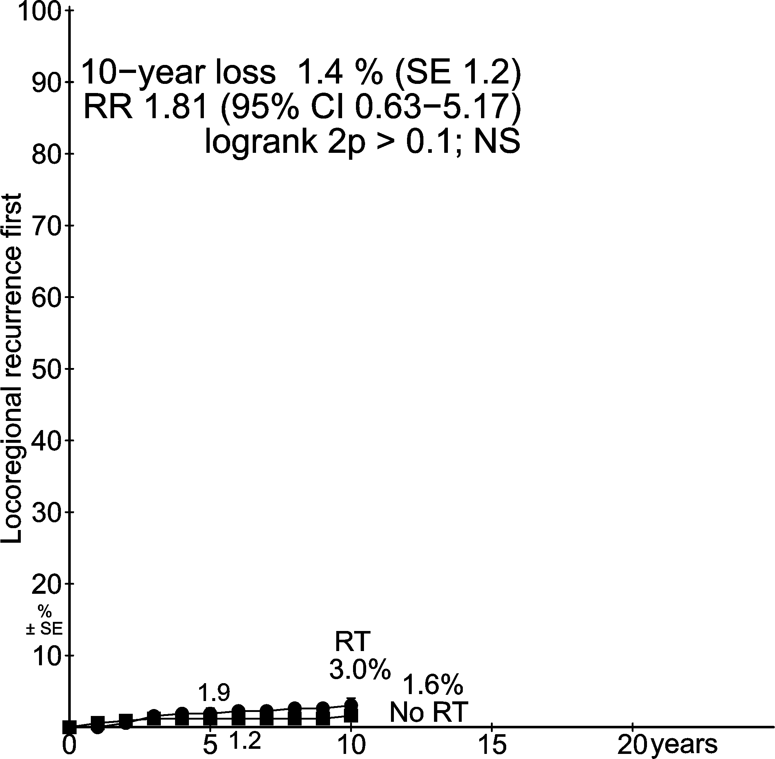
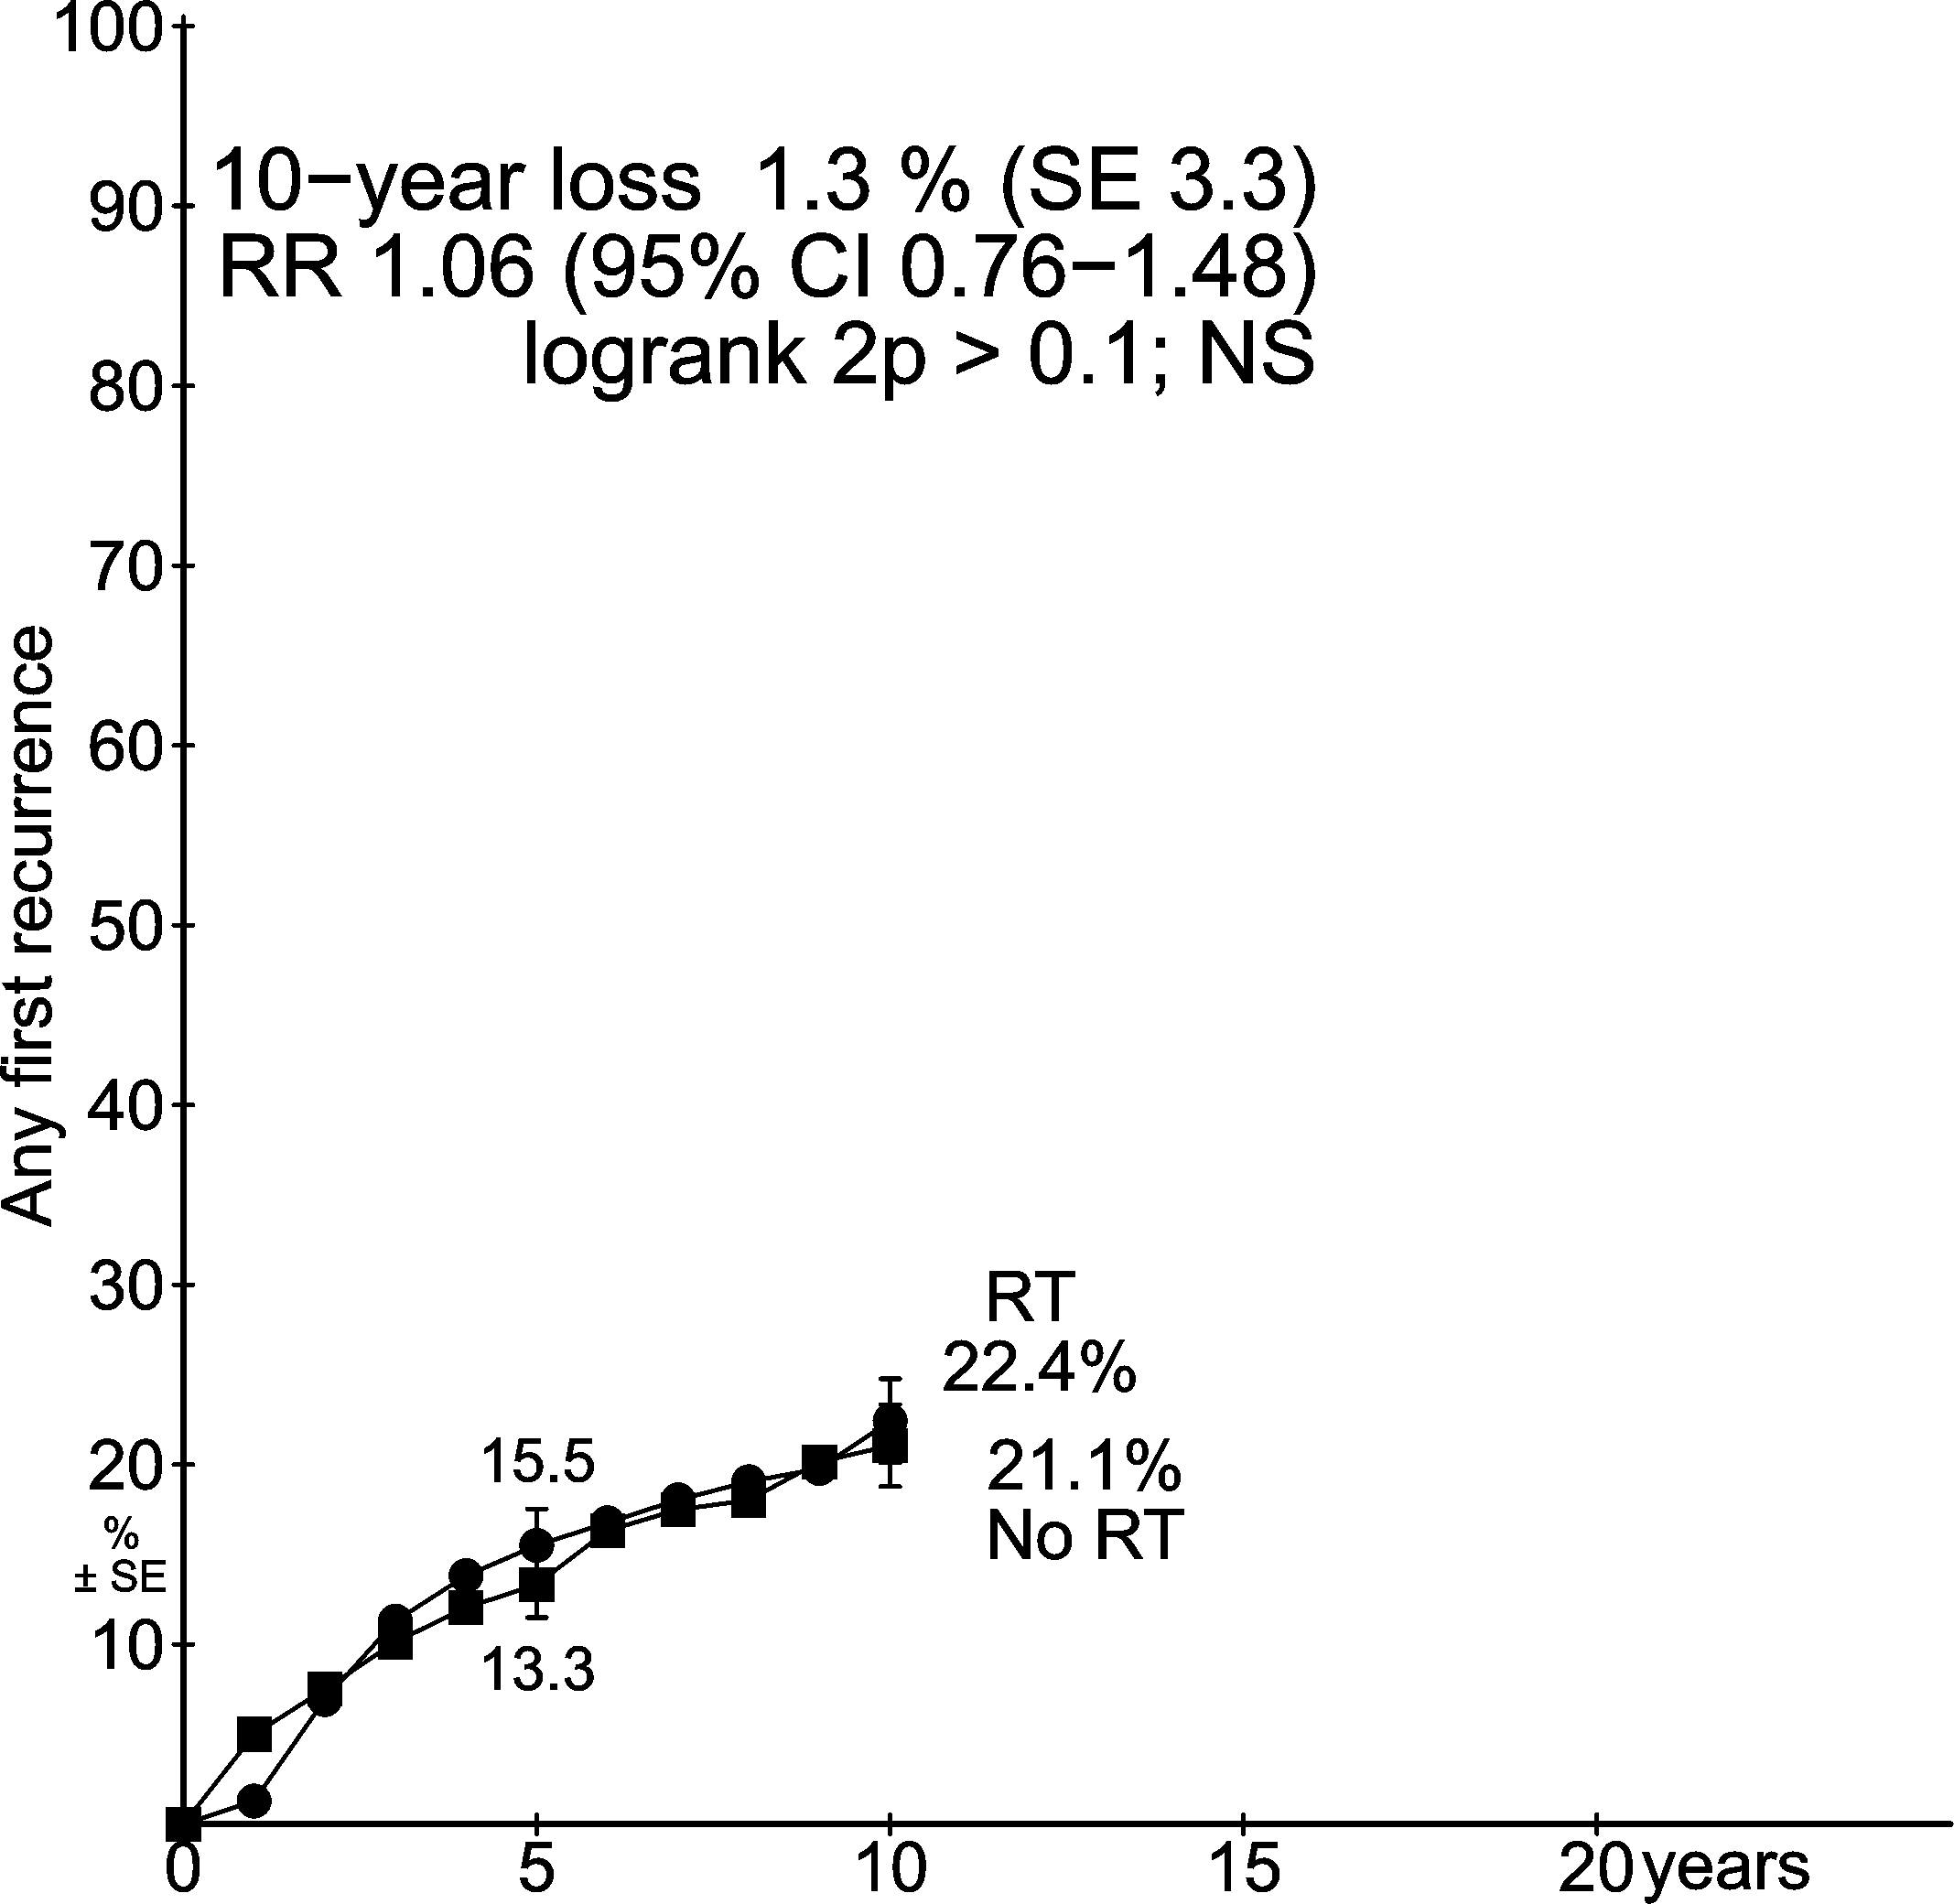
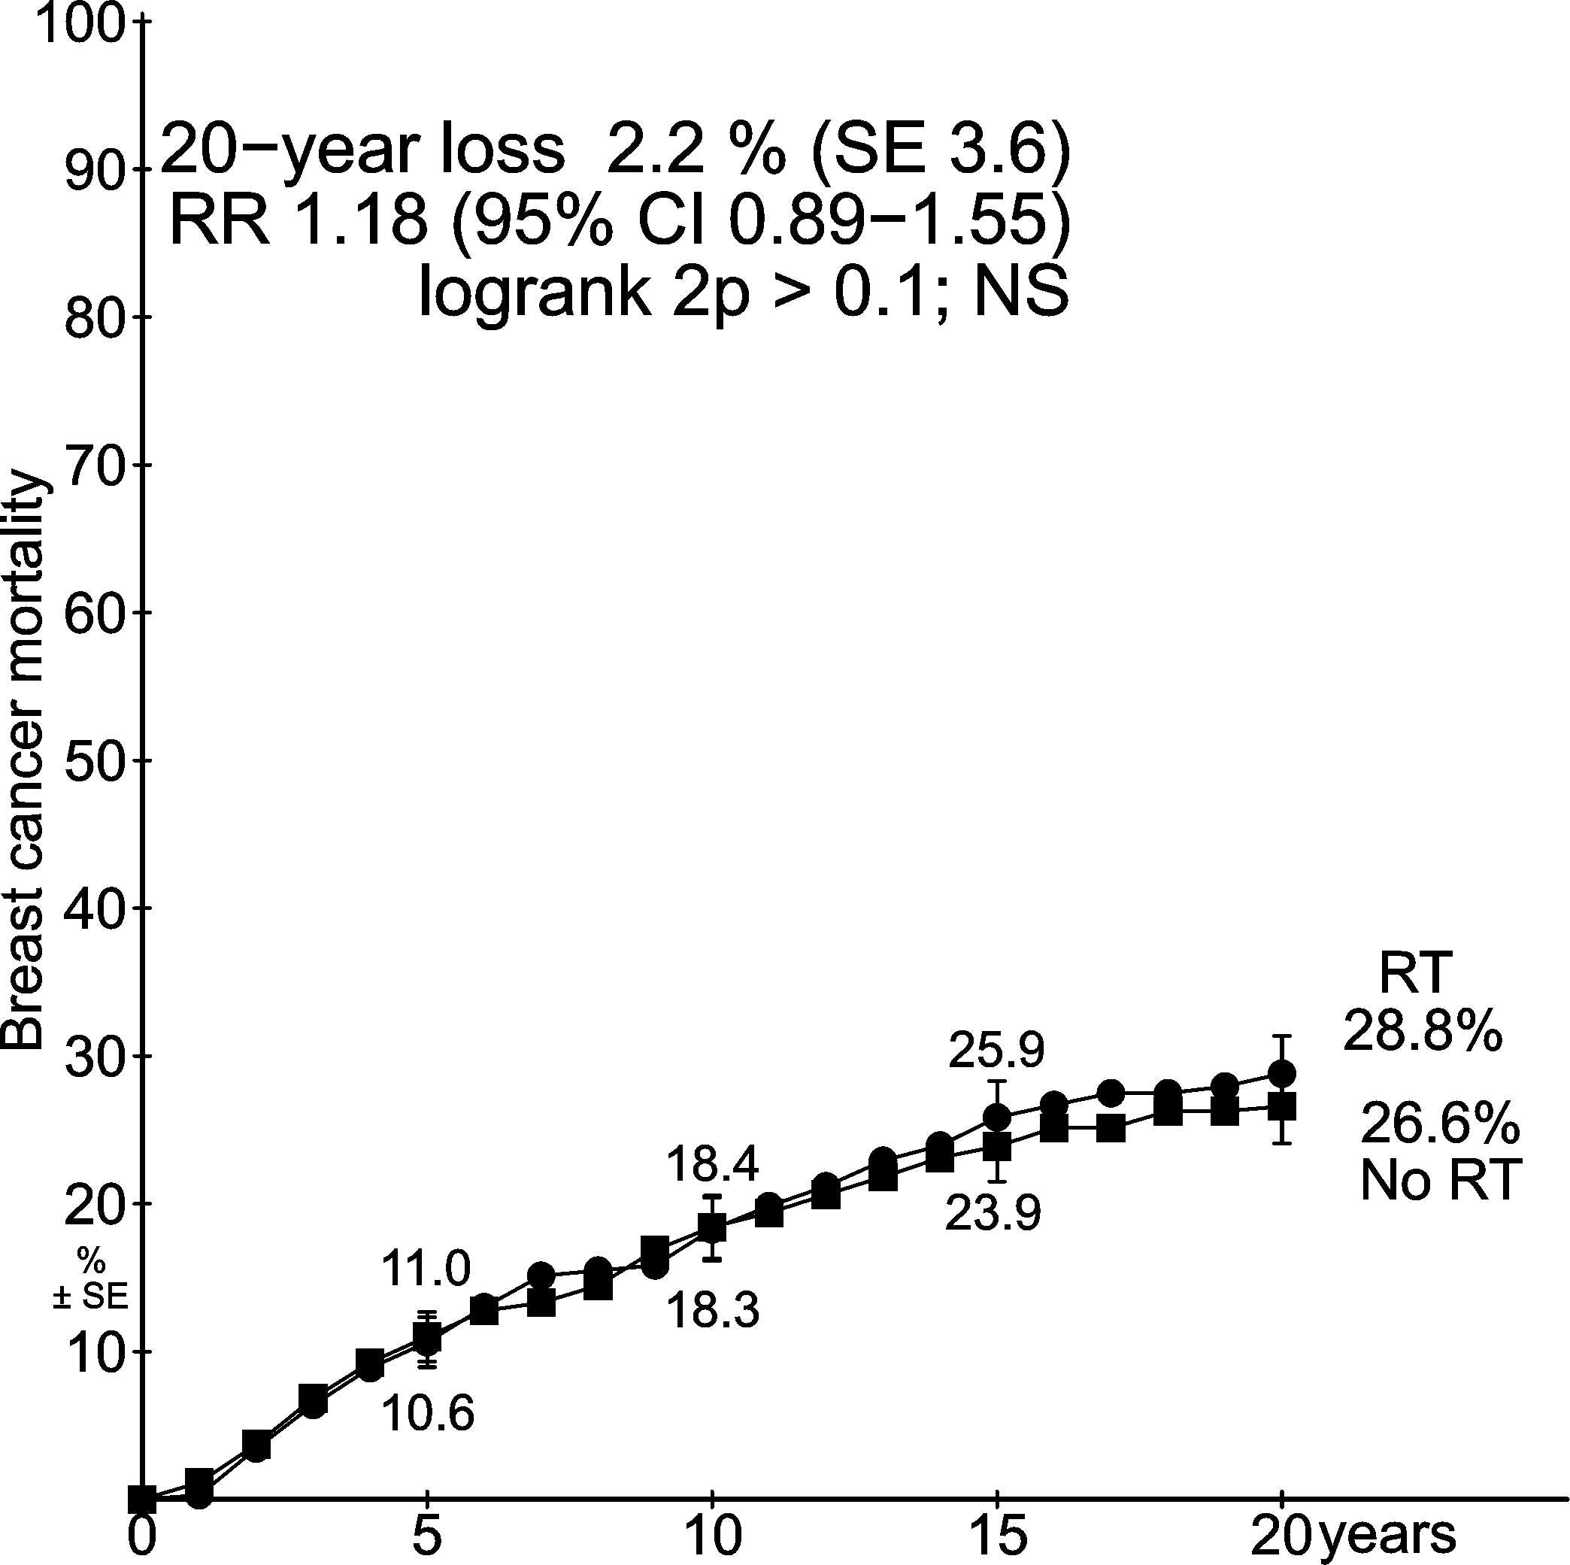
Trials of radiotherapy after mastectomy and axillary dissection
700 pN0 women
RT: No significant benefit
Locoregional recurrence first | Any first recurrence | Breast cancer mortality
Years since randomisation Years since randomisation Years since randomisation

Slide 10
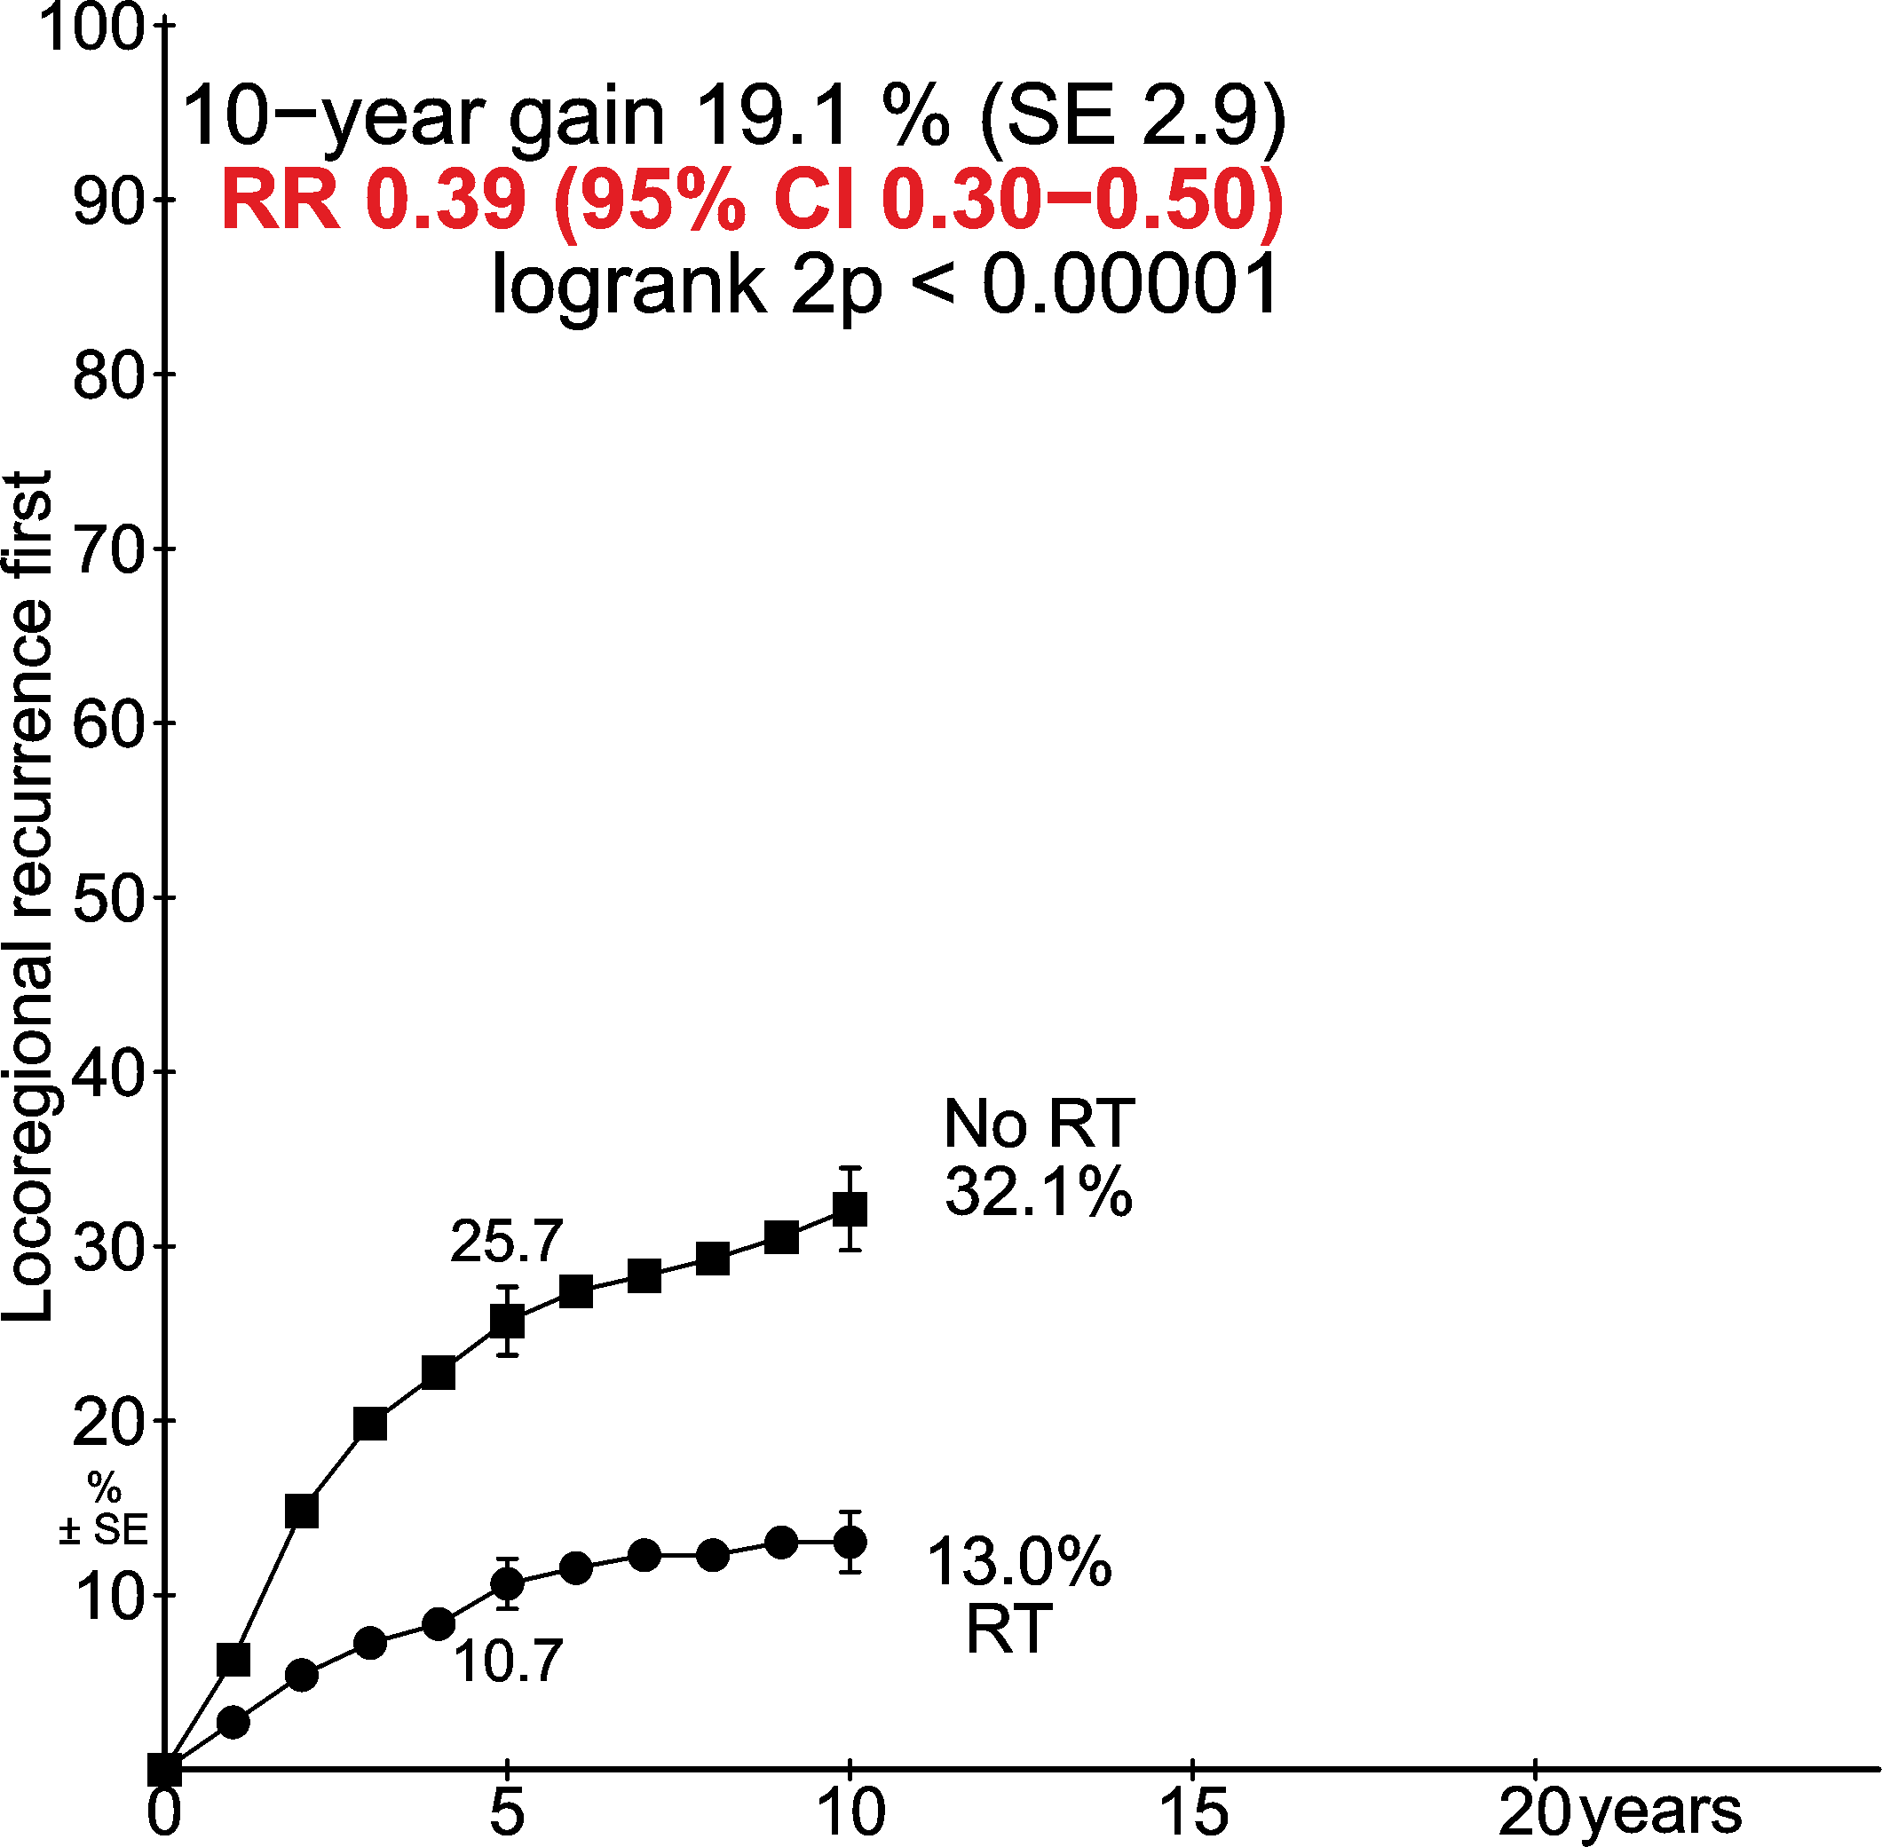
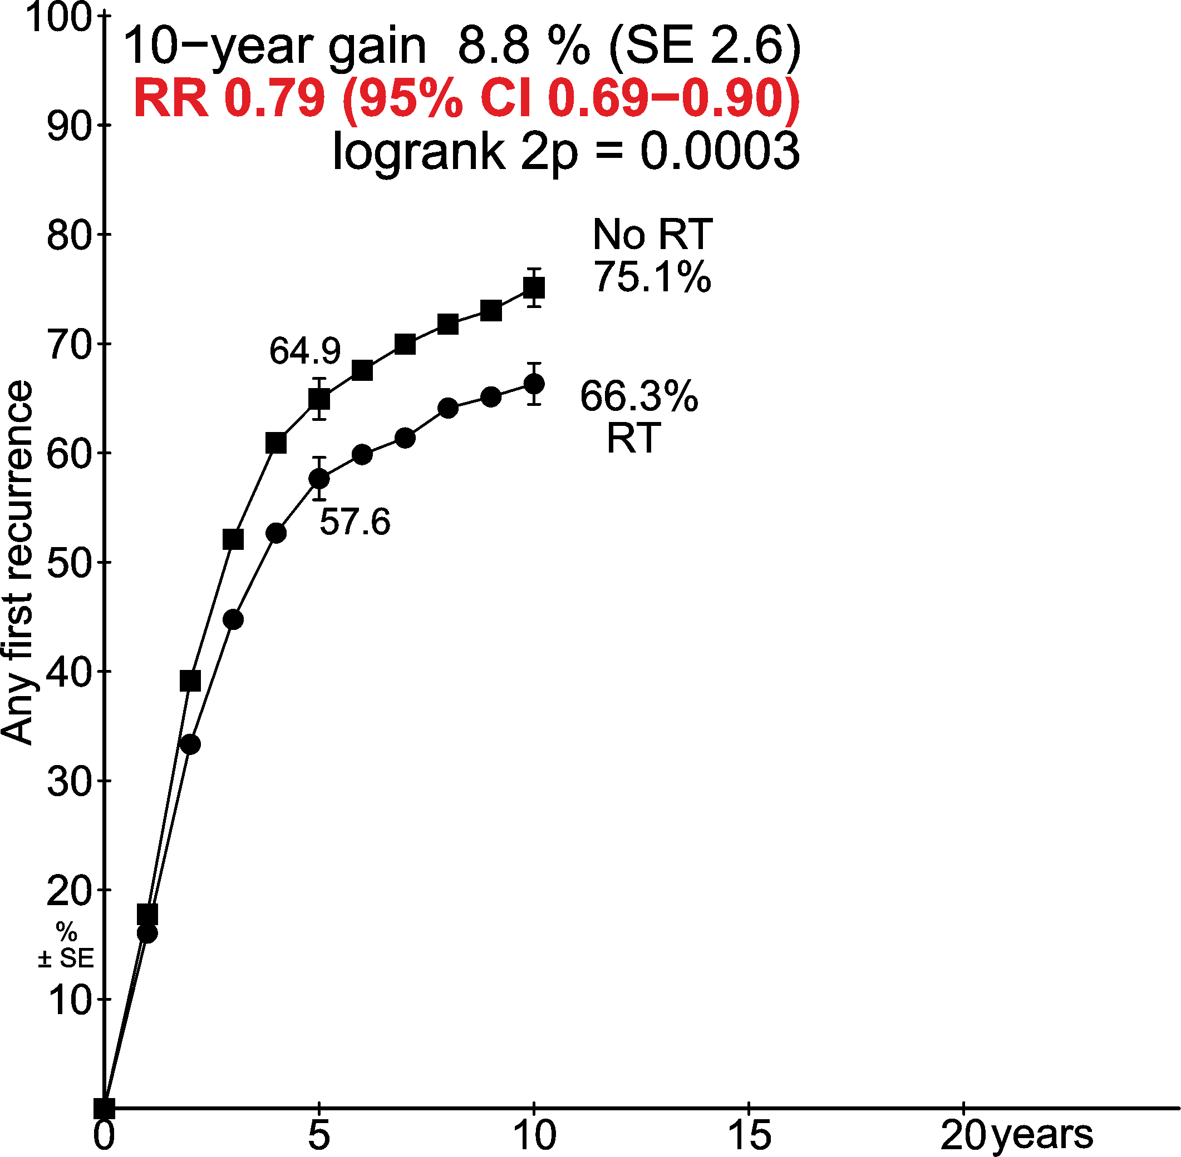
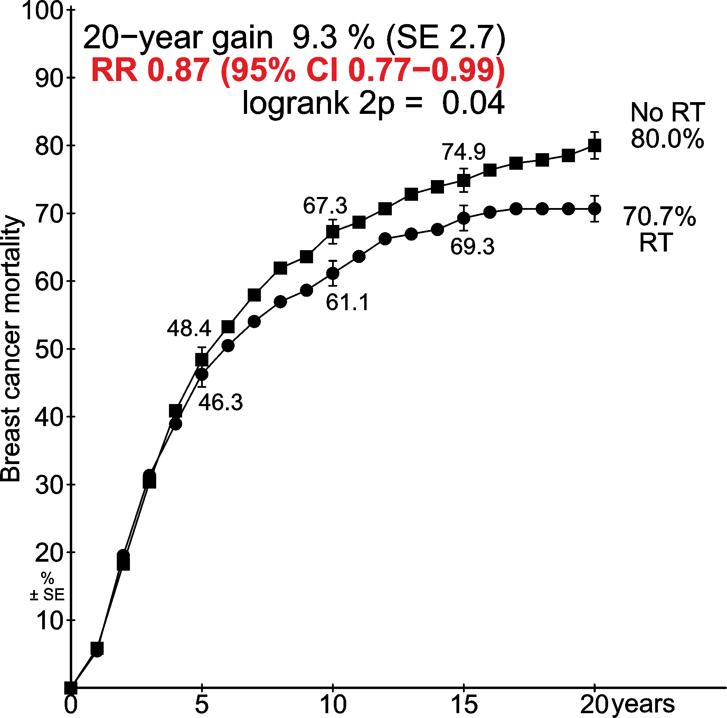
Trials of radiotherapy after mastectomy and axillary dissection
1772 pN4+ women
RT: Significant benefit
Locoregional recurrence first | Any first recurrence | Breast cancer mortality
8.8%
9.3%
19.1%
Years since randomisation Years since randomisation Years since randomisation

Slide 11
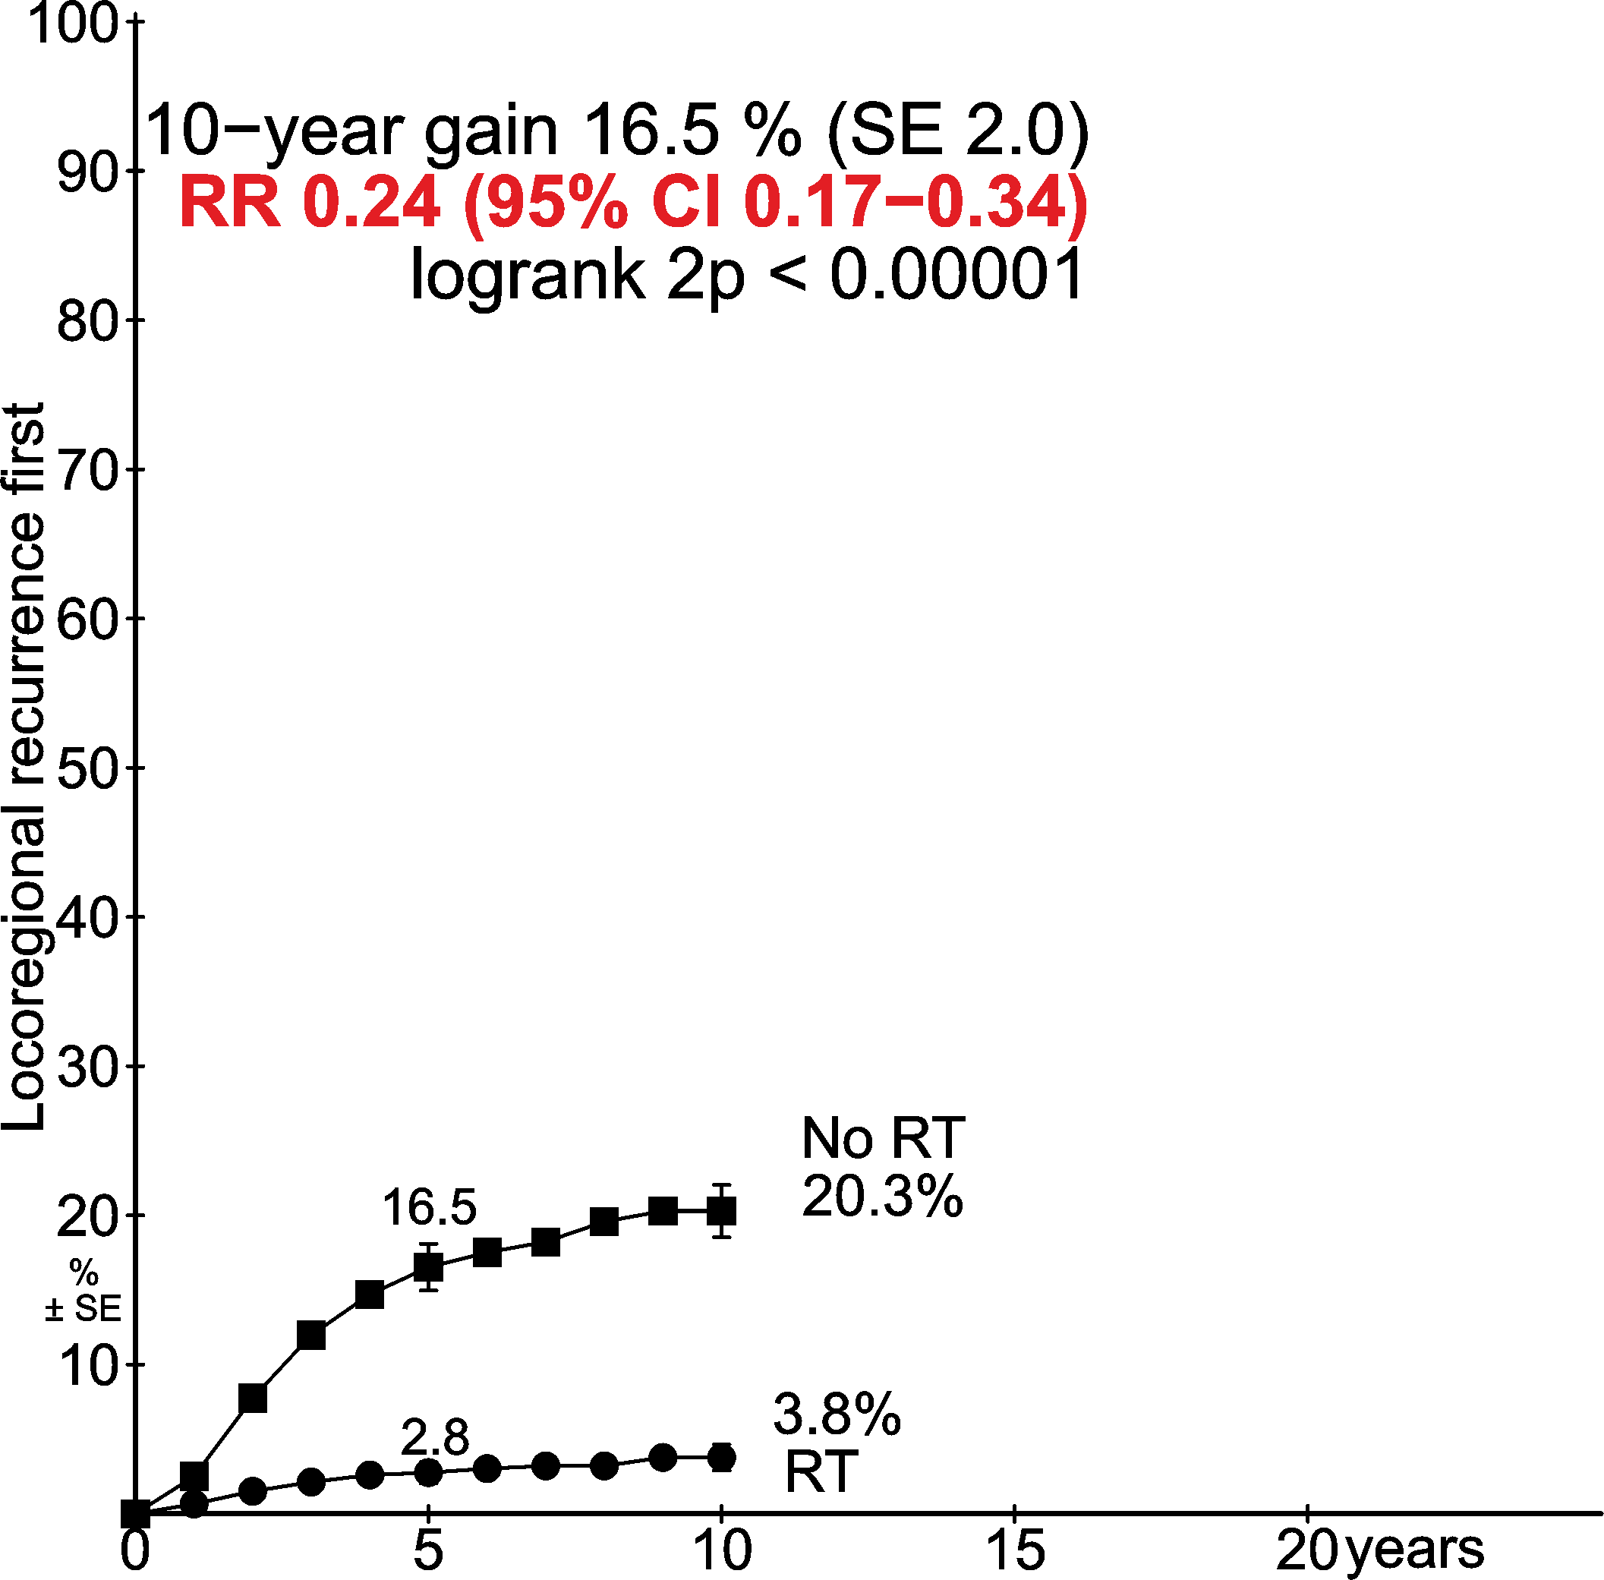
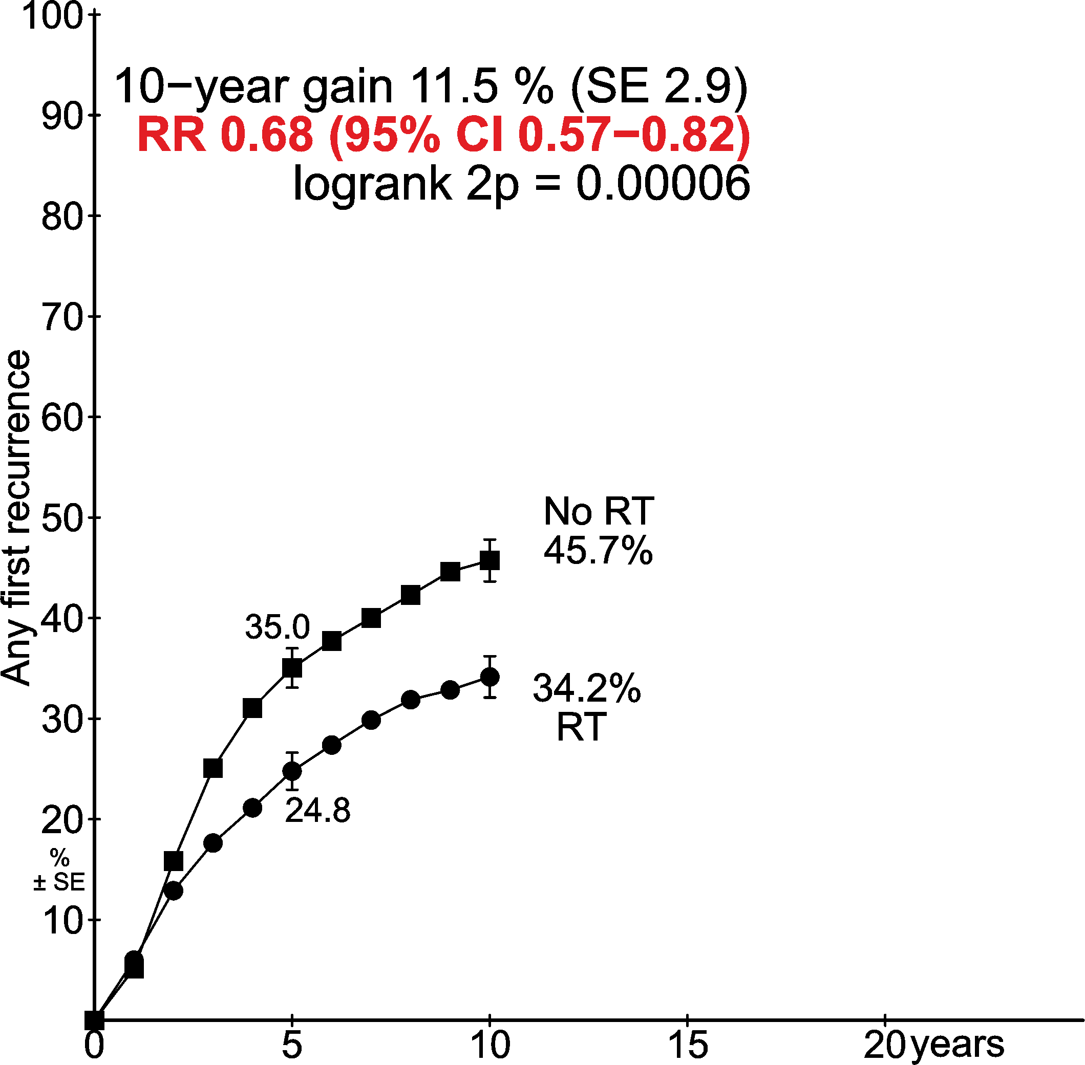
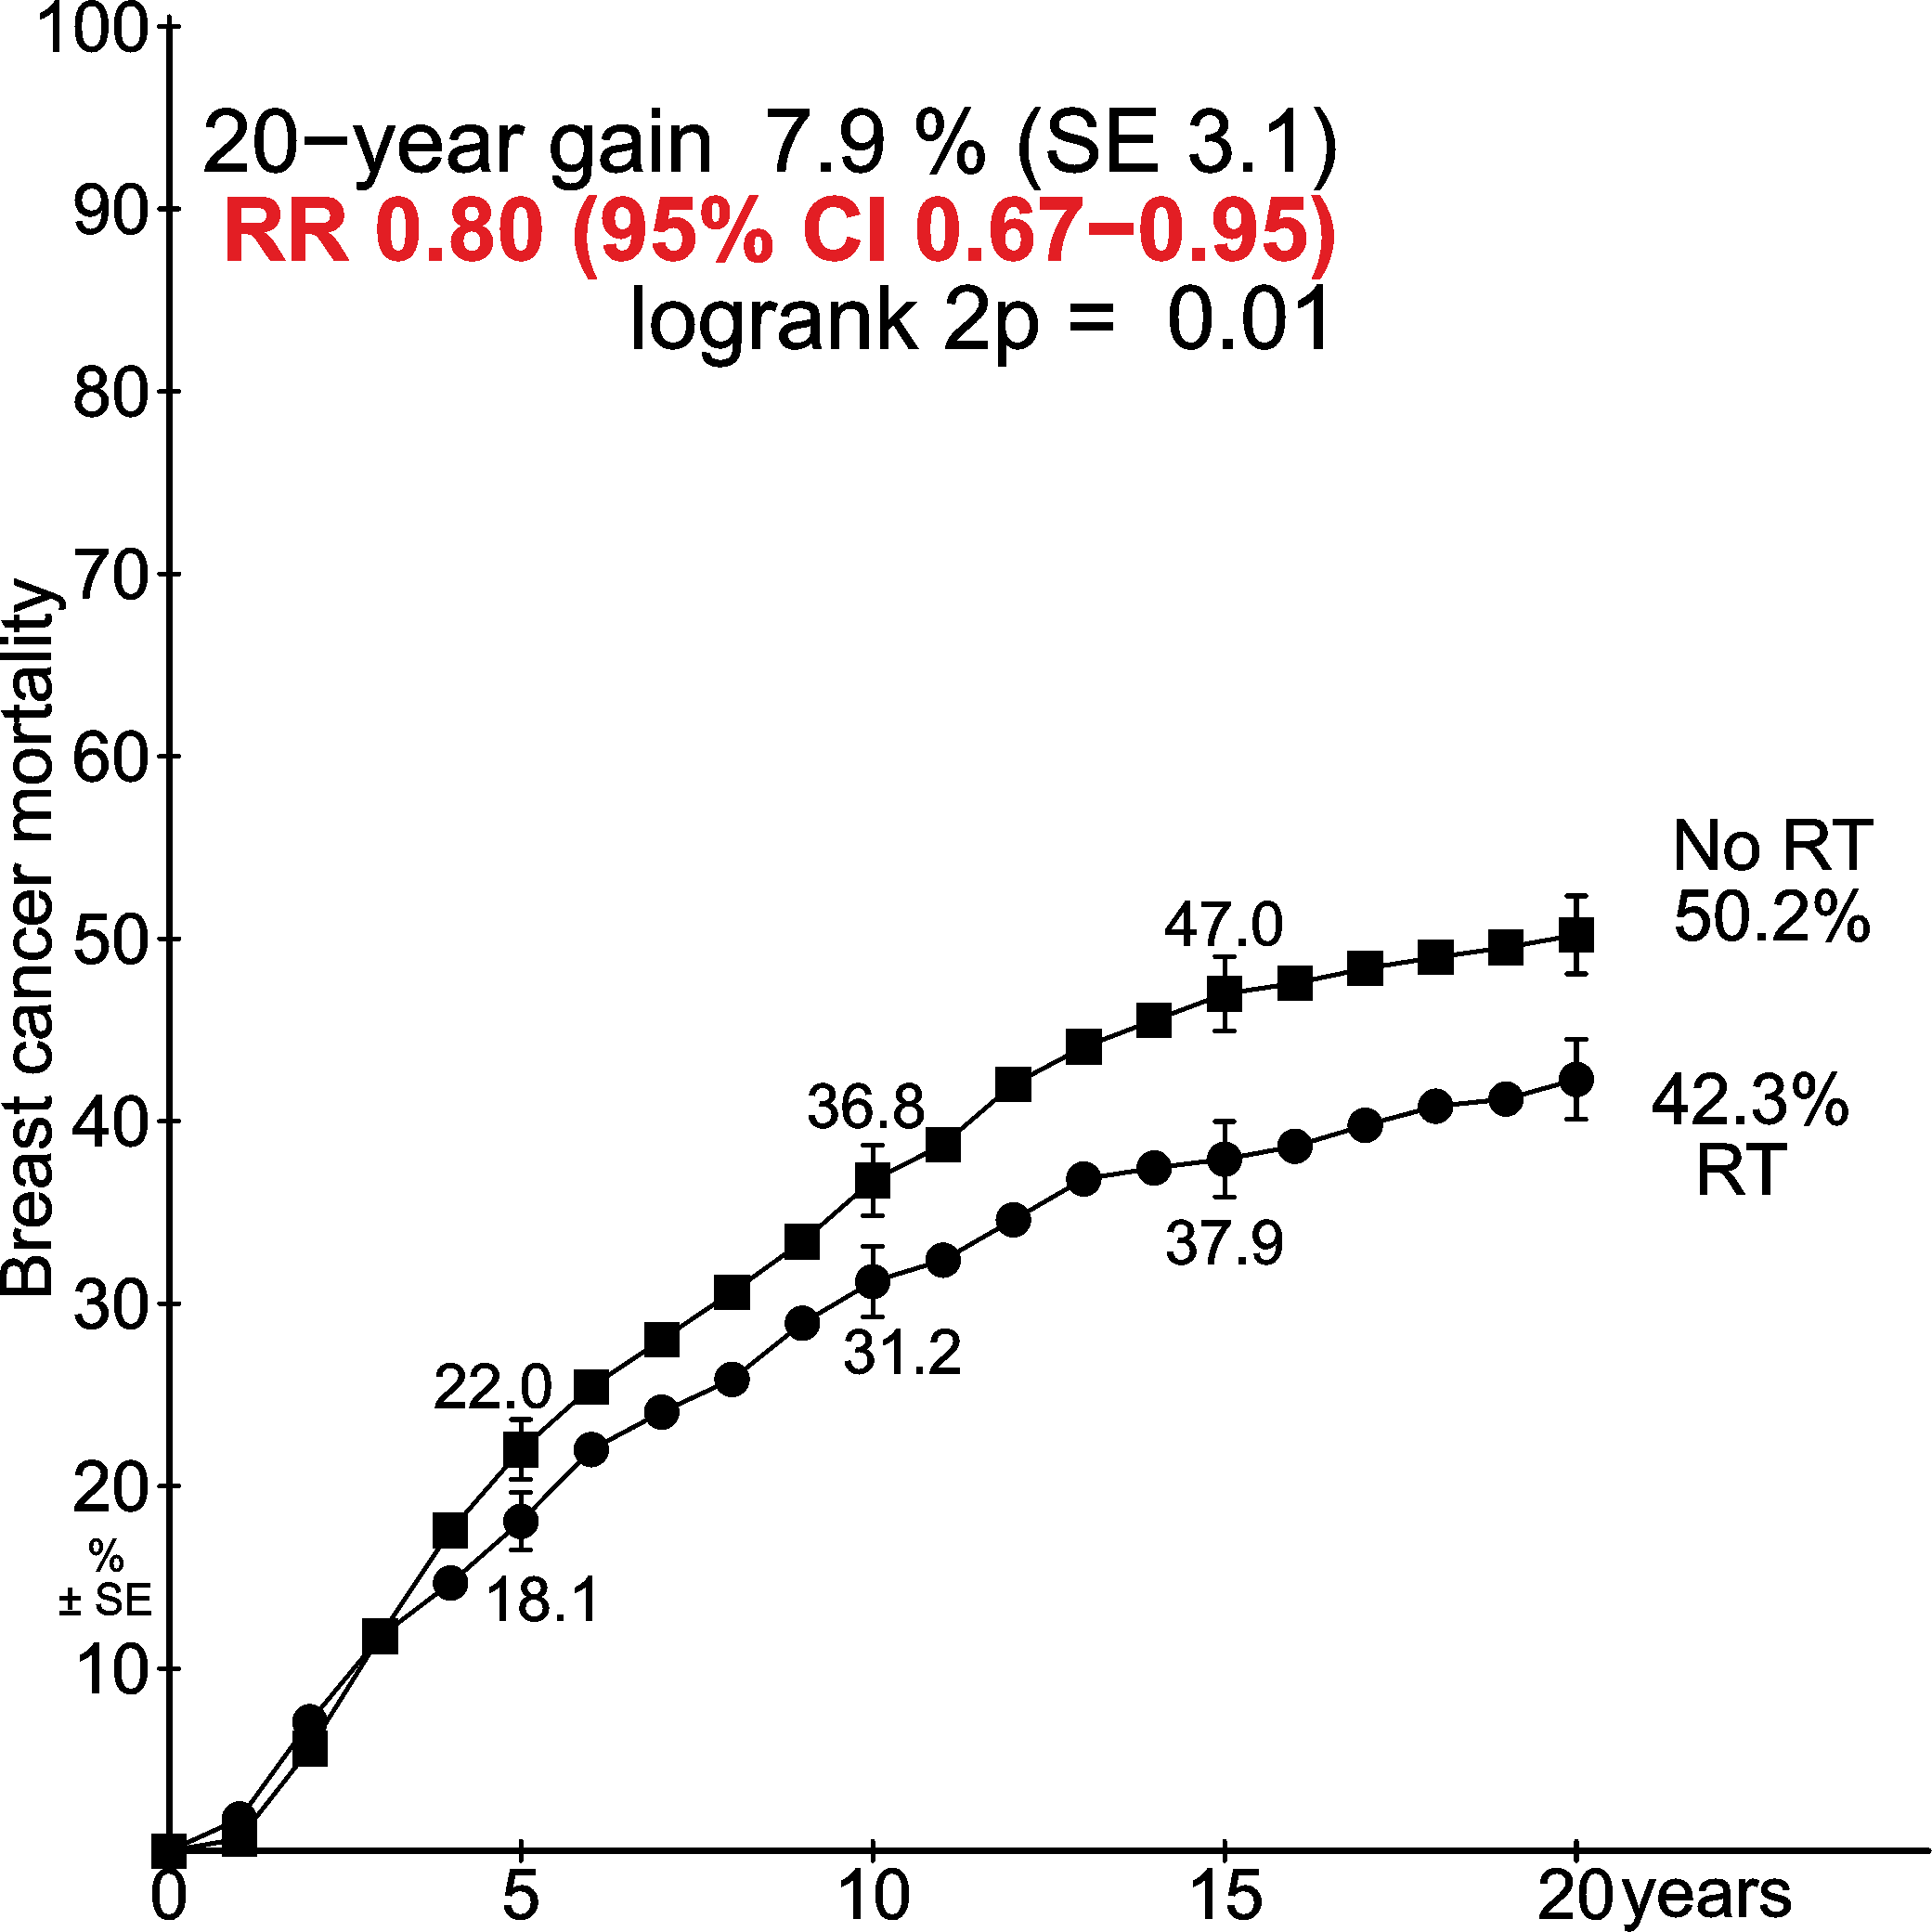
Trials of radiotherapy after mastectomy and axillary dissection
1314 pN1-3 women
RT: Significant benefit
Locoregional recurrence first | Any first recurrence | Breast cancer mortality
11.5%
7.9%
16.5%
Years since randomisation Years since randomisation Years since randomisation

Slide 12
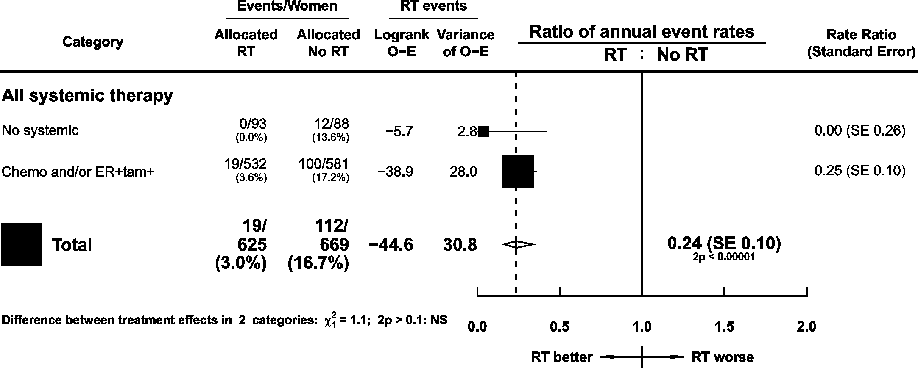
Trials of radiotherapy after mastectomy and axillary dissection
1314 pN1-3 women
RT: Significant benefit
Local recurrence by use of systemic therapy
Note: one trial did not supply local recurrence information, affecting 20 women in this pN category.

Slide 13
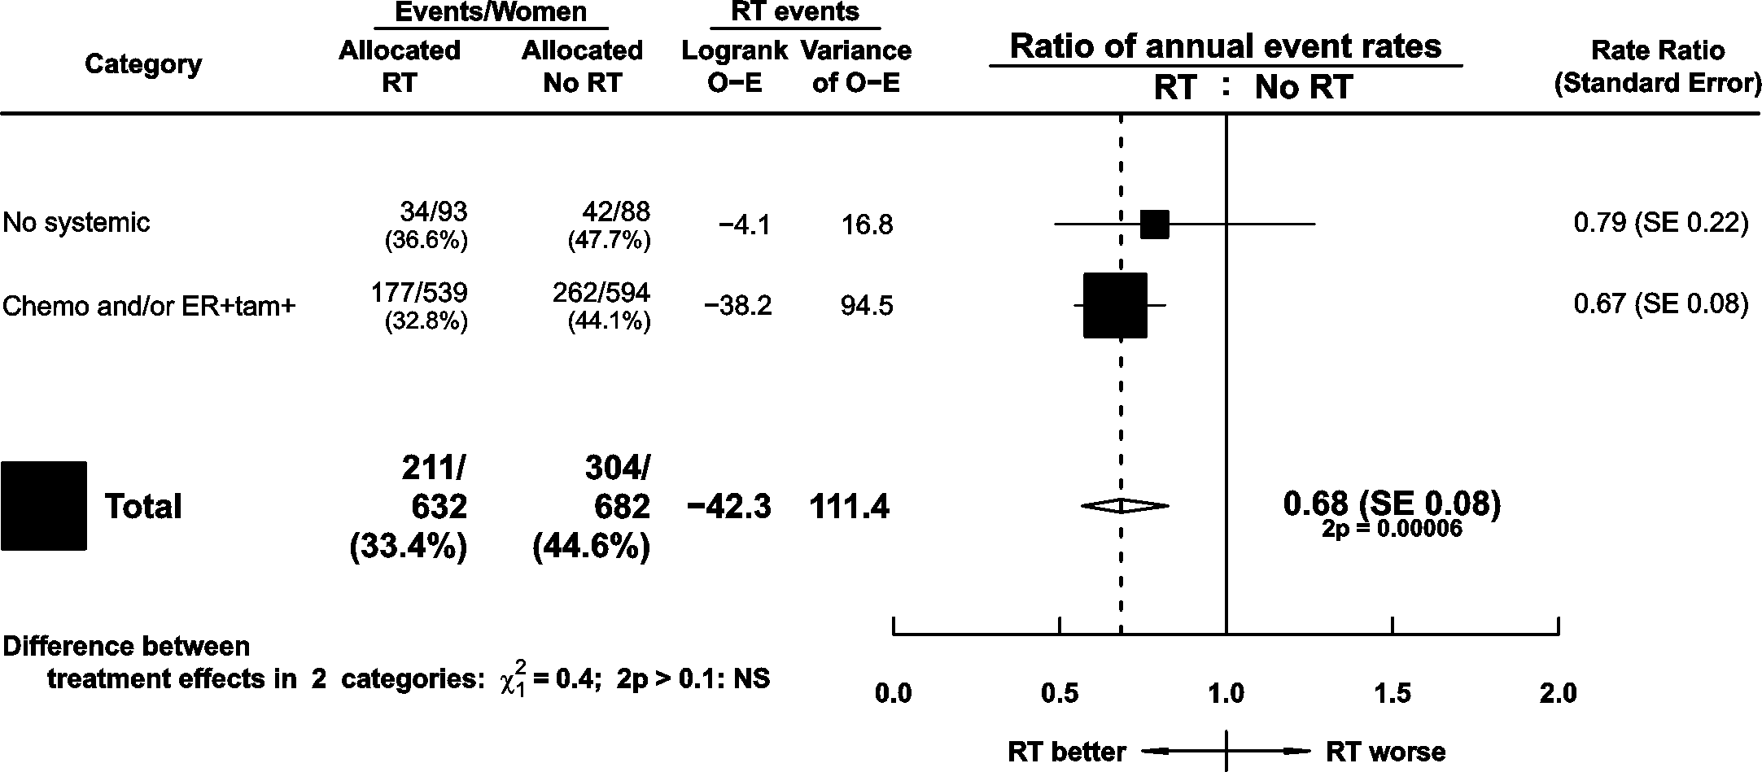
Trials of radiotherapy after mastectomy and axillary dissection
1314 pN1-3 women
RT: Significant benefit
Any first recurrence by use of systemic therapy

Slide 14
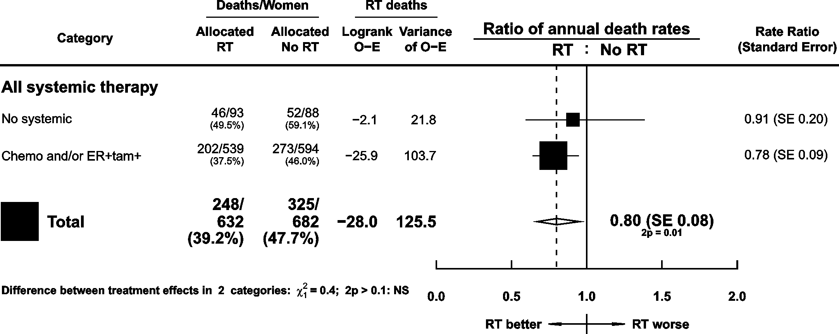
Trials of radiotherapy after mastectomy and axillary dissection
1314 pN1-3 women
RT: Significant benefit
Breast cancer mortality by use of systemic therapy

Slide 15
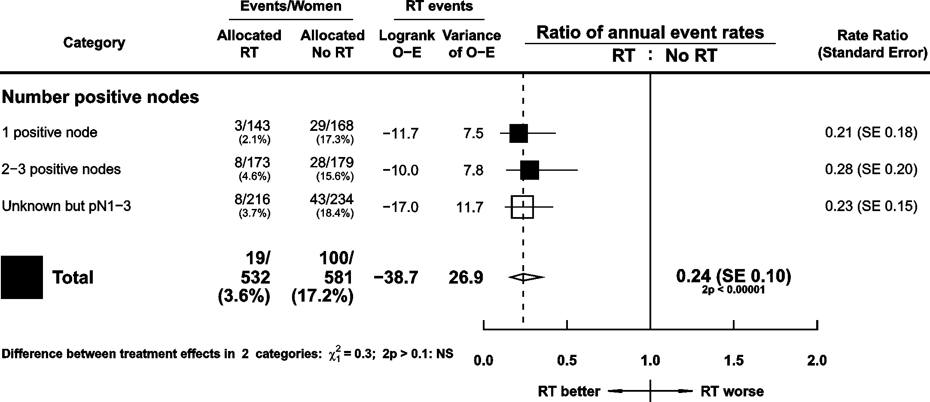
Trials of radiotherapy after mastectomy and axillary dissection
1133 pN1-3 women in trials with systemic therapy
RT: Significant benefit
Local recurrence by number of nodes positive
Note: one trial did not supply local recurrence information, affecting 20 women in this pN category.

Slide 16
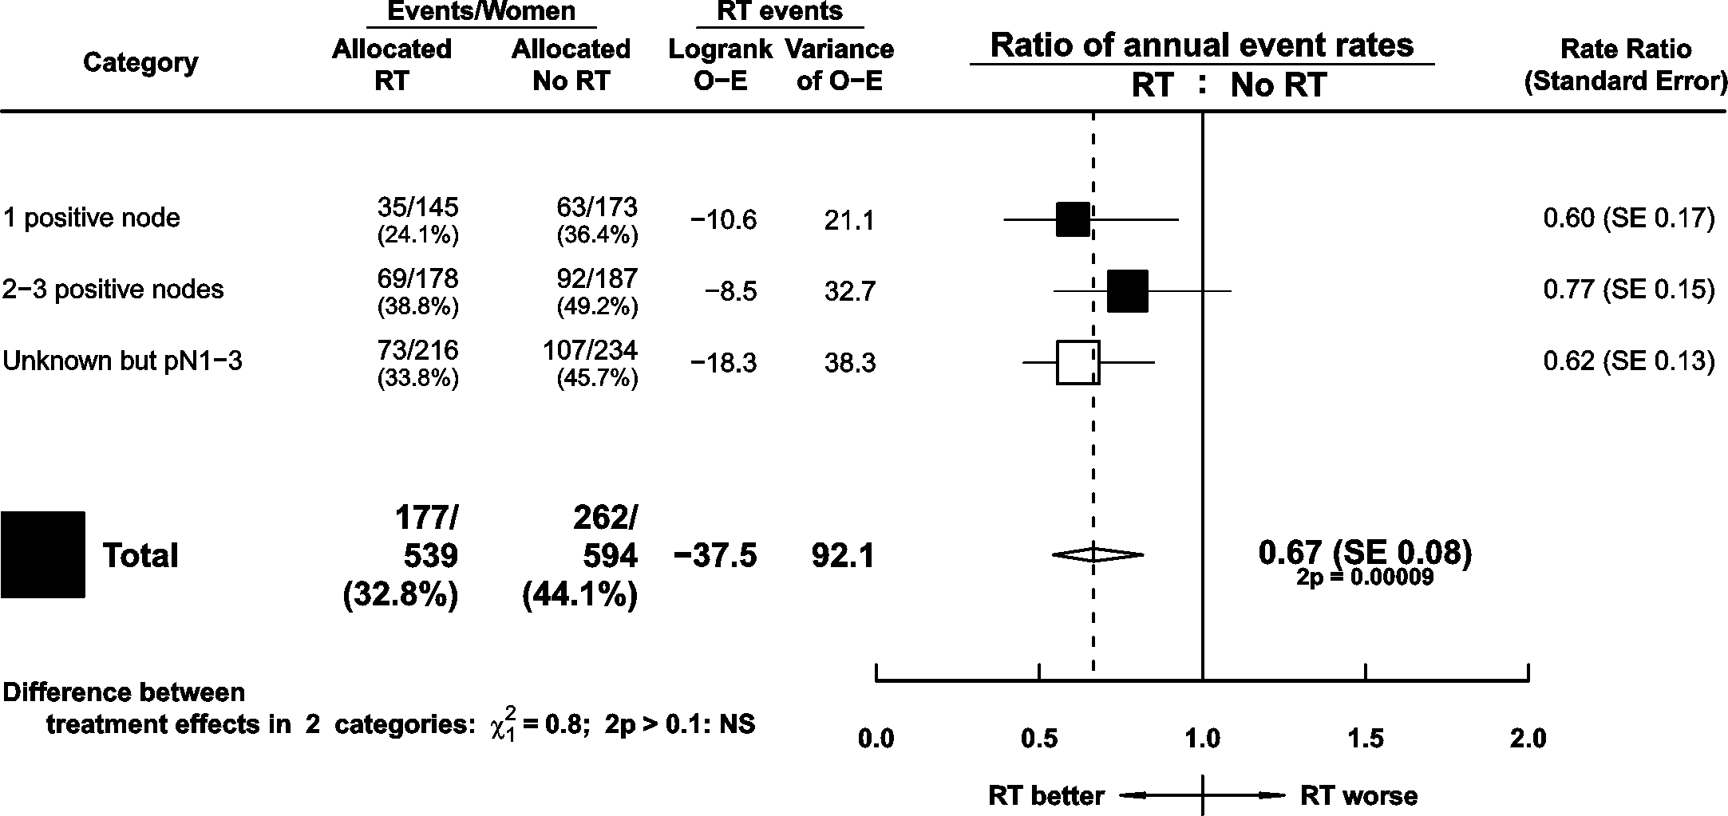
Trials of radiotherapy after mastectomy and axillary dissection
1133 pN1-3 women in trials with systemic therapy
RT: Significant benefit
Any first recurrence by number of nodes positive

Slide 17
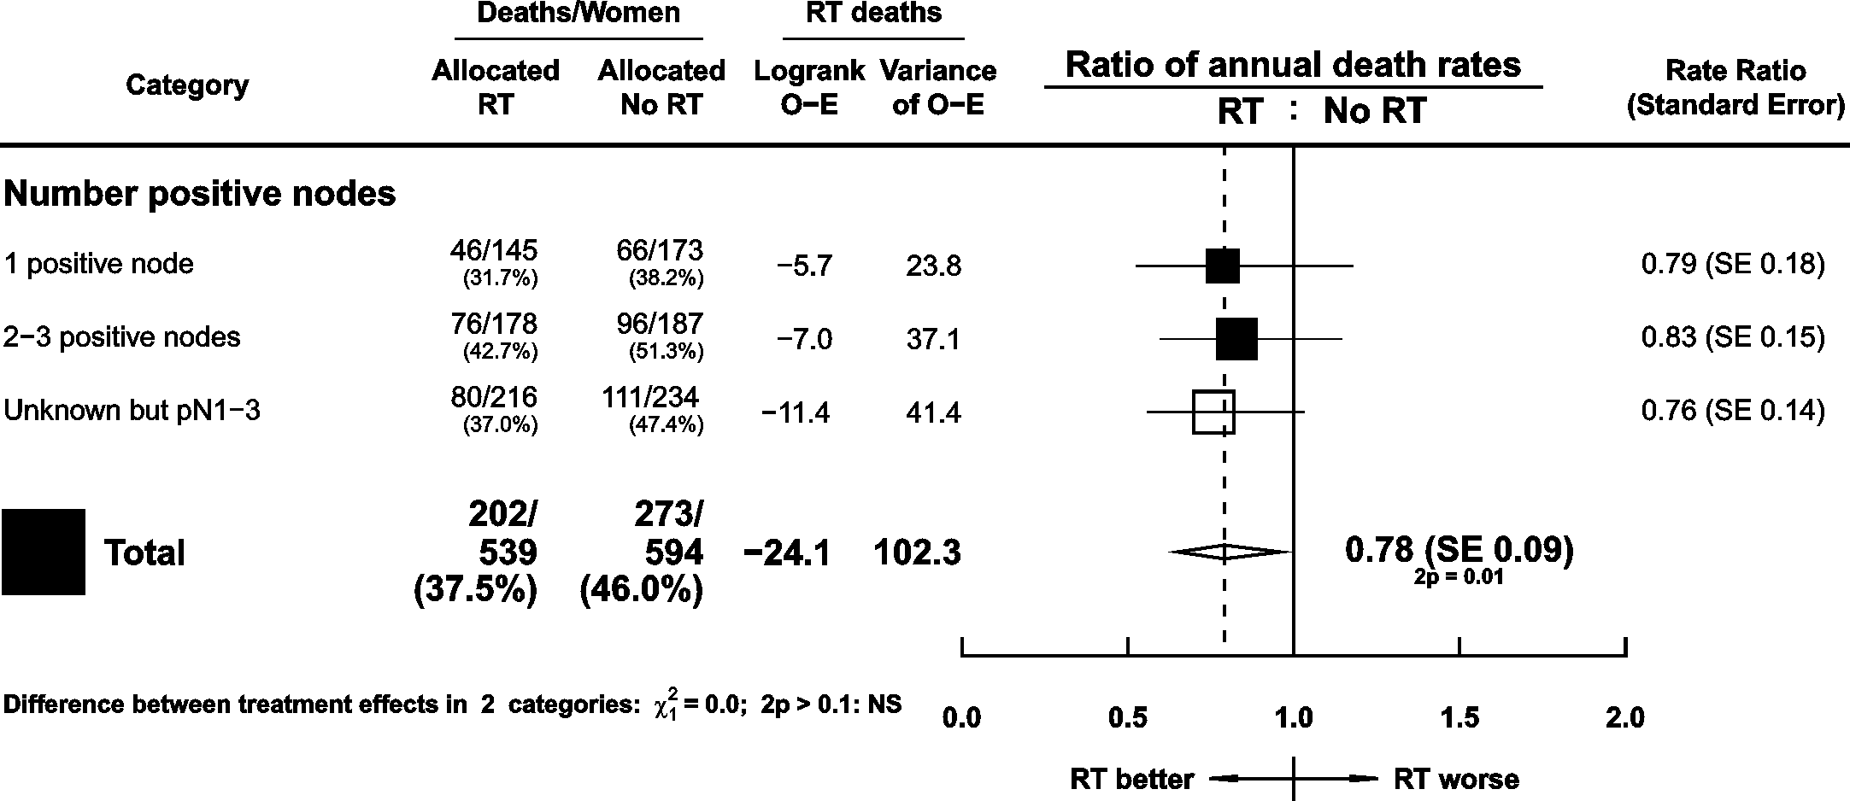
Trials of radiotherapy after mastectomy and axillary dissection
1133 pN1-3 women in trials with systemic therapy
RT: Significant benefit
Breast cancer mortality by number of nodes positive

Slide 18
Summary: radiotherapy after mastectomy and axillary dissection
In these trials, for pN1-3 women, RT gave significant benefit
  Absolute reductions
    10-year local recurrence: 16.5 % (34.2% vs. 45.7 %)
    10-year any recurrence: 11.5 % (34.2% vs. 45.7 %)
    20-year breast cancer mortality: 7.9% (42.3 % vs. 50.2 %)
  Proportional reductions
    Local recurrence: 76 % (SE 10)
    Any recurrence: 32 % (SE 8)
    Breast cancer mortality: 20 % (SE 8)
For women today, RT
  Absolute reductions likely to be smaller
  Proportional benefits at least as big

