Slide 1
Meta-analysis of trials of radiotherapy in DCIS Early Breast Cancer Trialists’ Collaborative Group (EBCTCG)

Slide 2
The world’s breast cancer trialists have shared their data every 5 years
1985, 1990, 1995, 2000, 2005/6
Many MODERATE gains in long-term survival have been identified
Together MODERATE gains from various treatment improvements (and a moderate contribution from breast screening) have almost halved UK/US breast cancer mortality at ages 35-69

Slide 3

#

Slide 4
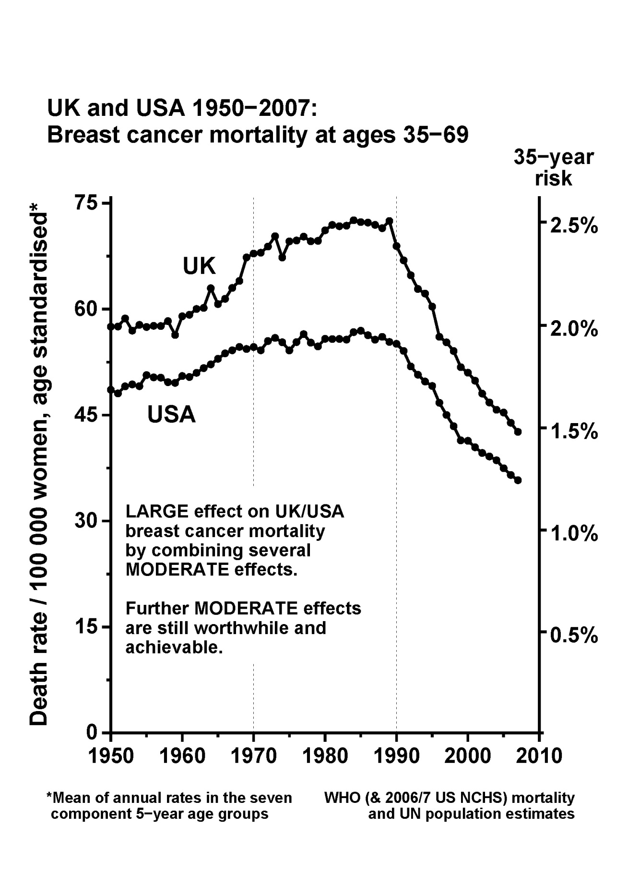

Slide 5
EBCTCG 5th Cycle
Trials starting before 1 Jan 2000
Events up to 30 Sept 2006
Included trials of BCS±RT in DCIS for the first time
ie, trials of RT versus the same management but without RT

Slide 9
Main outcome analysed:
Ipsilateral breast recurrence
(either recurrence of CIS or occurrence of invasive cancer)

Slide 10
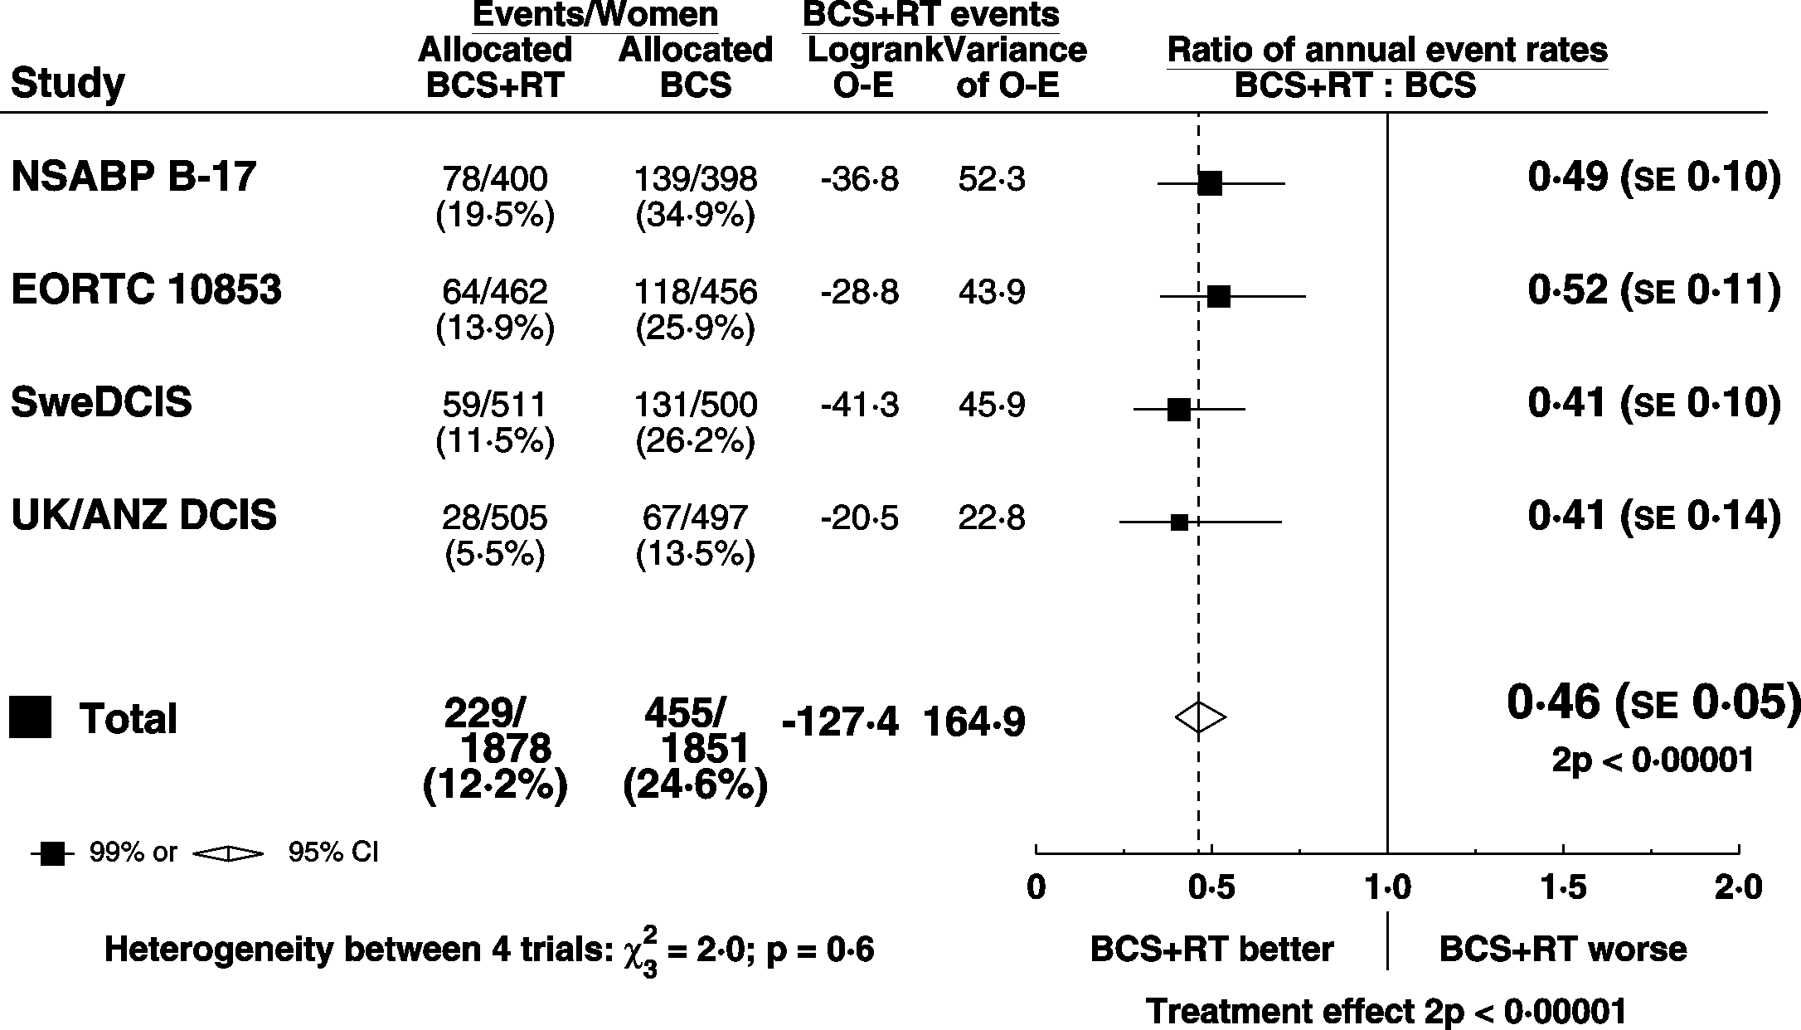
DCIS: BCS + RT vs. BCS Ips. BREAST RECURRENCE (CIS & Inv)

Slide 11
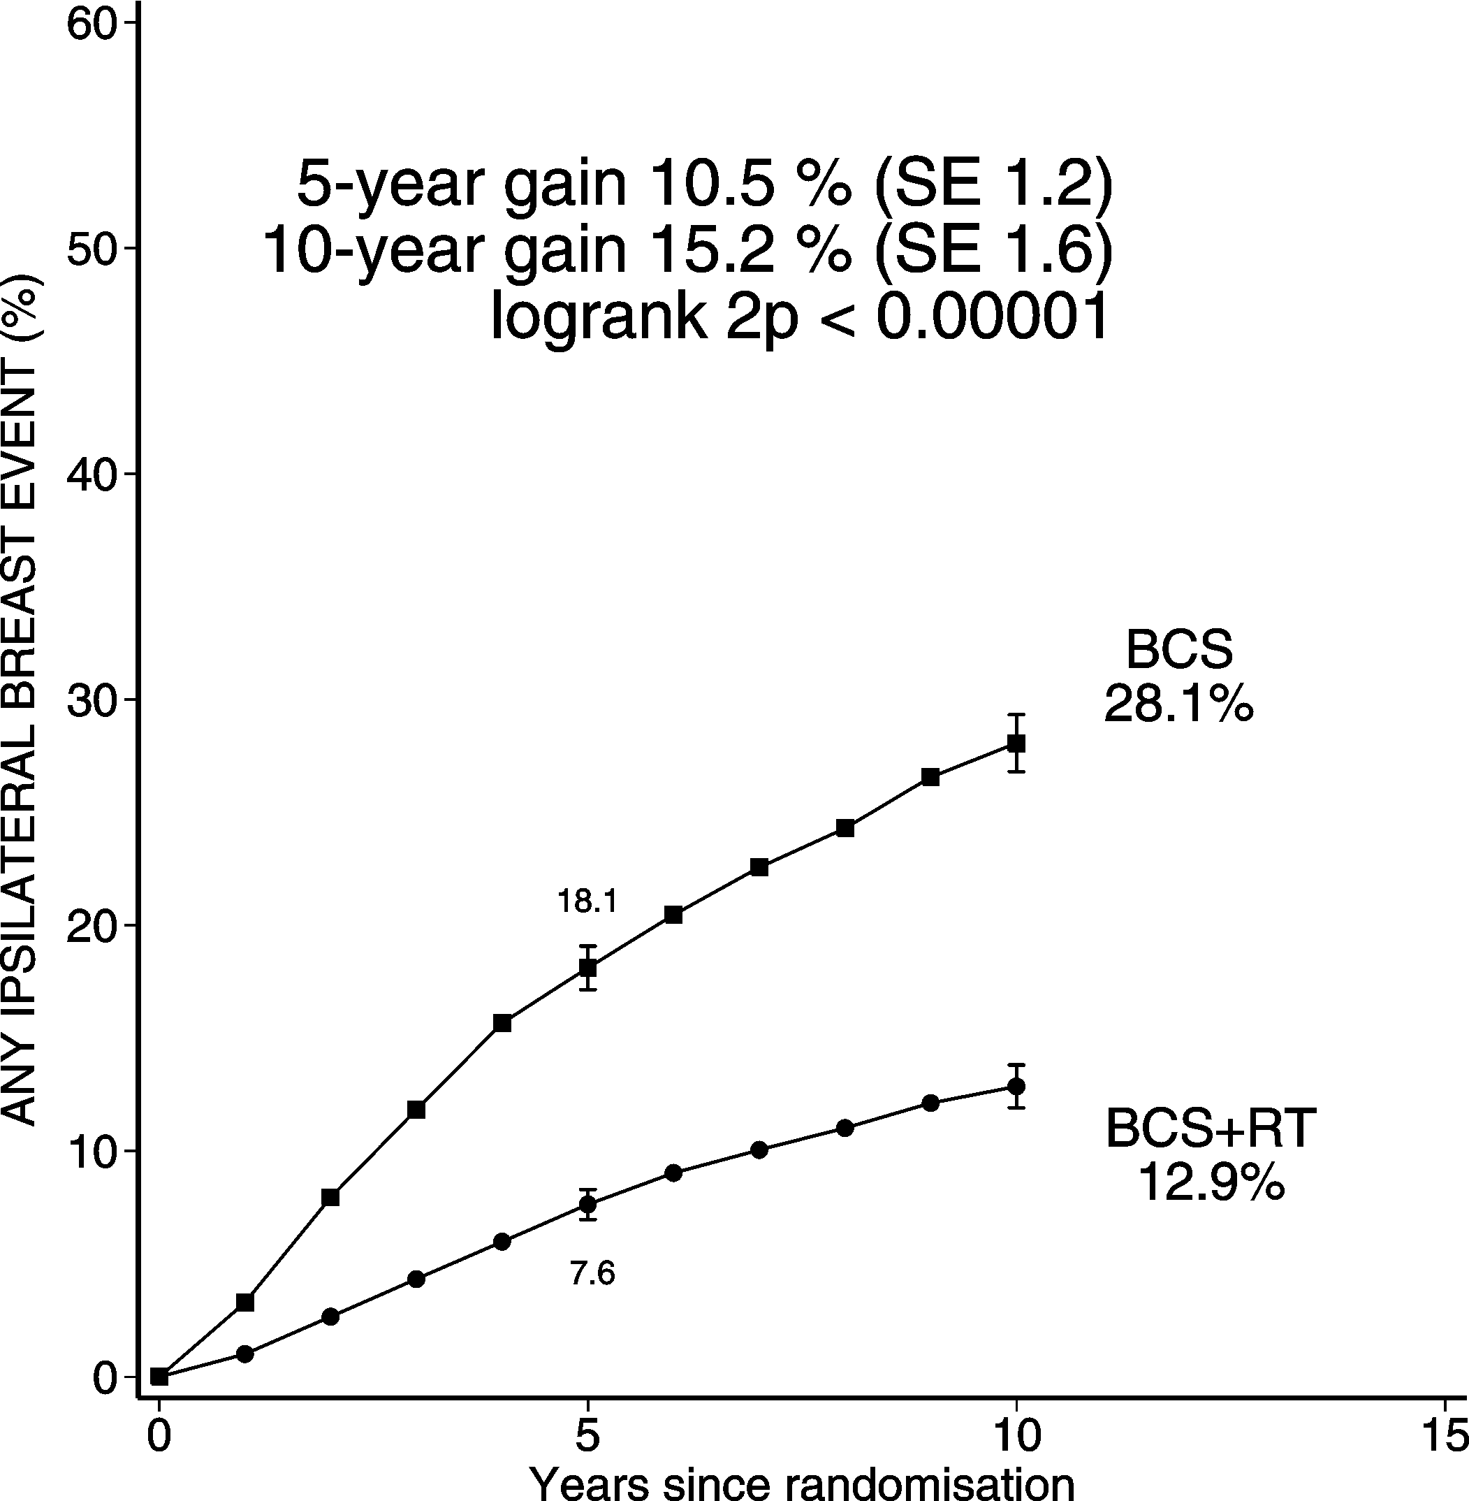
DCIS: BCS + RT vs. BCS Ips. BREAST RECURRENCE (CIS & Inv)
3729 women

Slide 12
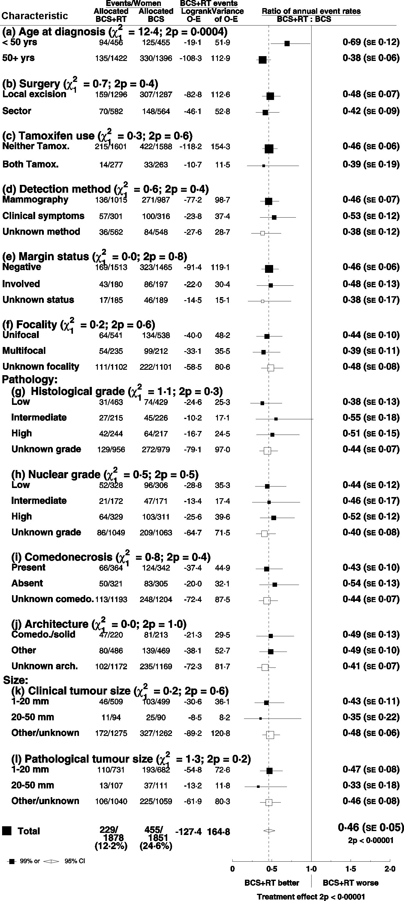
DCIS: BCS + RT vs. BCS Ips. BREAST RECURRENCE (CIS & Inv)
Ratio of annual event rates by patient and tumour characteristics

Slide 13
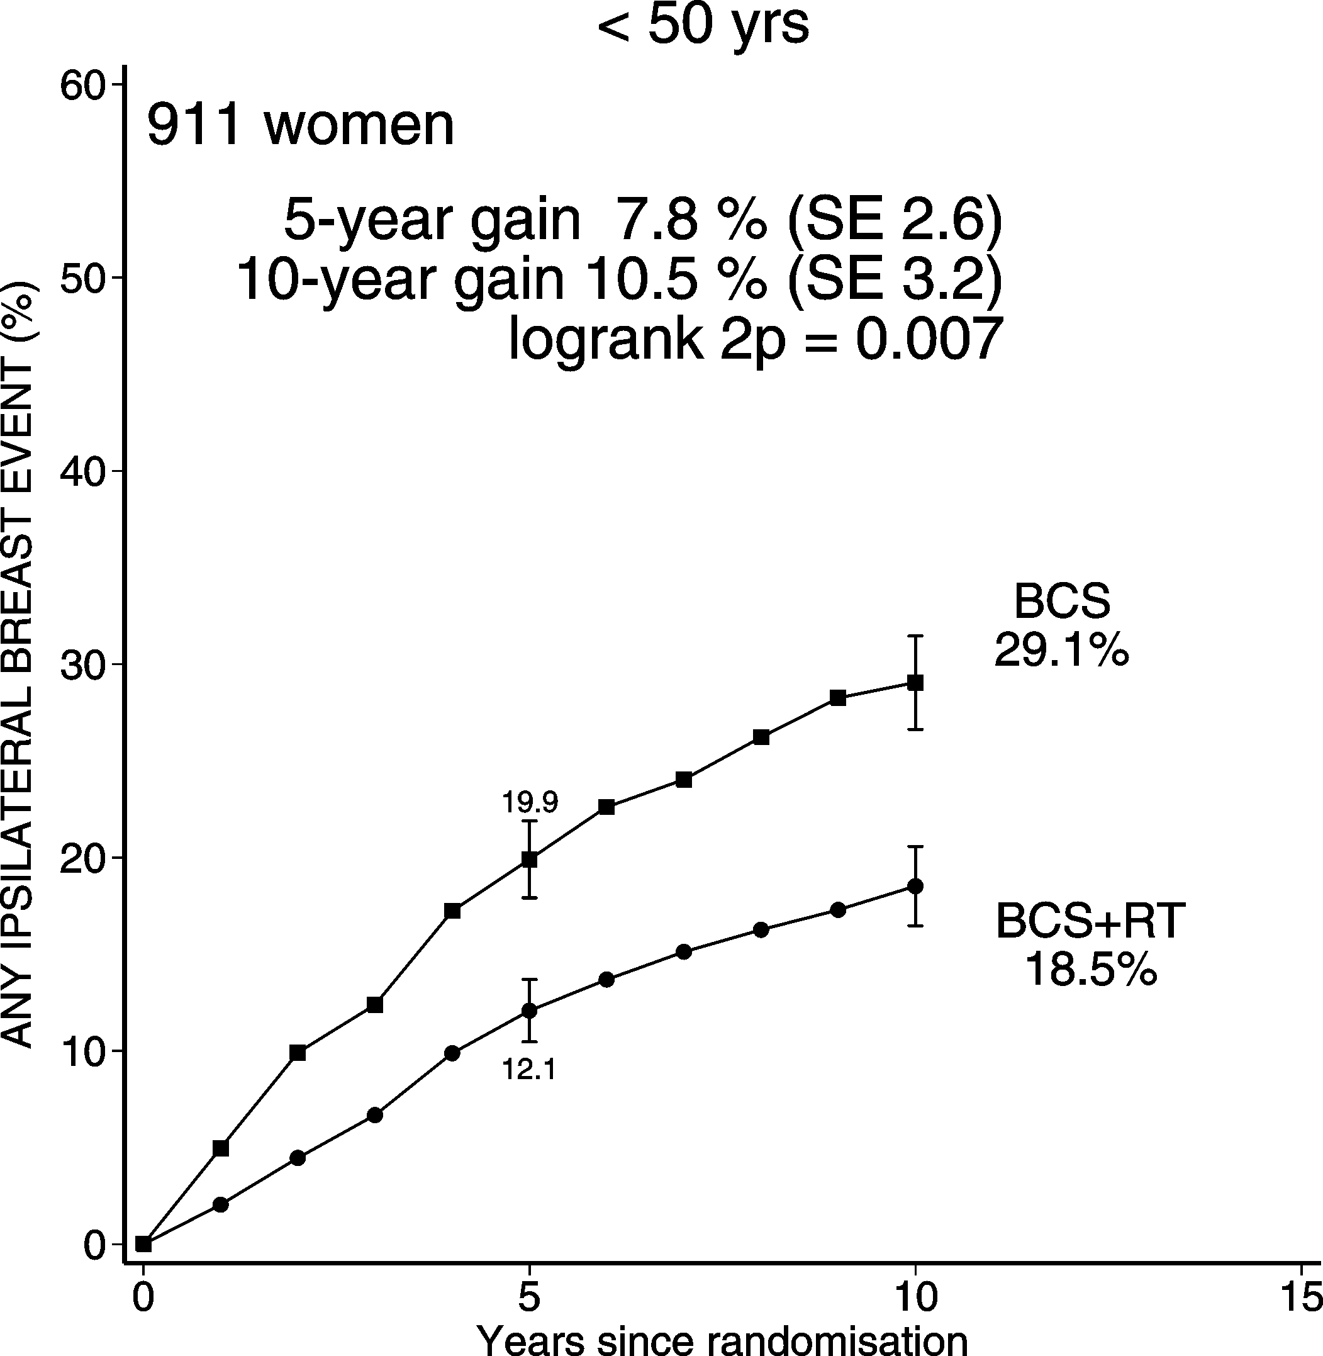
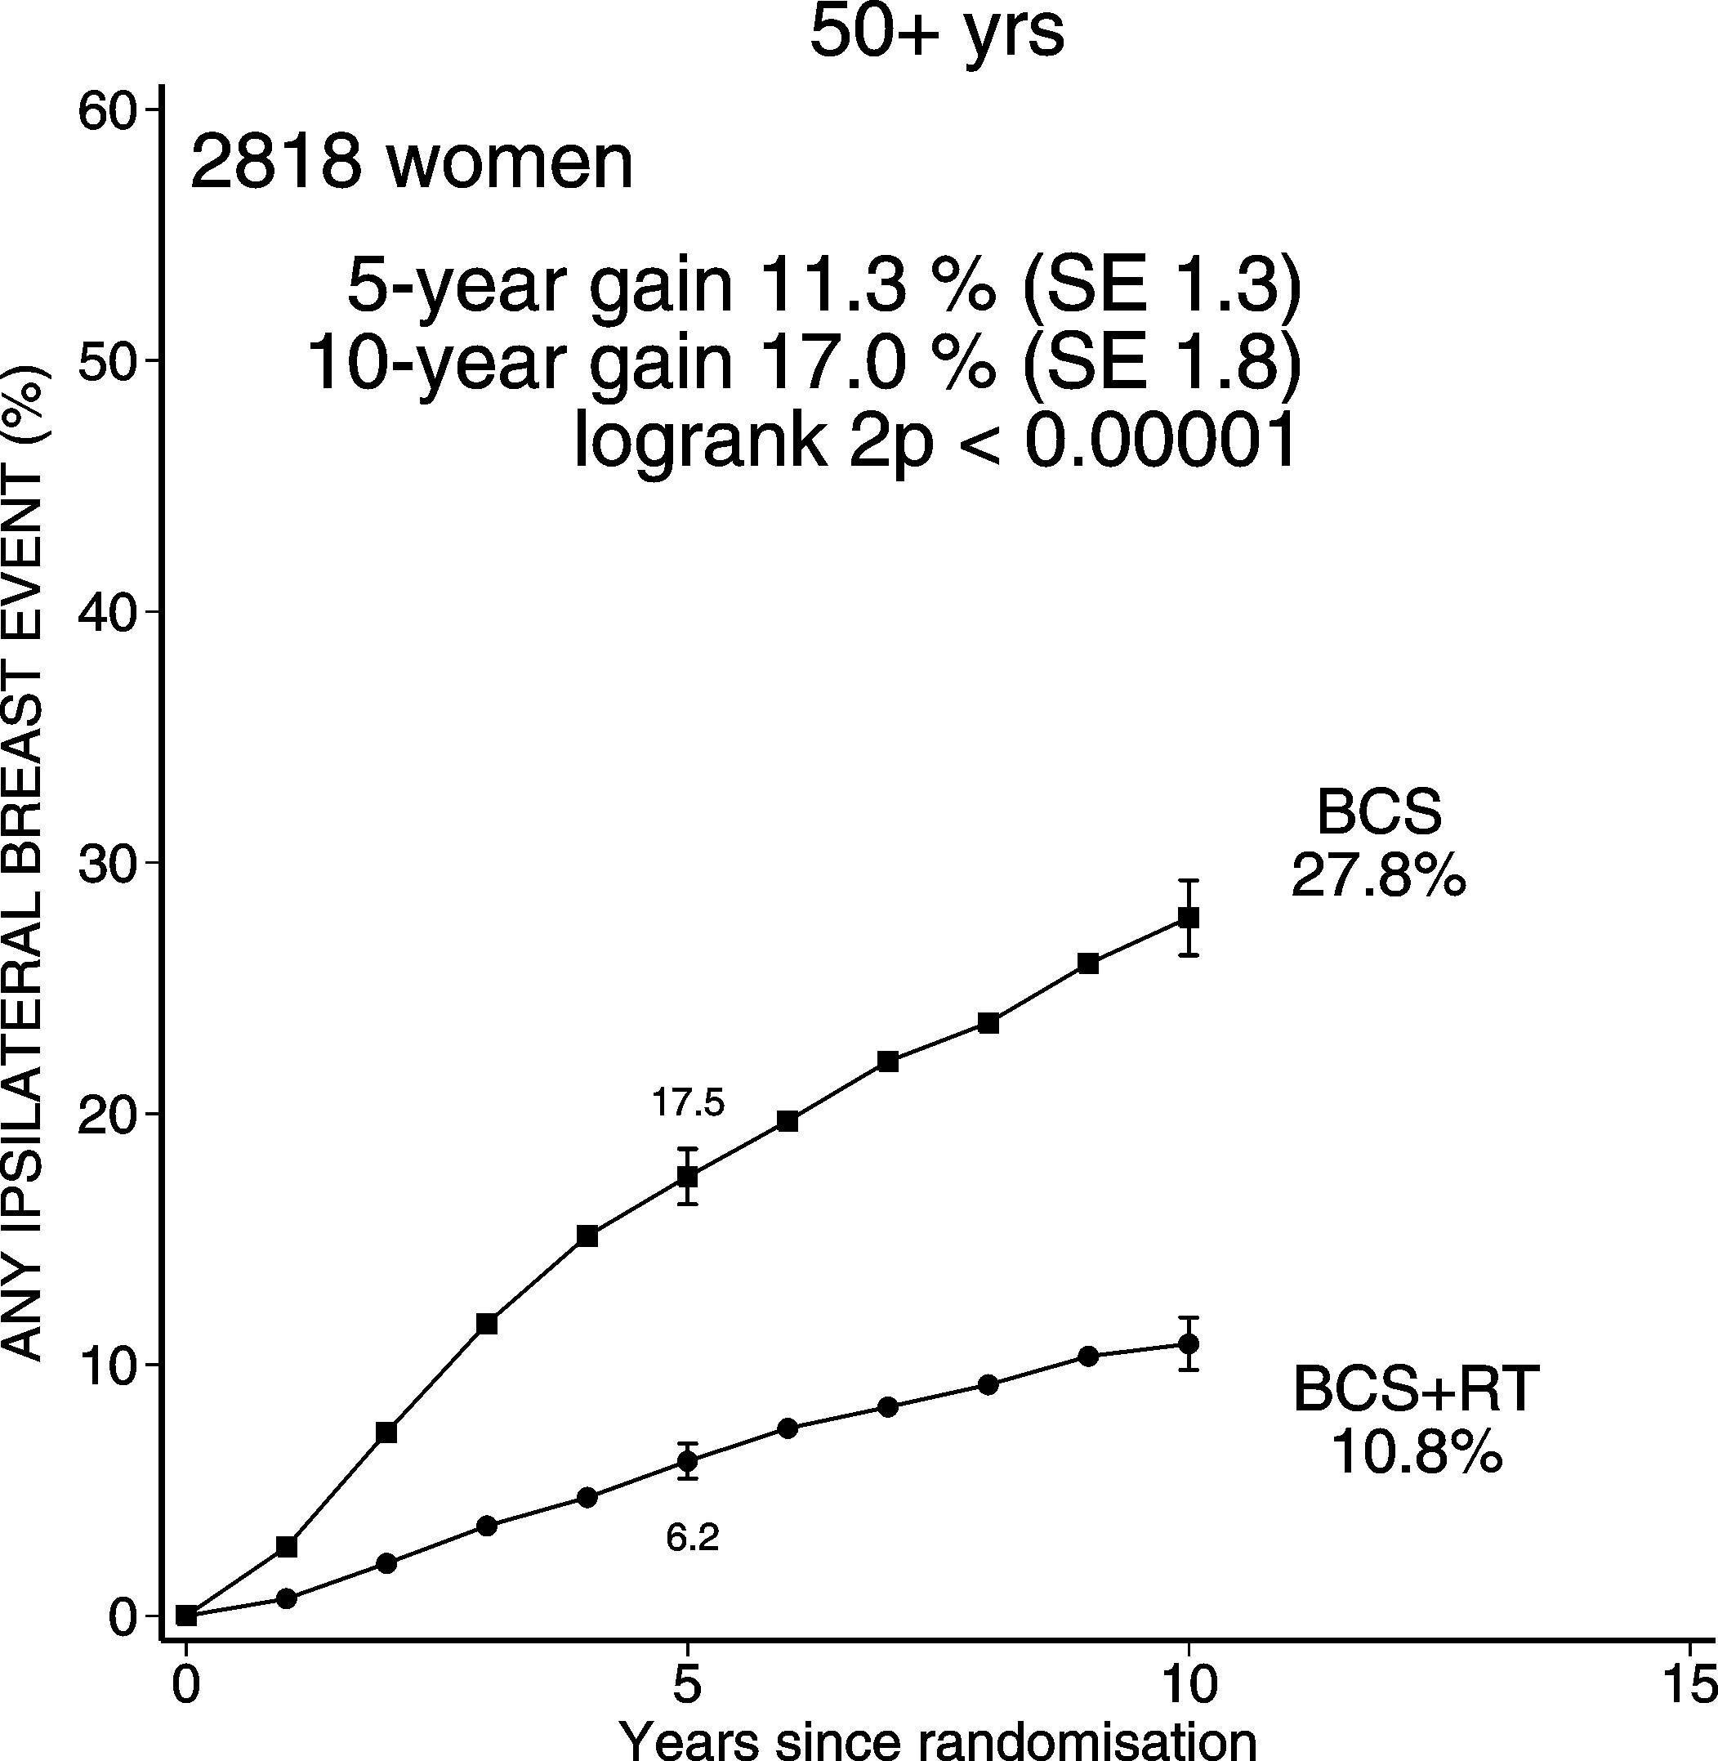
DCIS: BCS + RT vs. BCS Ips. BREAST RECURRENCE (CIS & Inv)
Age at diagnosis

Slide 14
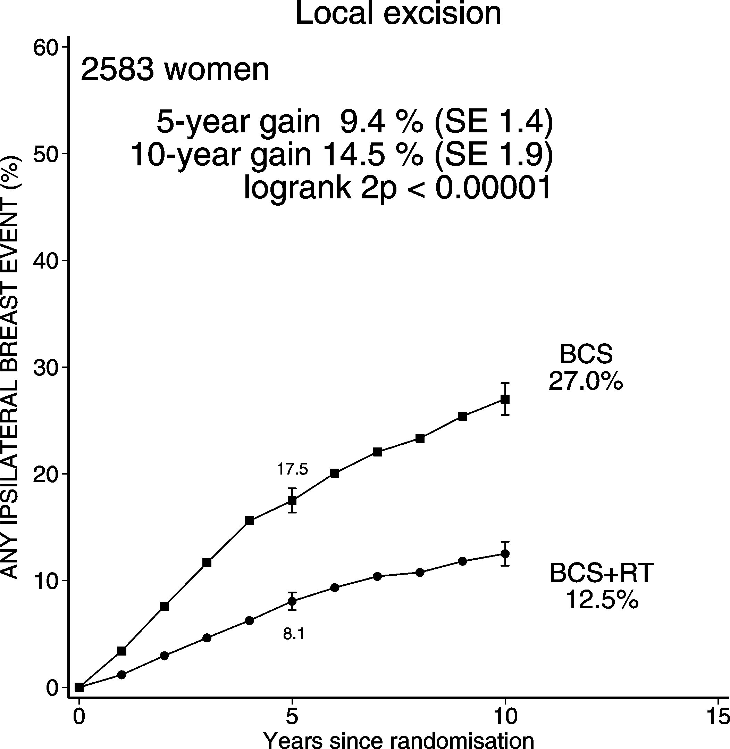
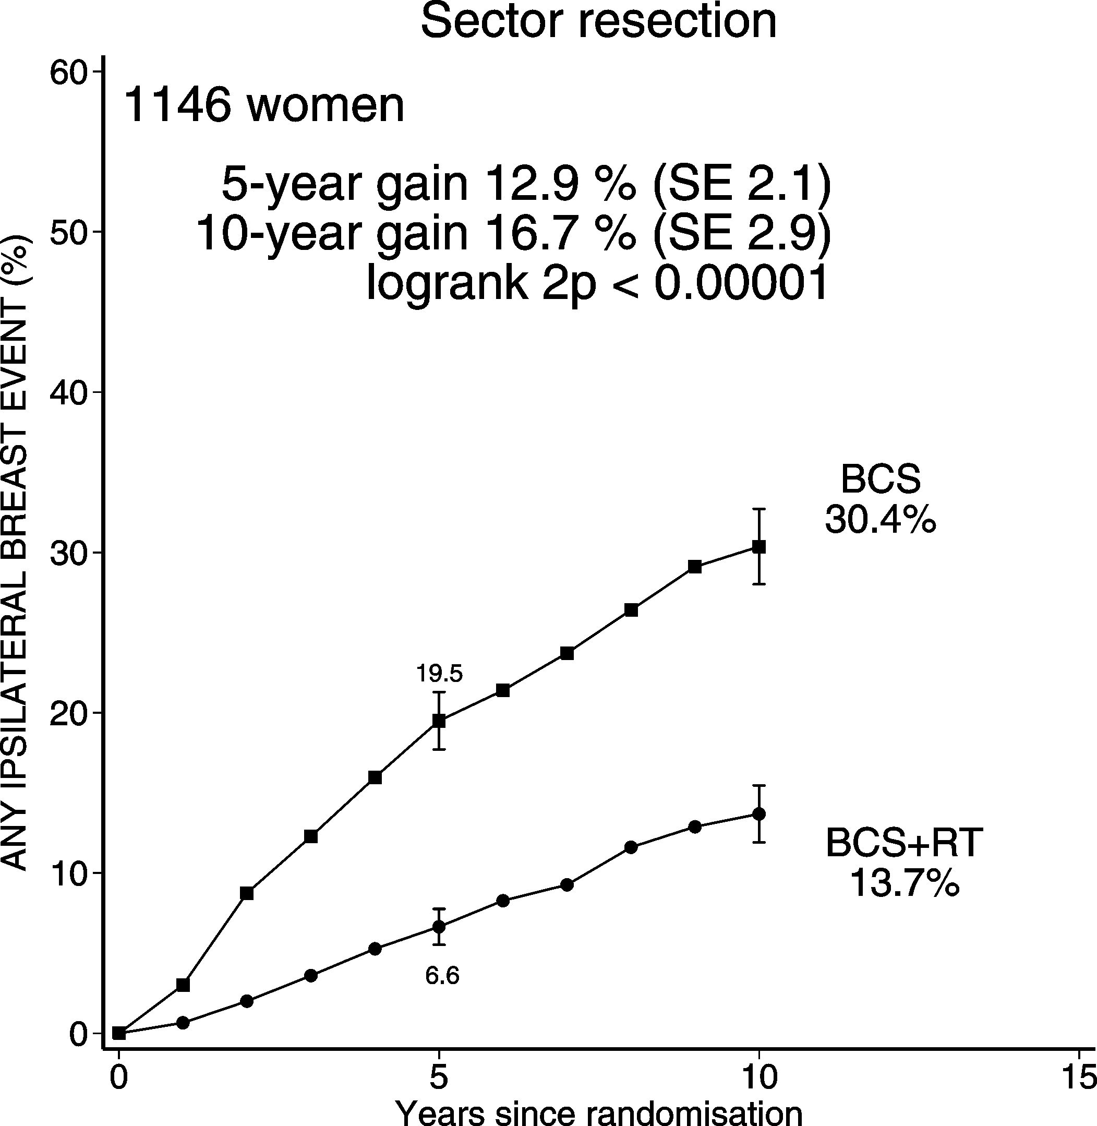
DCIS: BCS + RT vs. BCS Ips. BREAST RECURRENCE (CIS & Inv)
Extent of breast-conserving surgery

Slide 15
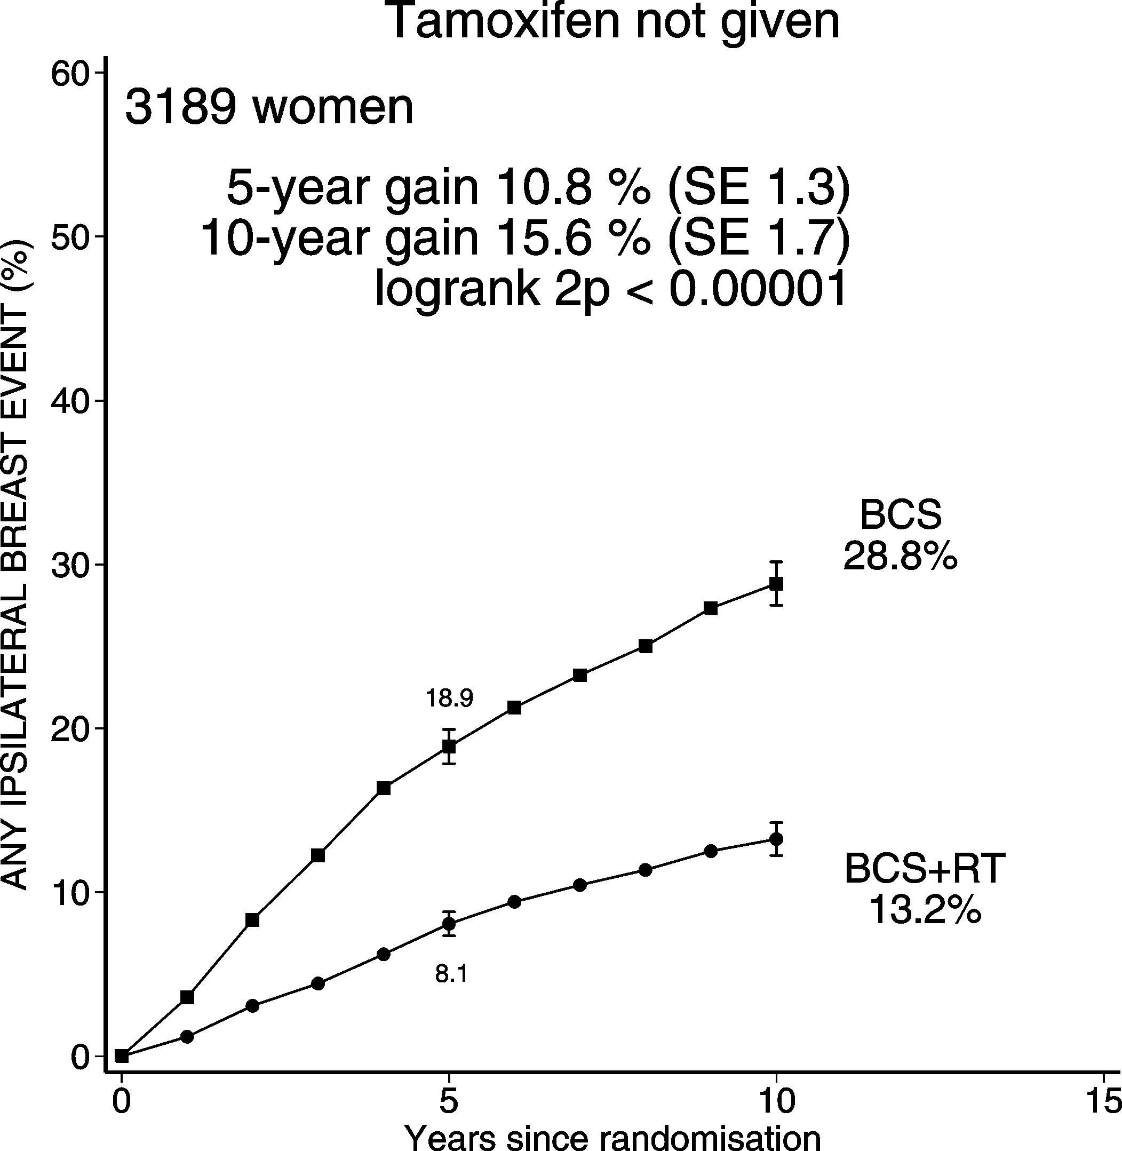
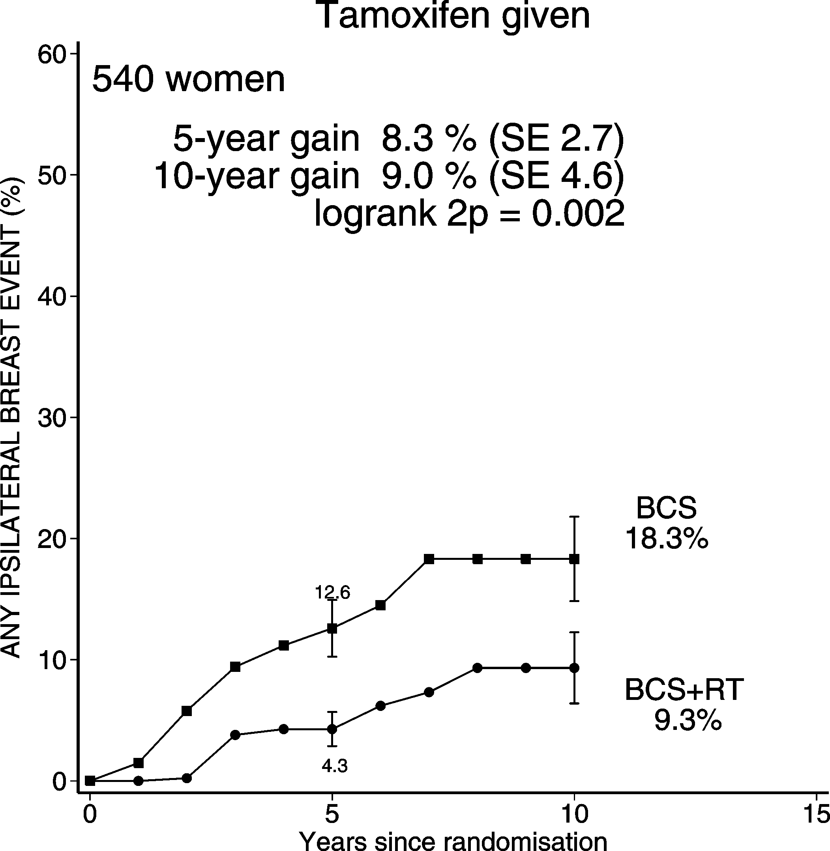
DCIS: BCS + RT vs. BCS Ips. BREAST RECURRENCE (CIS & Inv)
Use of tamoxifen (in both treatment arms)

Slide 16
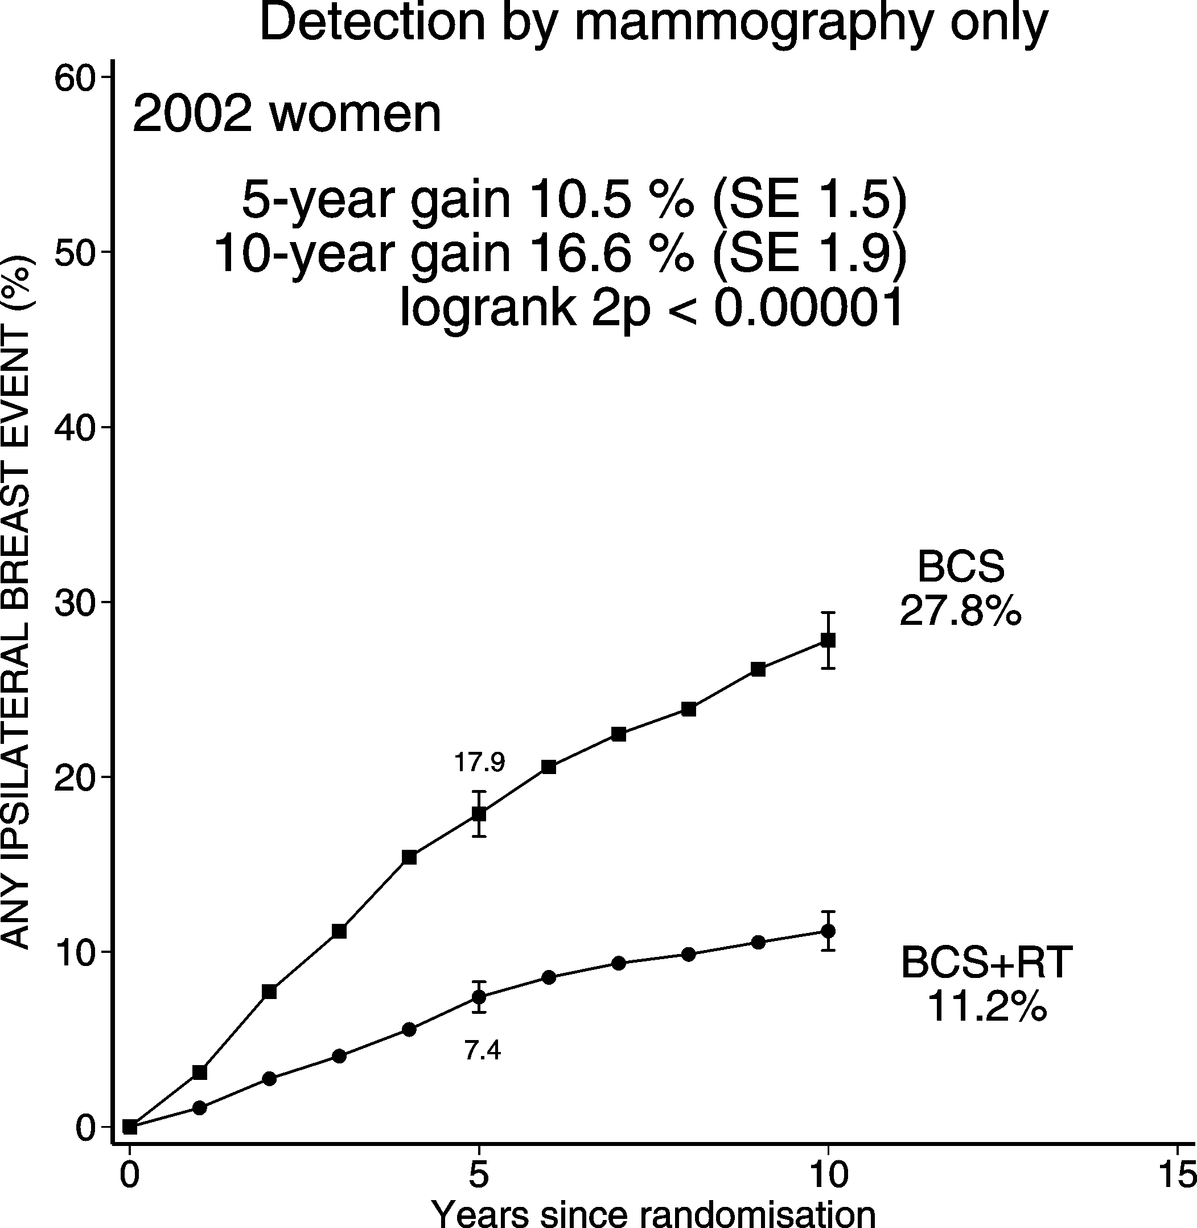
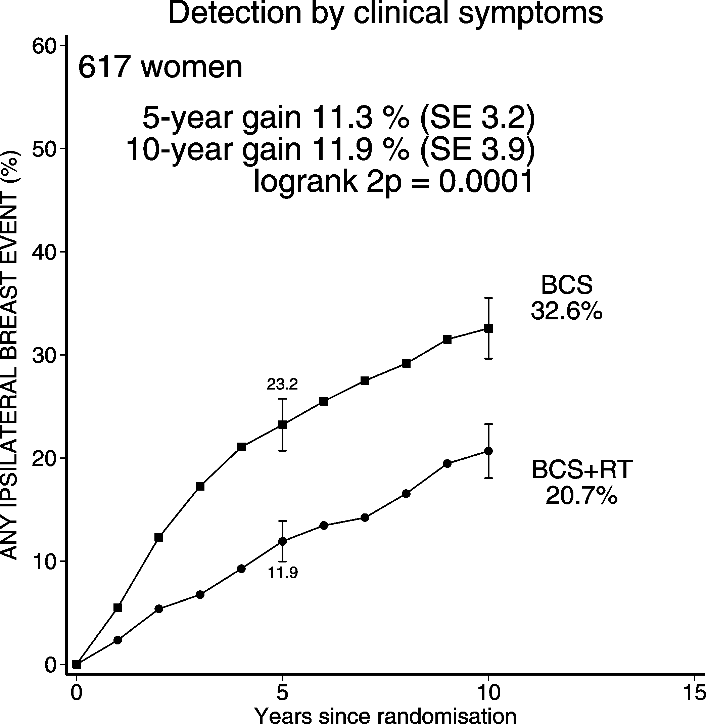
DCIS: BCS + RT vs. BCS Ips. BREAST RECURRENCE (CIS & Inv)
Method of DCIS detection

Slide 17
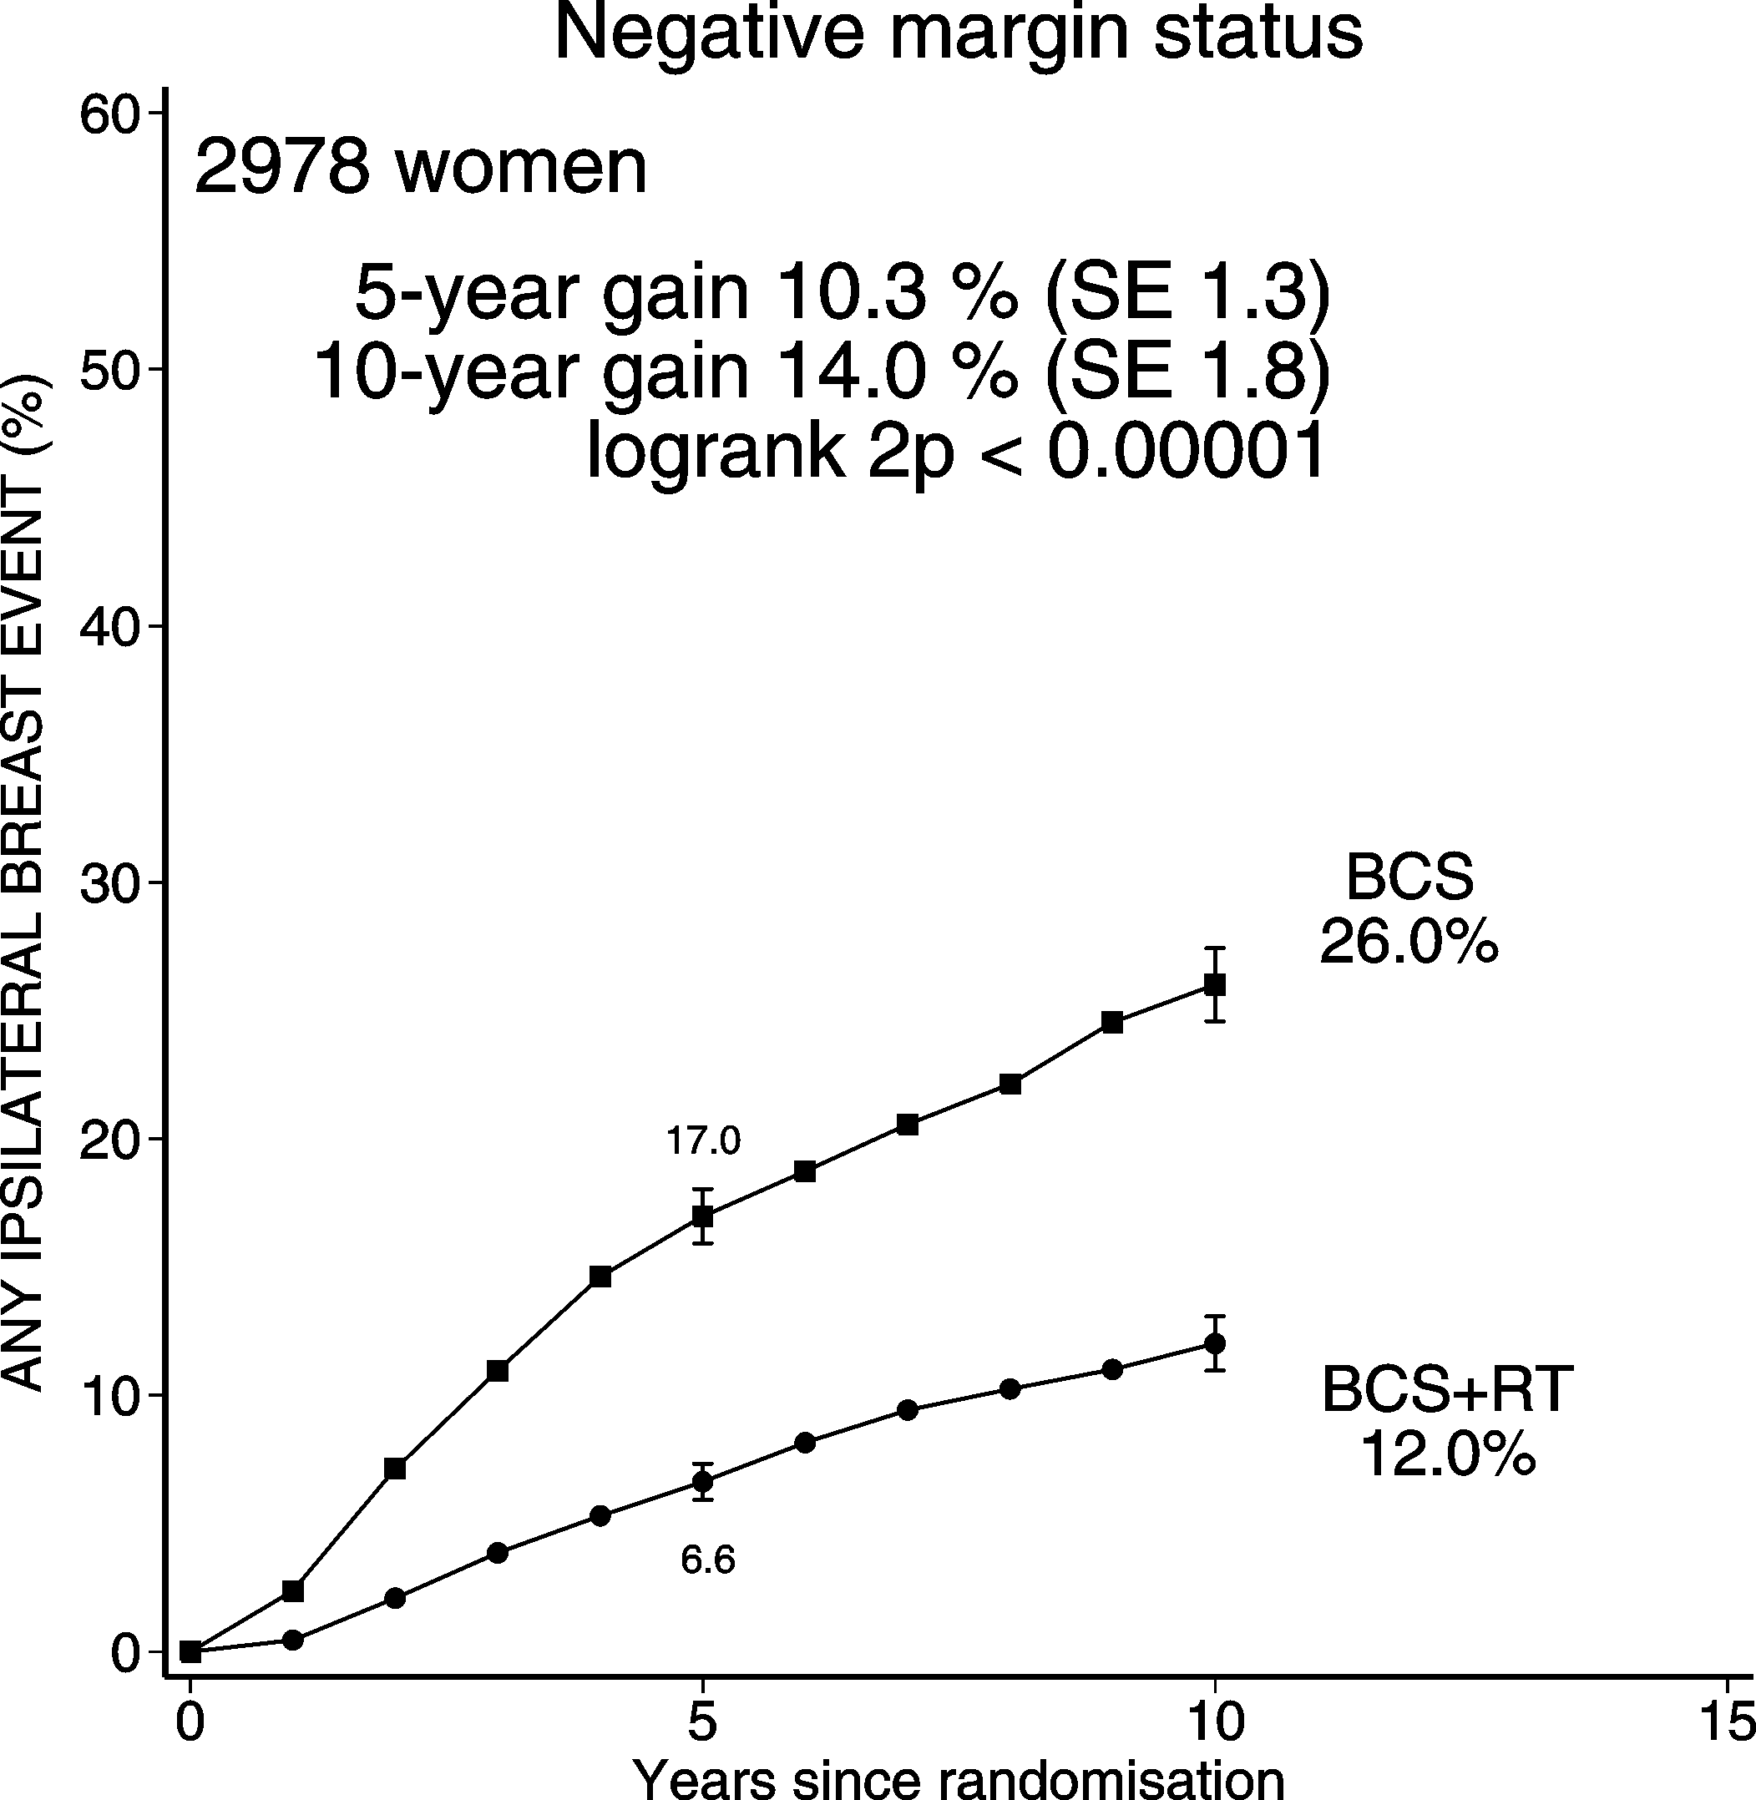
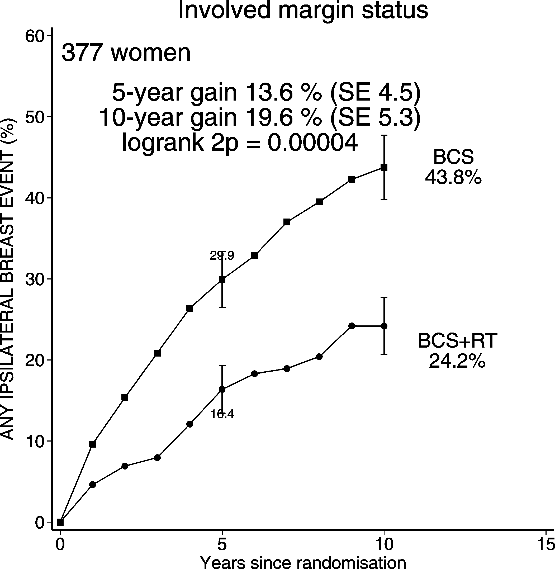
DCIS: BCS + RT vs. BCS Ips. BREAST RECURRENCE (CIS & Inv)
Margin status

Slide 18
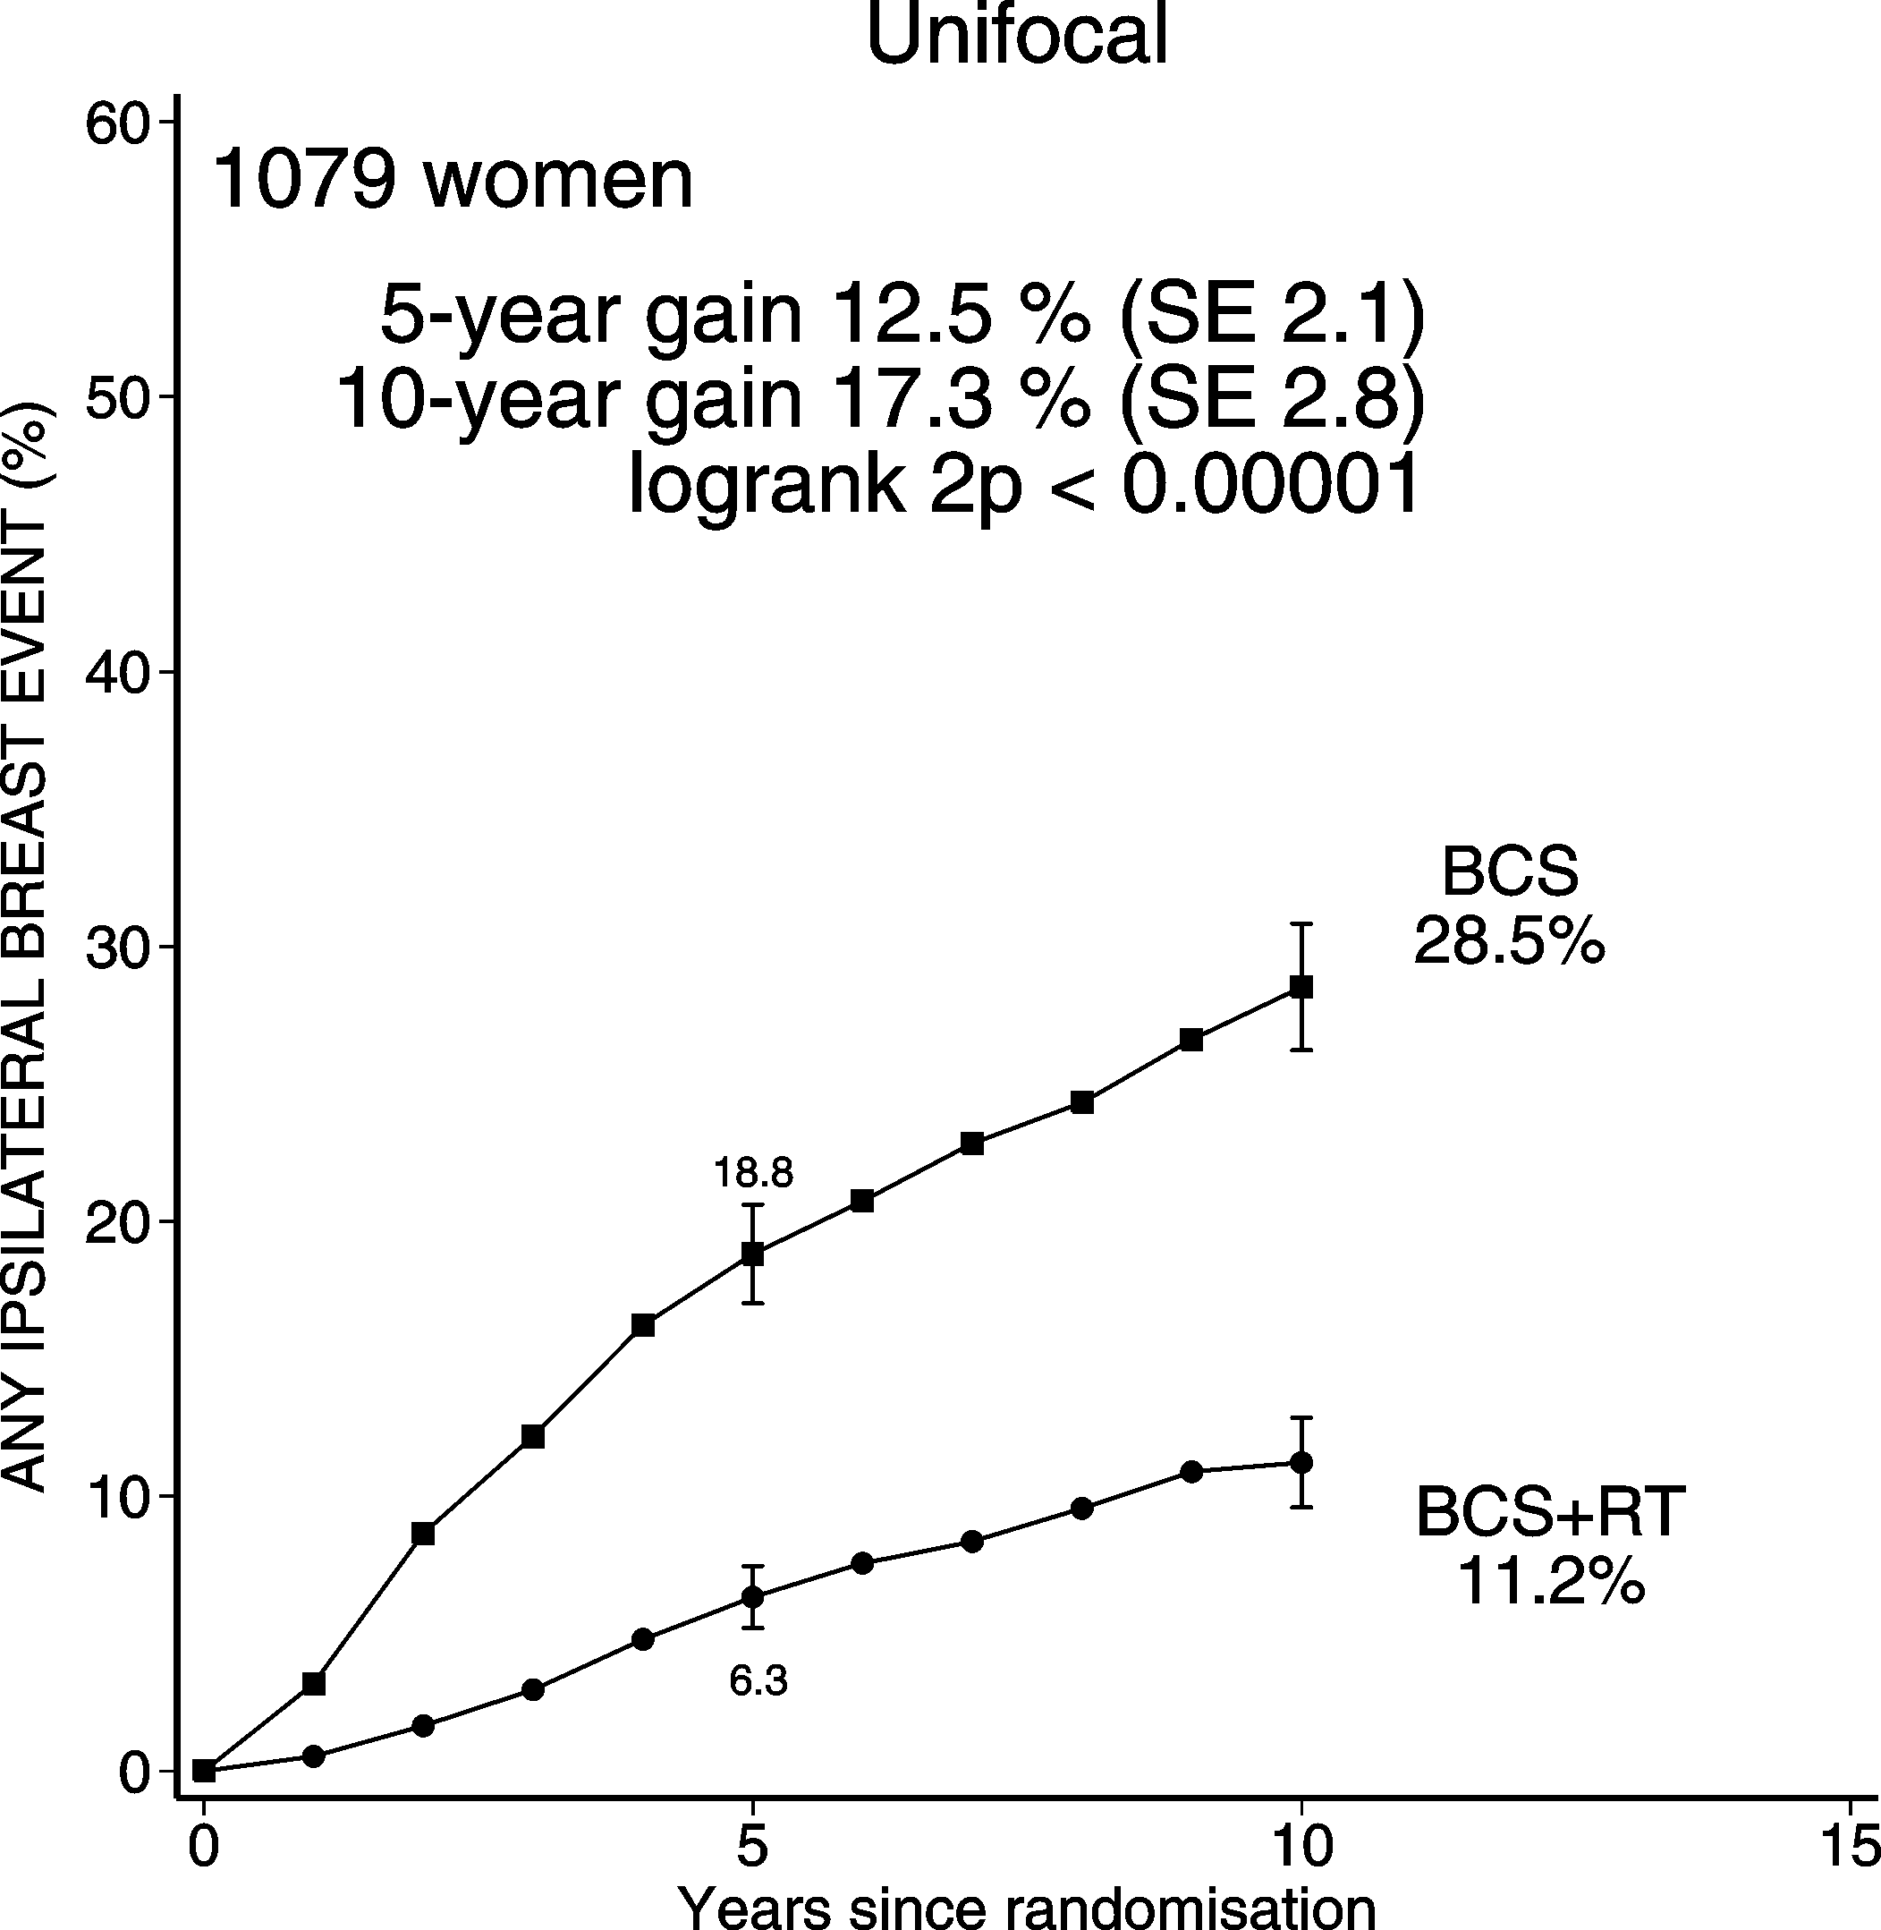
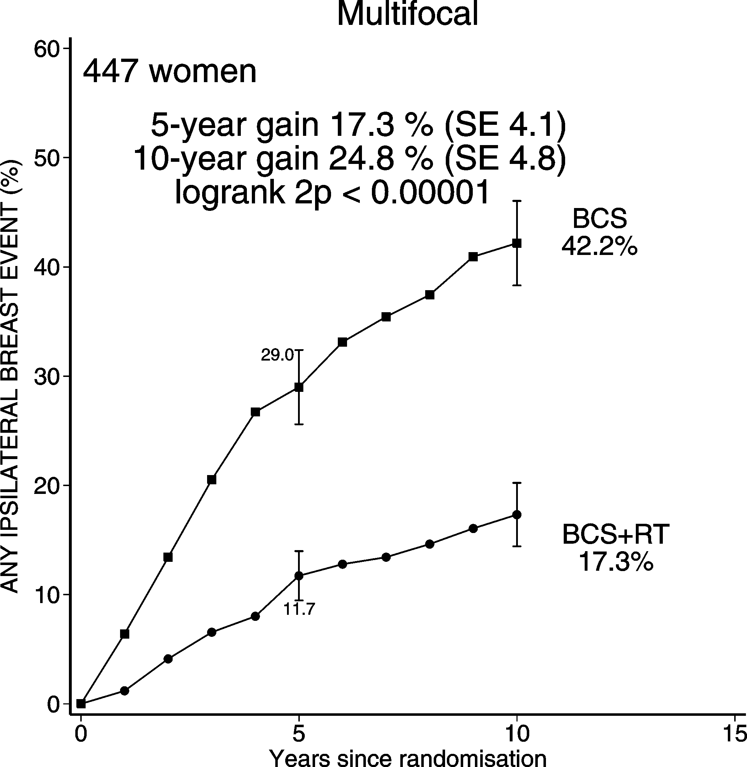
DCIS: BCS + RT vs. BCS Ips. BREAST RECURRENCE (CIS & Inv)
Focality

Slide 19
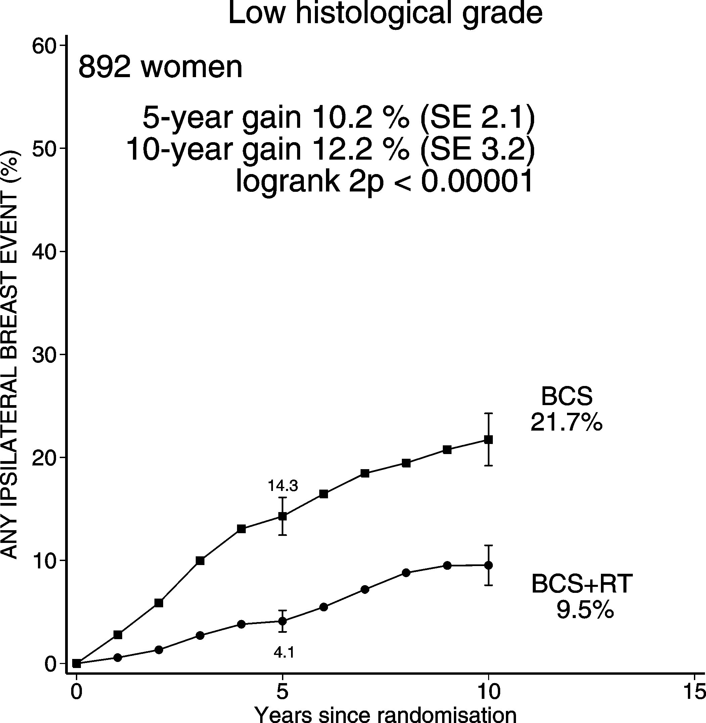
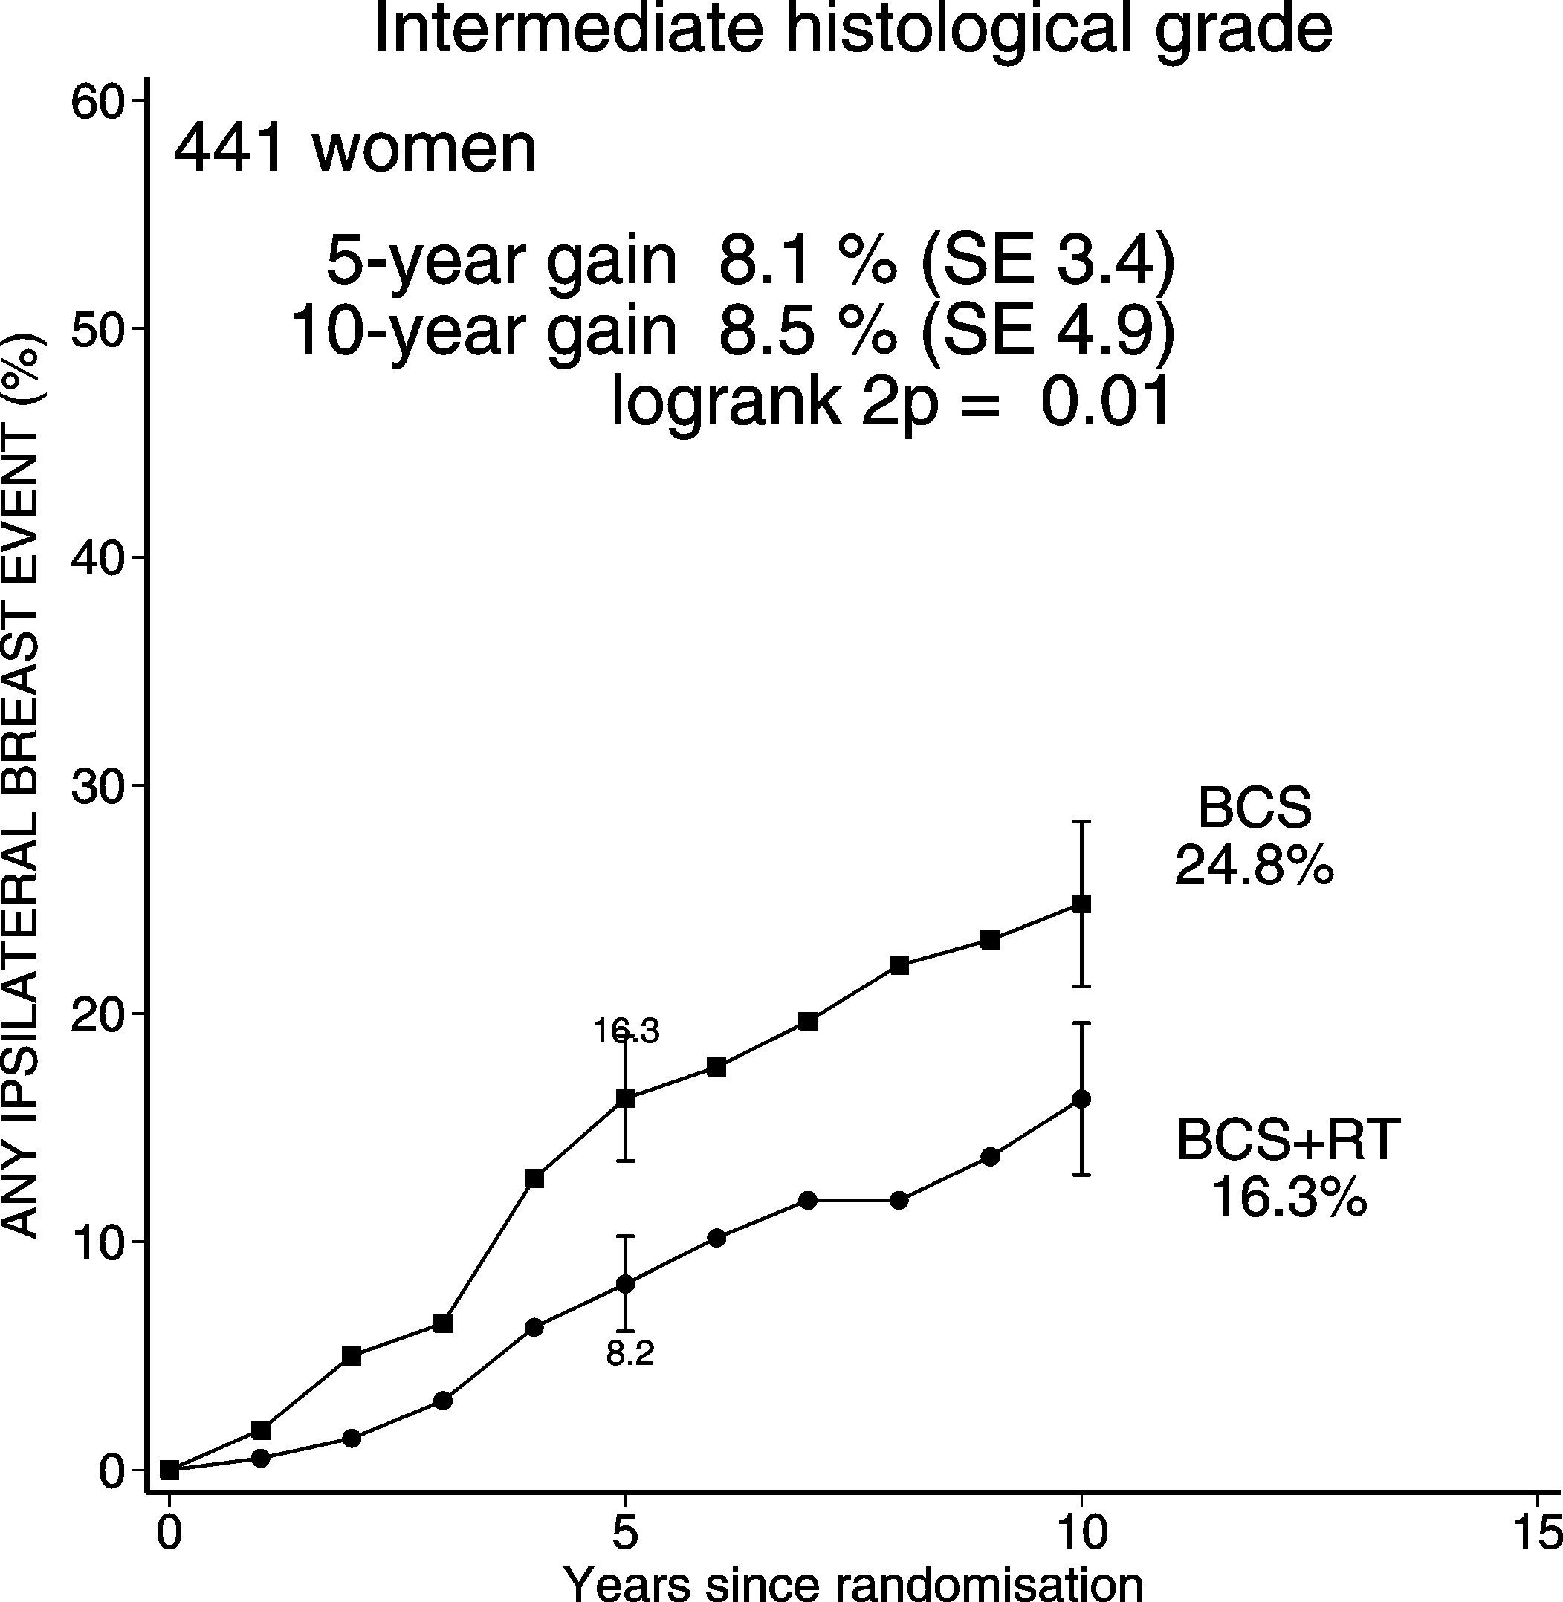
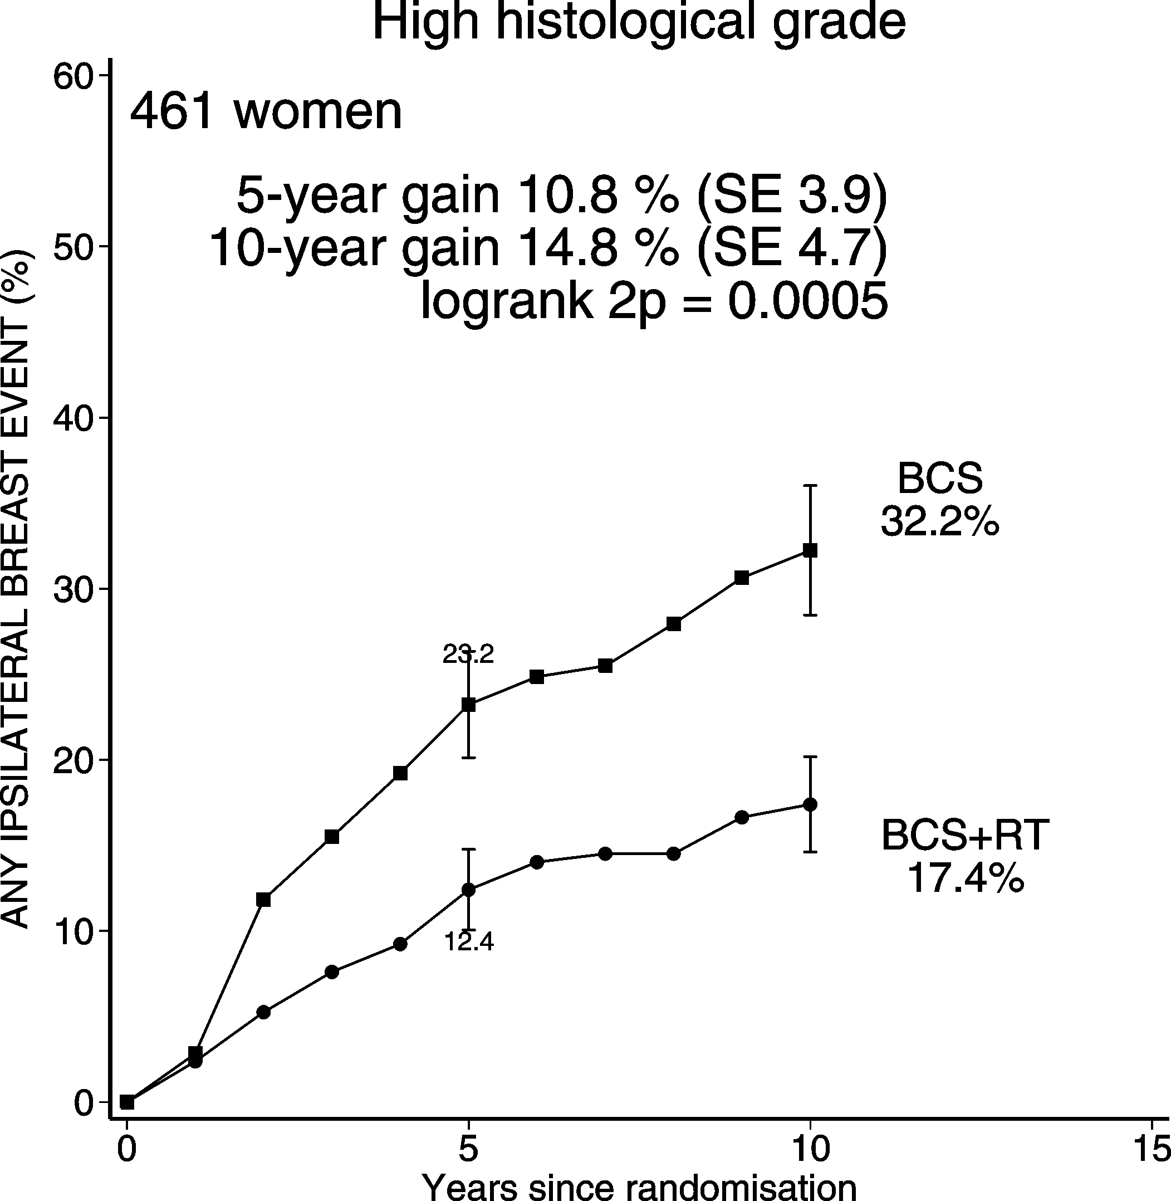
DCIS: BCS + RT vs. BCS Ips. BREAST RECURRENCE (CIS & Inv)
Histological grade

Slide 20
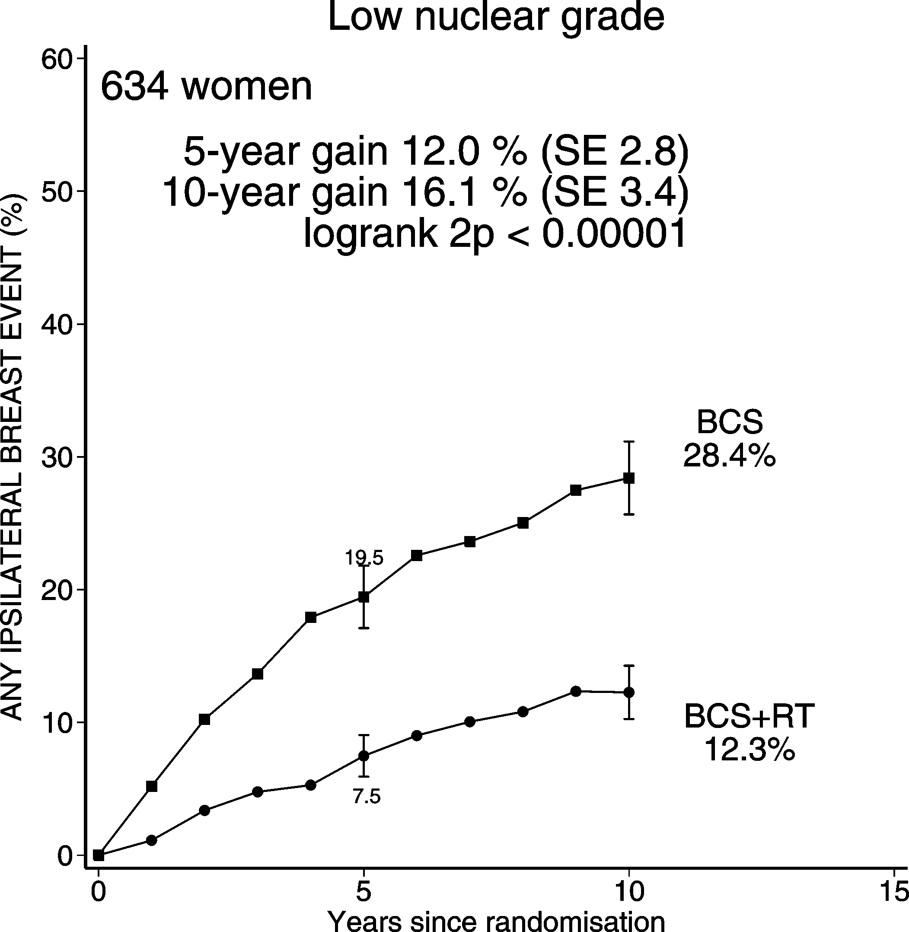
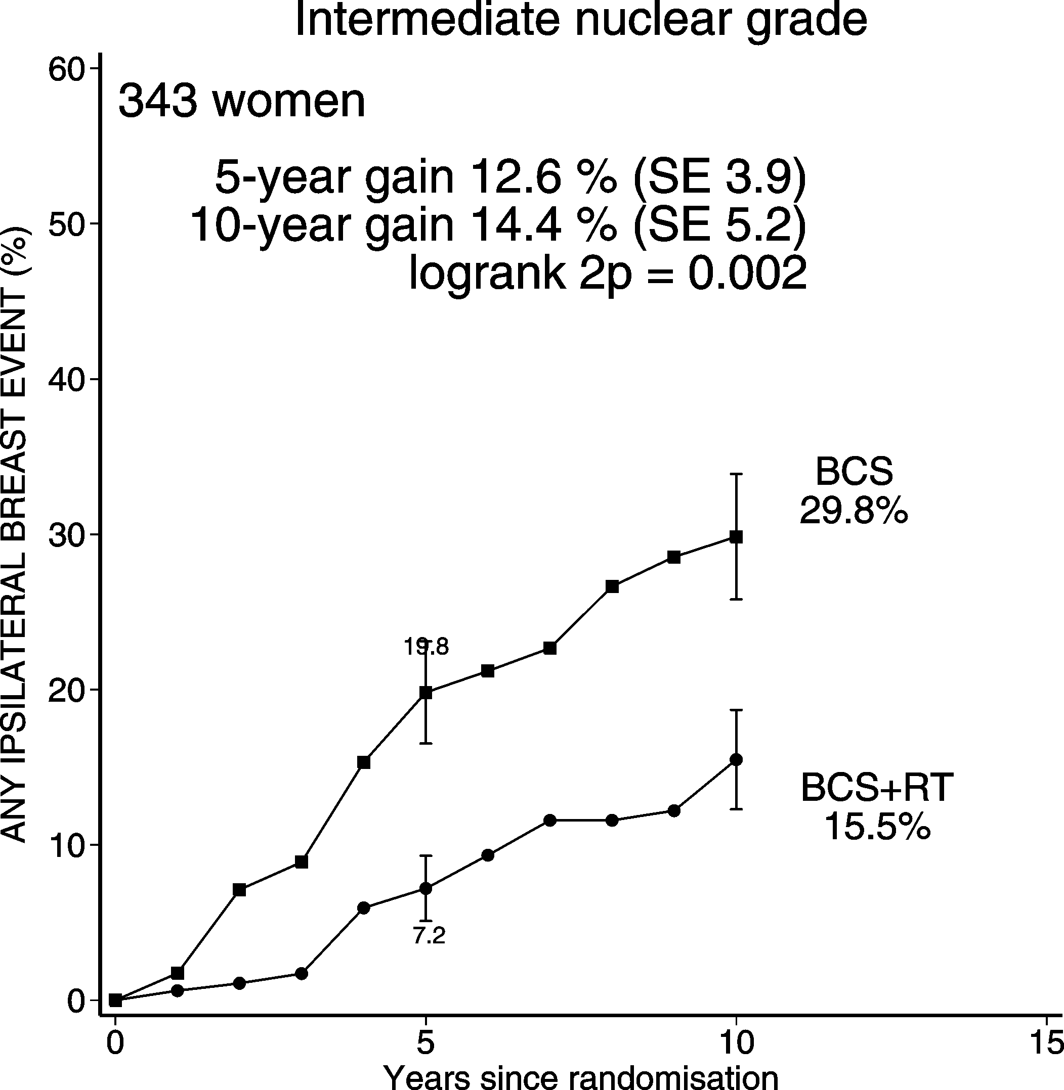
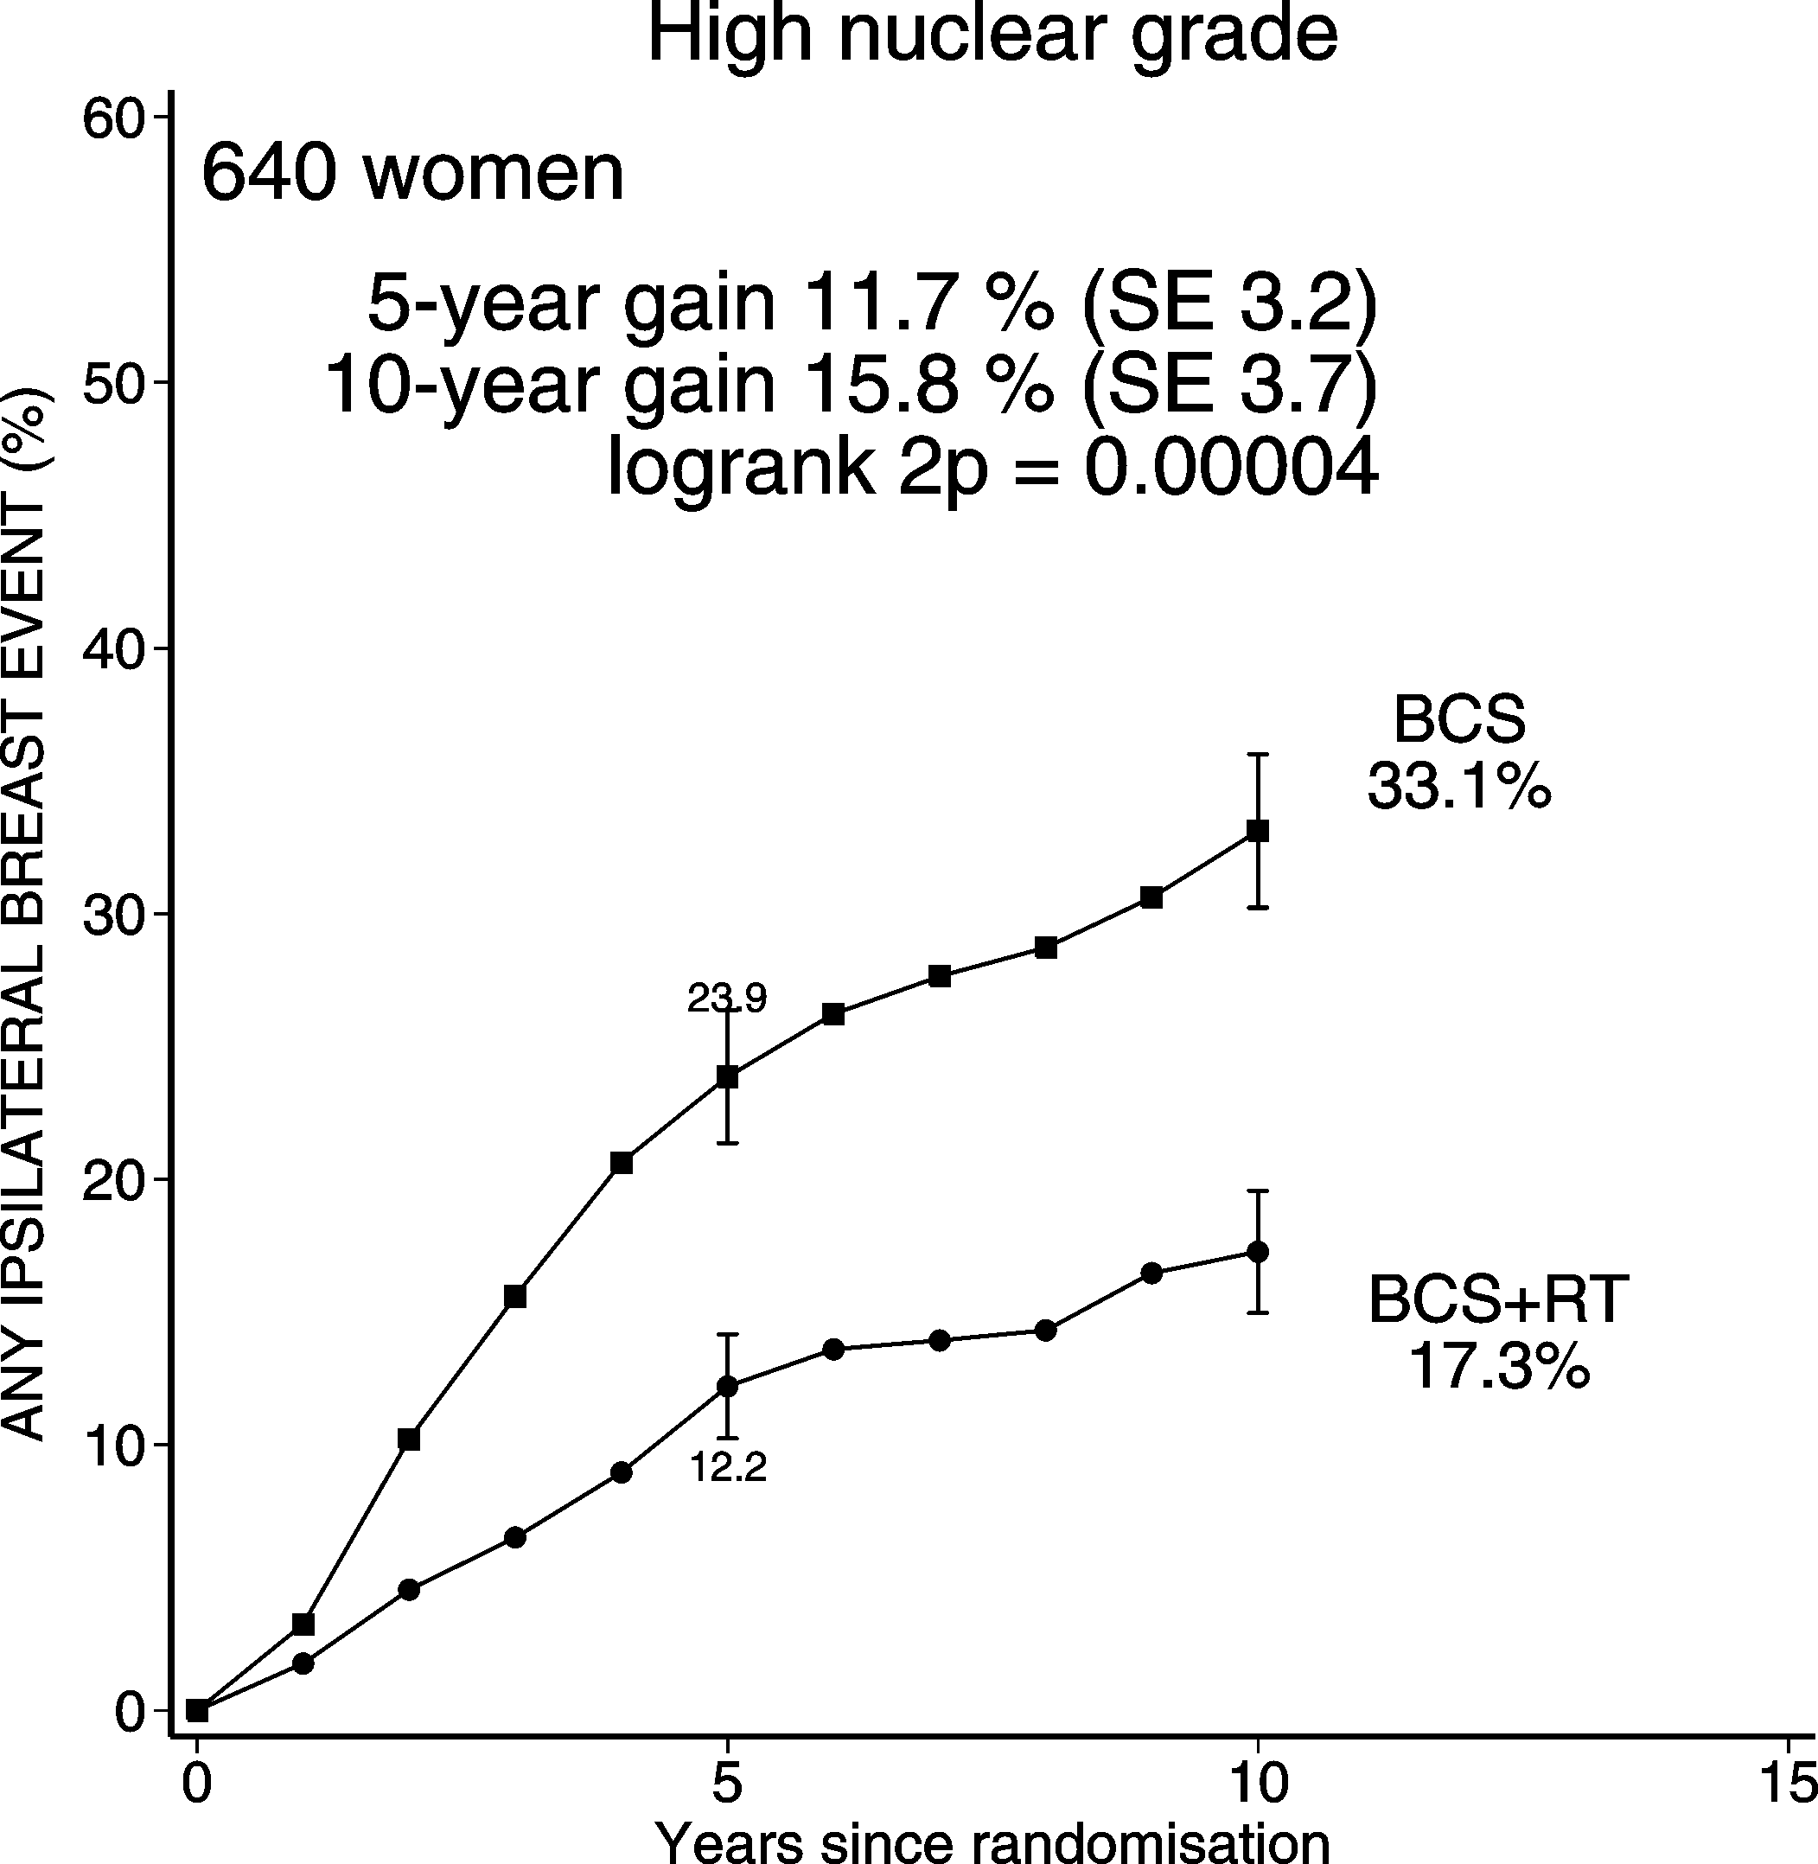
DCIS: BCS + RT vs. BCS Ips. BREAST RECURRENCE (CIS & Inv)
Nuclear grade

Slide 21
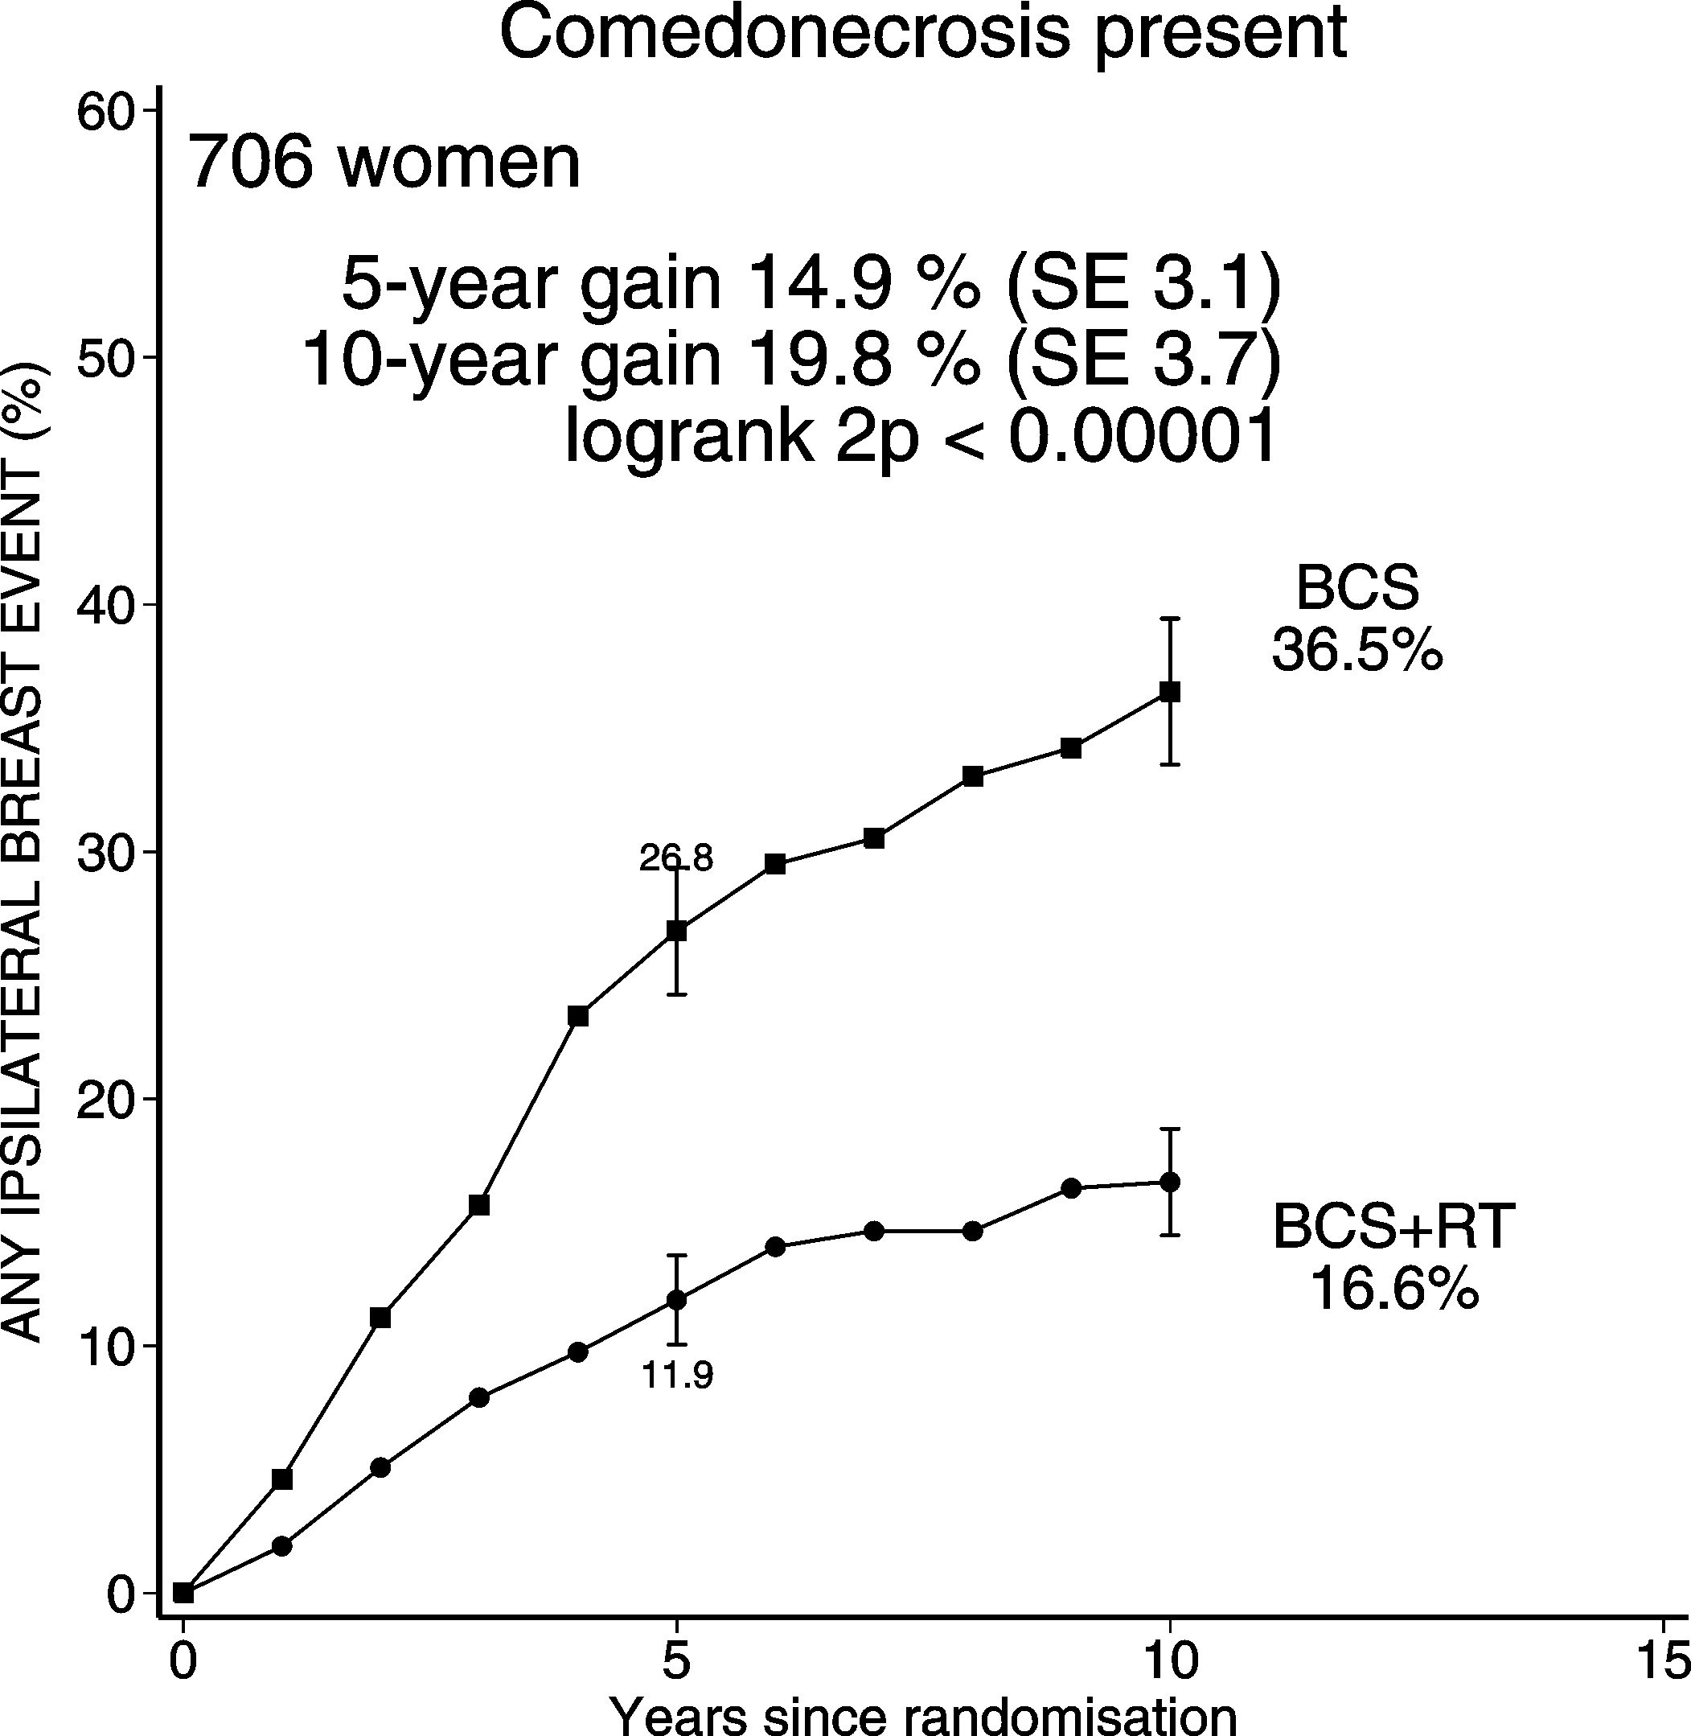
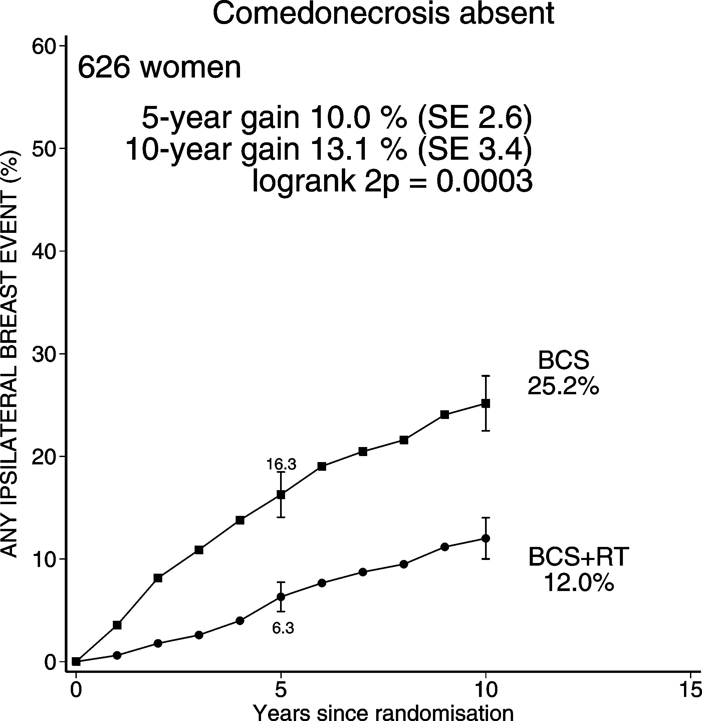
DCIS: BCS + RT vs. BCS Ips. BREAST RECURRENCE (CIS & Inv)
Comedonecrosis

Slide 22
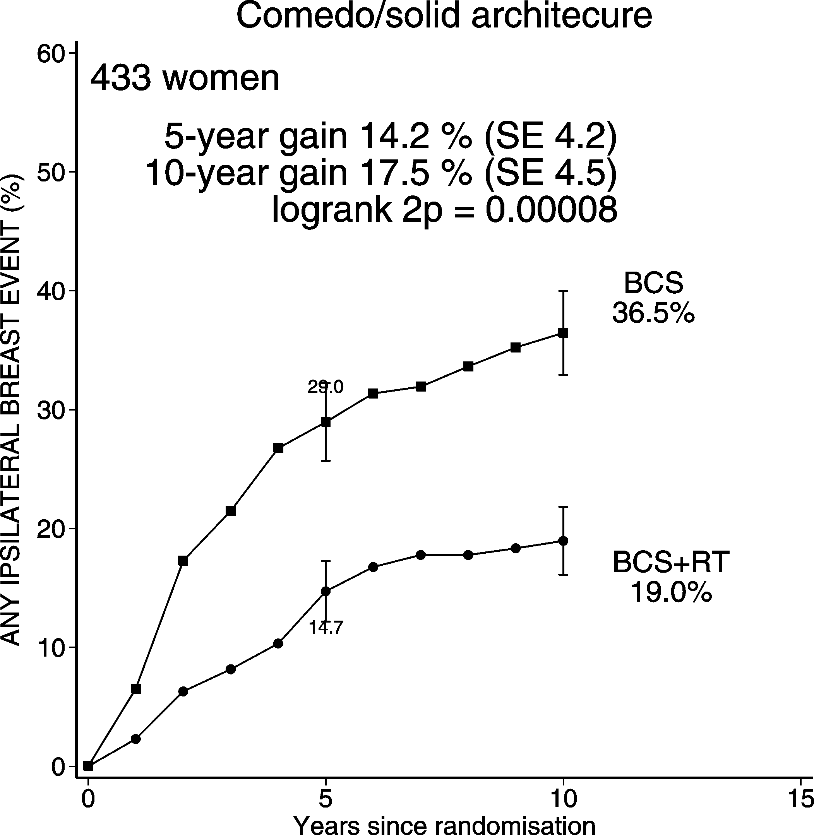
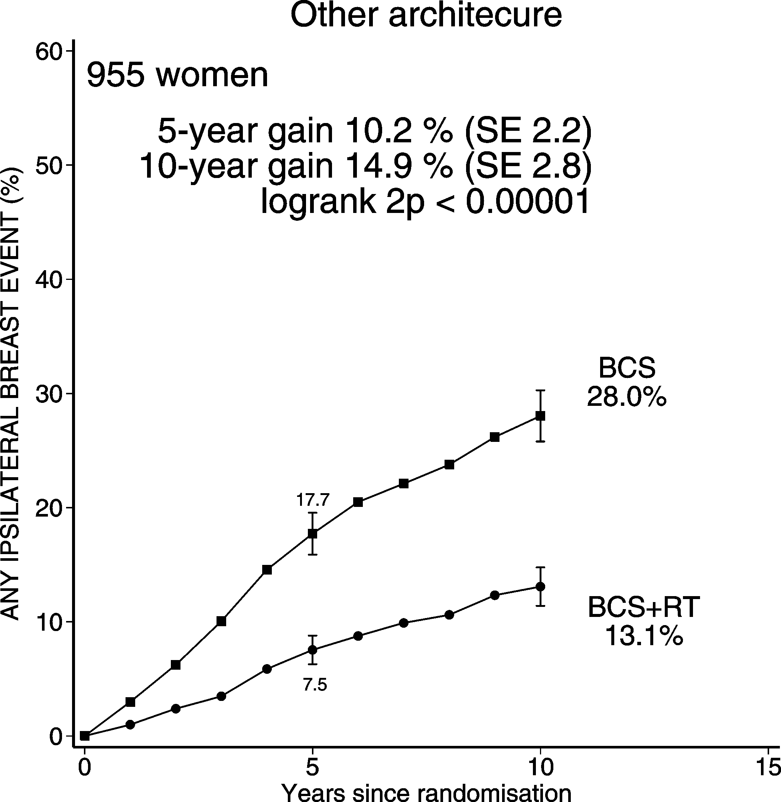
DCIS: BCS + RT vs. BCS Ips. BREAST RECURRENCE (CIS & Inv)
Architecture

Slide 23
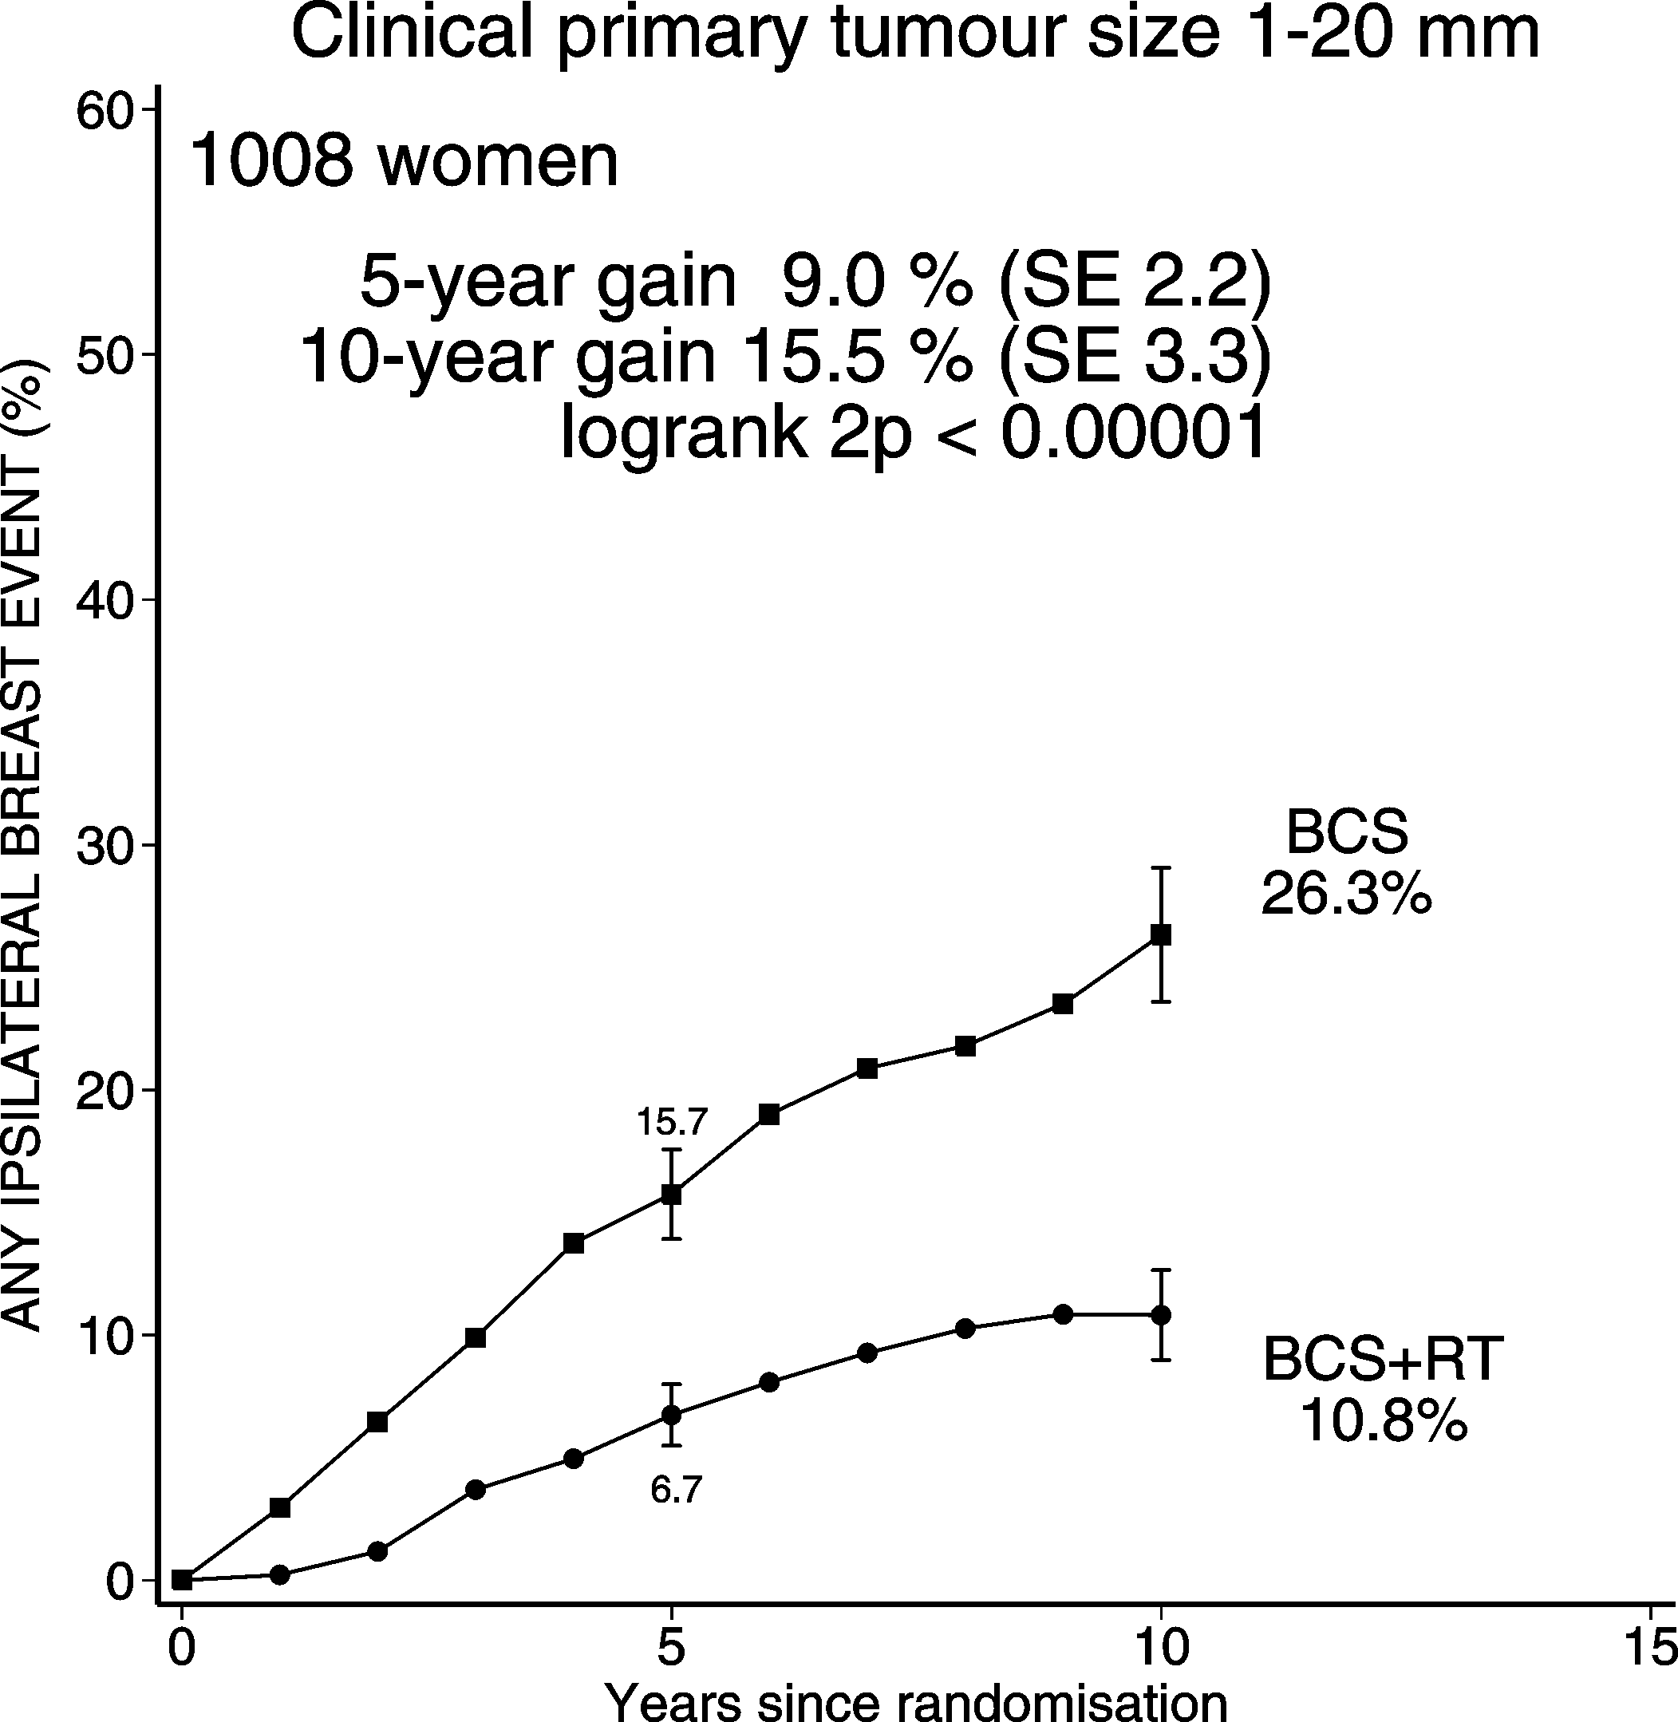
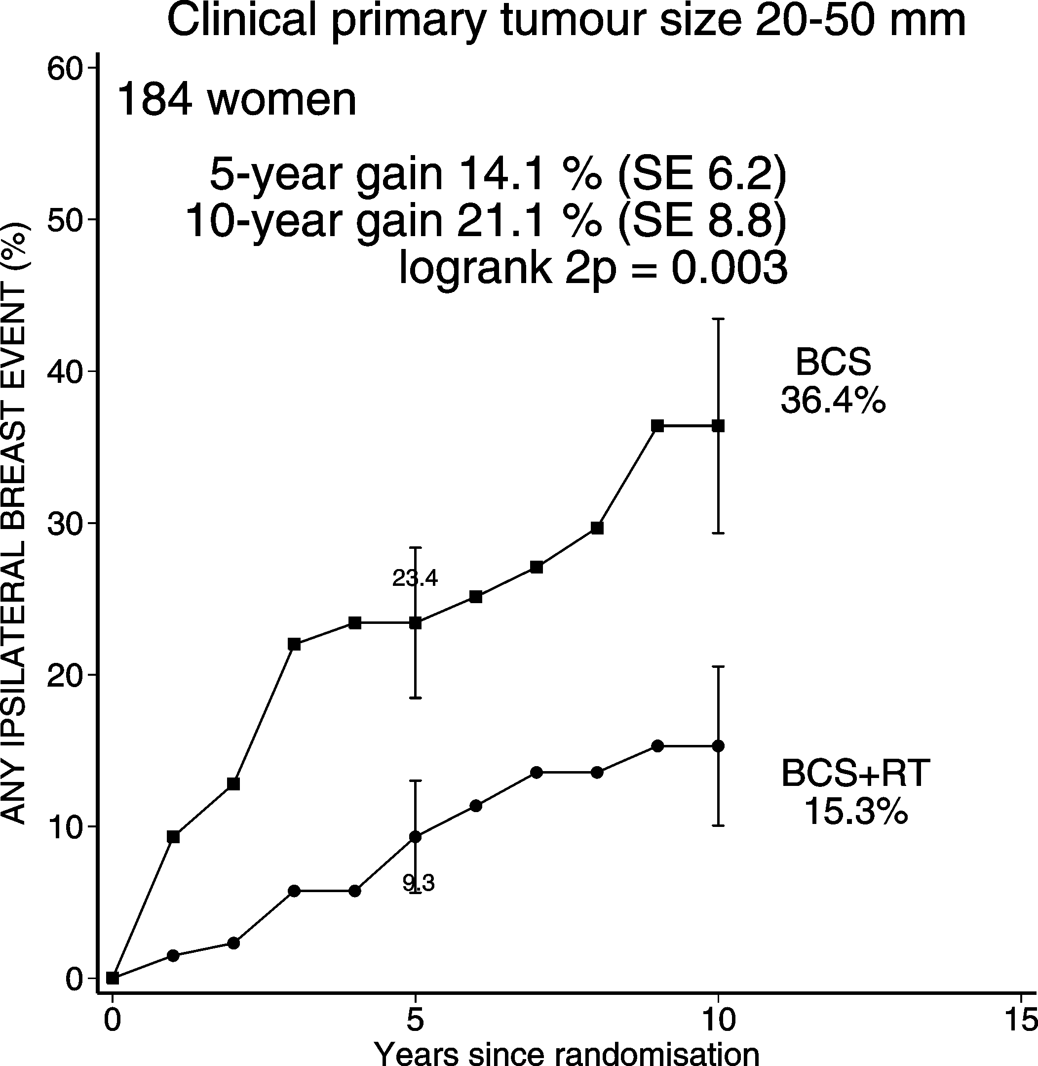
DCIS: BCS + RT vs. BCS Ips. BREAST RECURRENCE (CIS & Inv)
Clinical primary tumour size

Slide 24
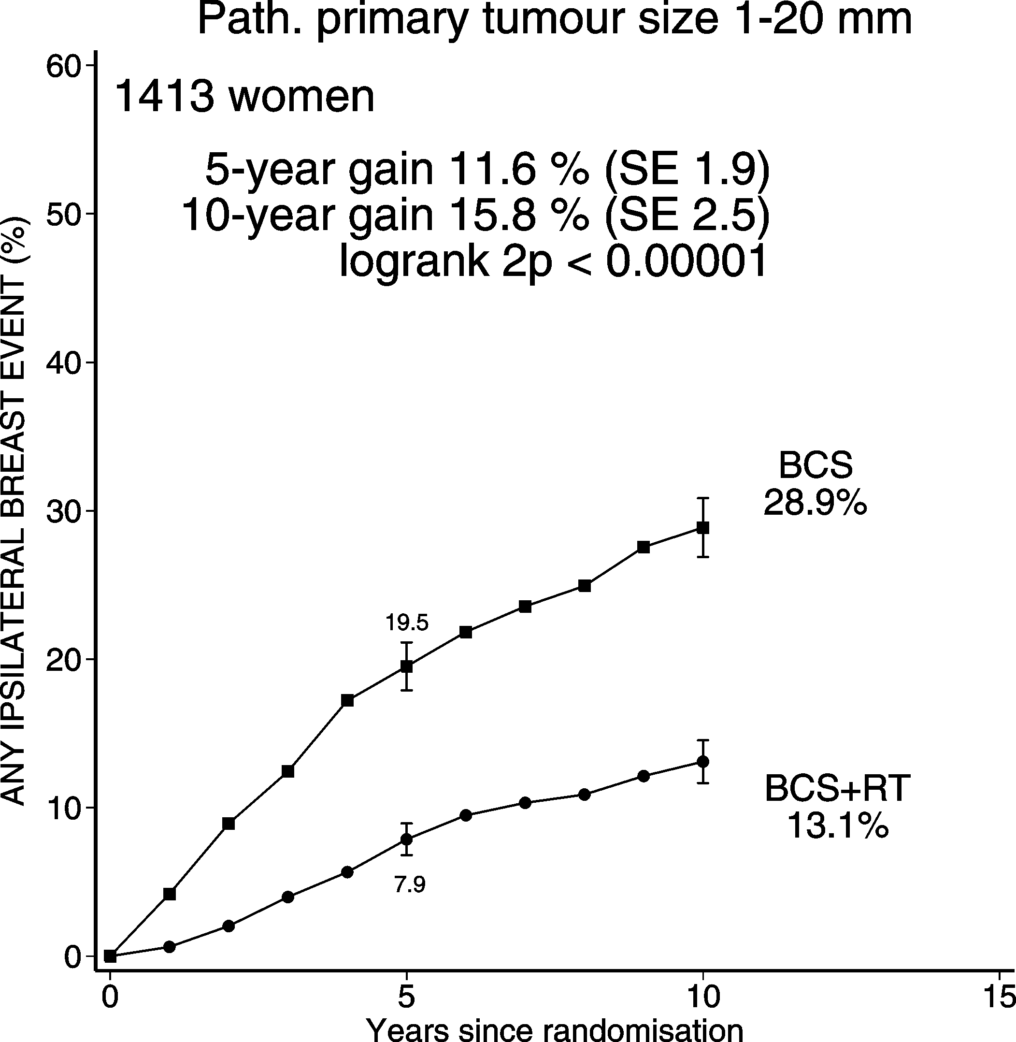
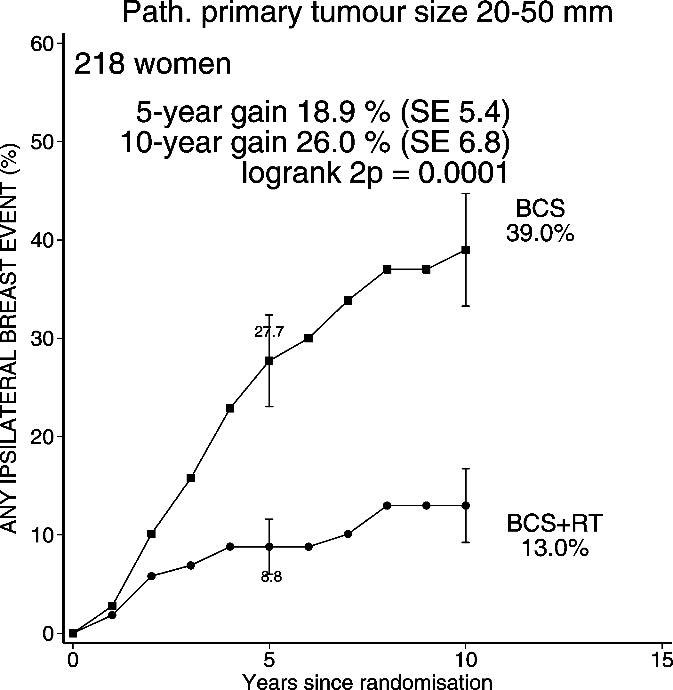
DCIS: BCS + RT vs. BCS Ips. BREAST RECURRENCE (CIS & Inv)
Pathological primary tumour size

Slide 25
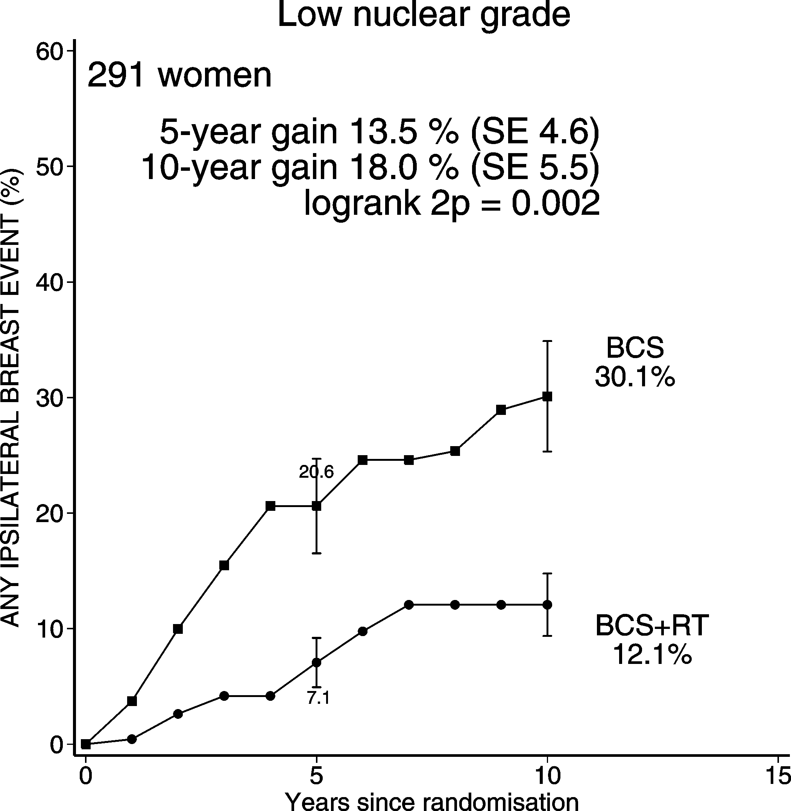
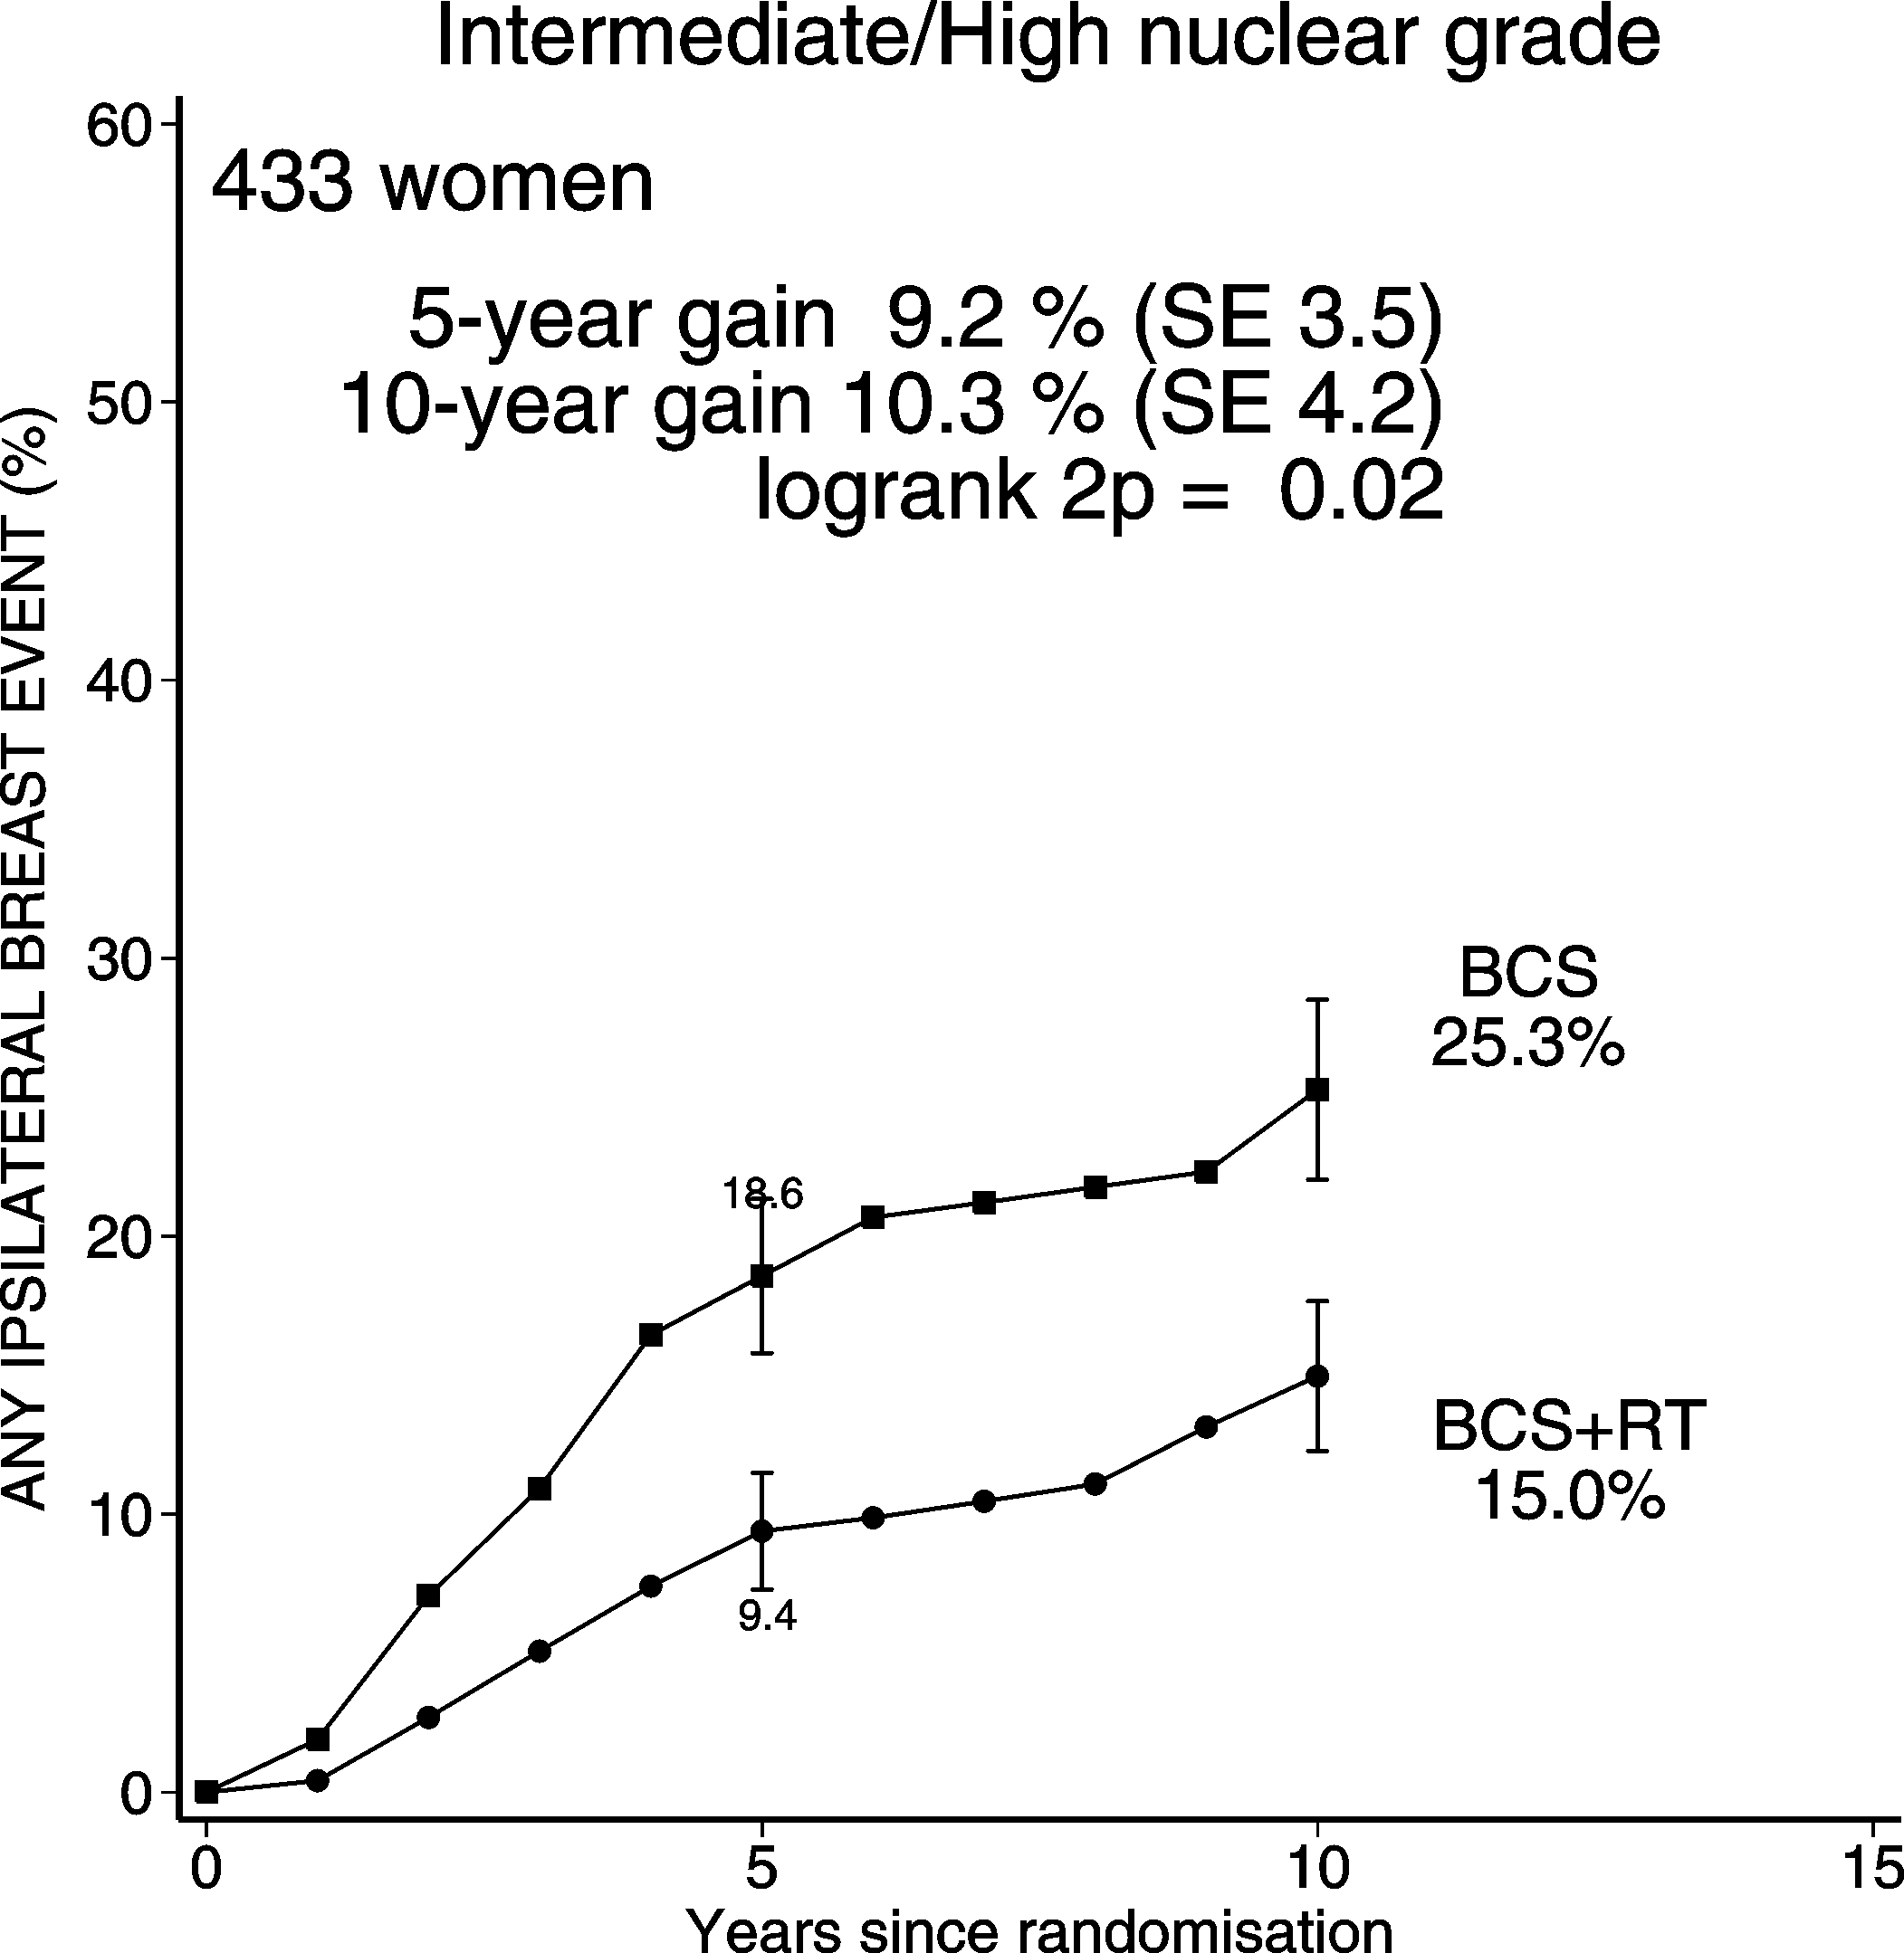
DCIS: BCS + RT vs. BCS Ips. BREAST RECURRENCE (CIS & Inv)
among women with 1-20 mm tumours and negative margin status

Slide 26
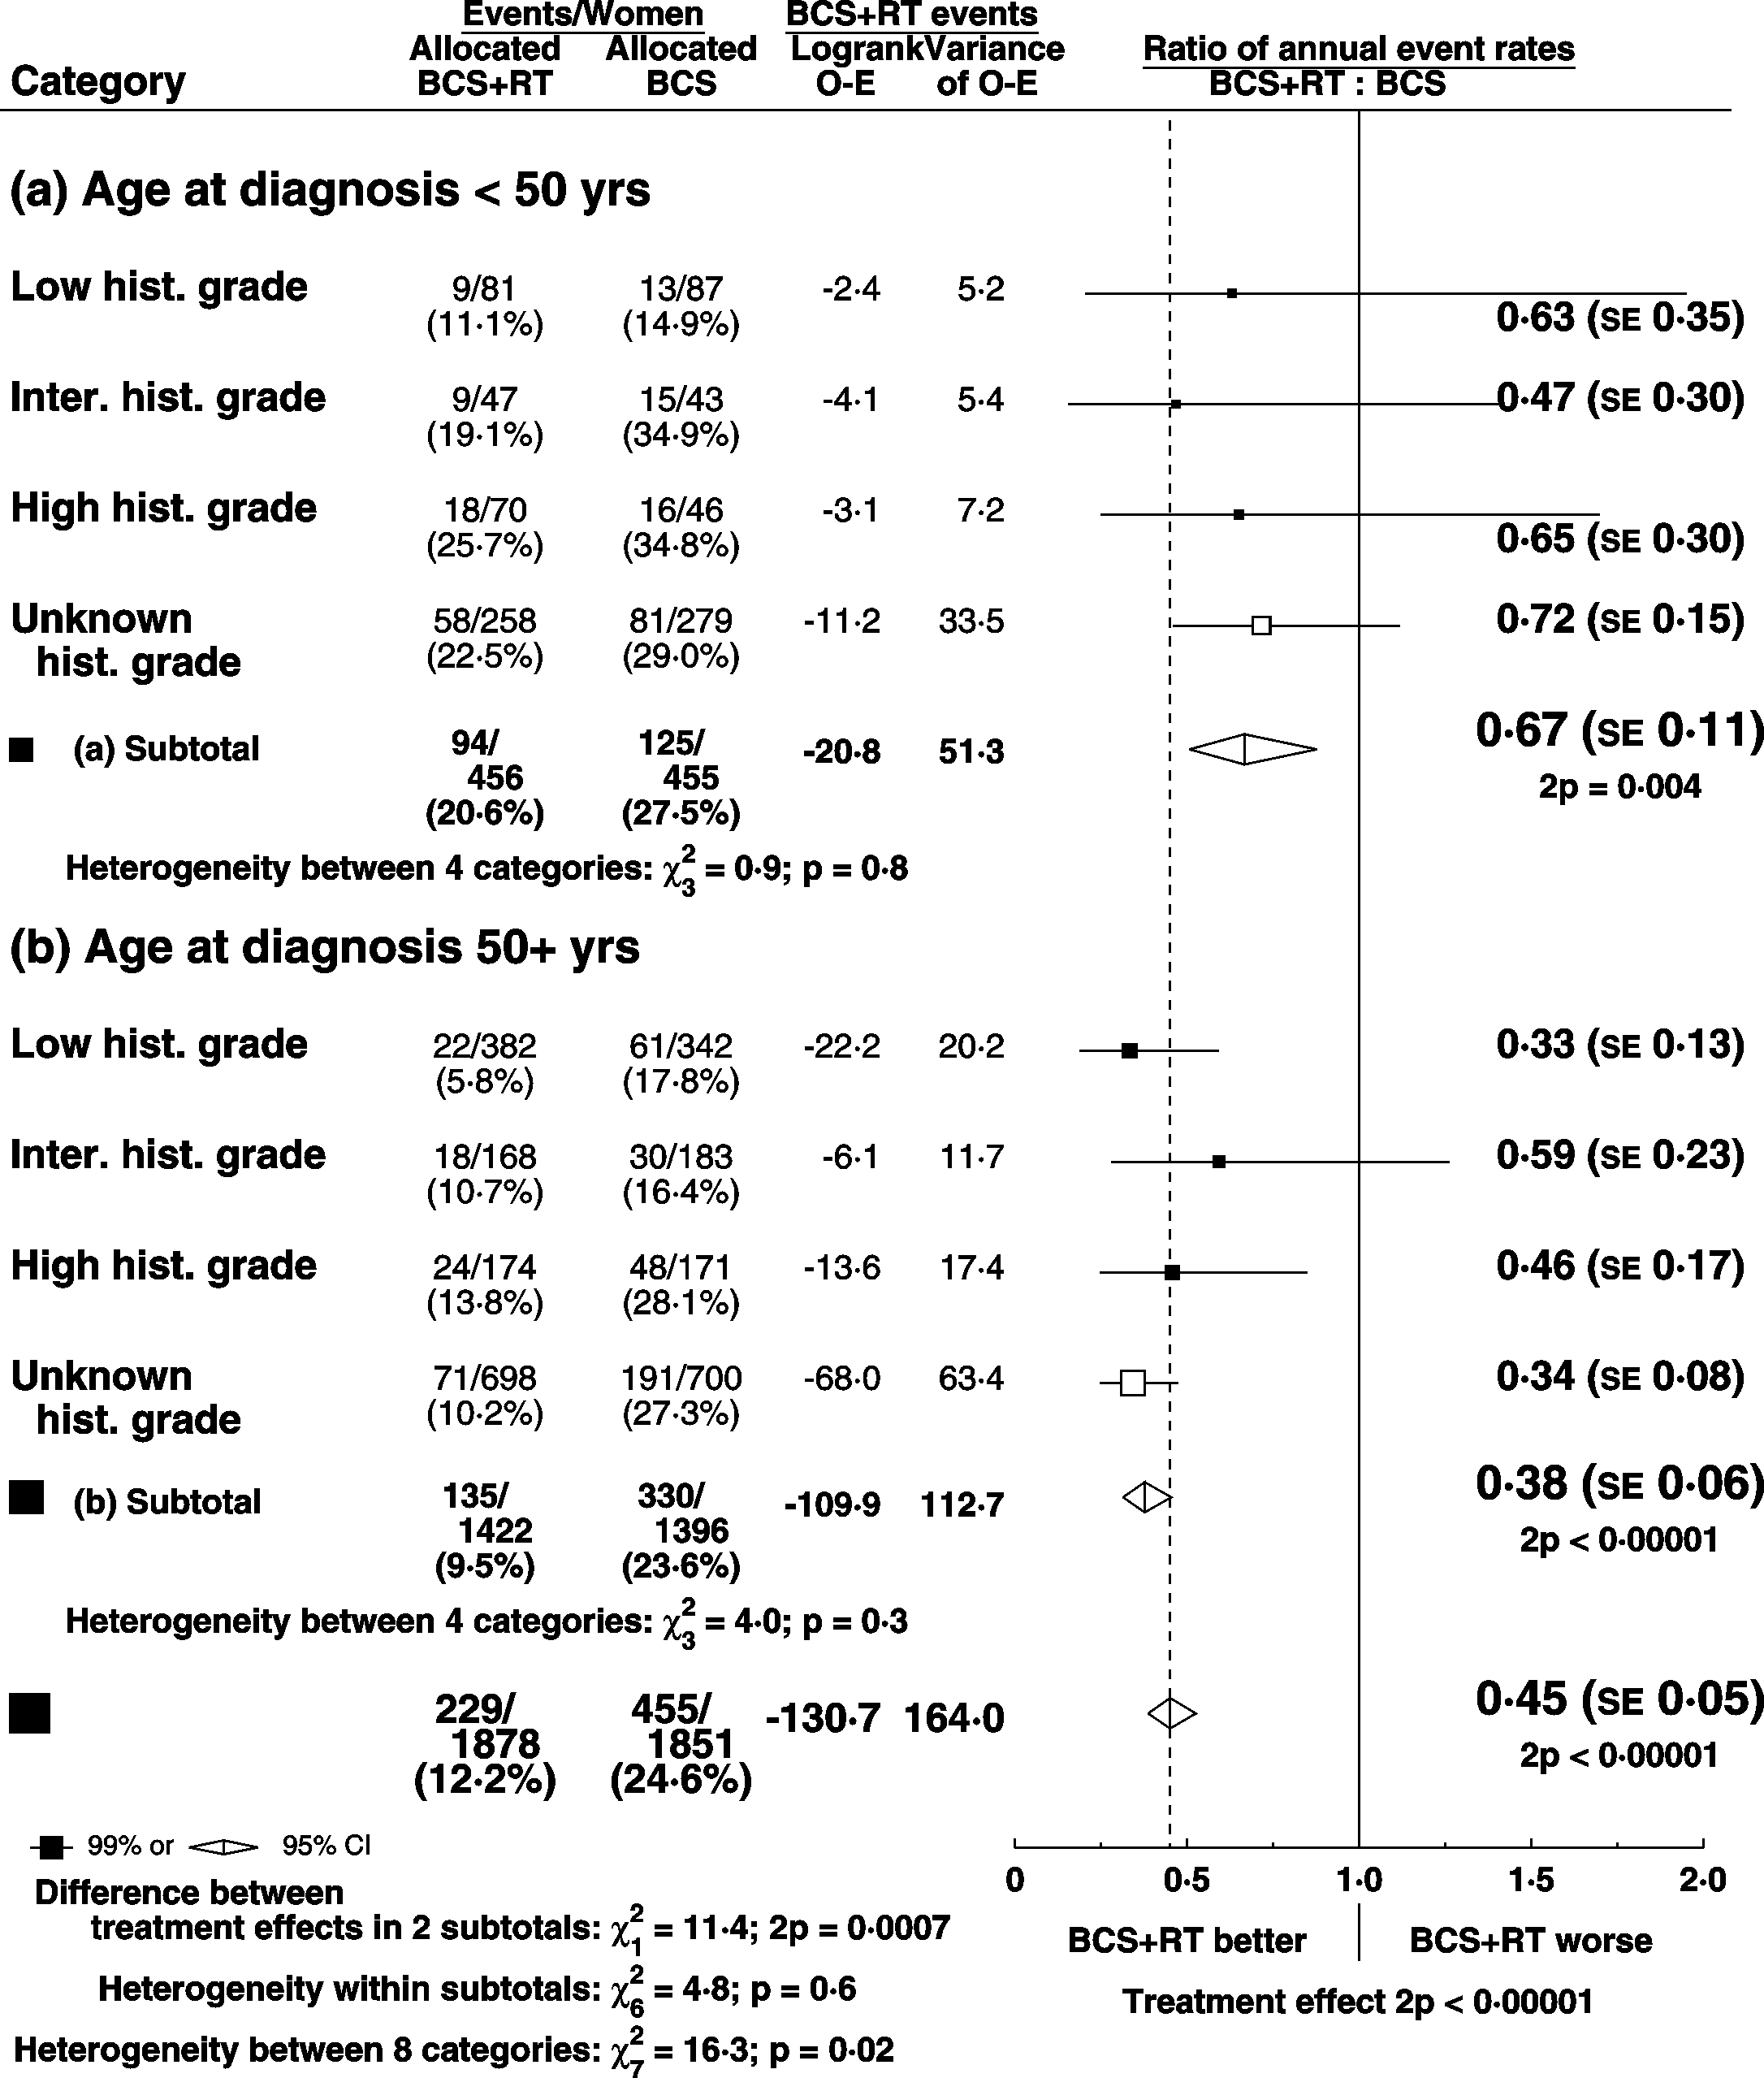
DCIS: BCS + RT vs. BCS Ips. BREAST RECURRENCE (CIS & Inv)
Ratio of annual event rates by age and histological grade

Slide 27
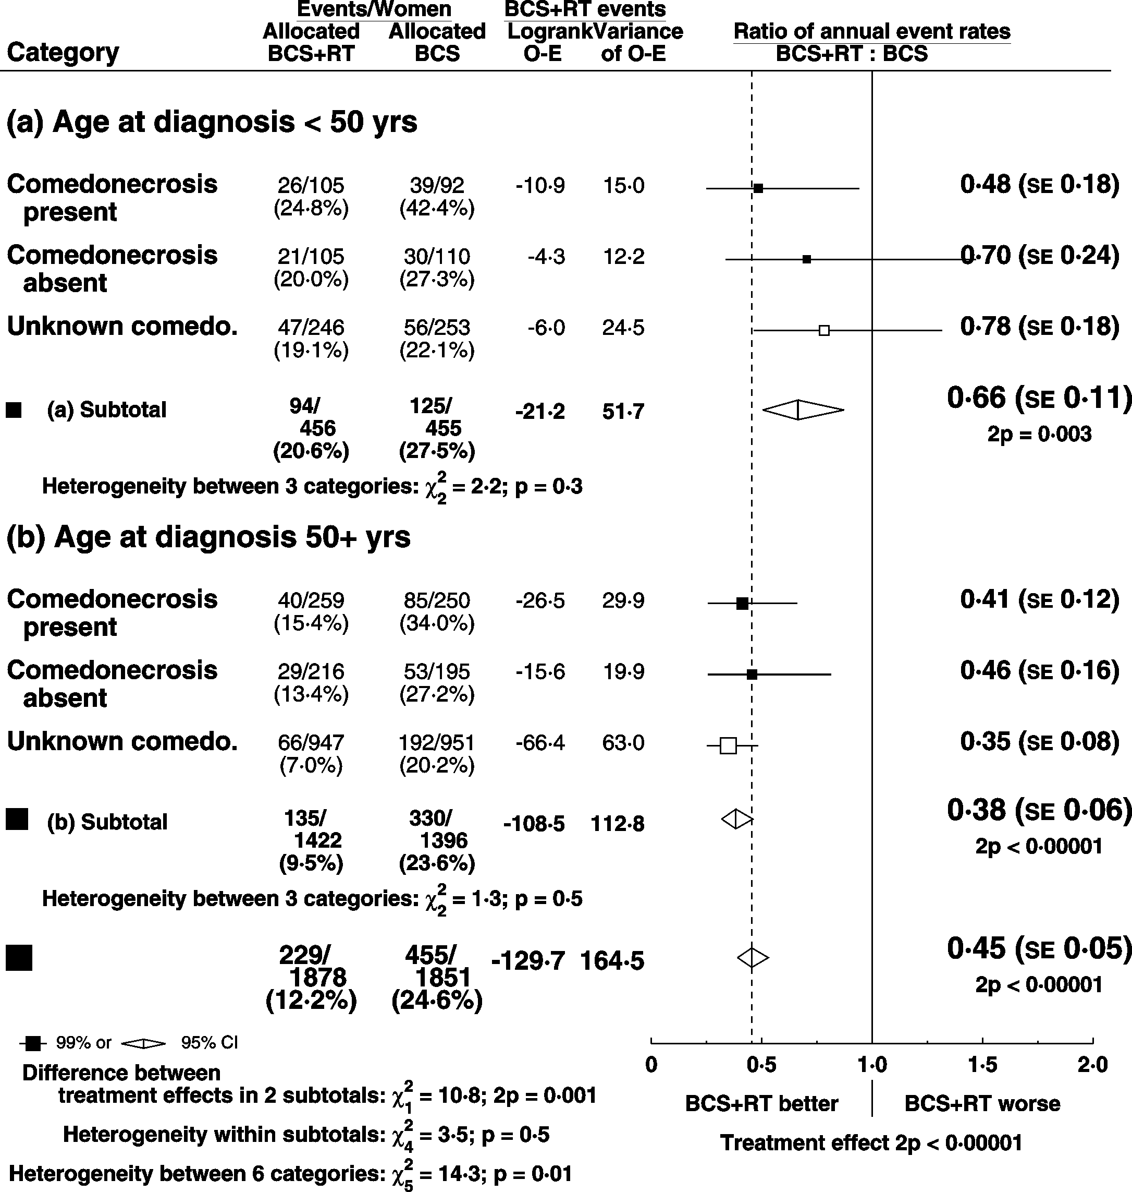
DCIS: BCS + RT vs. BCS Ips. BREAST RECURRENCE (CIS & Inv)
Ratio of annual event rates by age and comedonecrosis

Slide 28
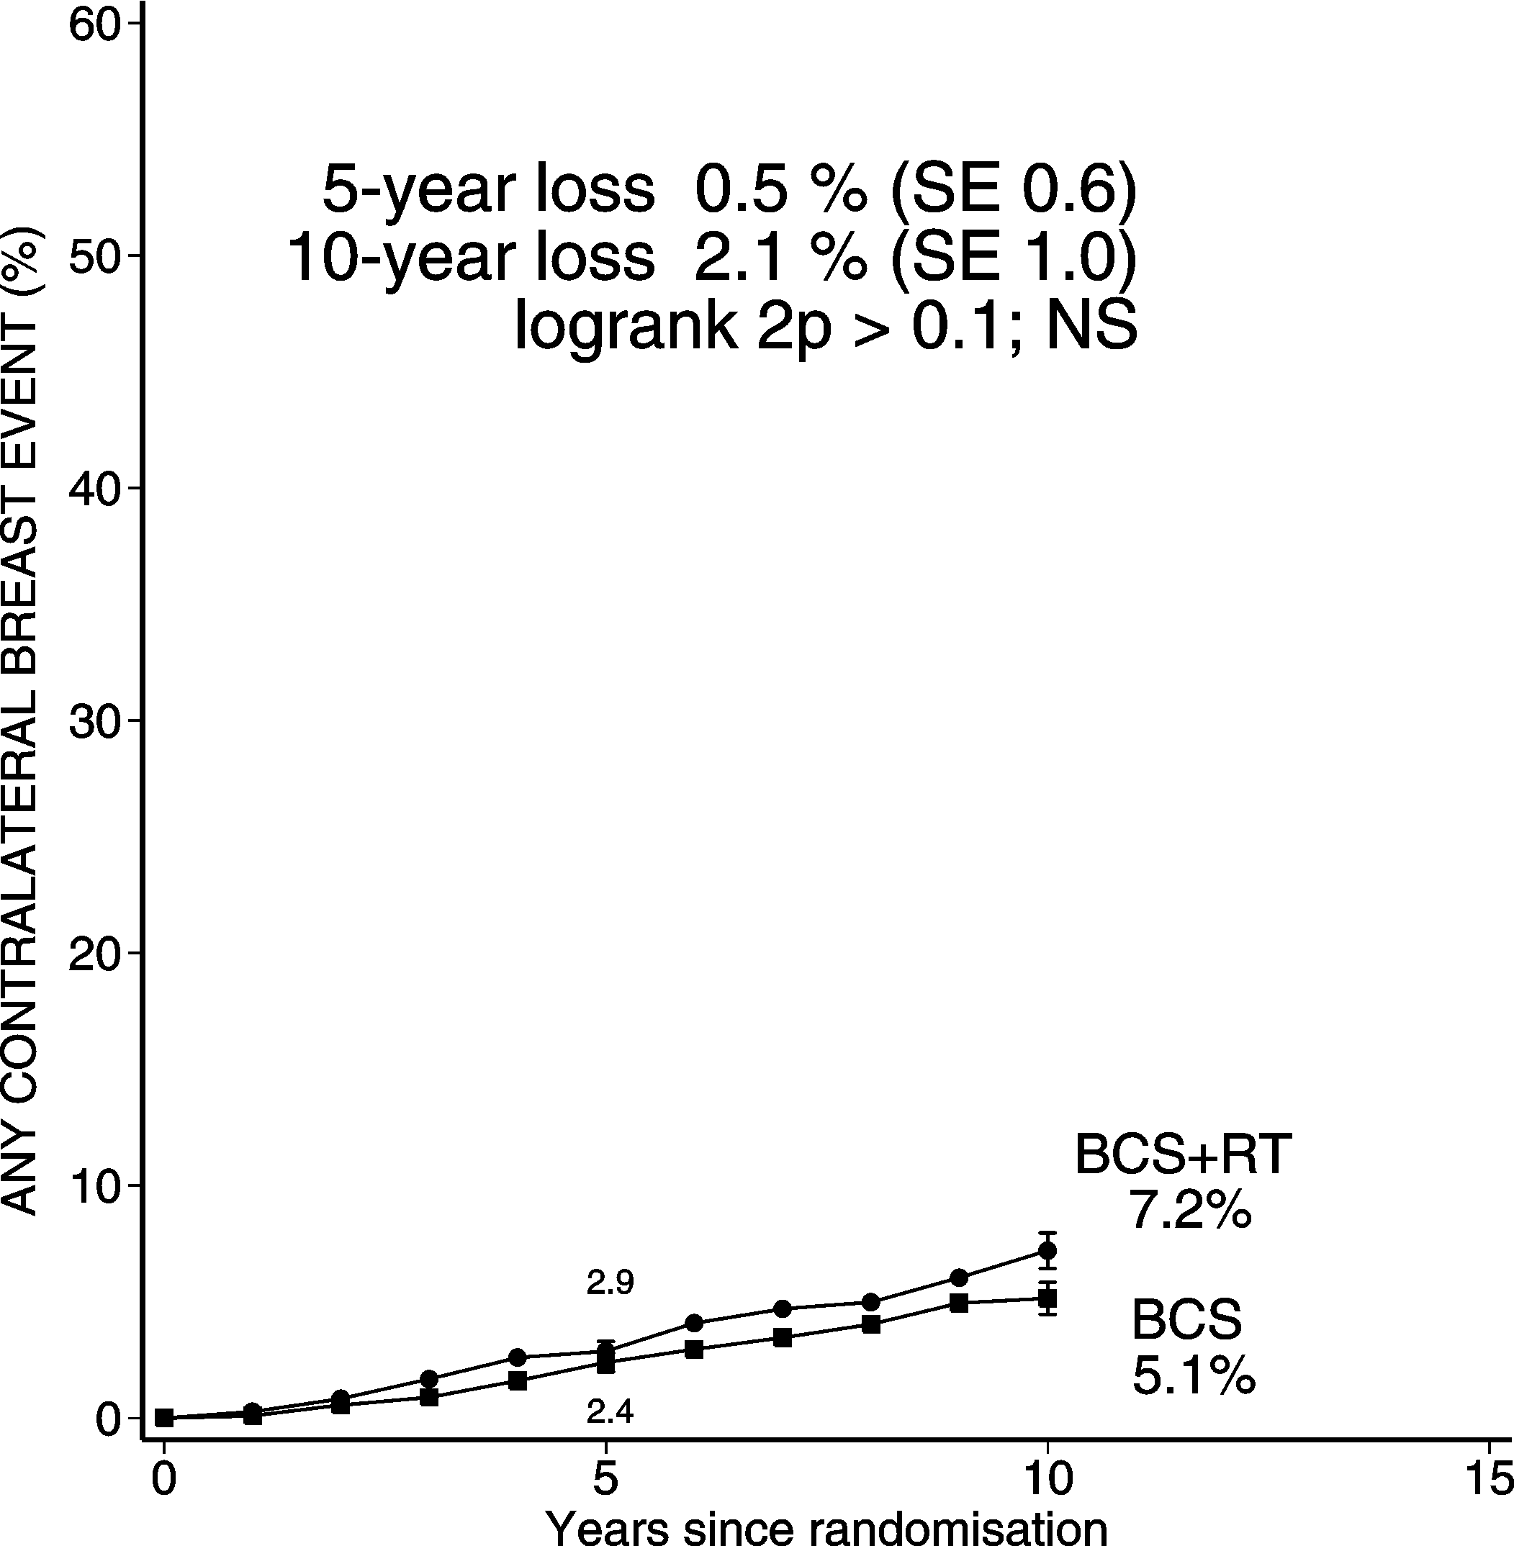
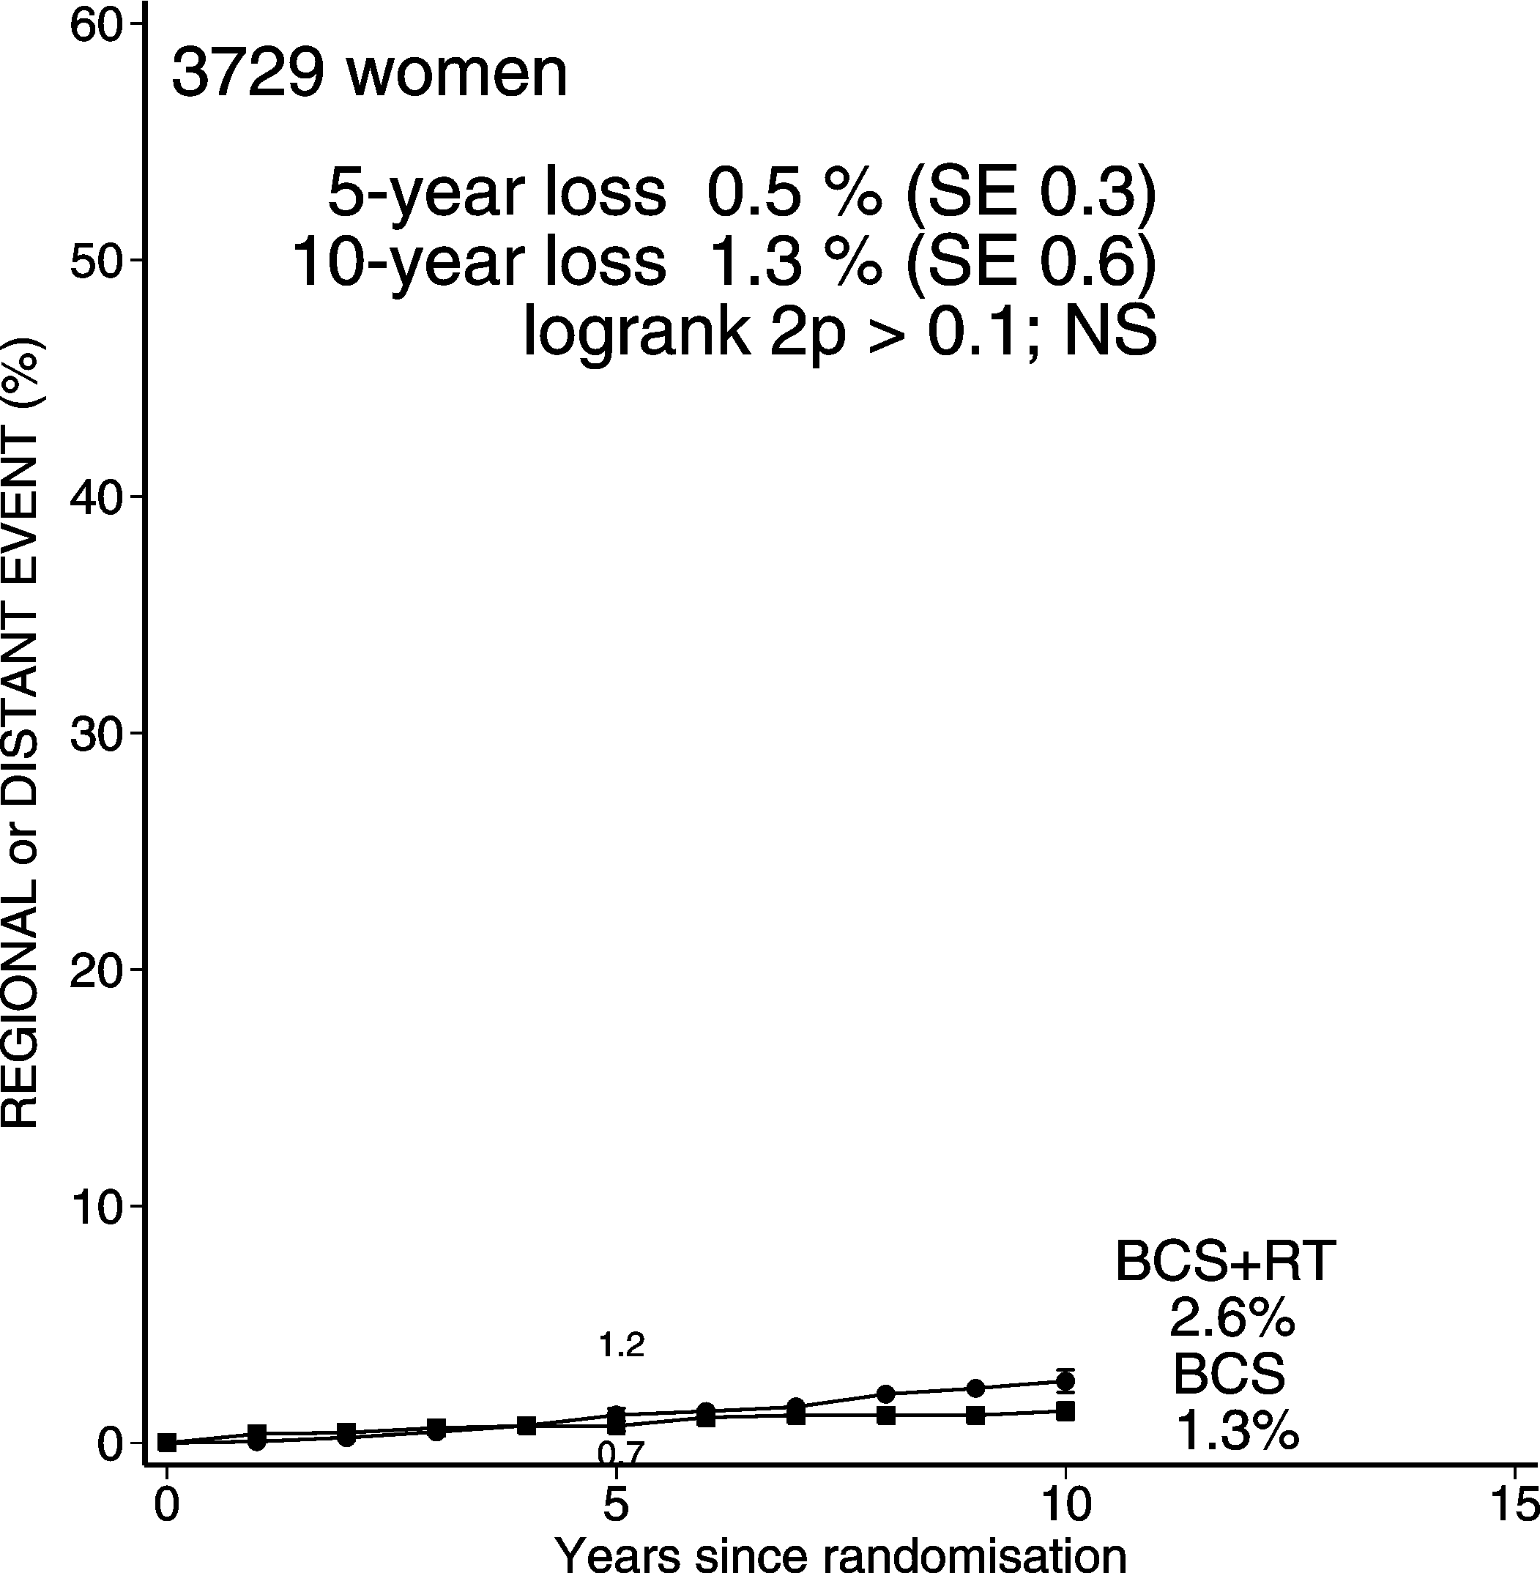
DCIS: BCS + RT vs. BCS 3729 women
Contralateral breast events Regional or distant events

Slide 29
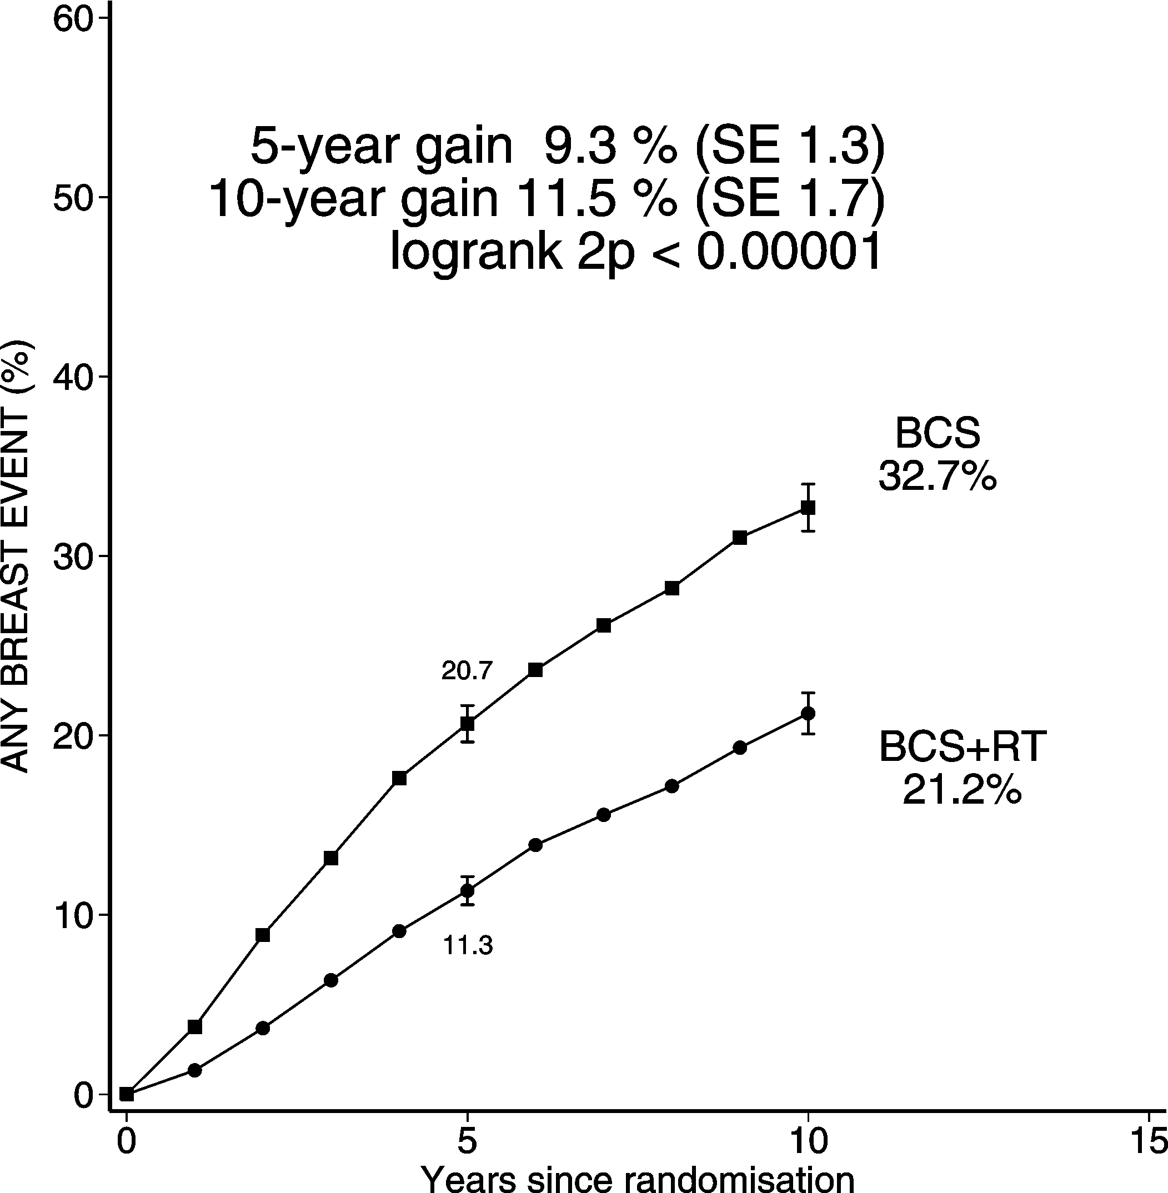
DCIS: BCS + RT vs. BCS 3729 women
Any breast event *
*ie ipsilateral or contralateral DCIS, ipsilateral or contralateral invasive cancer,
regional or distant metastasis, or death certified as due to breast cancer

Slide 30
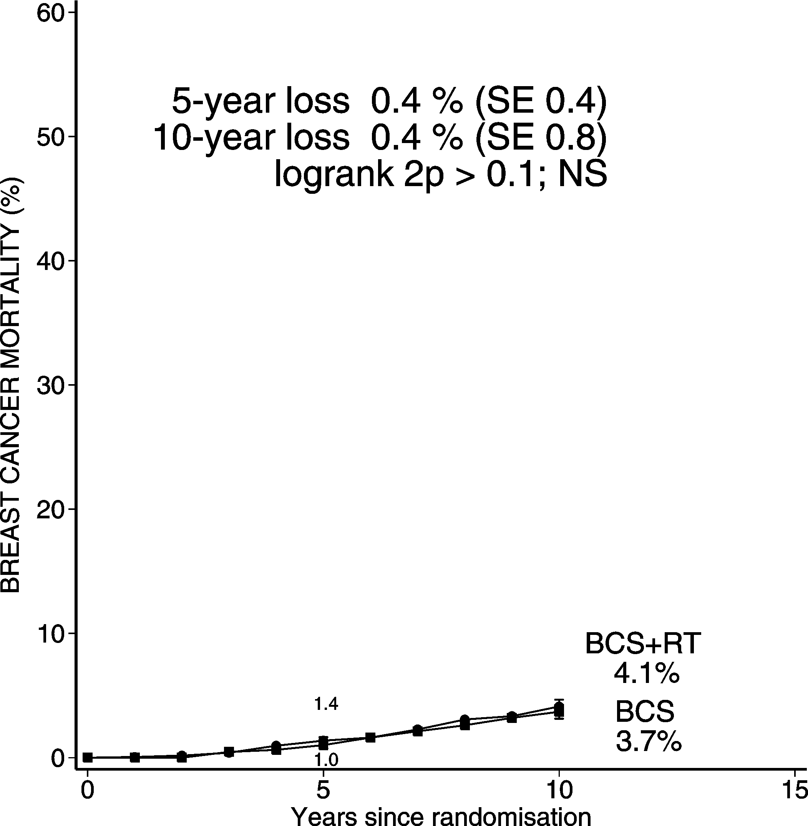
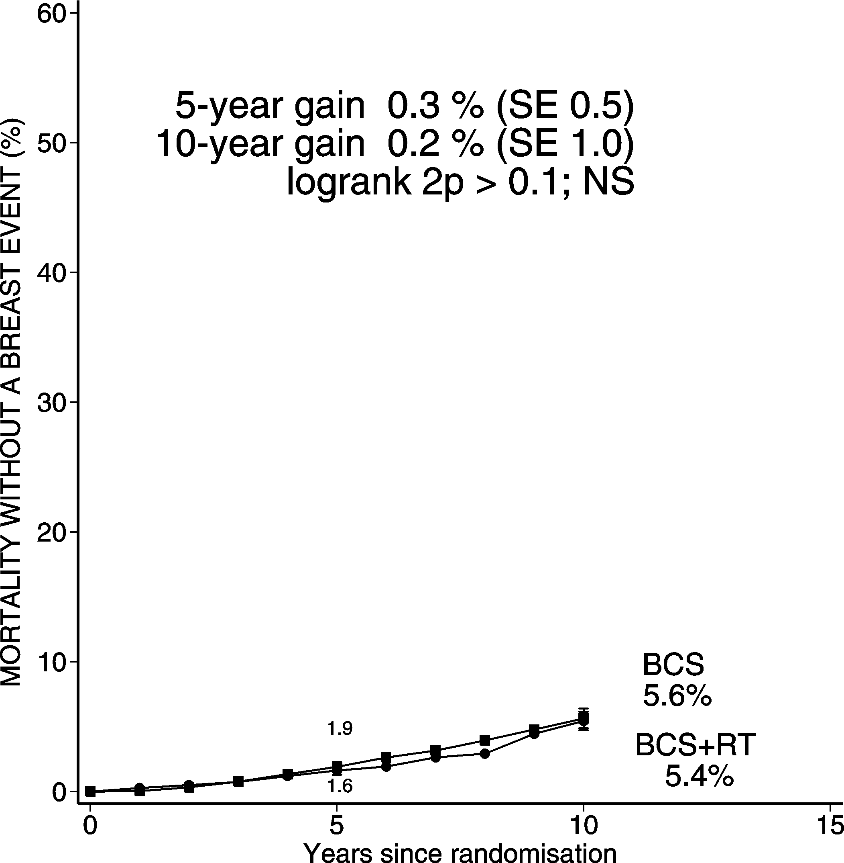
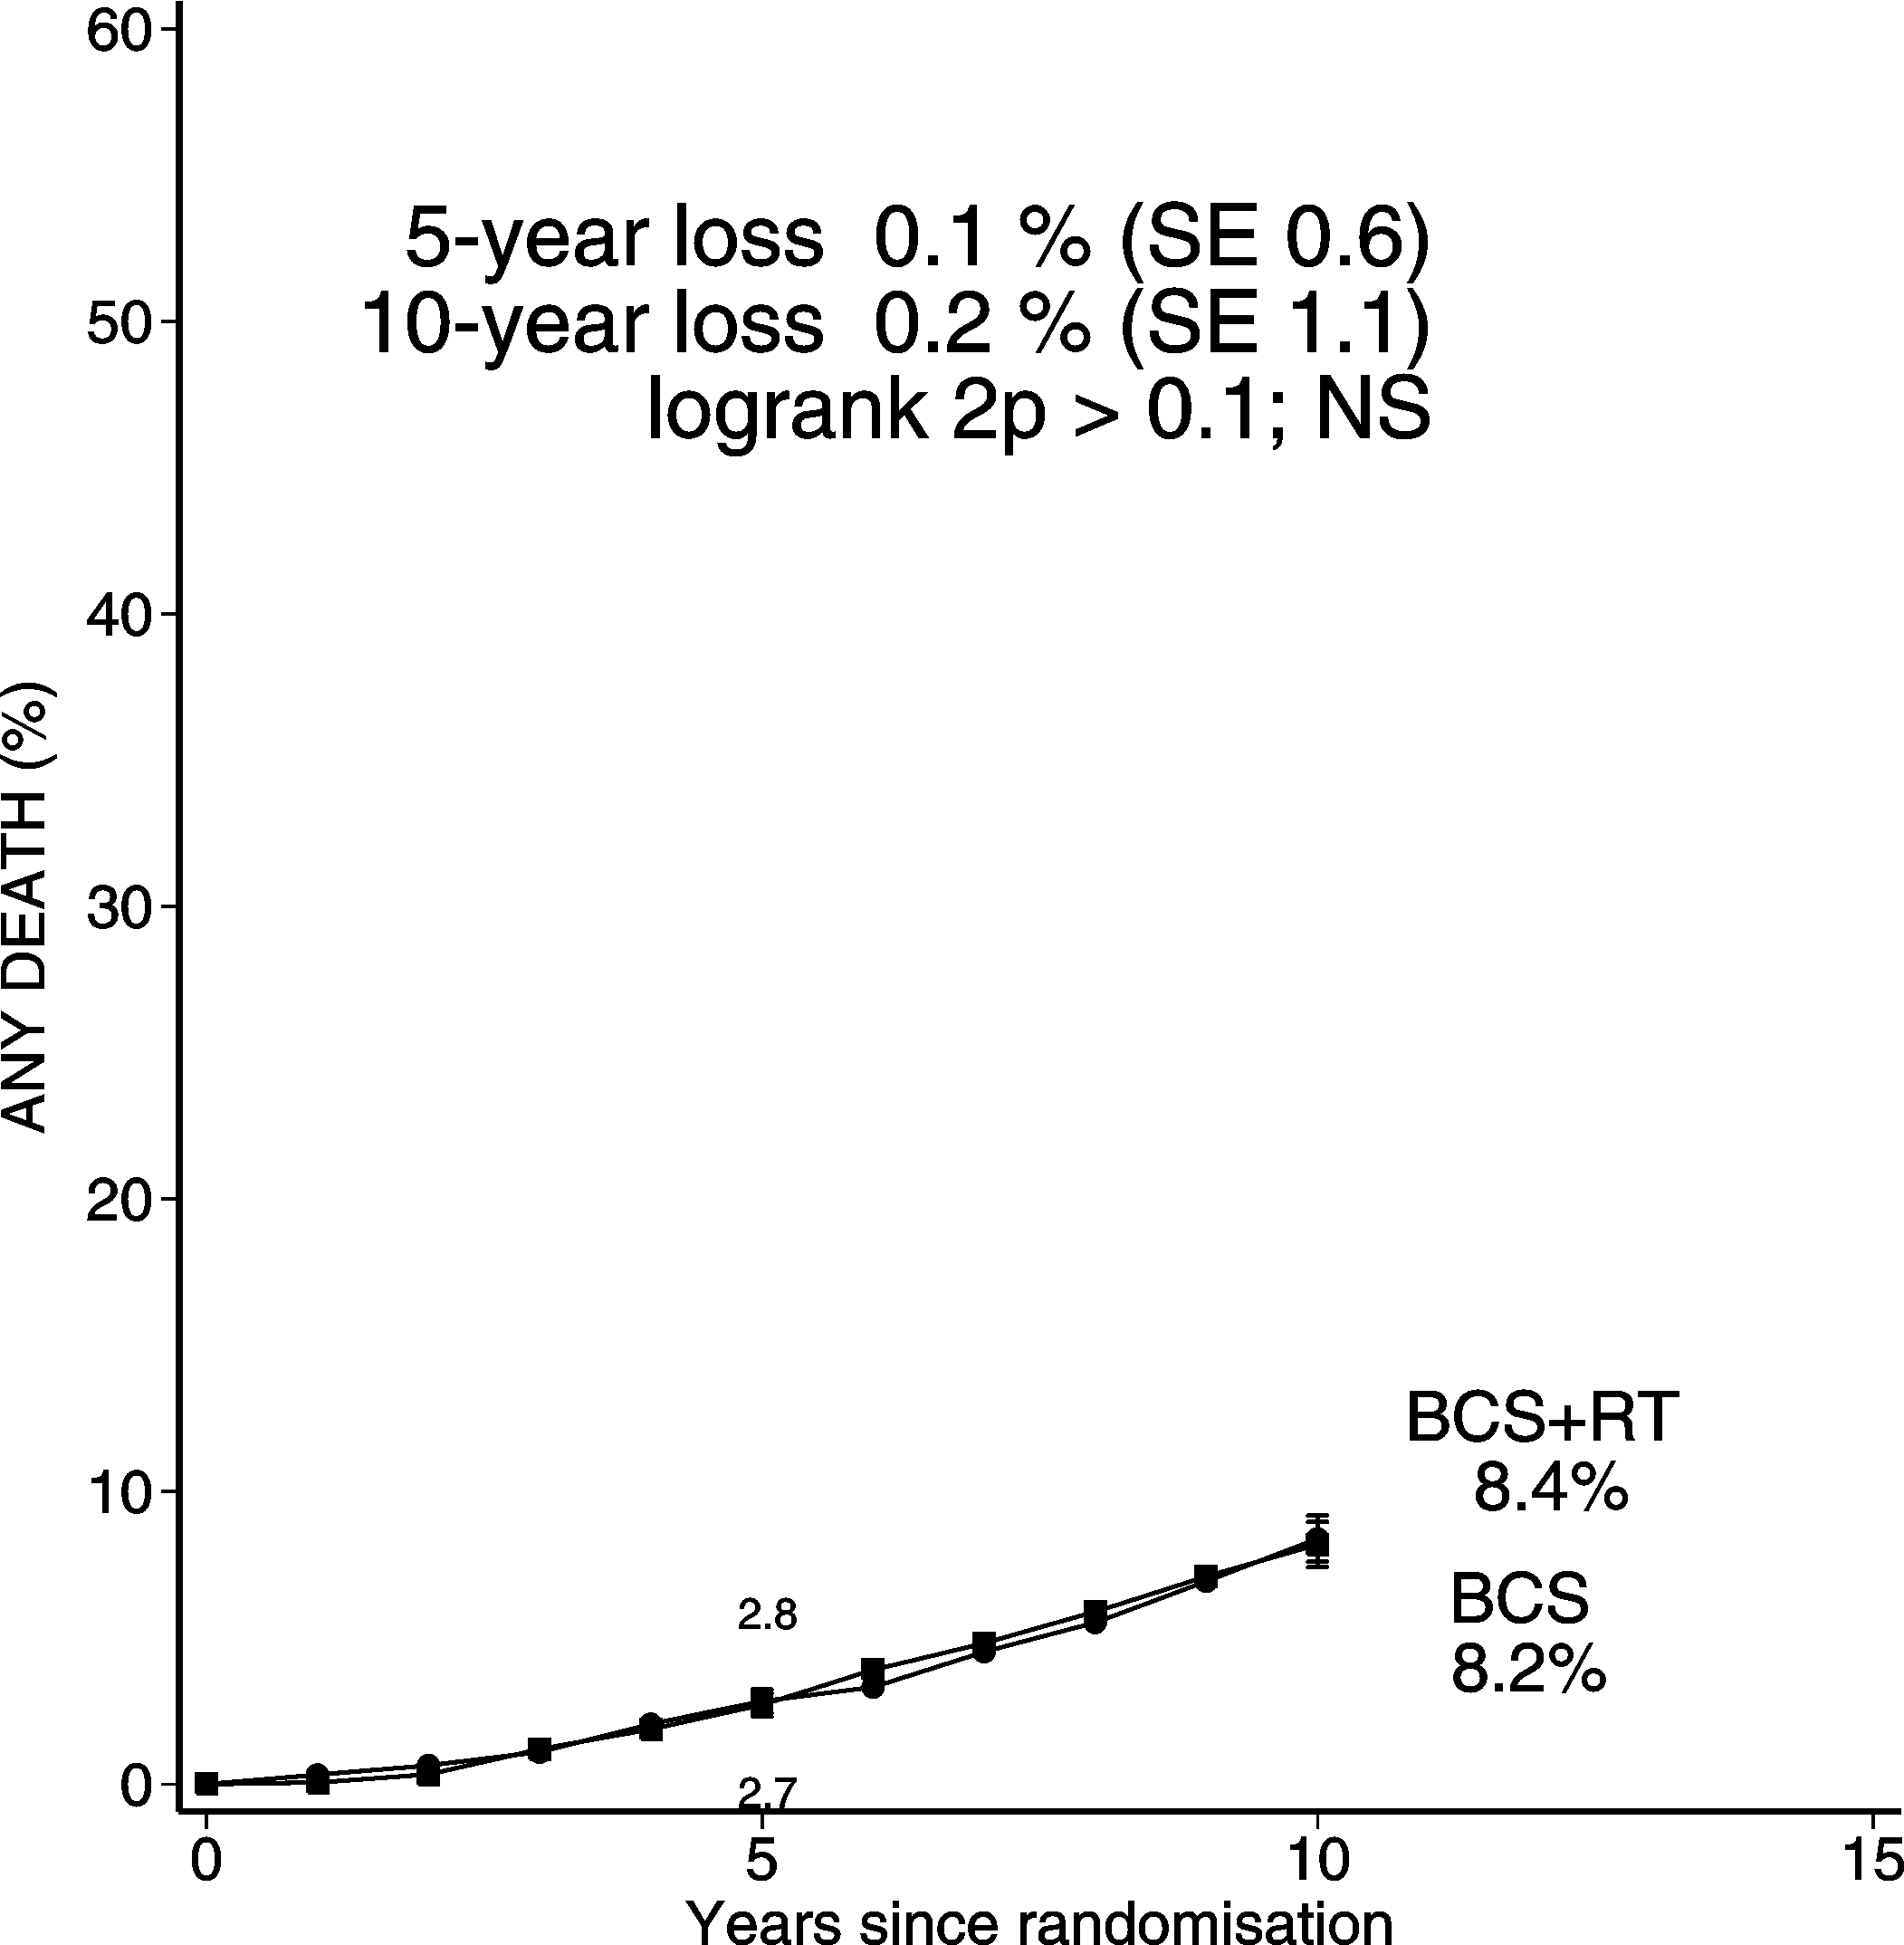
DCIS: BCS + RT vs. BCS 3729 women
Mortality with a breast event Mortality without a breast event Mortality from all causes

Slide 31
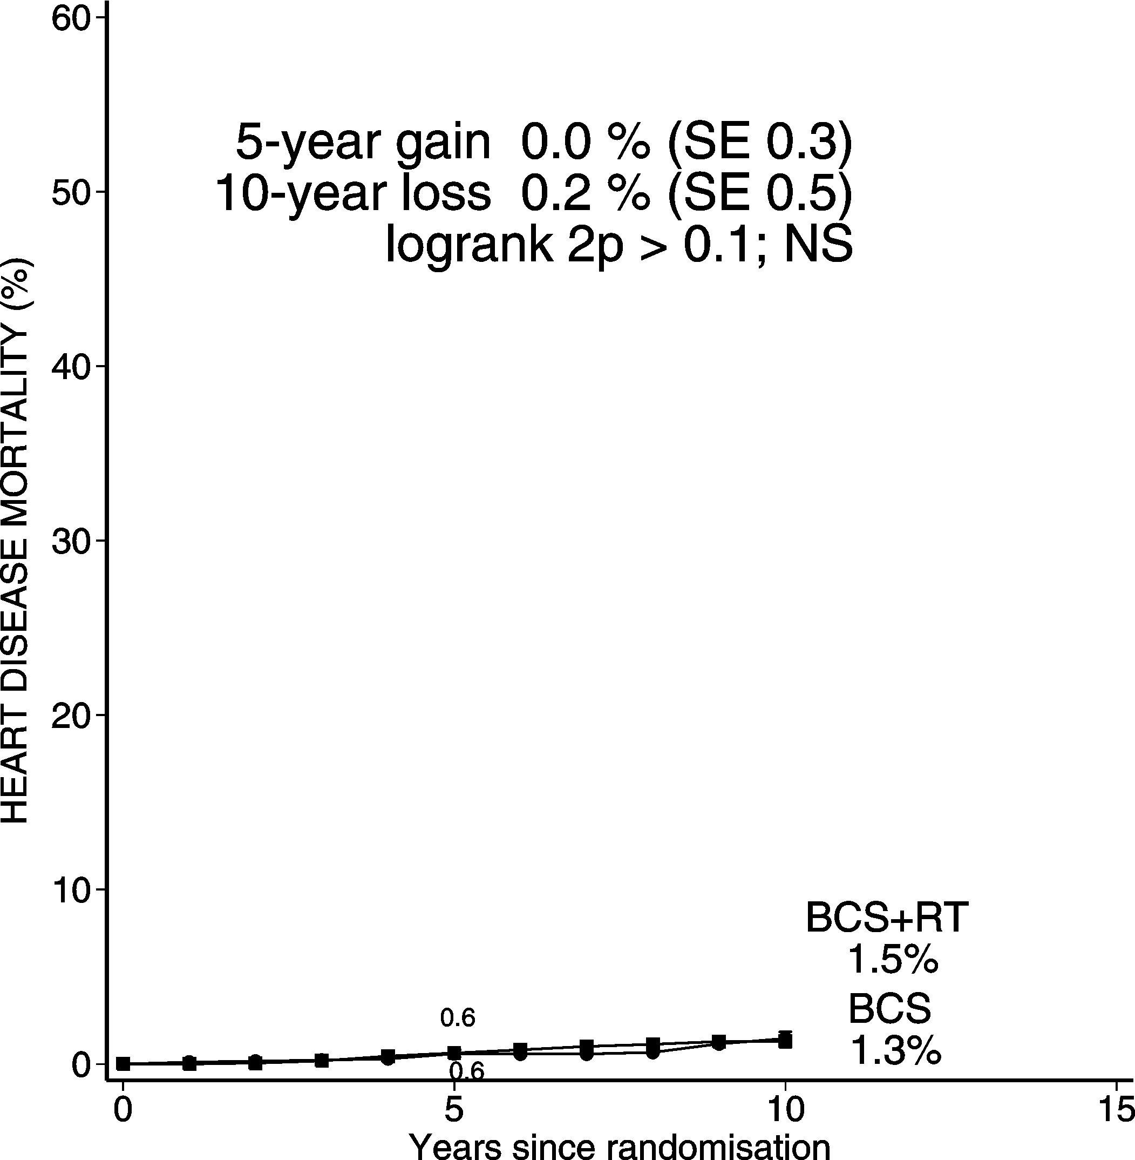
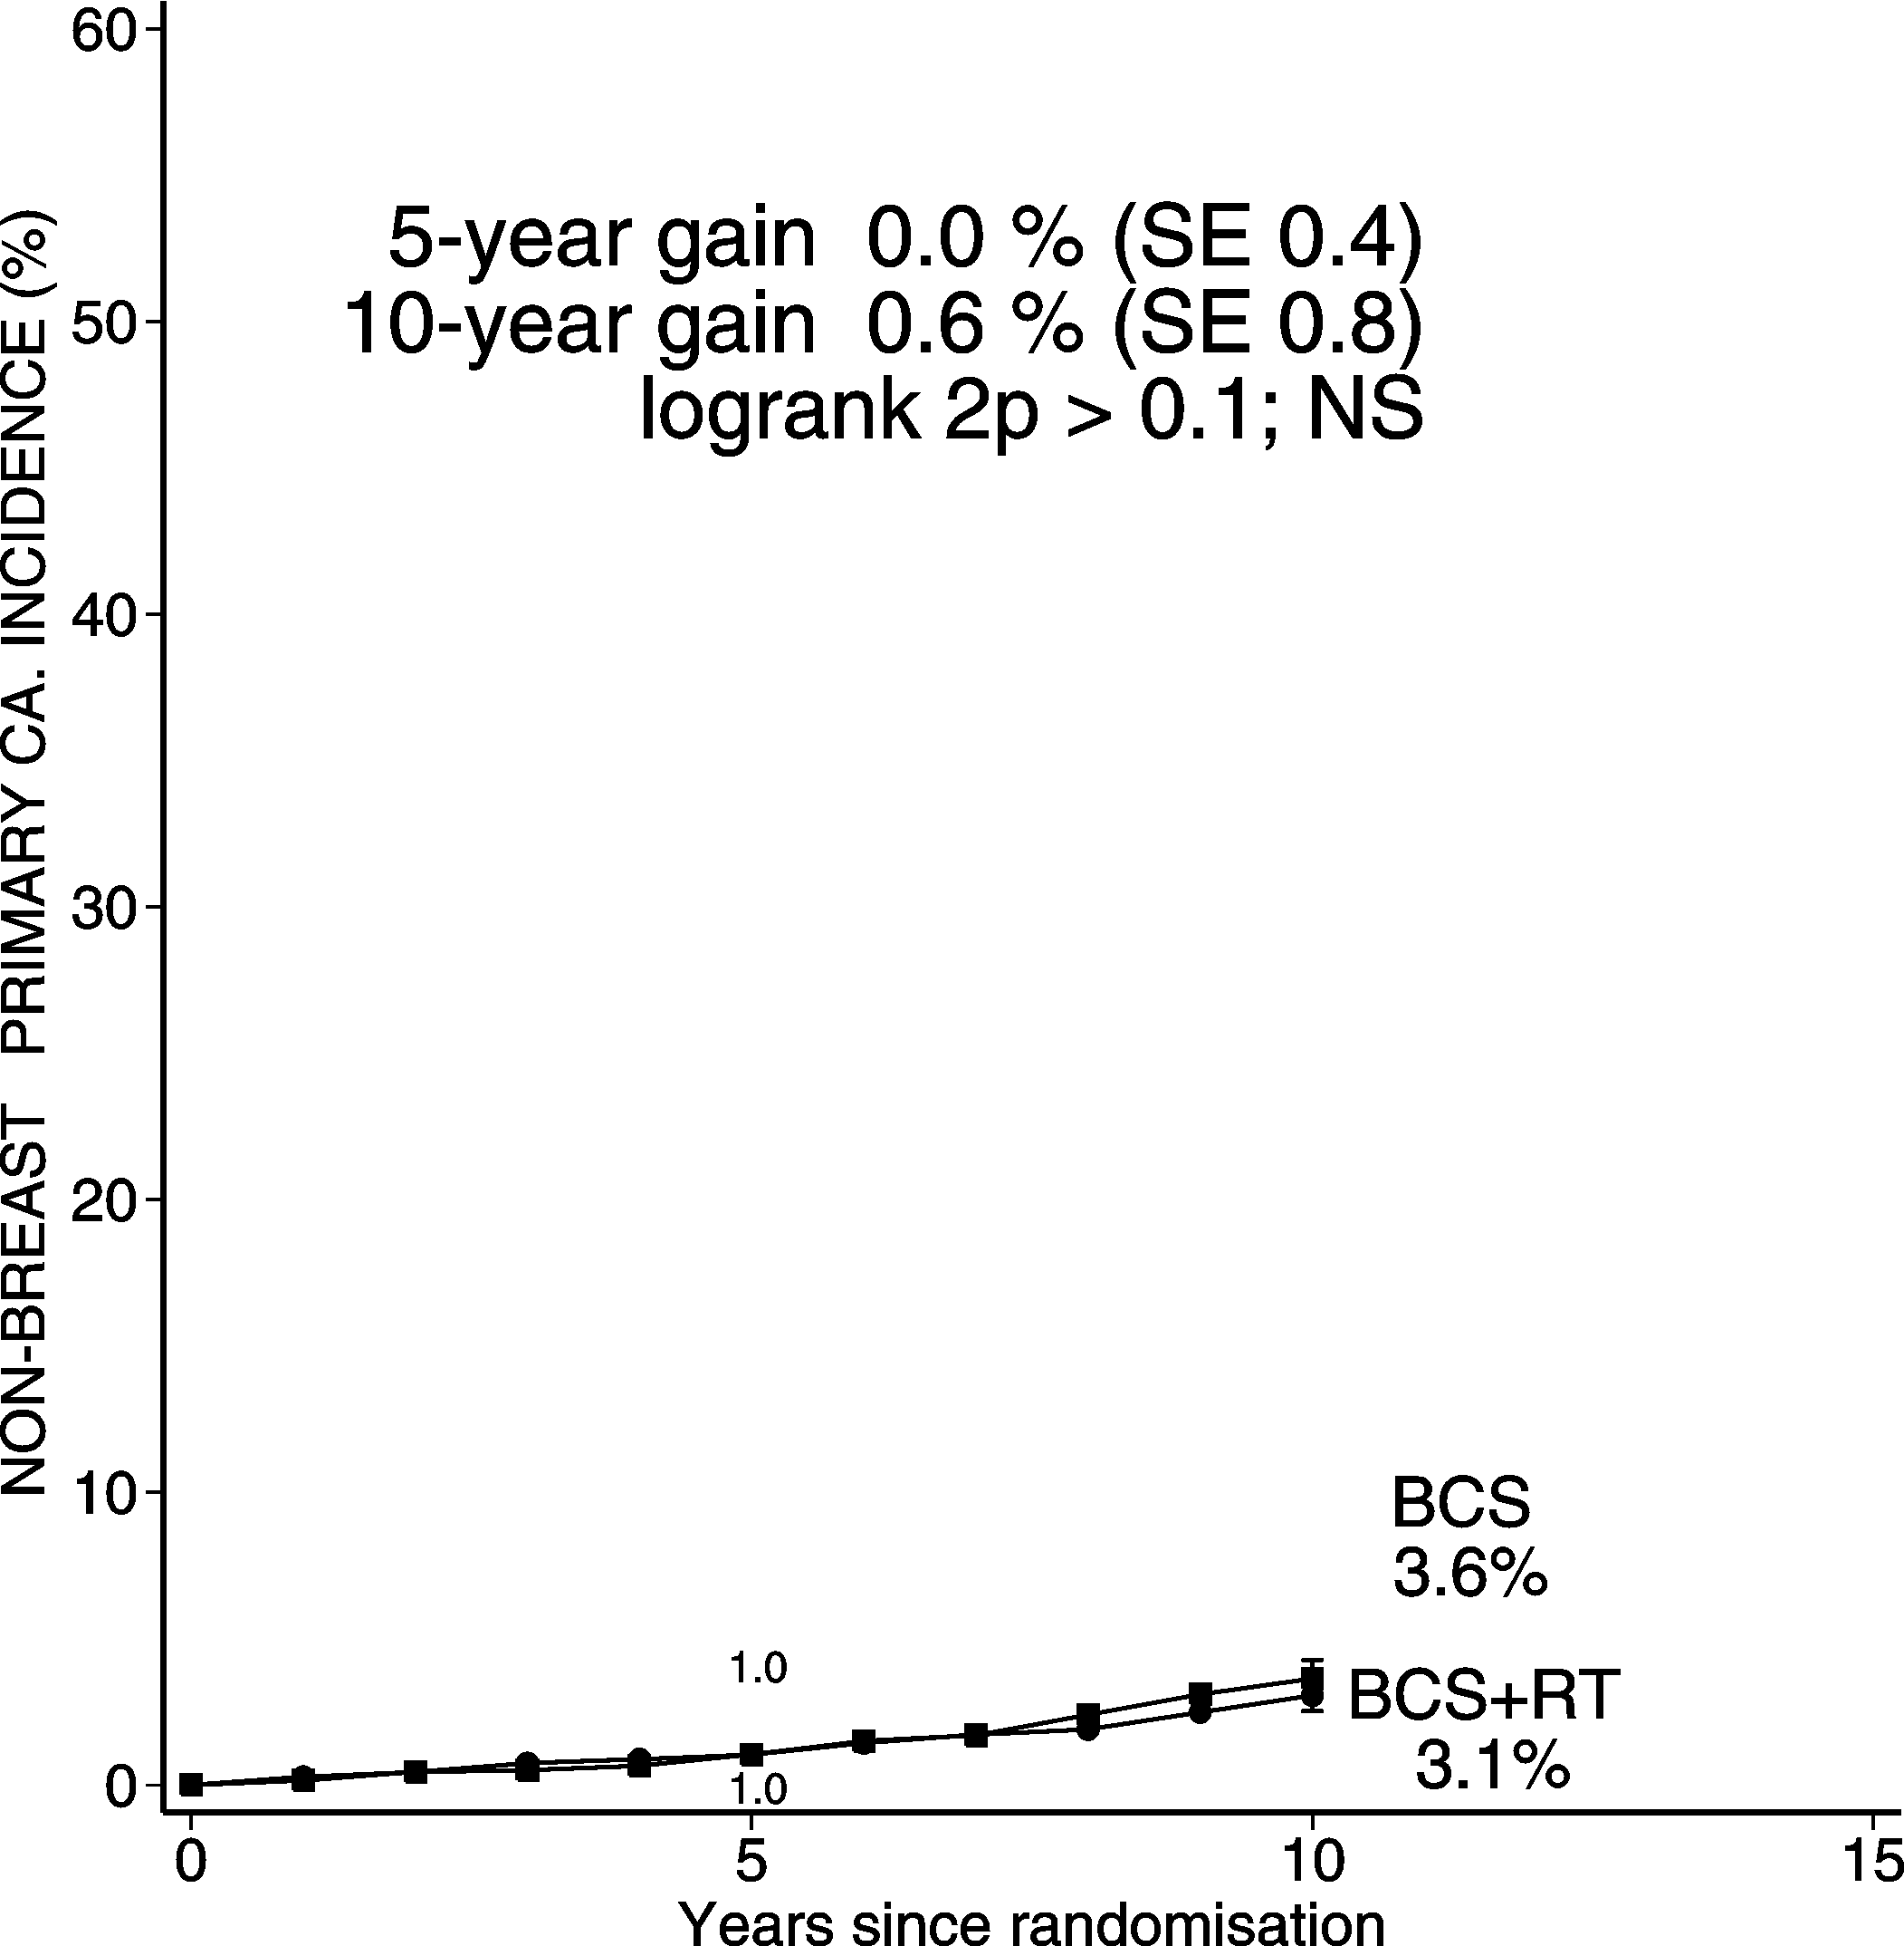
DCIS: BCS + RT vs. BCS 3729 women
Heart disease mortality Non-breast primary cancer incidence

Slide 32
EBCTCG analysis of radiotherapy in DCIS Conclusions
In these trials, radiotherapy halved the recurrence rate of either DCIS or invasive cancer in the ipsilateral breast. After 5 years the absolute gain was about 10% (18% vs. 8%) and after 10 years it was about 15% (28% vs. 13%).
The absolute gain in ‘low risk’ women was as large as in other other women.
The proportional reduction in the ipsilateral recurrence rate was greater in women aged 50+ years than in younger women.
Radiotherapy had no significant effect on mortality from breast cancer, at least to year 10.
In these data, radiotherapy had no significant adverse effect on cancers other than breast cancer, or on mortality from non-breast cancer causes, including heart disease.

