Slide 1
EBCTCG Steering Committee
Oxford, 18-19 September 2024

Slide 2
Chairs’ Update

Slide 3
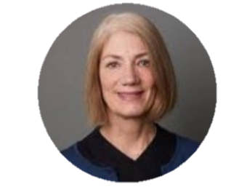
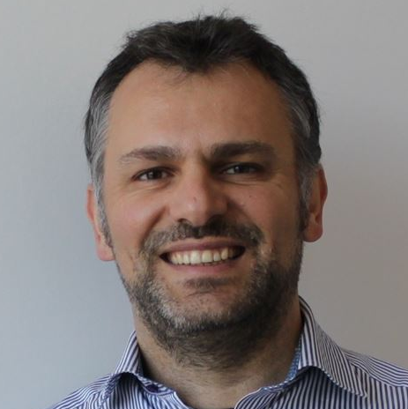
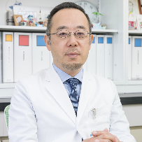
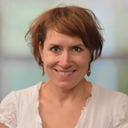
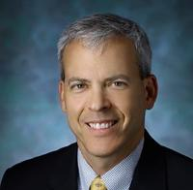
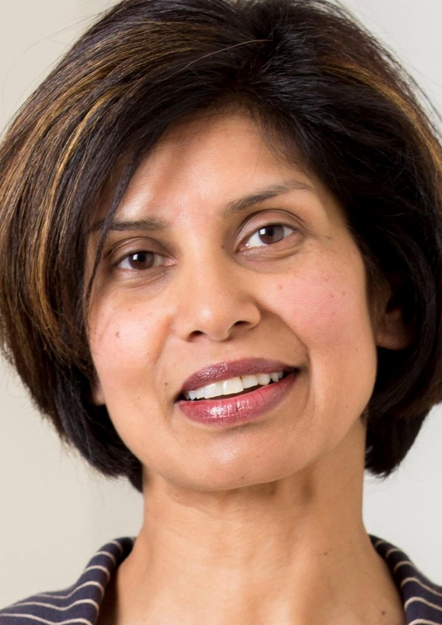
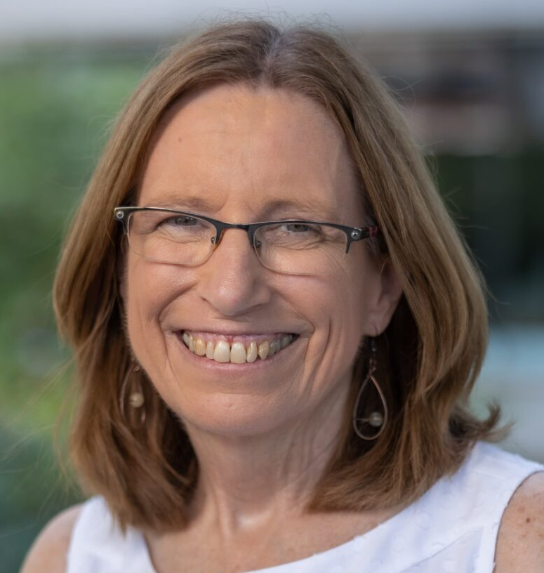
Changes to Steering Committee 2024
Welcome to new members of the Steering Committee
Karla Ballman Theodoros Foukakis Shigehira Saji Frederieke van Duijnhoven Antonio Wolff
- and new patient representatives
Almona Choudhury Patty Spears

Slide 4
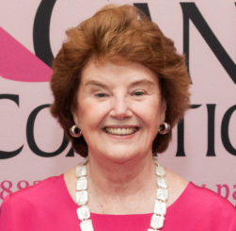
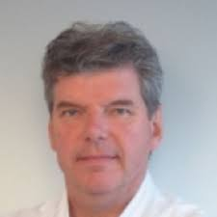
Changes to Steering Committee 2024
Thank you to those members stepping down
Pat Halpin-Murphy Emiel Rutgers

Slide 5
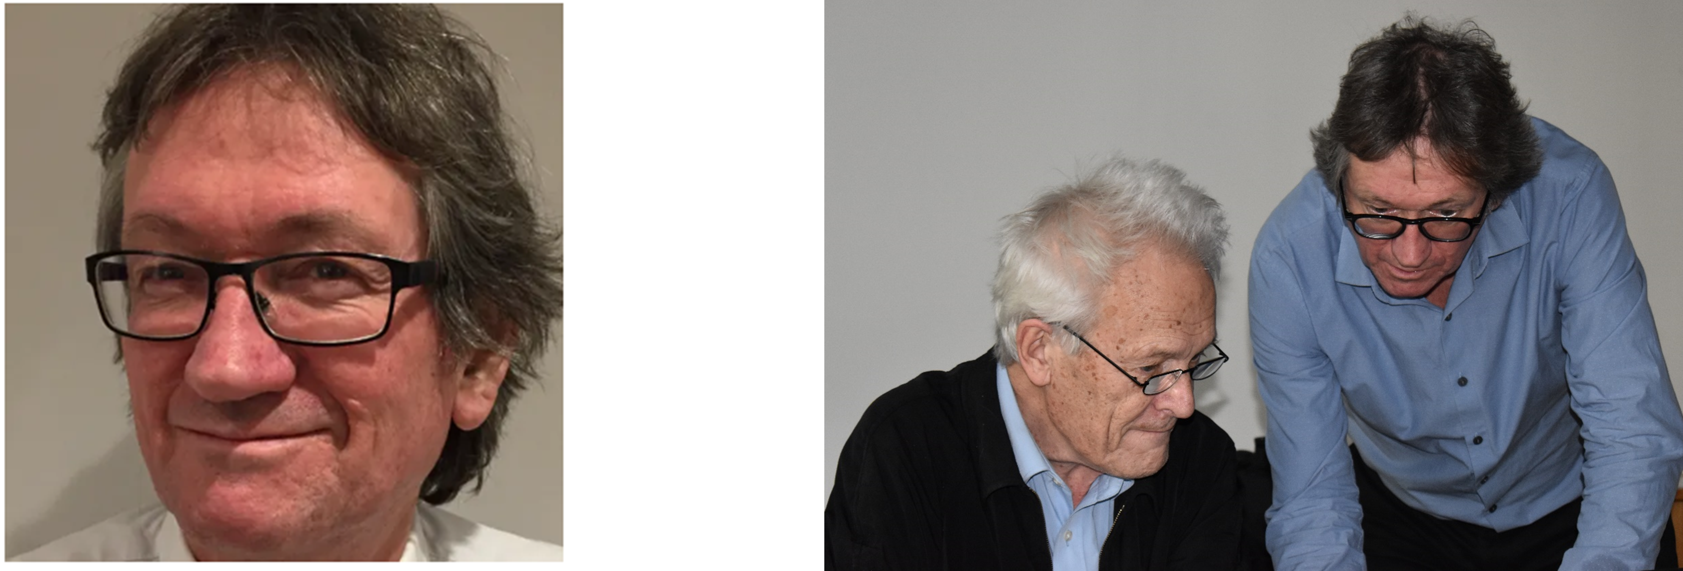
Richard Gray (1949-2023)

Slide 6
EBCTCG Progress Update

Slide 7
EBCTCG Secretariat 2024
EBCTCG co-chairs and vice-chair
Jonas Bergh Sandra Swain David Cameron
EBCTCG Secretariat
Graham Beake Richard Berry Clare Boddington Rosie Bradley
Jeremy Braybrooke Mike Clarke David Dodwell Vaughan Evans
Lucy Gettins Jon Godwin Robert Hills Sam James
Amanda Kerr Hui Liu Liz MacKinnon Paul McGale
Theresa McHugh Philip Morris Mariko Nakahara Hongchao Pan
Richard Peto Carolyn Taylor
Fran Duane Francesca Holt Gurdeep Mannu Karen Taylor

Slide 8
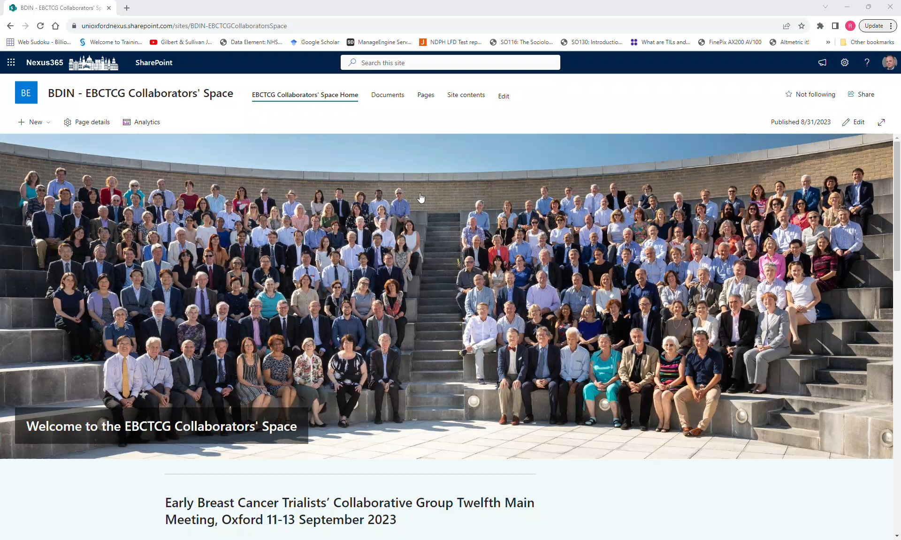
New collaborators’ space
Replaces old obsolete version

Slide 9
New collaborators’ space
New version went live March 2024 to Steering Committee members only
Some members reported difficulties – this may be related to having their own Institutional Sharepoint Website
We think we have a solution involving private browsing – we have asked some colleagues to test it – more details when we know it works

Slide 10
EBCTCG Work Update 2023-4
Concentrated on completing the work Richard Gray was working on – manuscripts either submitted or nearly ready
  Extended endocrine therapy with AIs
  Ovarian ablation/suppression
  Surgery
  Plus finalising work on axilla
  Updates later in session

Slide 11
EBCTCG Funding
EBCTCG applied for funding to Cancer Research UK in 2023
In December, we were invited to resubmit this year
Interview 26 September – hear in late November
Funding is less than last cycle £5 million -> £2.5 million
  Therefore also applied to BCRF

Slide 12
Funding application
1. Local therapy
2. Chemotherapy
3. Targeted agents (incl. hormonal)
4. Translational
5. Methodology
Programme grant for five interlinked workpackages

Slide 13
Meeting format
Format reflects the fact that we are moving to a new period with new meta-analyses
We will present an update on work completed over the last year
For each succeeding session we will present our plans – completing ongoing work, and new meta-analyses
Additional time for discussion compared to previous years

Slide 14
Data Update - September 2024
Data available for analysis on:
  725,000 women in 648 treatment trials
  176,000 recurrences; 192,000 deaths; 530,000 survivors
  5.9 million woman-years of follow-up
Plus >600,000 women in breast cancer screening trials

Slide 15
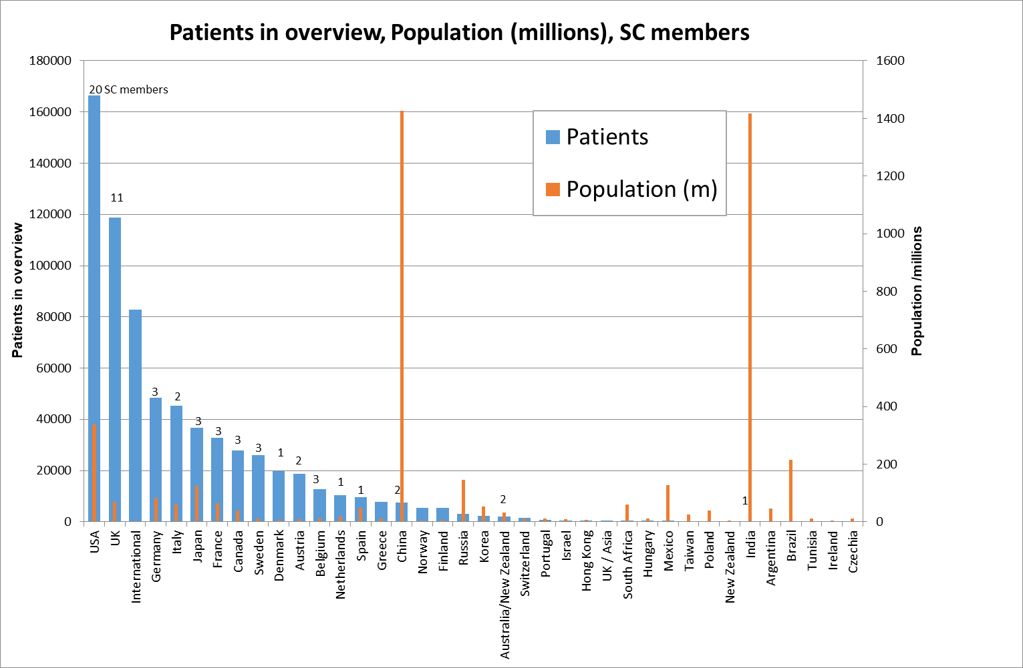
Number of women with data by country
International groups: EORTC/IBCSG/TRIO/
TEAM/Pharma

Slide 16
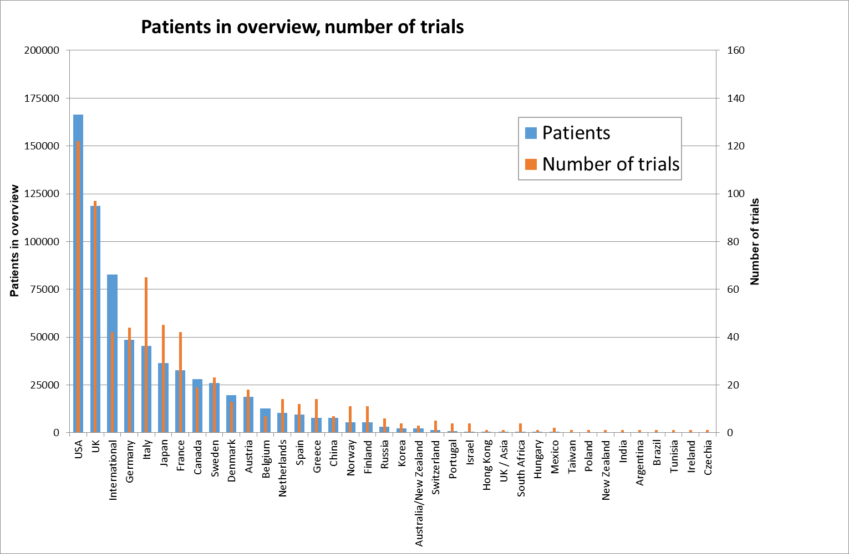
Number of women with data by country
International groups: EORTC/IBCSG/TRIO/
TEAM/Pharma

Slide 17
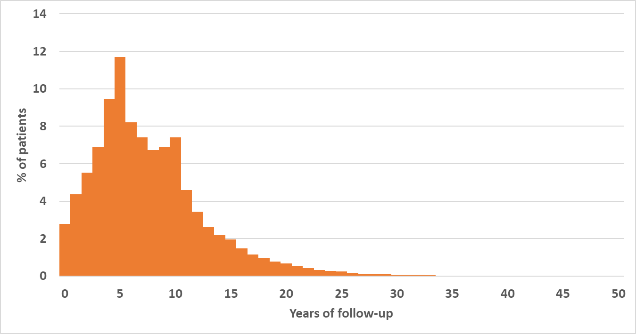
Number of years of follow-up per participant
Median FU 9 yrs
Upper quartile 12.3 yrs

Slide 18
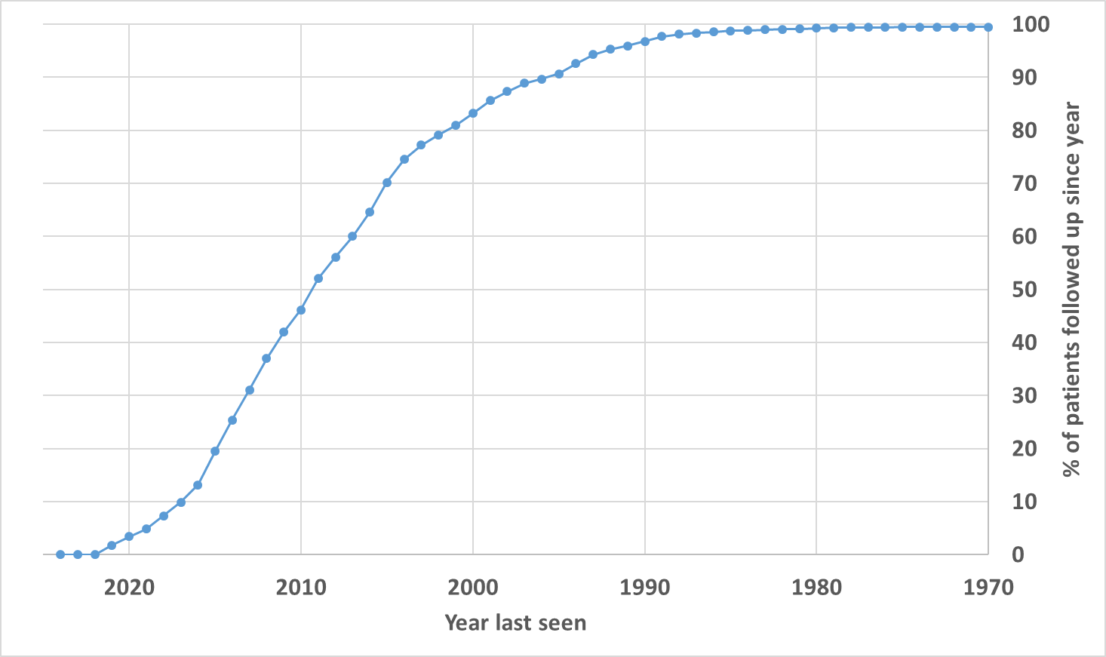
Proportion of living participants by year of FU

Slide 19
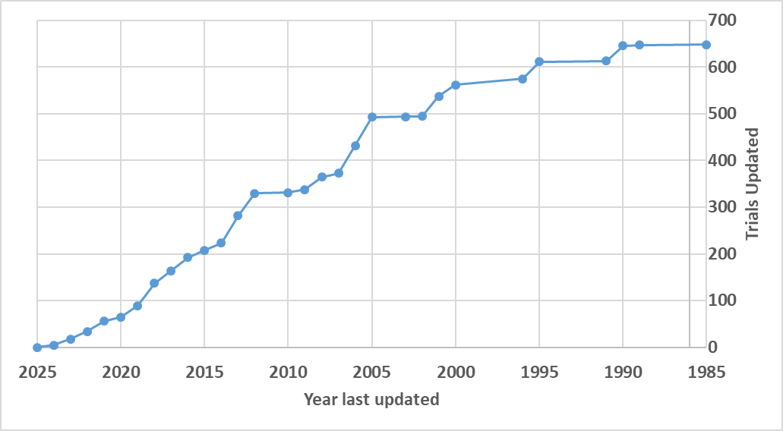
Year of last update (number of trials)

Slide 20
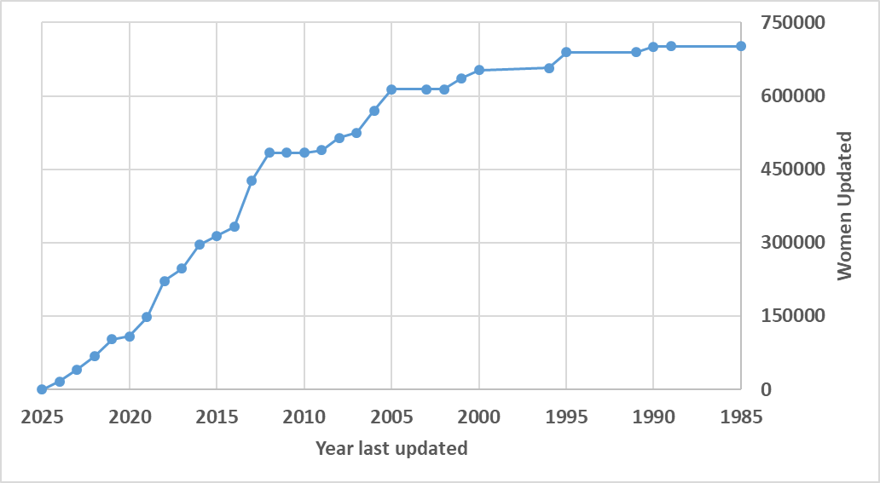
Year of last update (no. of women updated)

Slide 21
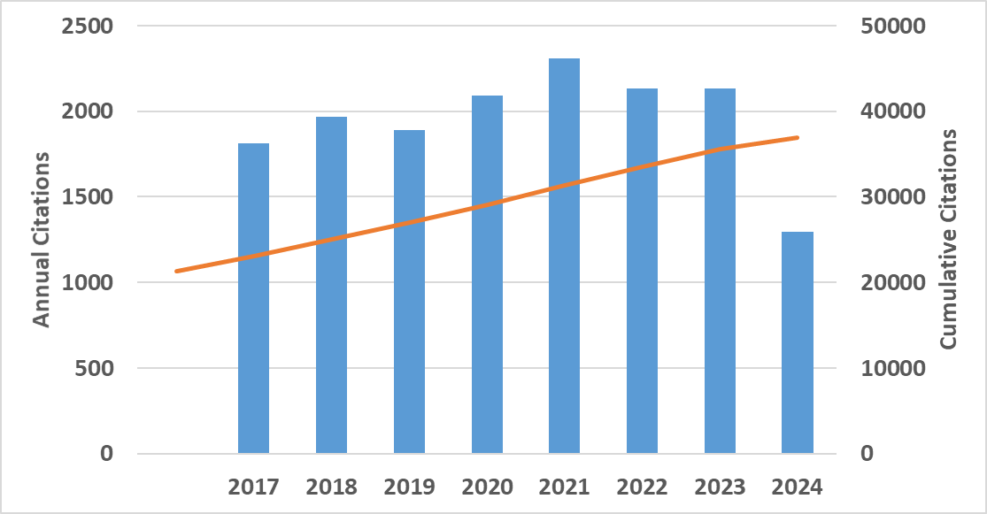
Citation update
The 27 EBCTCG publications (1984-2023) have 37,000 citations
14,000 citations since 2018

Slide 22
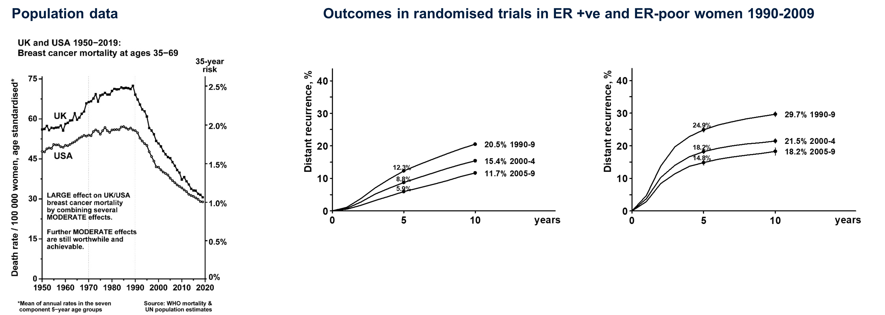
Changing landscape of patient outcomes
Outcomes in randomised trials in EBCTCG database 1990-2009
ER-positive disease, ≥5 yrs ET ER-negative disease

Slide 23
Reasons for improving trial outcomes
Combination of factors:
  Changing population in trials – notably more node-negative disease
  Better therapies
  These two aspects together account for 80-90% of the improvement
  Plus other unquantifiable factors

Slide 24
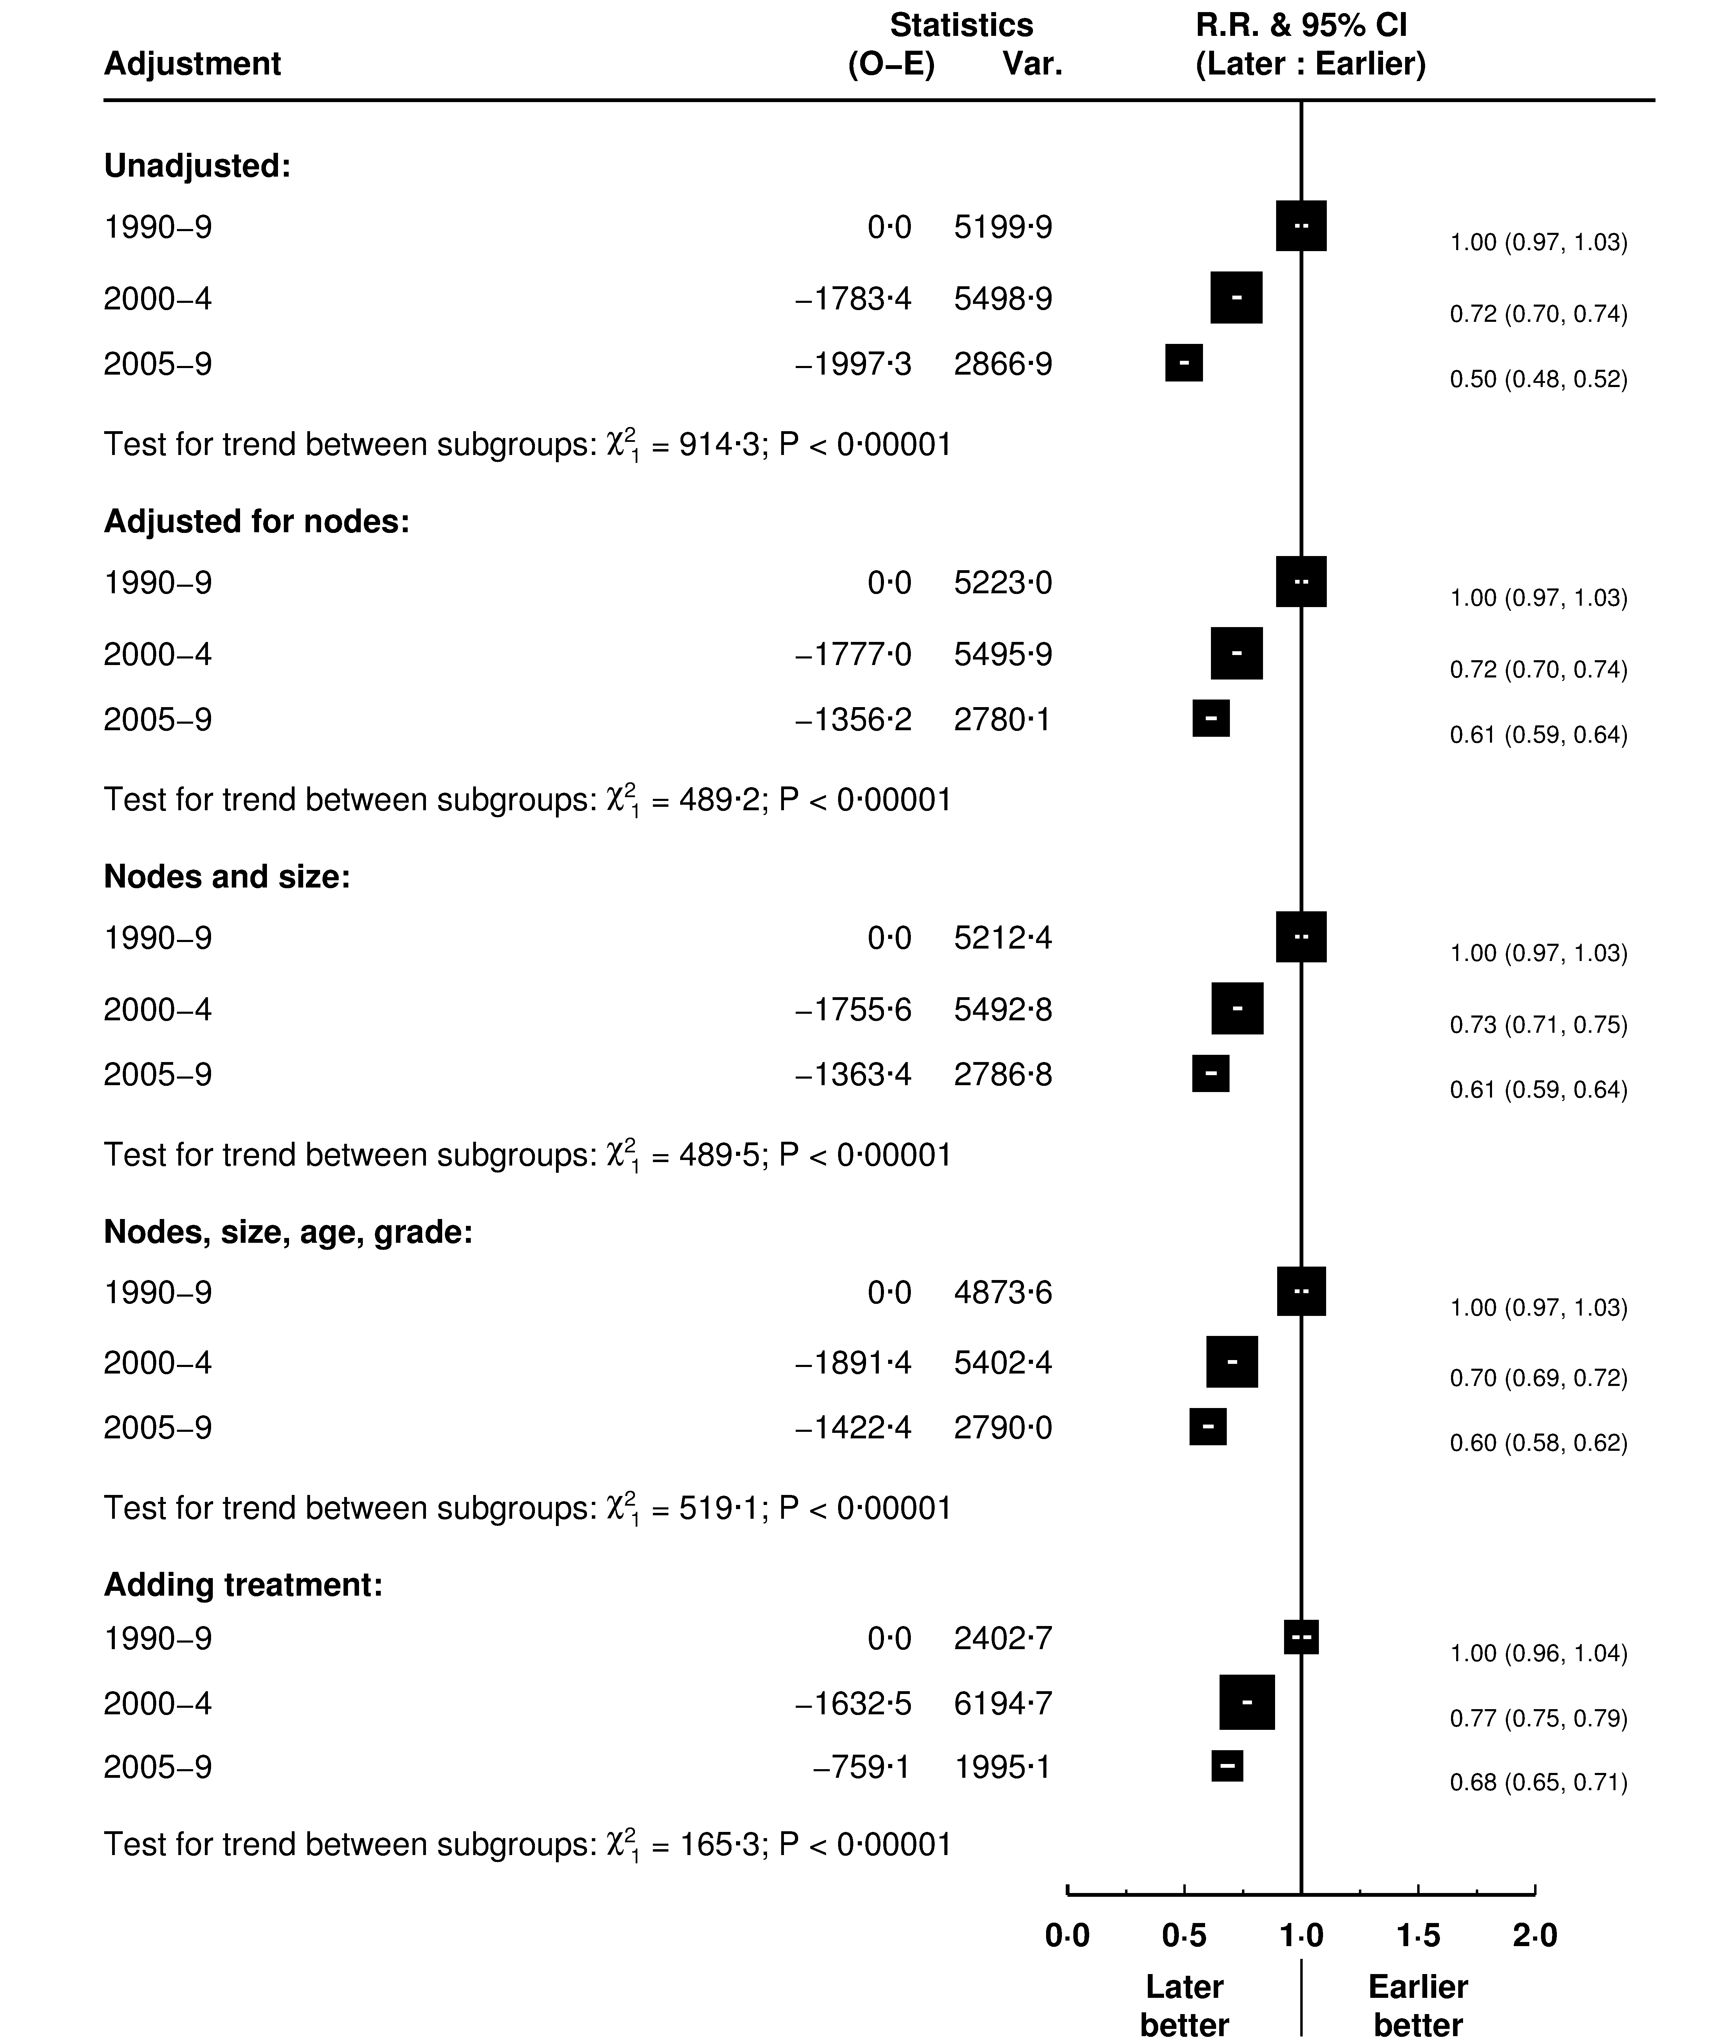
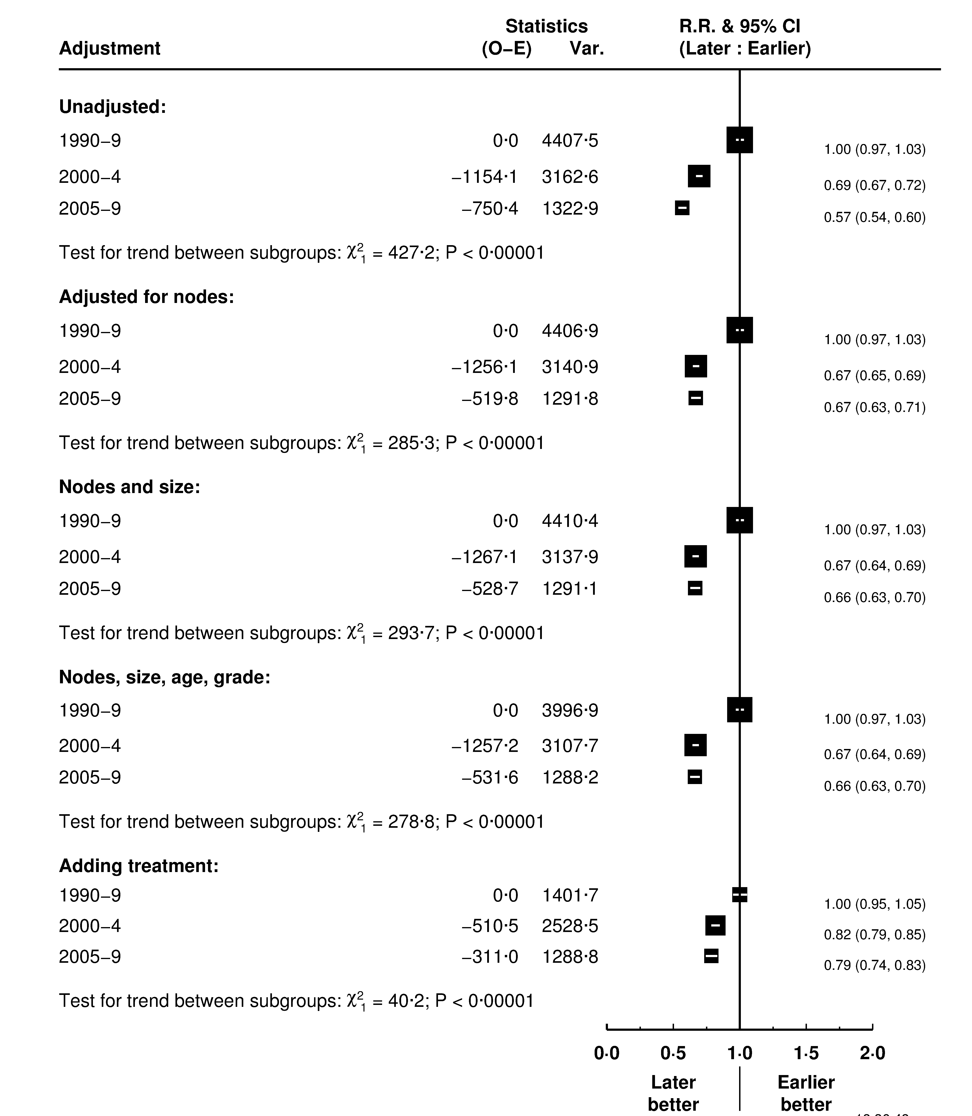
Women with ER-positive disease Women with ER-negative disease

Slide 25
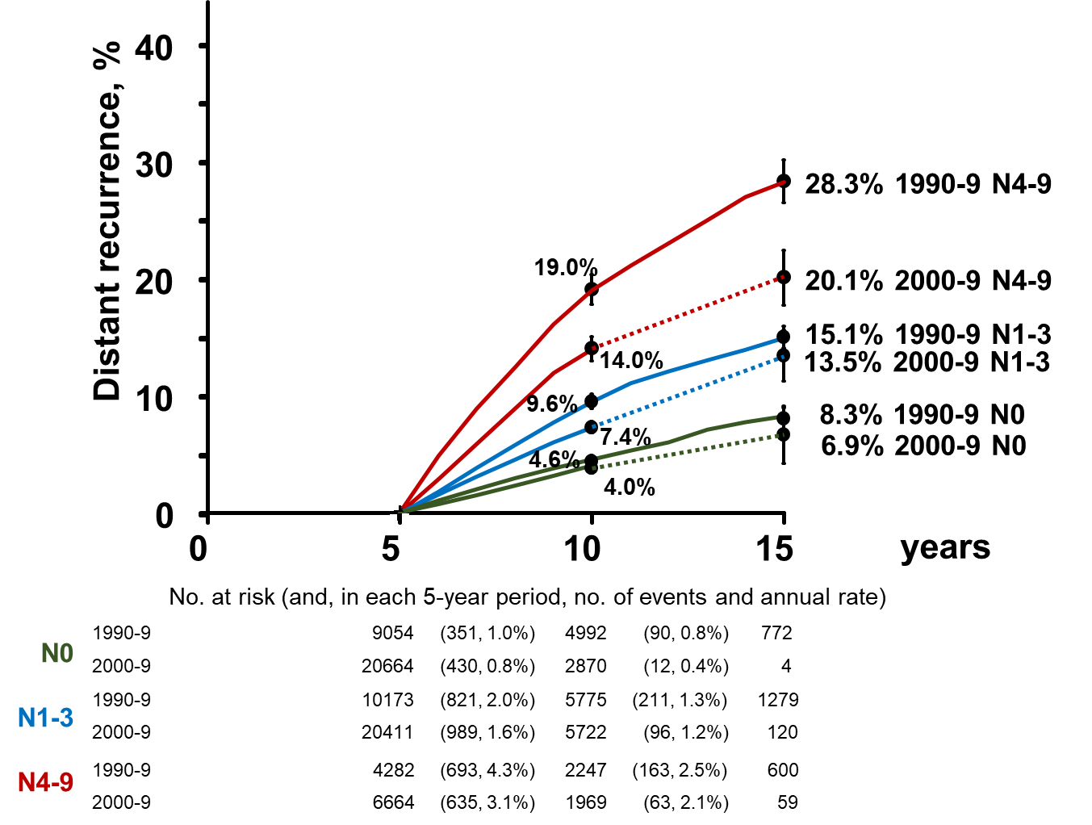
Women with ER+ disease, after 5years ET

