Slide 1
EBCTCG Progress Update

Slide 2
EBCTCG Secretariat 2023
EBCTCG co-chairs and vice-chair
Jonas Bergh Sandra Swain David Cameron
EBCTCG Secretariat
Graham Beake Richard Berry Clare Boddington Rosie Bradley
Jeremy Braybrooke Mike Clarke David Dodwell Vaughan Evans
Lucy Gettins Jon Godwin Richard Gray Robert Hills
Sam James Amanda Kerr Hui Liu Liz MacKinnon
Paul McGale Theresa McHugh Philip Morris Mariko Nakahara
Hongchao Pan Richard Peto Carolyn Taylor Hannah Taylor
Fran Duane Francesca Holt Gurdeep Mannu

Slide 3
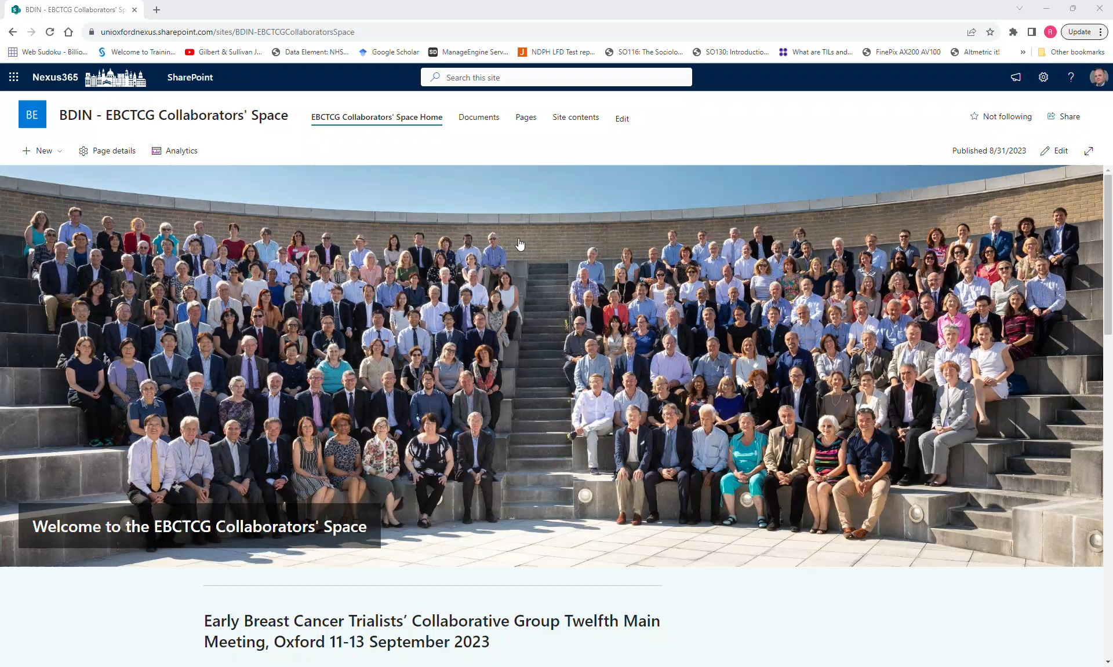
Coming soon – new collaborators’ space
Phased rollout of site over the next month – look out for your invitation

Slide 4
As of September 2023
Data available for analysis on:
  717,000 women in 642 treatment trials
  176,000 recurrences; 190,000 deaths; 525,000 survivors
  5.8 million woman-years of follow-up
Plus >600,000 women in breast cancer screening trials

Slide 5
By comparison
In the 1985 first cycle of the EBCTCG meta-analyses
About 40,000 women
28 trials of tamoxifen
40 trials of chemotherapy

Slide 6
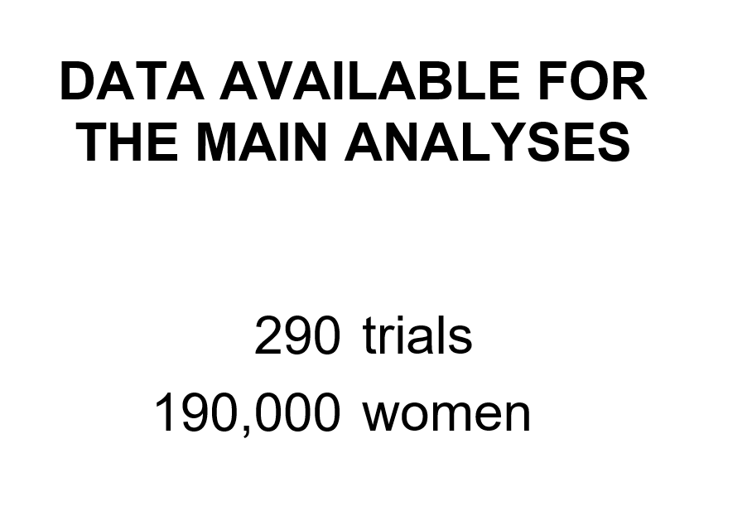
By comparison
The same slide (or OHP transparency) from 2000….

Slide 7
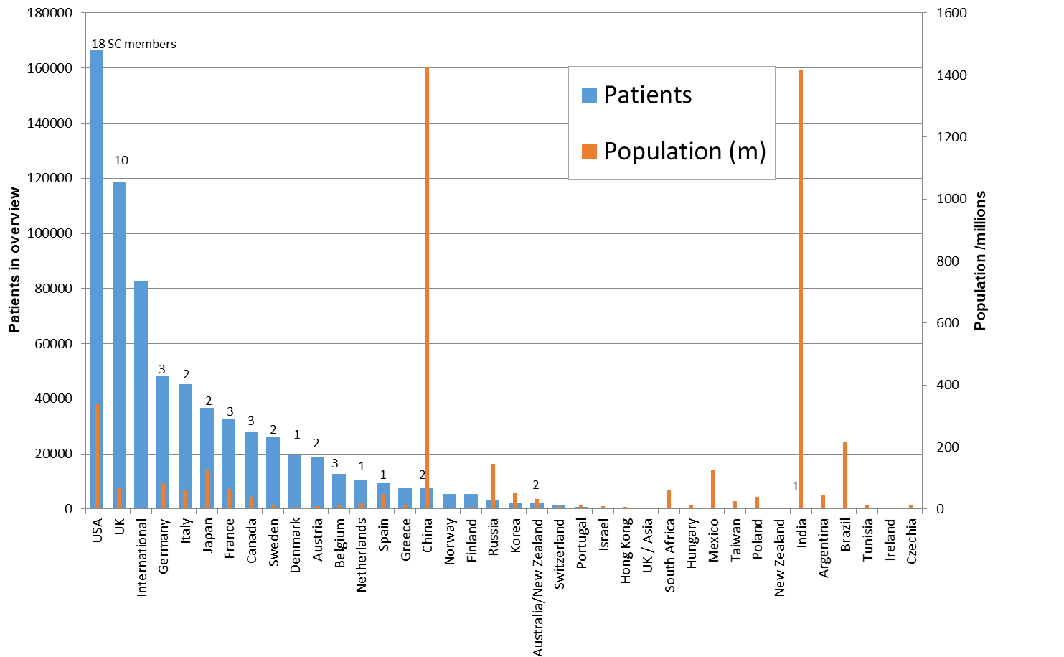
Number of women with data by country
International groups: EORTC/IBCSG/TRIO/
TEAM/Pharma

Slide 8
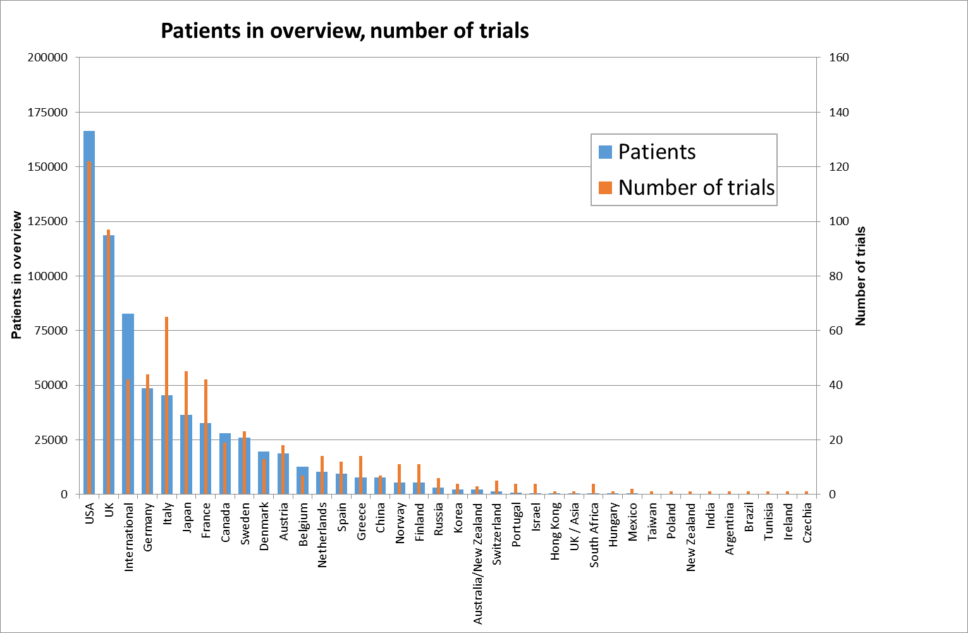
Number of women with data by country
International groups: EORTC/IBCSG/TRIO/
TEAM/Pharma

Slide 9
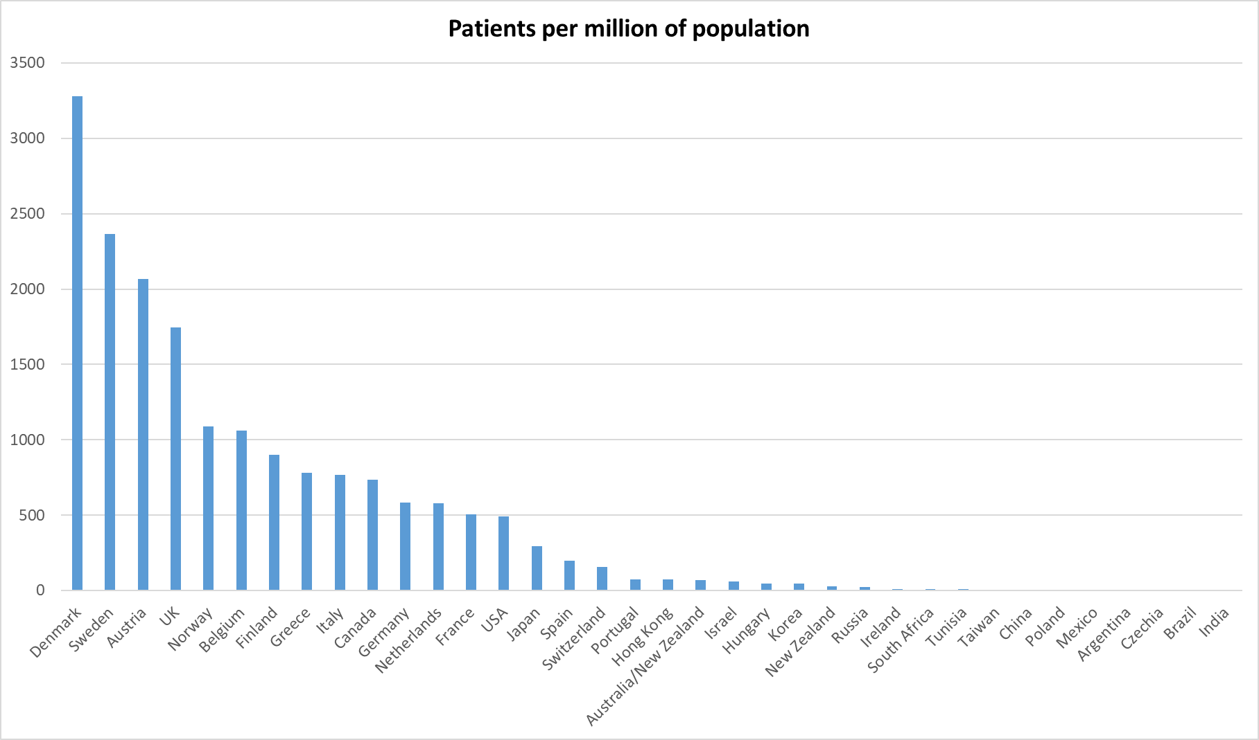
Number of women with data by country

Slide 10
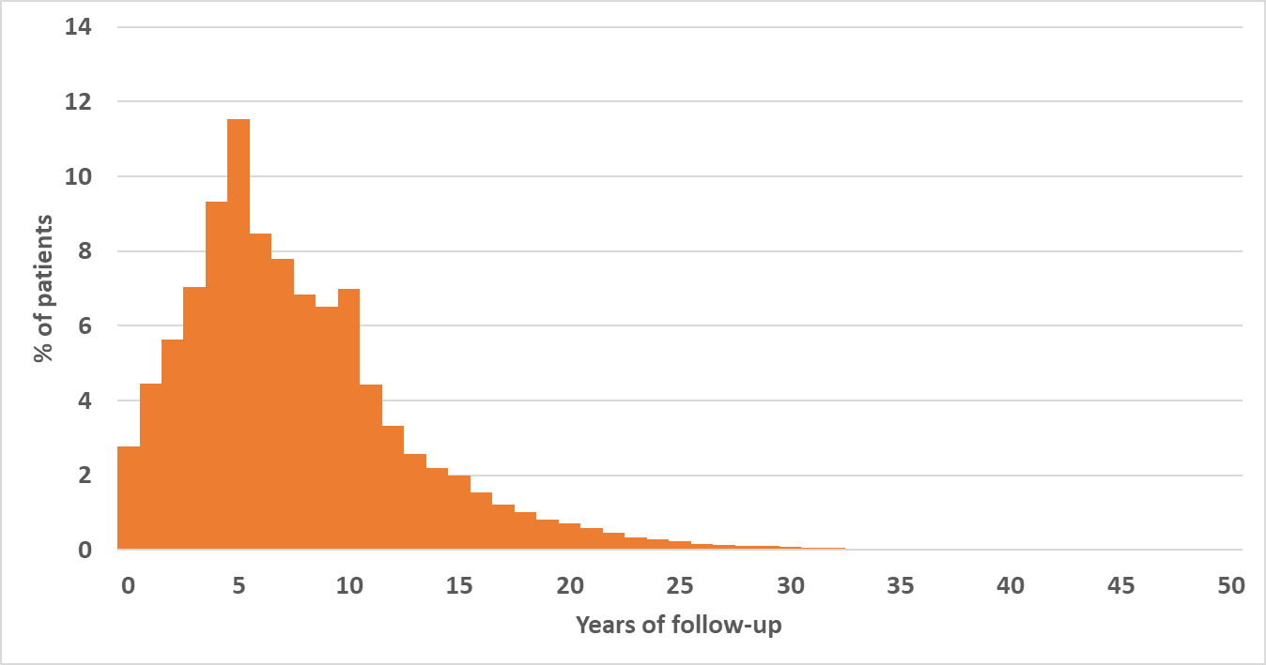
Number of years of follow-up per participant
Median FU 8.9 yrs
Upper quartile 12.3 yrs

Slide 11
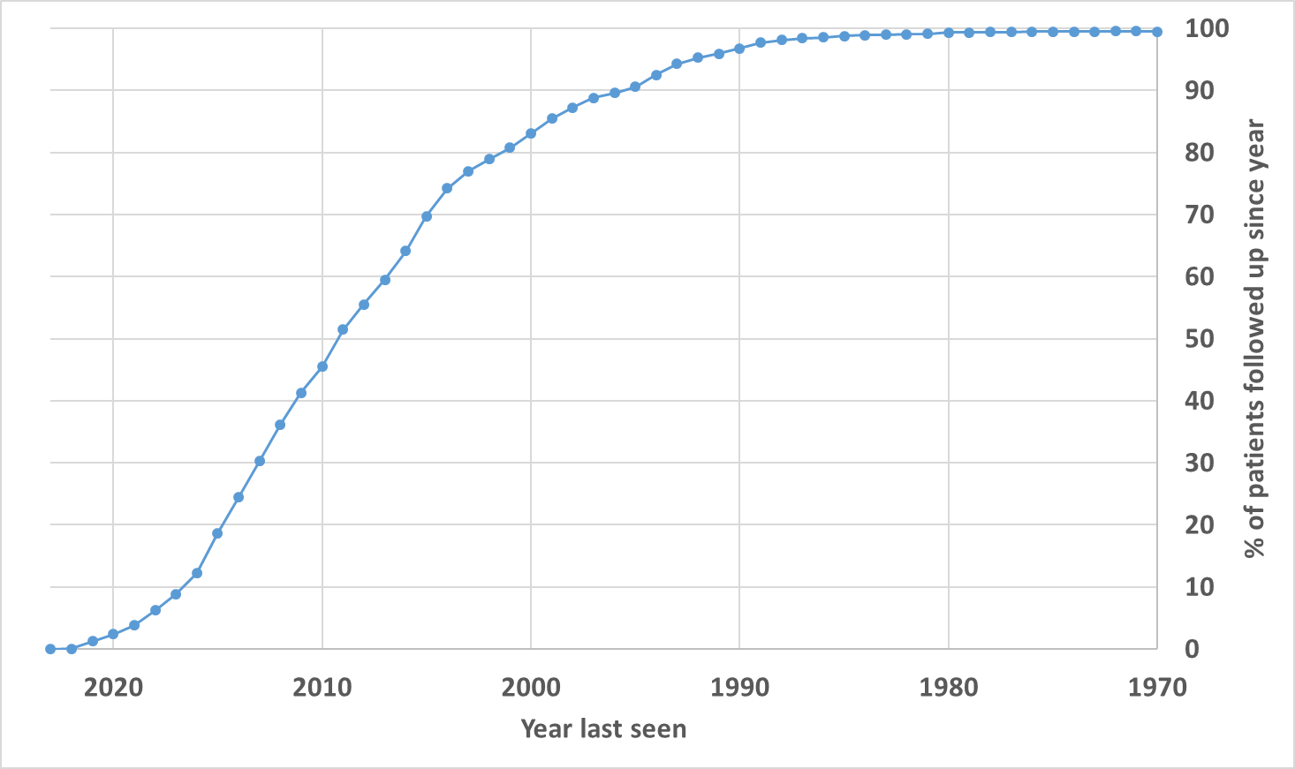
Proportion of living participants by year of FU

Slide 12
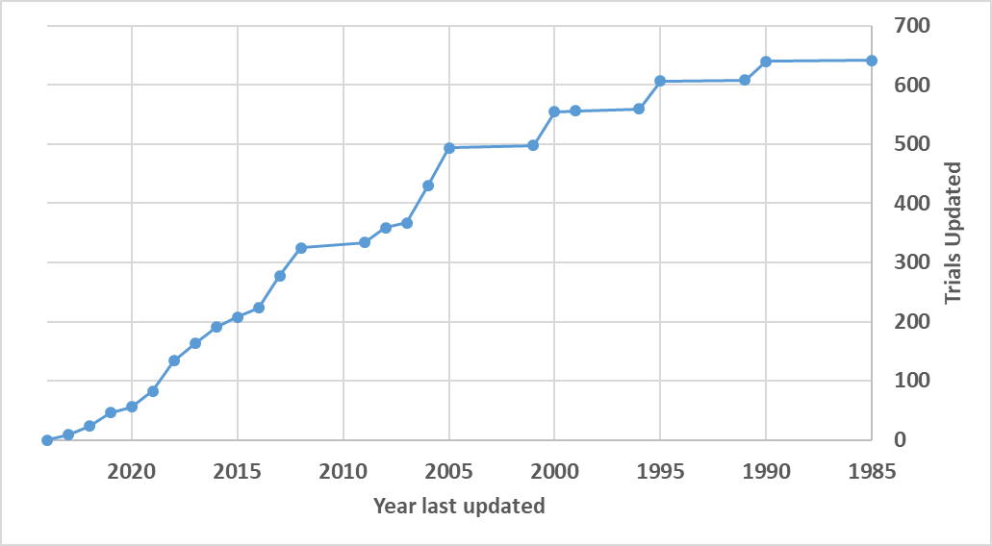
Year of last update (number of trials)

Slide 13
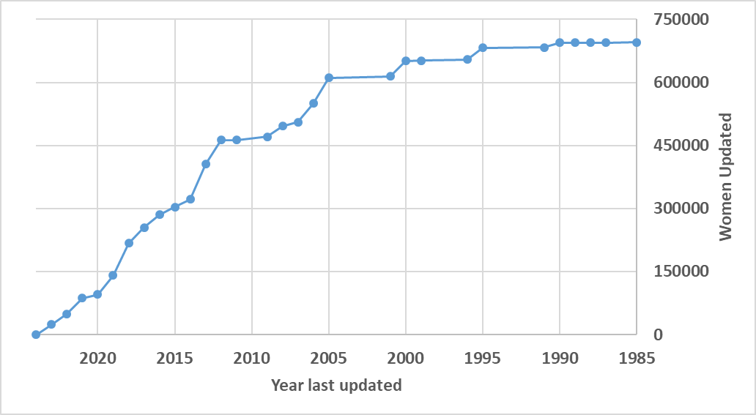
Date of last update (no. of women updated)

Slide 14
Meta-Analysis update
Published since 2018 meeting
  Dose-dense chemotherapy
  Trastuzumab vs not
  Aromatase inhibitors vs tamoxifen in pre-menopausal women
  Anthracycline and taxane therapy
In press
  Regional node radiotherapy

Slide 15
Meta-Analysis update
Presentations
  Aromatase inhibitors in ductal vs lobular carcinoma
  Ovarian suppression
  Trastuzumab therapy and tumour infiltrating lymphocytes
  Management of the axilla

Slide 16
Meta-Analysis update
Drafts circulated for this meeting
  Ovarian suppression
  Surgery
  Improvements in outcomes since 1990
  Extended Ais
All available on meeting website

Slide 17
Citation update
The 26 EBCTCG publications (1984-2023) have 34,805 citations
11,700 citations in period 2018-2023

Slide 18
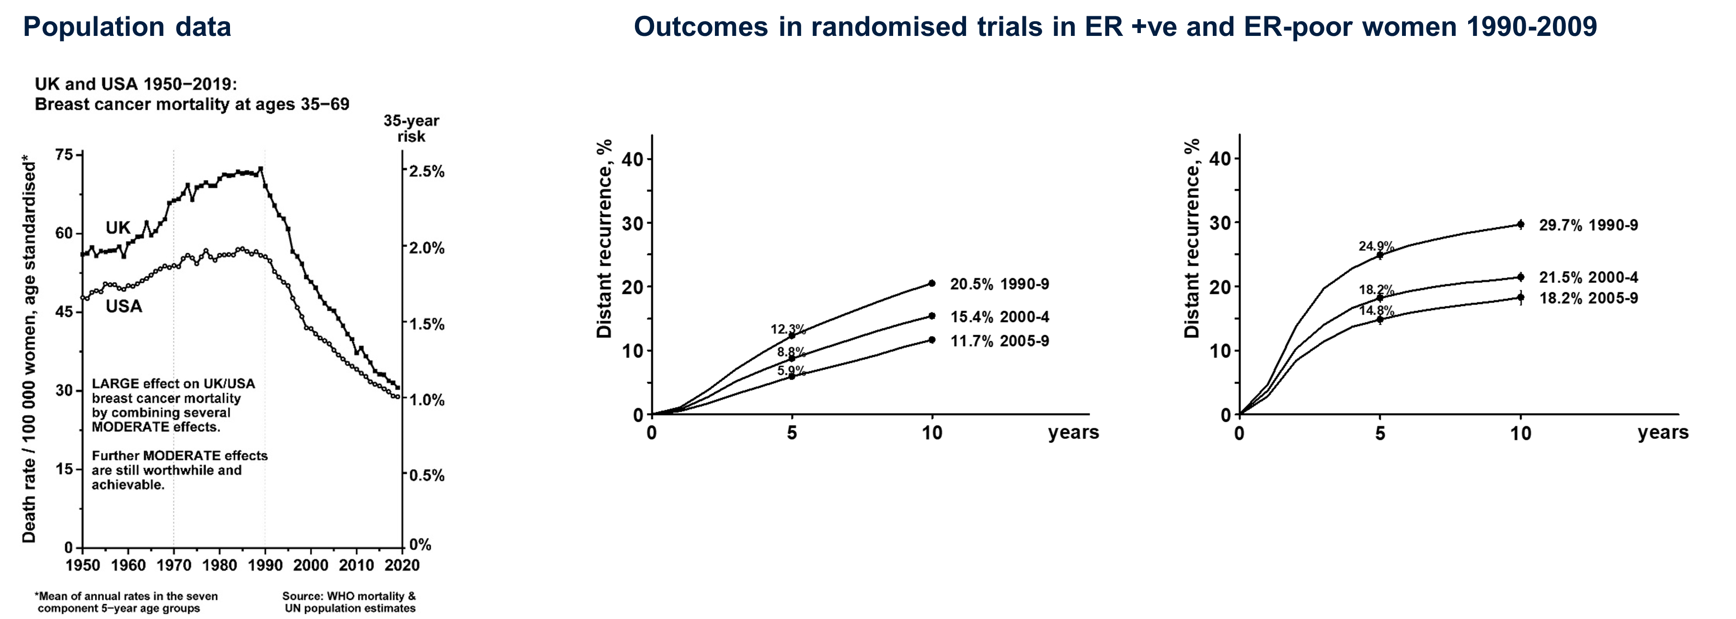
Changing landscape of patient outcomes
Outcomes in randomised trials in EBCTCG database 1990-2009
ER-positive disease, ≥5 yrs ET ER-negative disease

