Slide 1

Adjuvant bisphosphonate treatment in early breast cancer: meta-analyses of individual patient data from randomised trials
Early Breast Cancer Trialists’ Collaborative Group (EBCTCG)
www.thelancet.com
Published online July 24, 2015
http://dx.doi.org/10.1016/S0140-6736(15)60908-4

Slide 2
Bisphosphonates: statistical analysis plan
Primary outcomes
Time to recurrence: includes distant recurrence, local recurrence and new second primary breast cancer (ipsilateral or contralateral), and the definitions of these will be as in each trial.
Time to first distant recurrence: includes distant recurrence and ignores any prior loco-regional or contralateral recurrences.
Breast cancer mortality: by logrank subtraction.

Slide 3
Primary subgroup analyses
Site of recurrence (distant metastasis, local recurrence or contralateral breast cancer)
Site of distant metastasis (bone±other, not bone)
Menopausal status: Premenopausal (or <45 if U/K); perimenopausal (or 45-54 if U/K), postmenopausal (natural/induced) or 55+ if U/K;
Type of bisphosphonate (aminobisphosphonate, other, ie clodronate)

Slide 4
Other planned subgroup analyses
Bisphosphonate agent
Age (<45, 45-54, 55-69, ≥70, unknown);
ER status (ER-poor, ER+, unknown);
Nodal status (negative, positive, N1-3, N4+, N unknown);
Histological grade (1, 2, 3, unknown);
Presence/ absence of chemotherapy; and
Follow-up period (years 0-1, 2-4, 5-9, and 10+ after randomisation).

Slide 5
Data received: 18,766 women
 | Studies identified |  | Studies with data received
 | Trials | Patients | Trials | Patients | % | Years
<1 year clodronate | 2 | 120 | 1 | 72 | 60 | 0·5
<1 year aminobisphosphonate | 2 | 208 | 1 | 40 | 19 | 0·1
1 year aminobisphosphonate | 7 | 1088 | 3 | 448 | 41 | 1·0
Subtotal: ≤1 year of treatment | 11 | 1416 | 5 | 560 | 40% | 0·9
2 years clodronate | 4 | 3978 | 3 | 3912 | 98 | 2·0
3-5 years clodronate | 1 | 1069 | 1 | 1069 | 100 | 3.0
2 years aminobisphosphonate | 10 | 3654 | 8 | 3514 | 96 | 2·0
3-5 years aminobisphosphonate | 12 | 11 910 | 9 | 9711 | 82 | 4·5
Subtotal: 2-5 yrs of treatment | 27 | 20 611 | 21 | 18 206 | 88% | 3·5
Any clodronate regimen | 7 | 5167 | 5 | 5053 | 98 | 2·6
Any aminobisphosphonate‡ | 31 | 16 860 | 21 | 13 713 | 81 | 3·8
Total: All regimens | 38 | 22 027 | 26 | 18 766 | 85% | 3·4

Slide 6
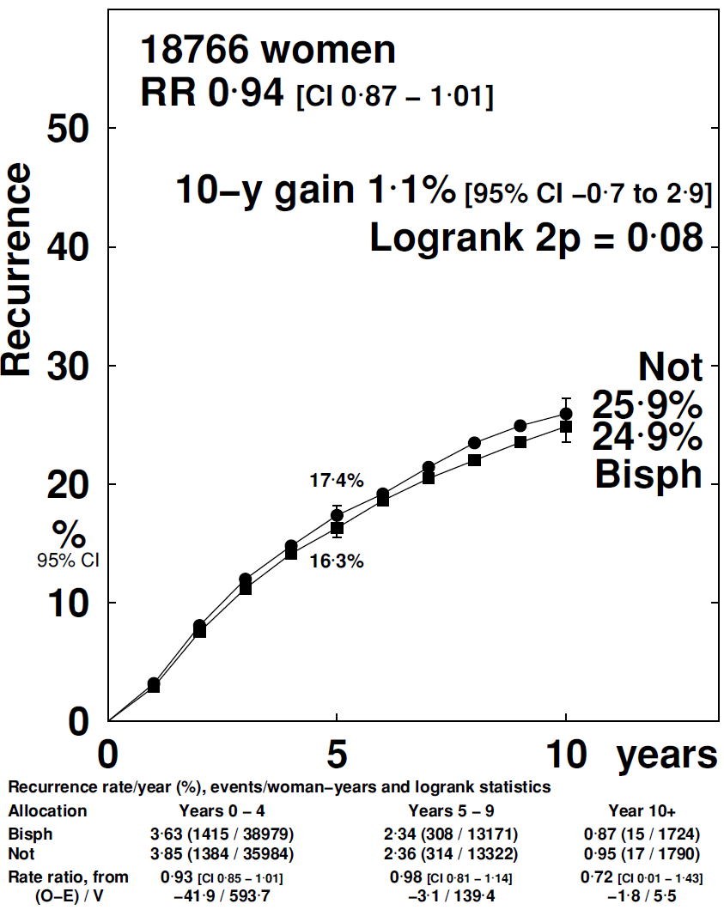
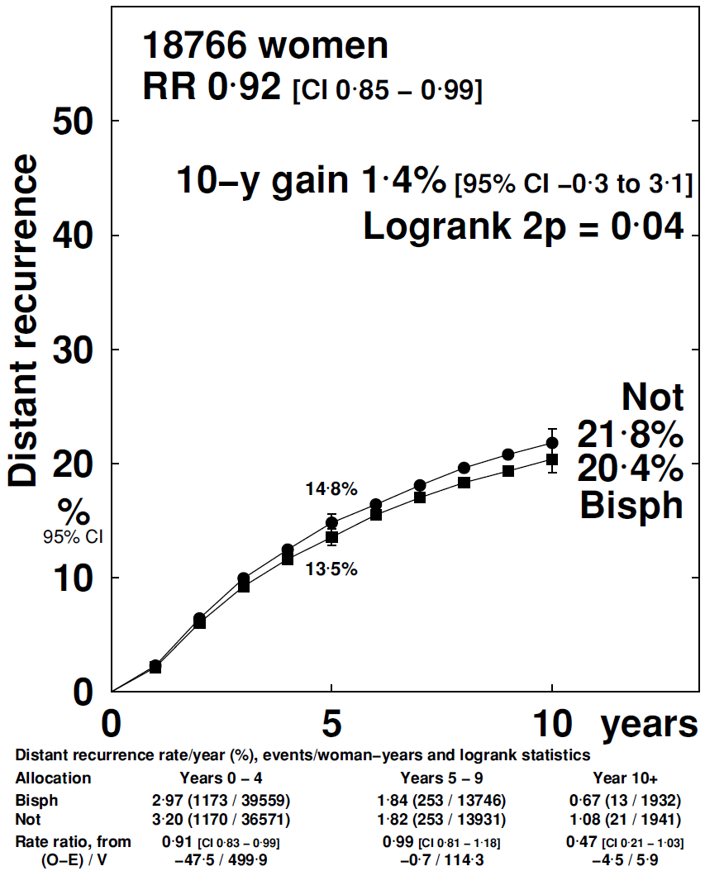
Bisphosphonates: Recurrence
Any recurrence
Distant recurrence

Slide 7
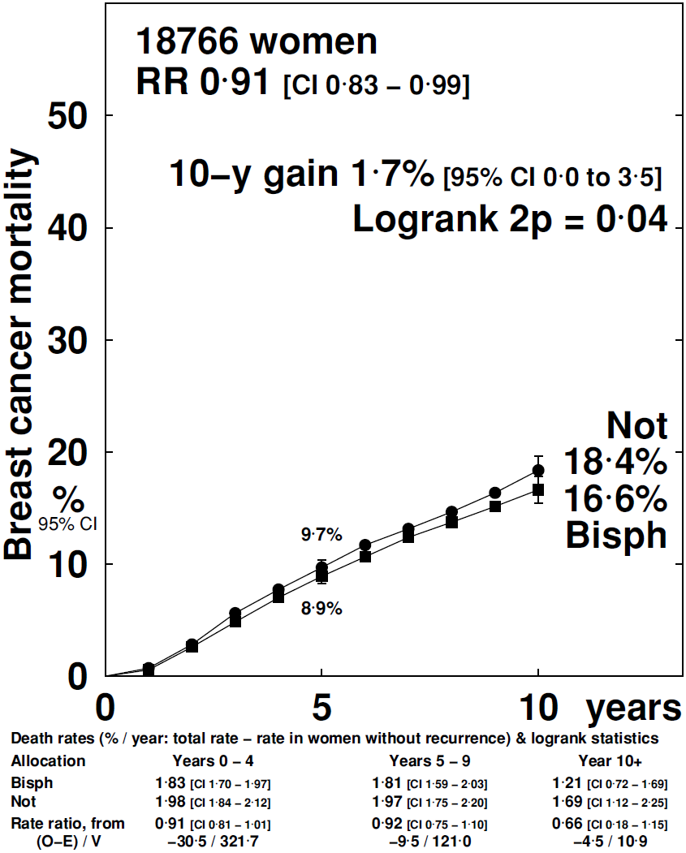
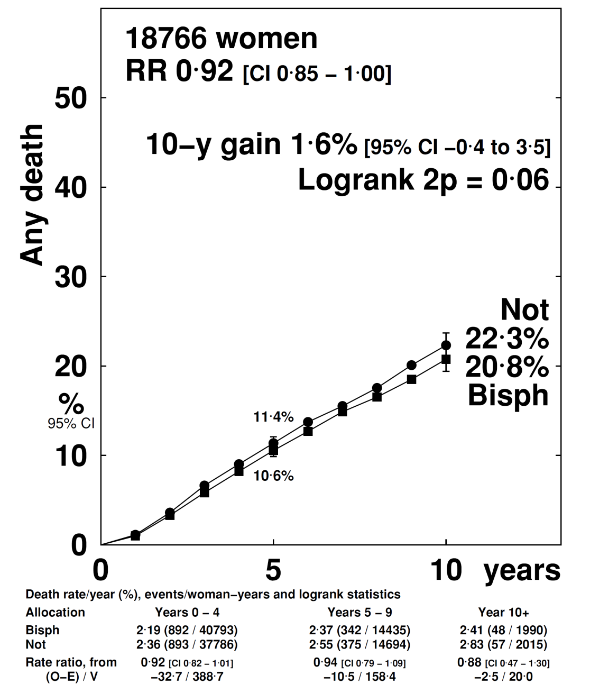
Bisphosphonates: mortality
Breast cancer mortality
All-cause mortality

Slide 8
Primary subgroup analyses
Site of recurrence (distant metastasis, local recurrence or contralateral breast cancer)

Slide 9
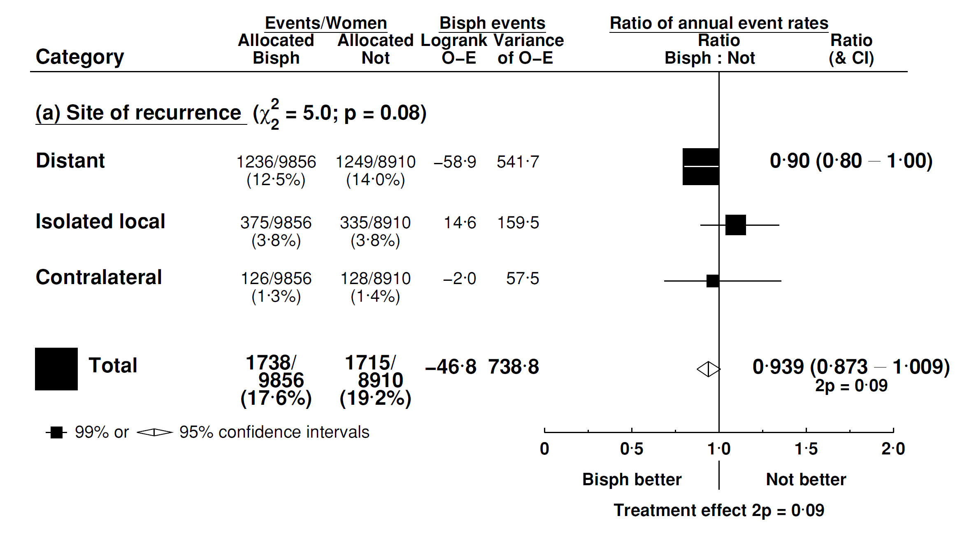
Subgroup analyses by site of recurrence

Slide 10
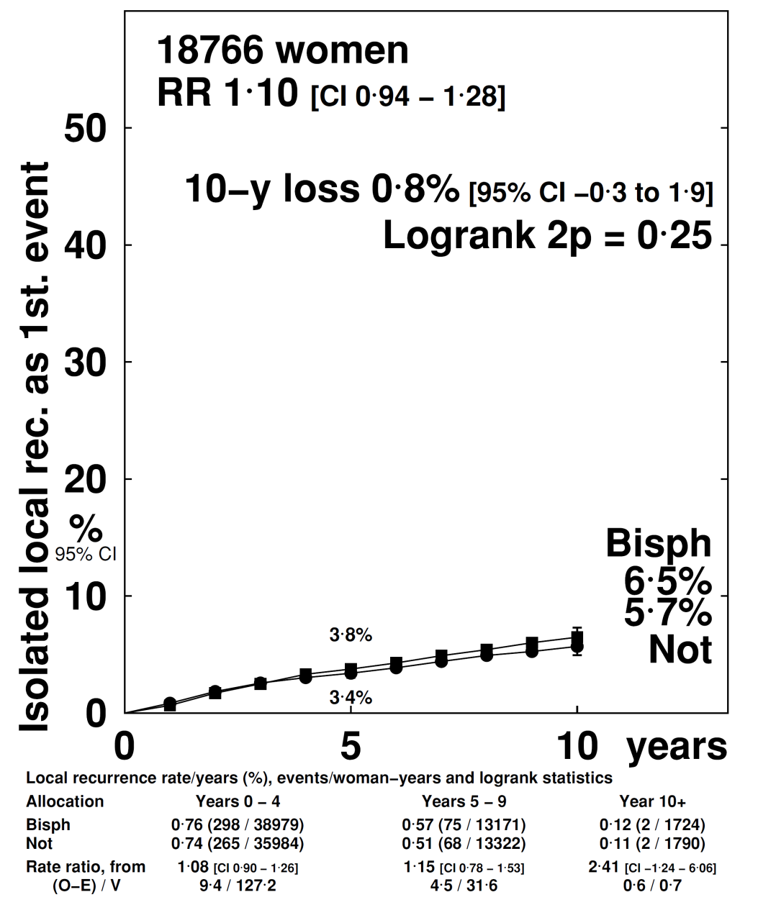
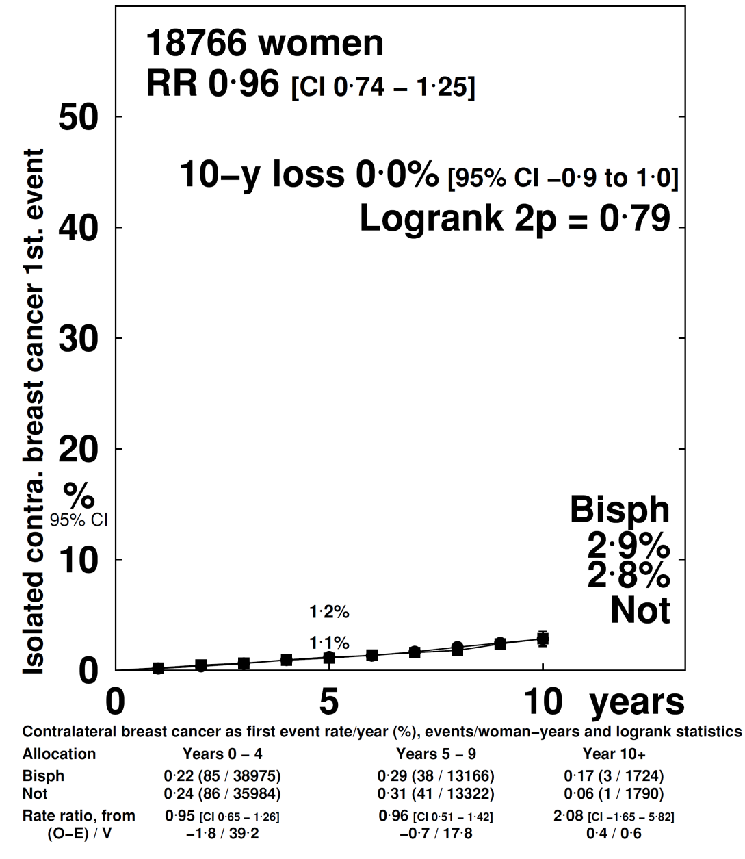
BSP: Local and contralateral recurrence
Local recurrence
Contralateral breast
recurrence

Slide 11
Primary subgroup analyses
Site of recurrence (distant metastasis, local recurrence or contralateral breast cancer)
Site of distant metastasis (bone±other, not bone)

Slide 12
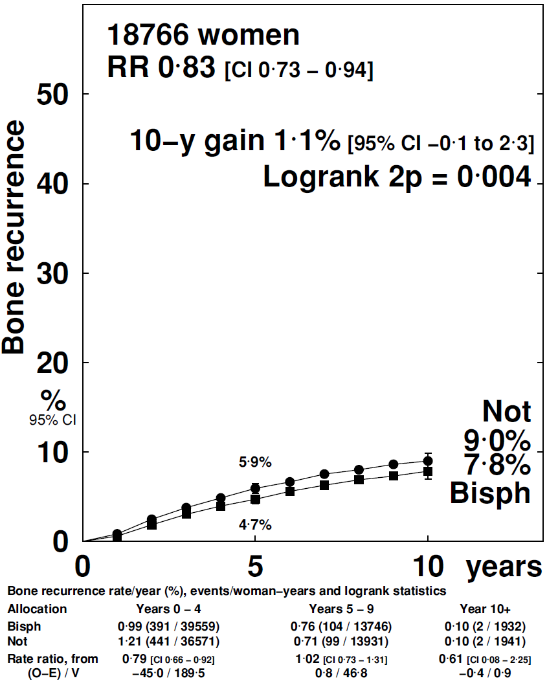
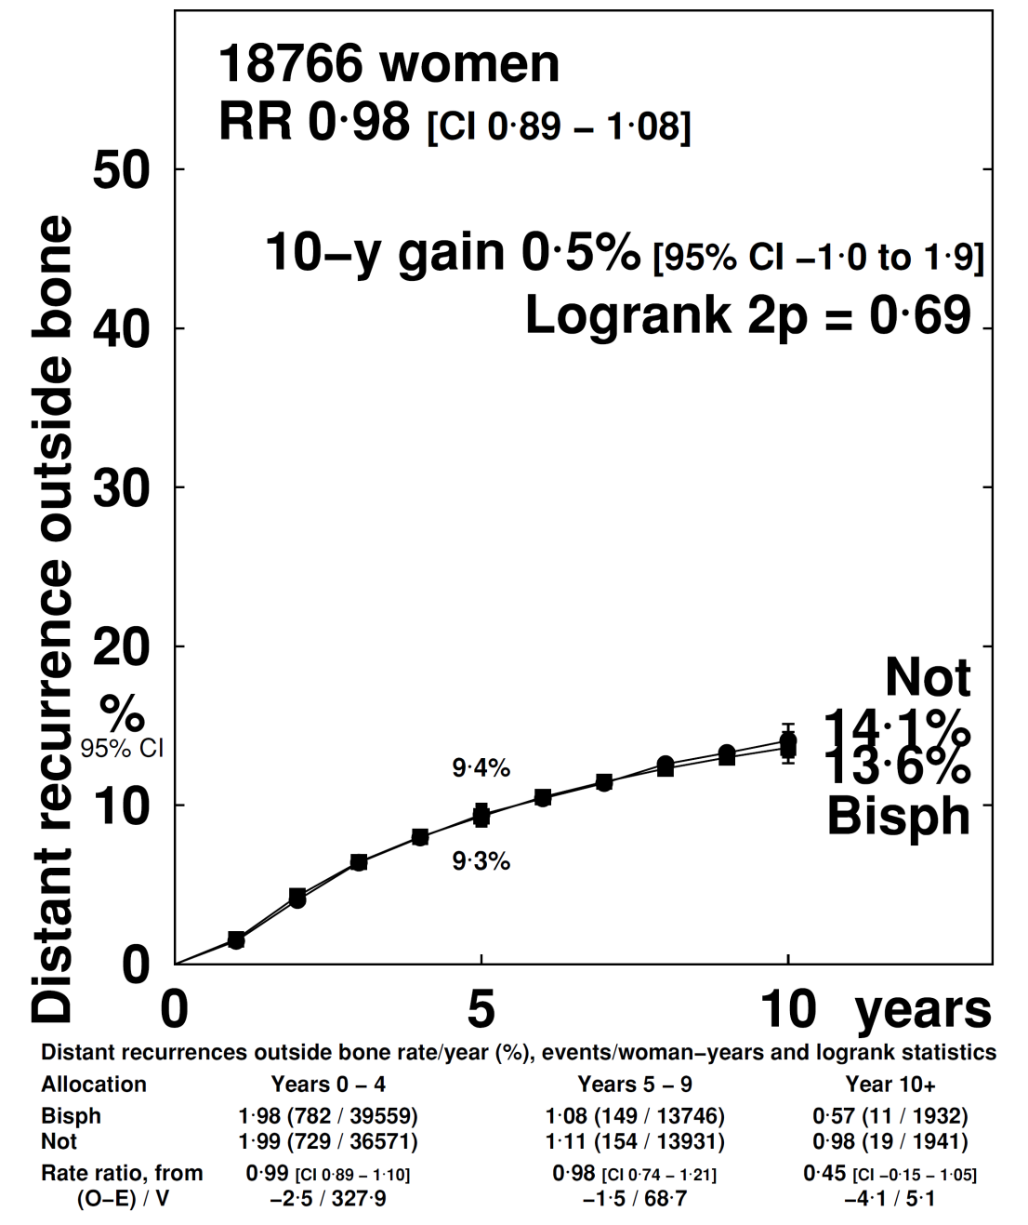
BSP: site of distant recurrence
Bone recurrence
Other distant
recurrence

Slide 13
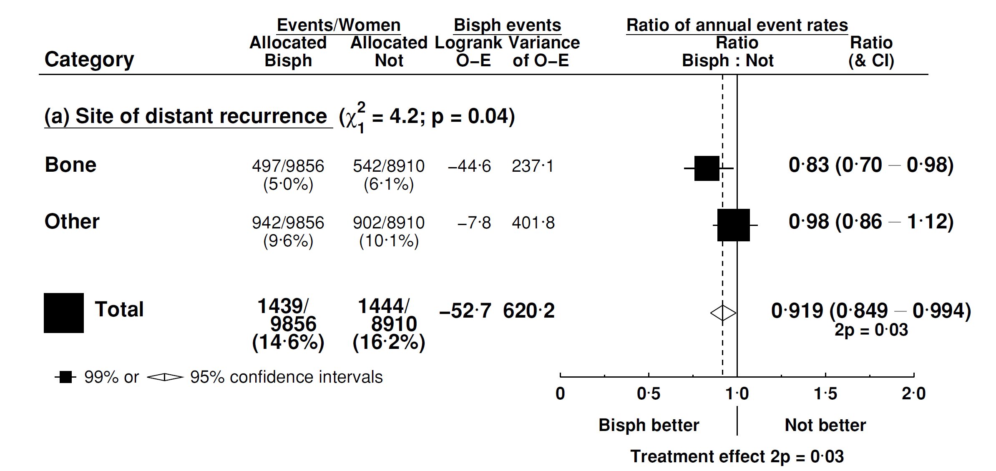
Subgroup analyses by site of recurrence

Slide 14
Primary subgroup analyses
Site of recurrence (distant metastasis, local recurrence or contralateral breast cancer)
Site of distant metastasis (bone±other, not bone)
Menopausal status: Premenopausal (or <45 if U/K); perimenopausal (or 45-54 if U/K), postmenopausal (natural/induced) or 55+ if U/K;

Slide 15

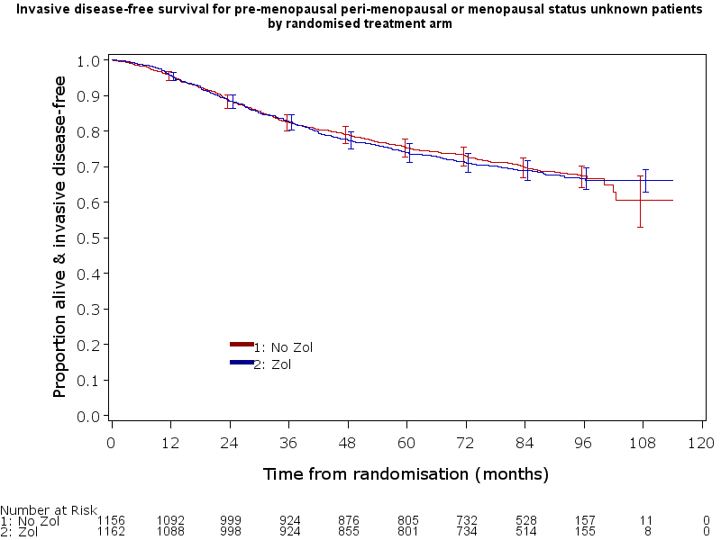
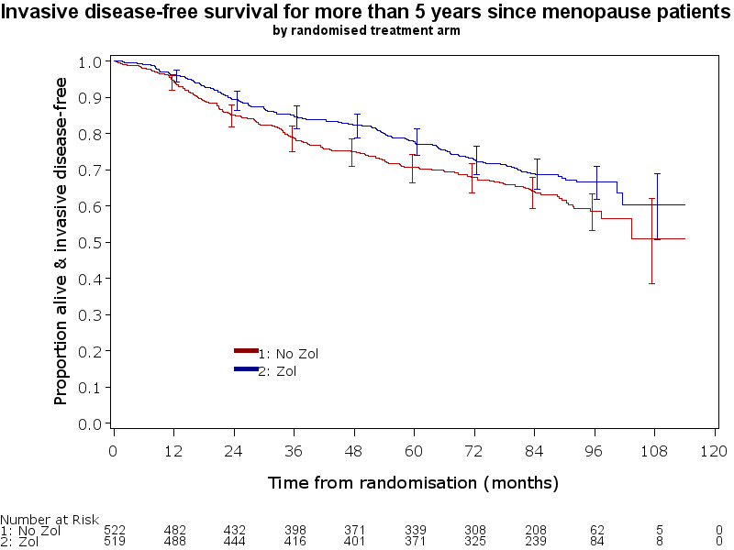
AZURE (hypothesis generating trial): Effects of zoledronic acid on Invasive DFS by Menopausal Status
Pre, peri and unknown
menopausal status
>5 years post-menopausal
Adjusted HR 1.03
95% CI: 0.89-1.20
Adjusted HR 0.77
95% CI: 0.63-0.96
Control
Zoledronic acid
N = 2318
702 events
Control
Zoledronic acid
N = 1041
347 events
No. at risk
Control
ZOL
No. at risk
Control
ZOL
Menopausal Interaction: χ²₁ =4.71; P=0.030

Slide 16
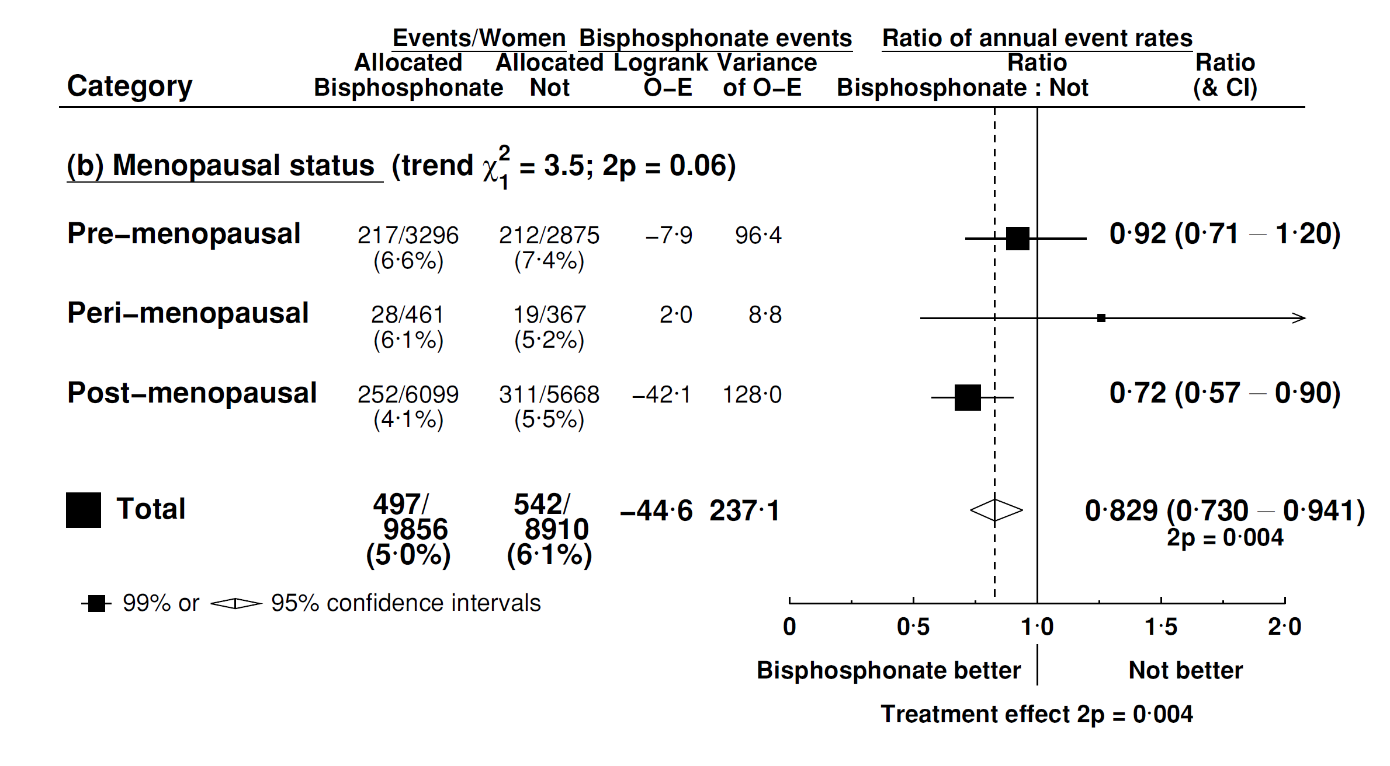
EBCTCG meta-analysis of bone recurrence by menopause: all trials

Slide 17
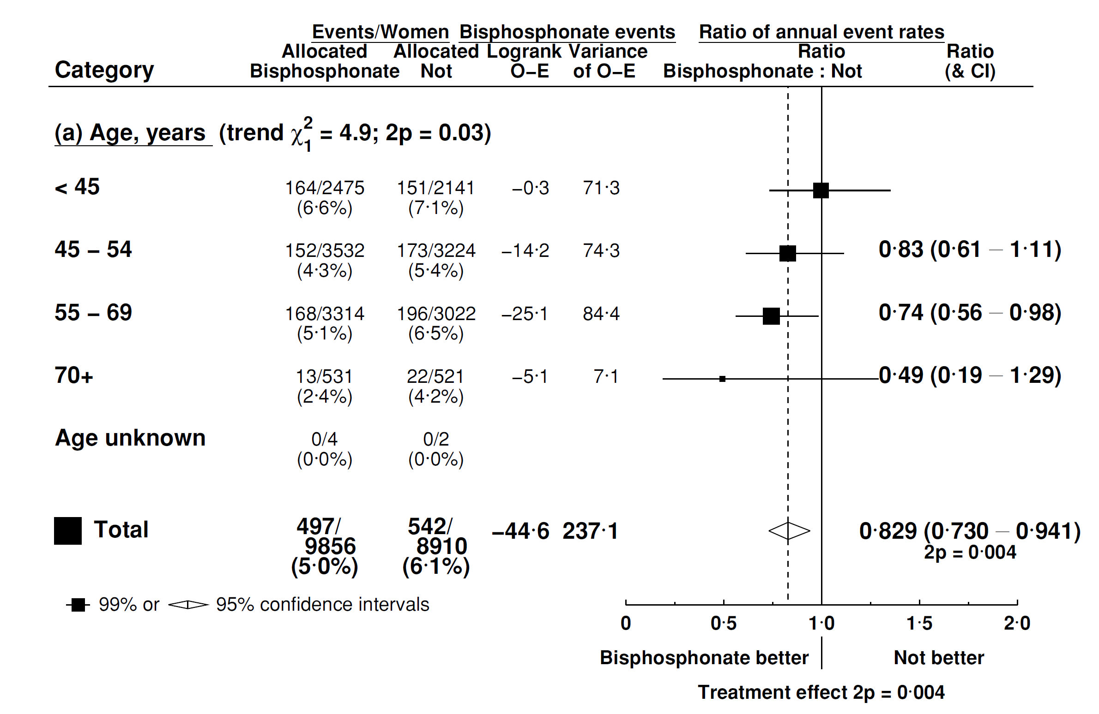
Bone recurrence by age: all trials

Slide 18
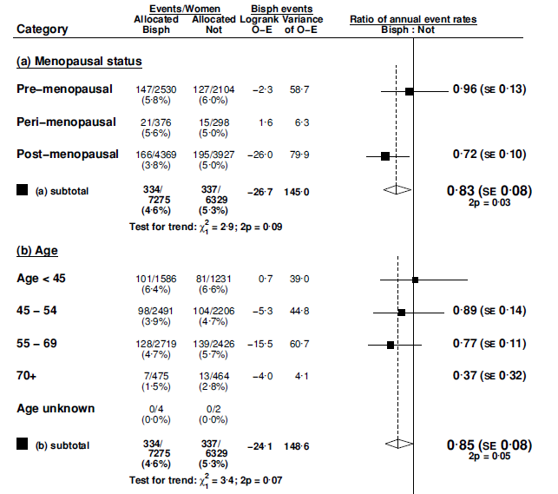
Bone recurrence by menopause and age
Without AZURE and ABCSG XII

Slide 19
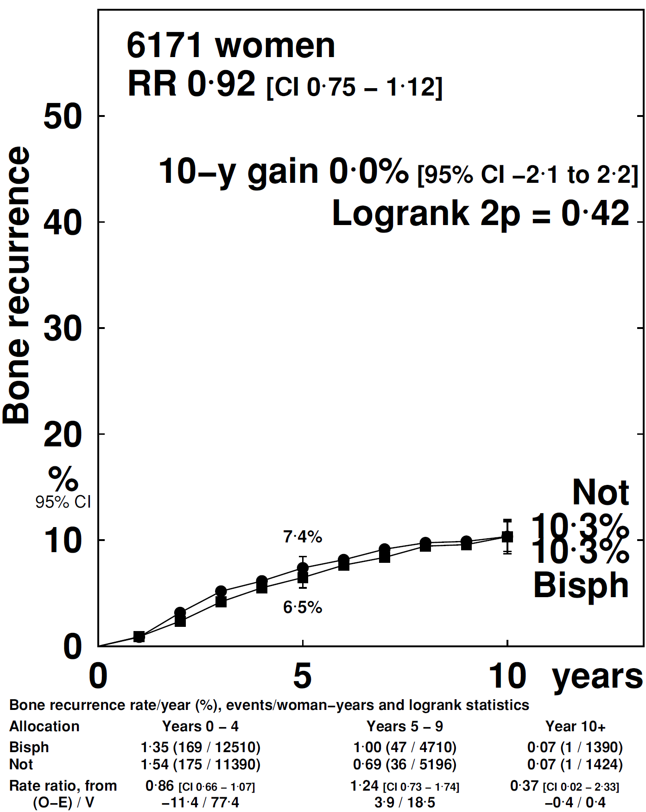
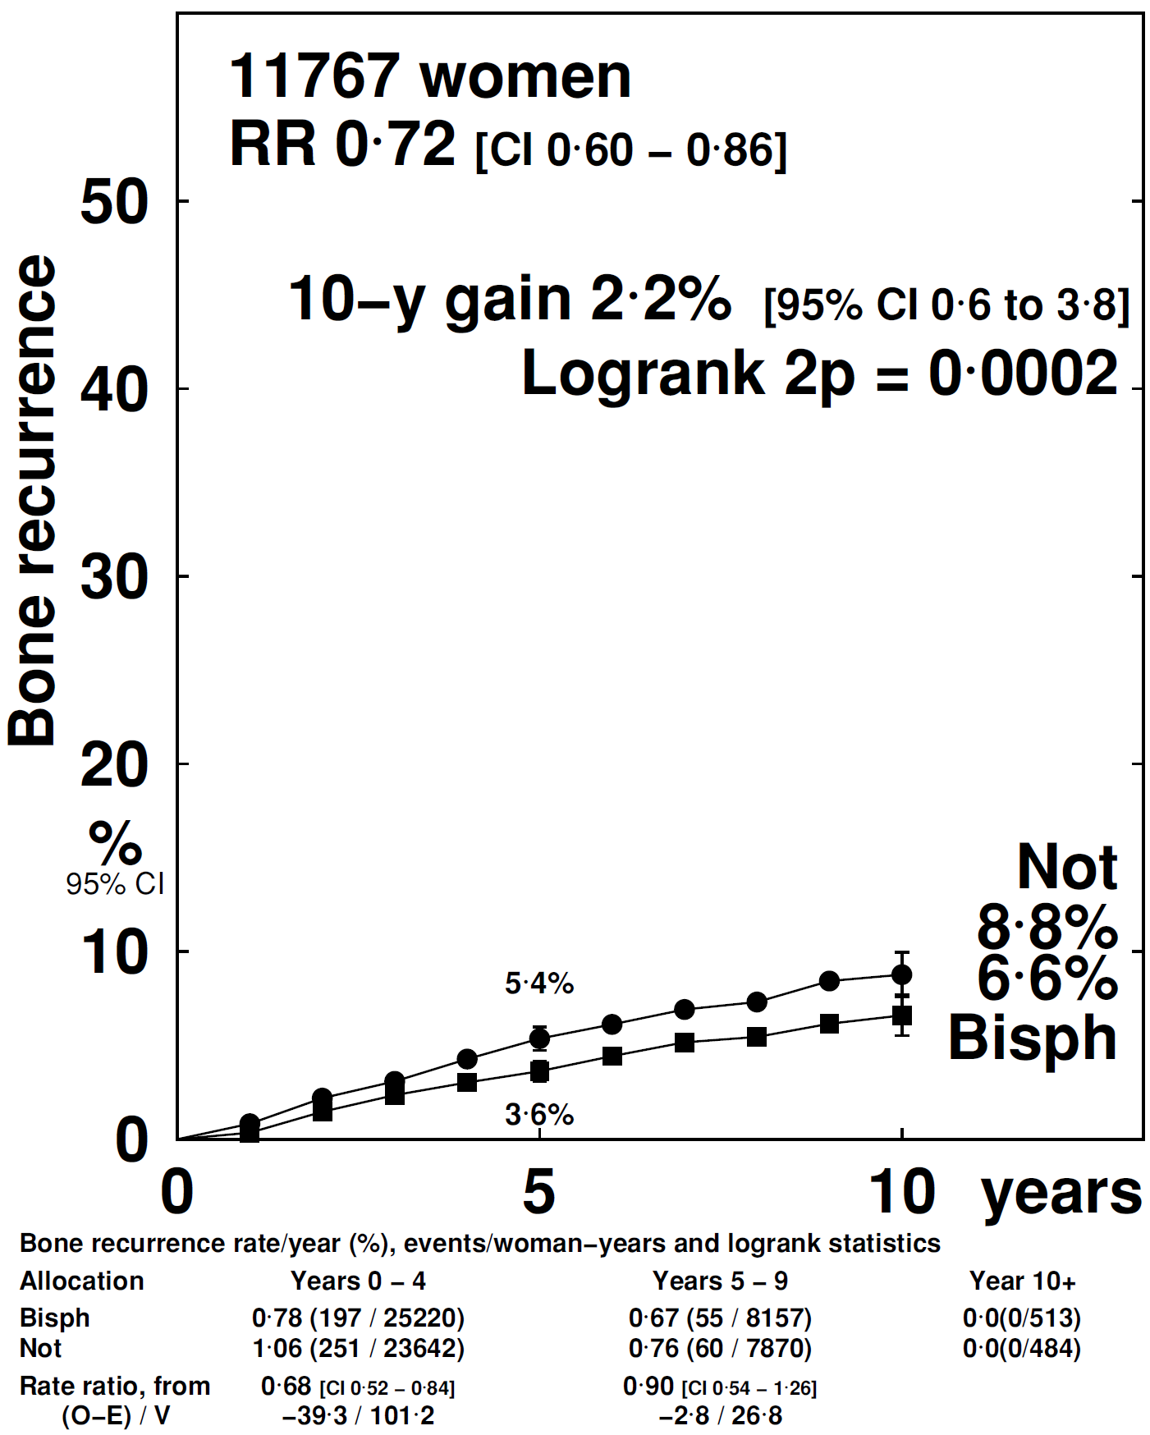
Bone recurrence by menopausal status
Premenopausal
Postmenopausal

Slide 20
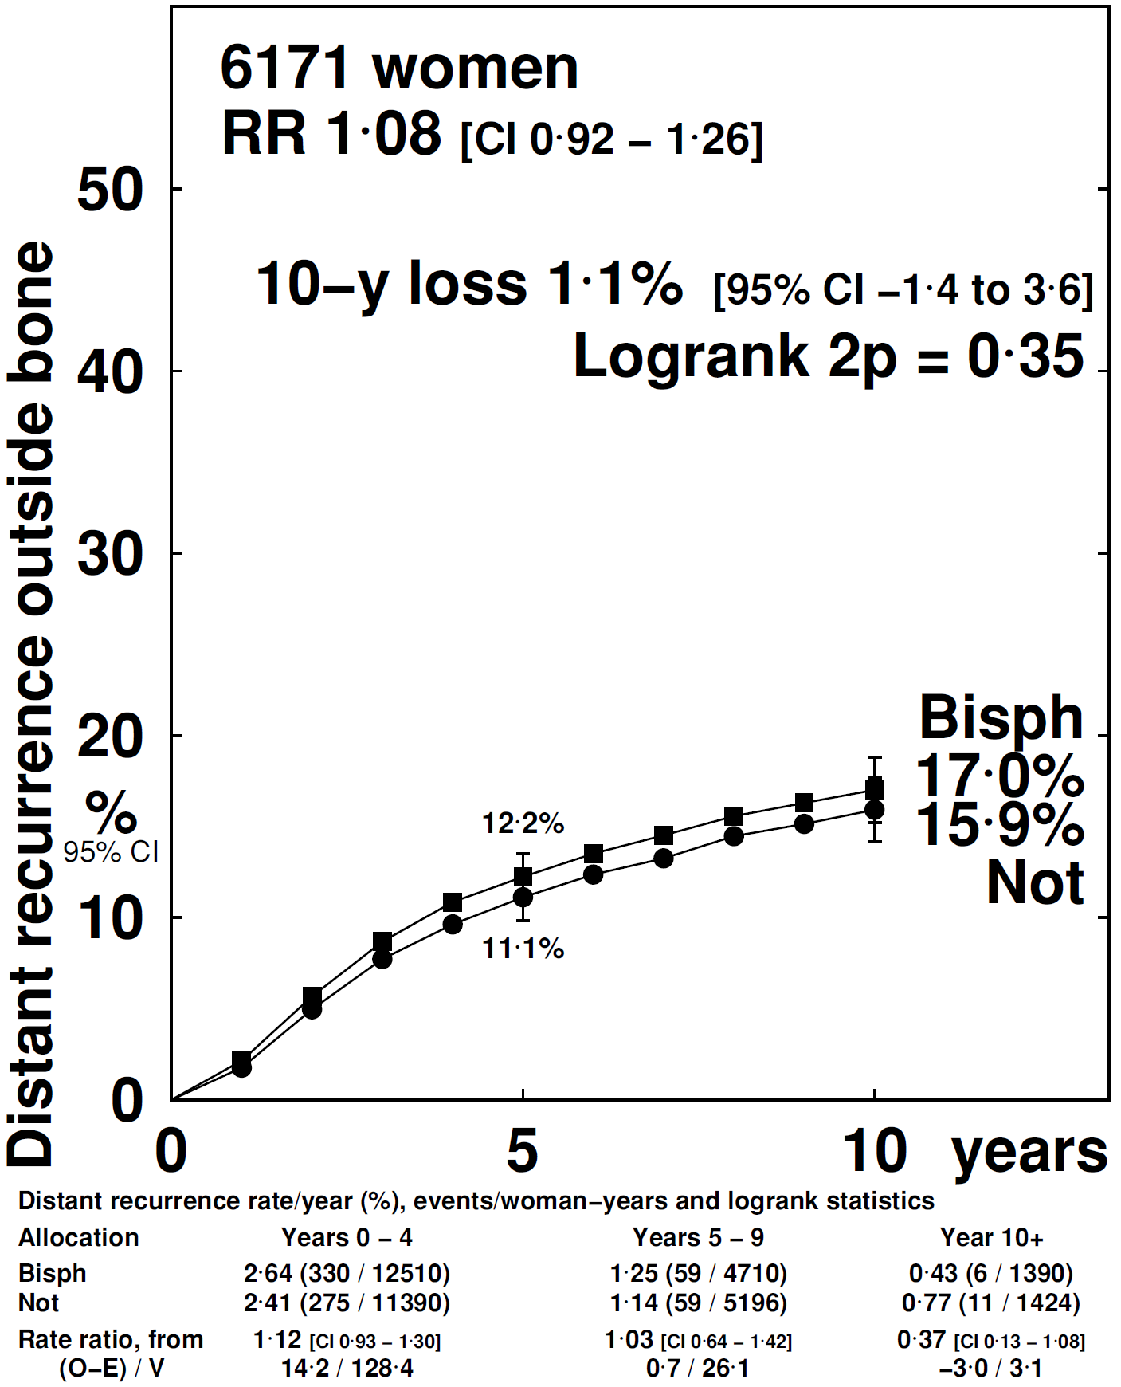
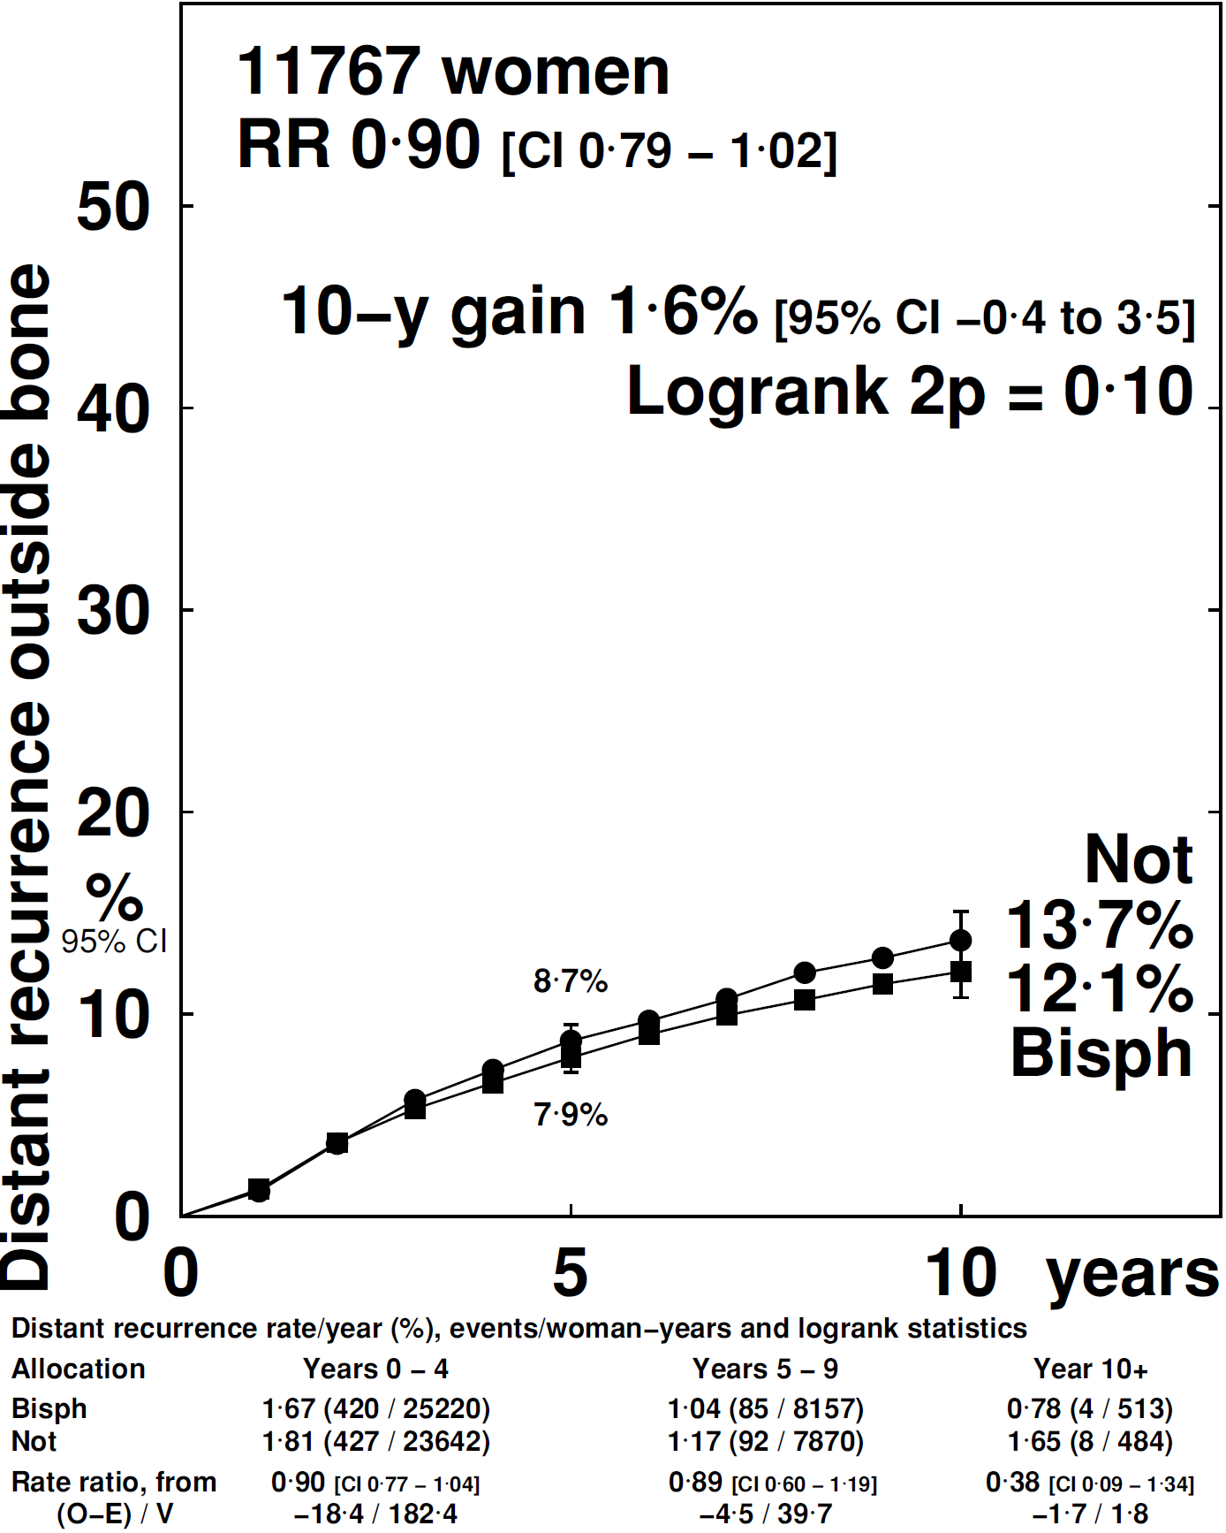
Non-bone distant recurrence by menopause
Premenopausal
Postmenopausal

Slide 21
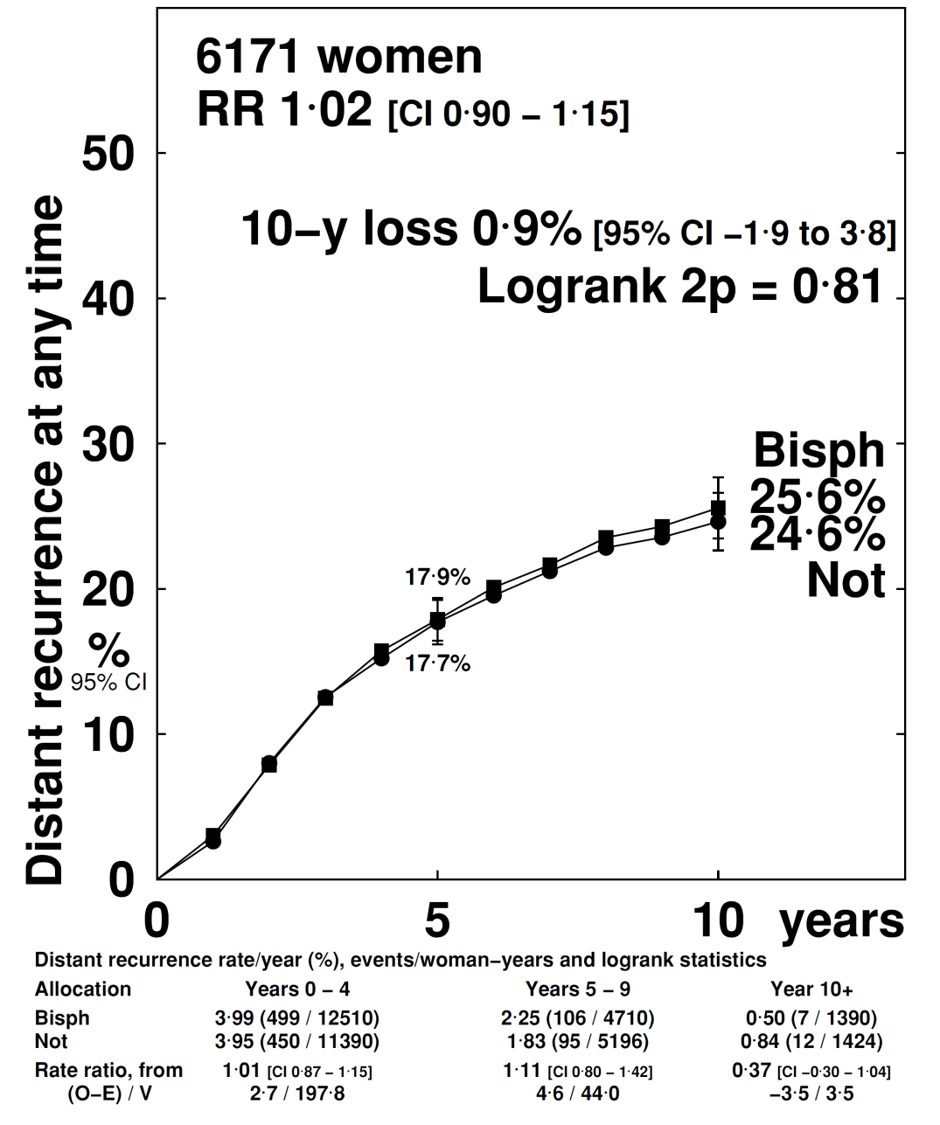
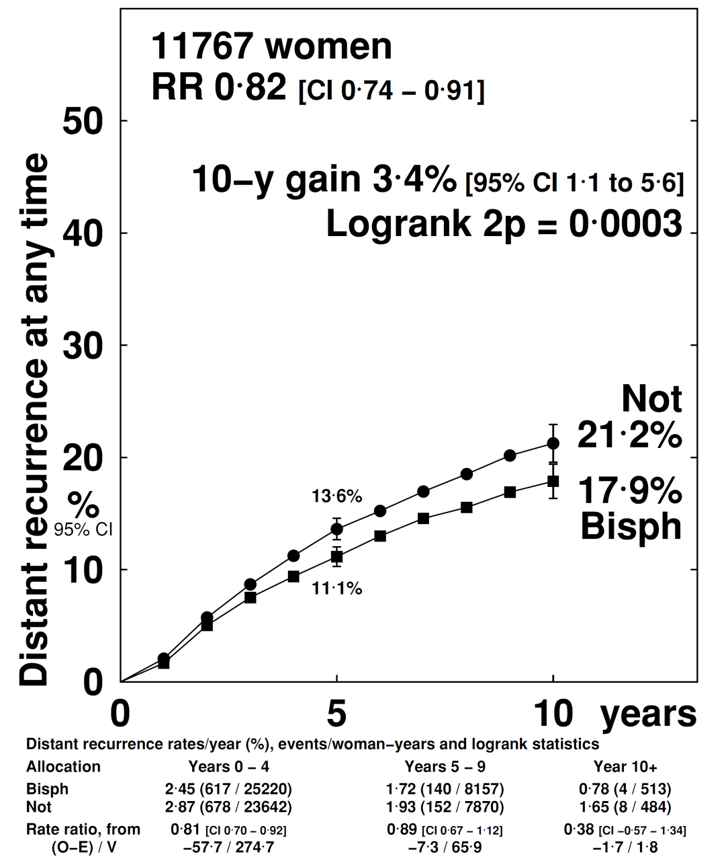
Any distant recurrence by menopause
Premenopausal
Postmenopausal

Slide 22
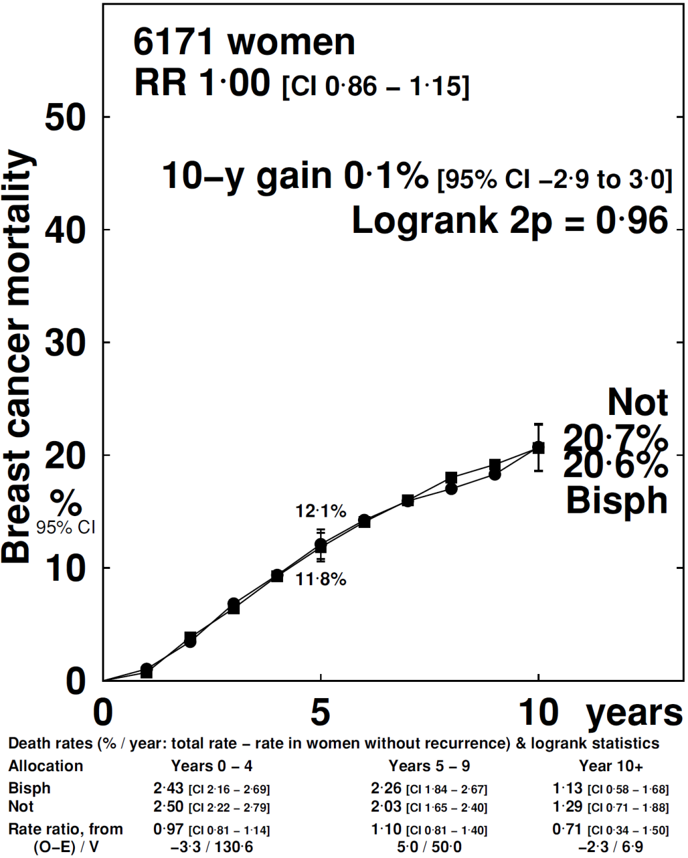
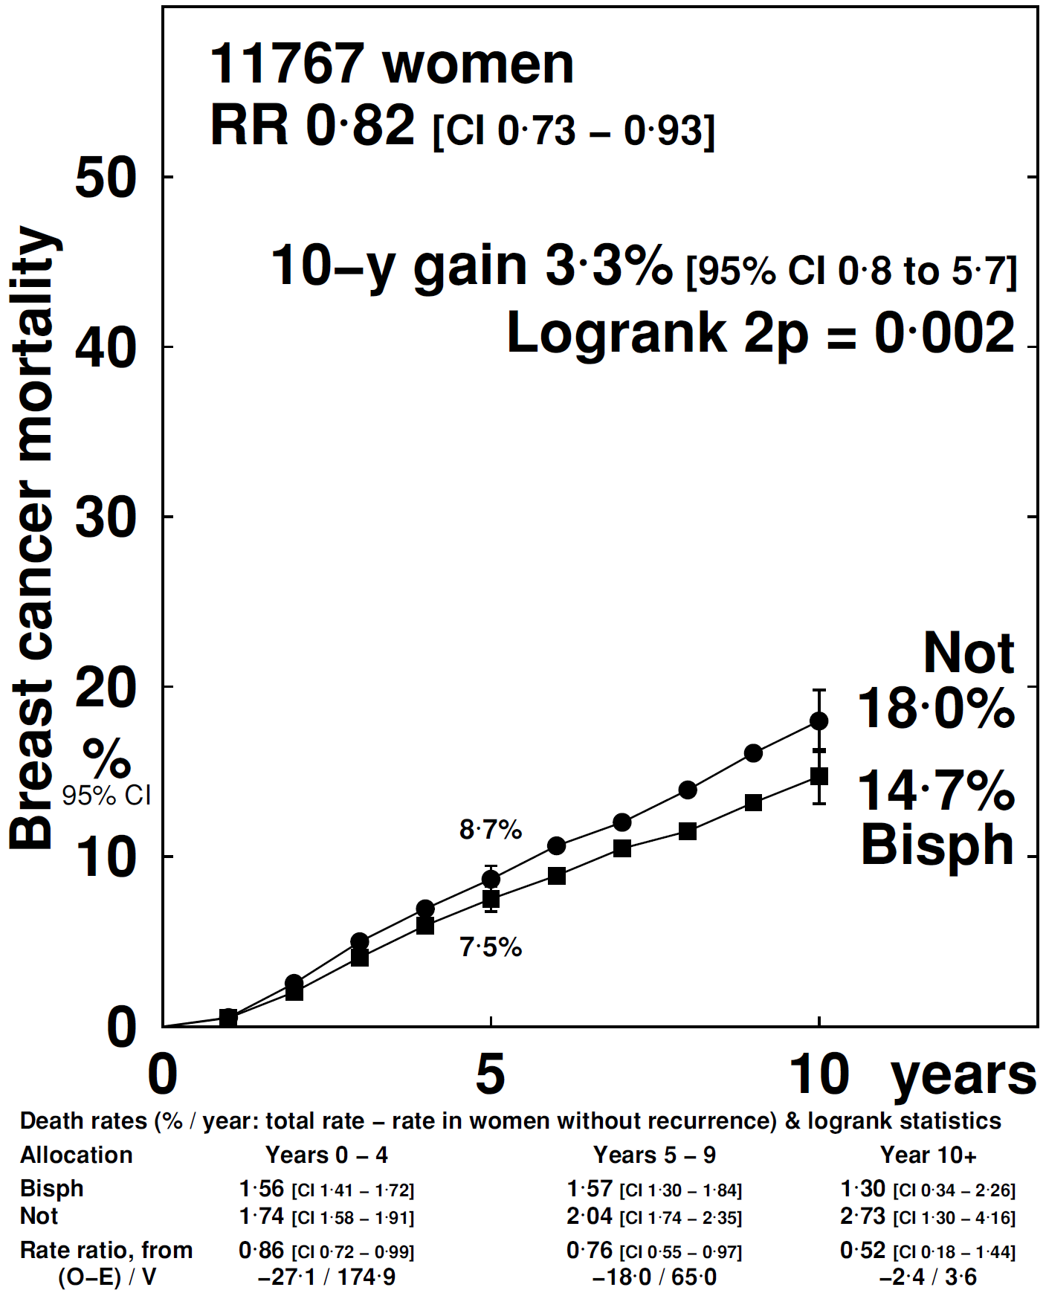
Breast cancer mortality by menopausal status
Premenopausal
Postmenopausal

Slide 23
Primary subgroup analyses
Site of recurrence (distant metastasis, local recurrence or contralateral breast cancer)
Site of distant metastasis (bone±other, not bone)
Menopausal status: Premenopausal (or <45 if U/K); perimenopausal (or 45-54 if U/K), postmenopausal (natural/induced) or 55+ if U/K;
Type of bisphosphonate: aminobisphosphonate, other (clodronate)

Slide 24
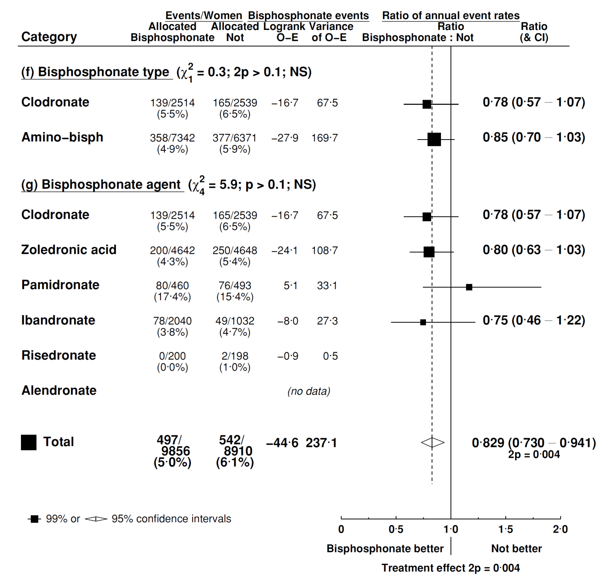
Bone recurrence by bisphosphonate type

Slide 25
Other subgroup analyses
Based on bone recurrence in all bisphosphonate trials

Slide 26
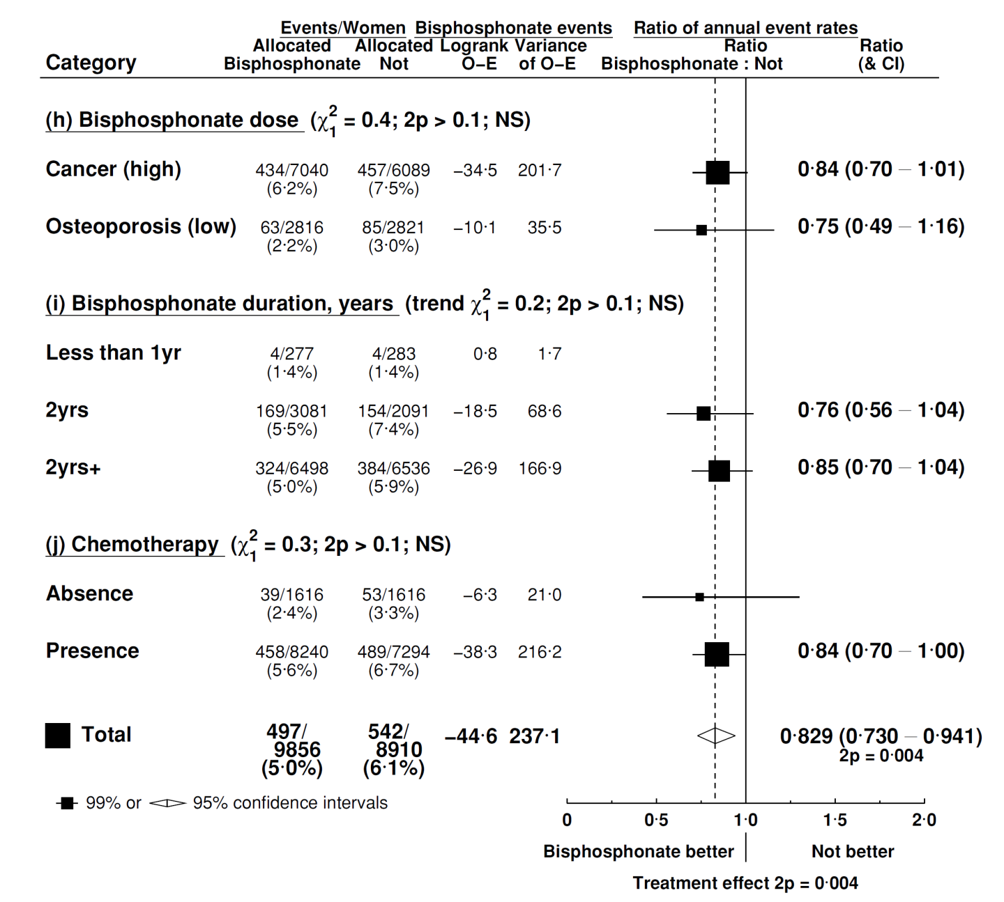
Bone recurrence by BSP dose, duration, absence/presence of chemotherapy

Slide 27
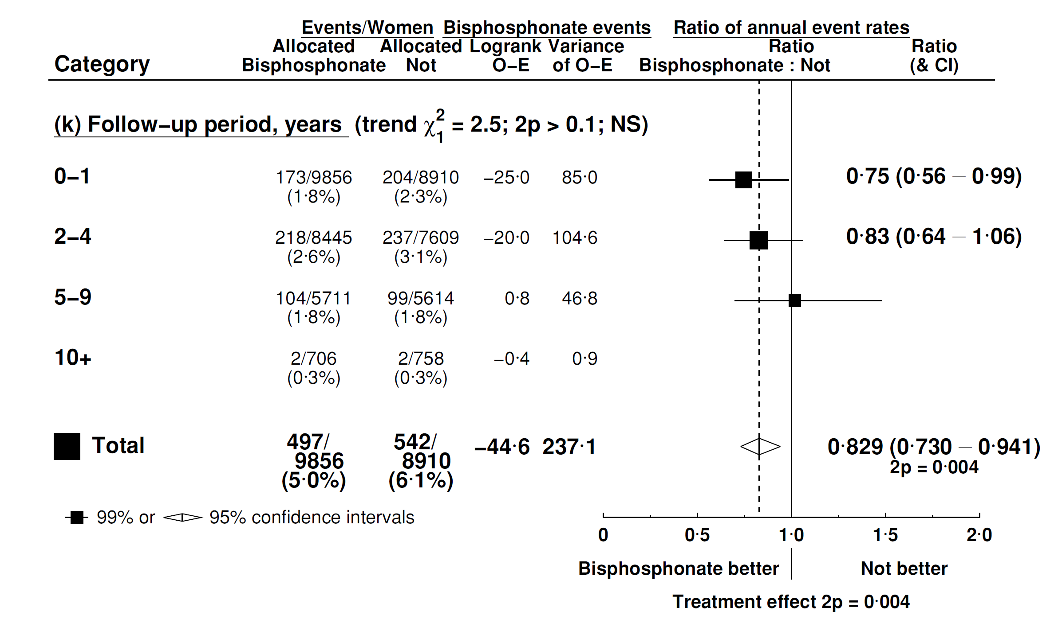
Bone recurrence by year of follow-up

Slide 28
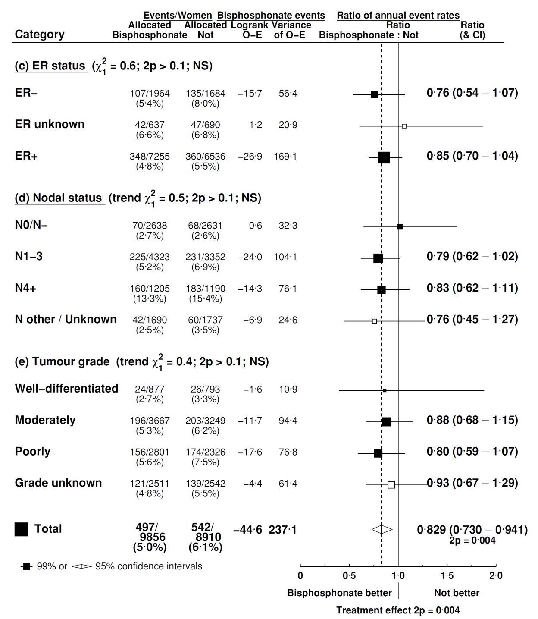
Bone recurrence by ER, nodal status and grade

Slide 29
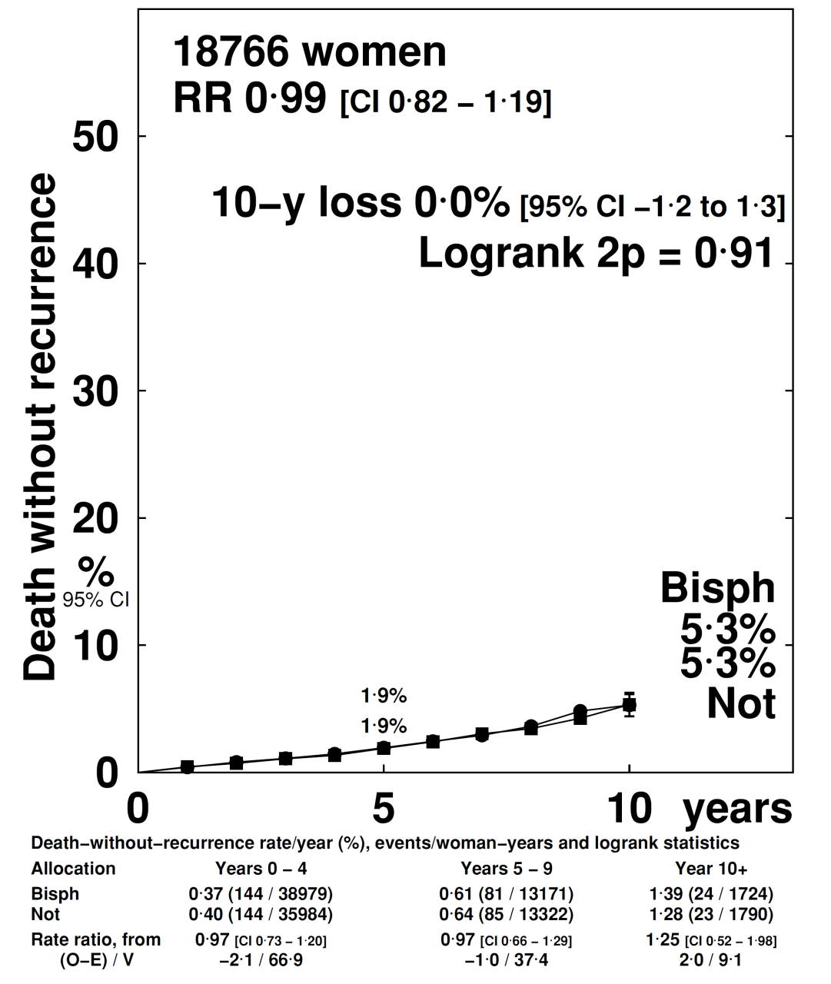
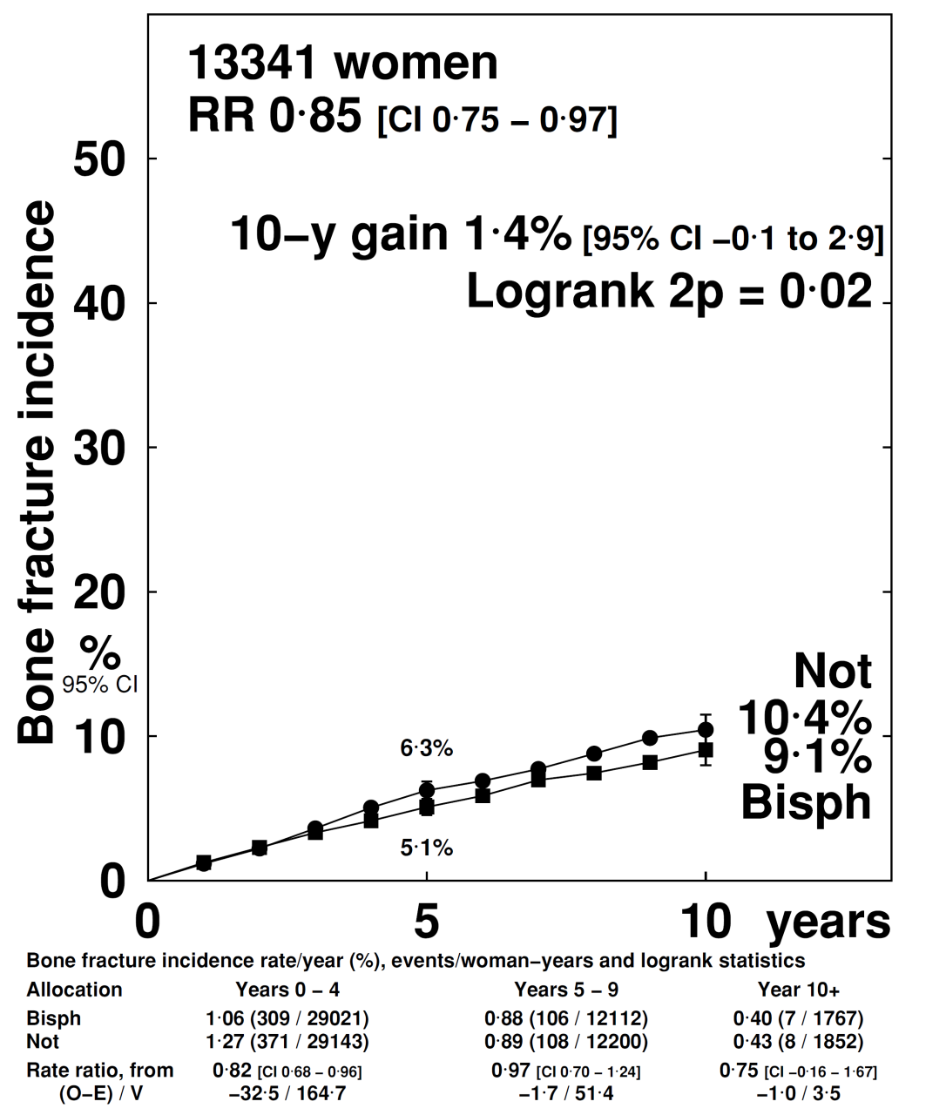
Non-breast cancer events
Non-breast cancer death
Bone fracture

Slide 30
Bisphosphonates – conclusions*
Fewer bone recurrences with bisphosphonate
Benefits appear to be confined to postmenopausal/ older women
Among postmenopausal women, significant reductions in any recurrence, distant recurrence, and breast cancer mortality
Fewer bone fractures and no effect on non-breast cancer mortality
*EBCTCG, Lancet, published online July 24, 2015:
http://dx.doi.org/10.1016/S0140-6736(15)60908-4

Slide 31


Acknowledgements
We thank the tens of thousands of women who took part in the trials, the many staff in trial centres and participating clinics who helped conduct the trials, and the trialists who shared their data.
This presentation was prepared by Rosie Bradley and Richard Gray of the EBCTCG Secretariat, which is funded through direct support from Cancer Research UK and the UK Medical Research Council, to the Clinical Trial Service Unit and Epidemiological Studies Unit, Nuffield Department of Population Health, University of Oxford, UK.

